Slide 1
Phases of Motion in Coordinated Hand Movement
Avinash Baskaran, Chad G. Rose

Slide 2
We will describe:
Are there phases of motion (PoM) in hand gestures?
Do hand PoMs have central or peripheral origin?
How can PoMs inform robot control?

Slide 3
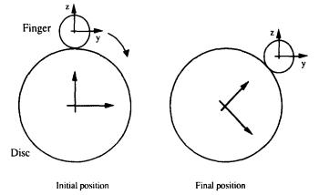
PoMs are supported by hand peripheral dynamics
“The model is tested using data from a rapid pinch experiment as well as a hypothetical trajectory of disc rotation… the three phases; free motion, motion with external force and external pinch force without motion”
https://journals.sagepub.com/doi/pdf/10.1007/s11552-013-9517-6

Slide 4
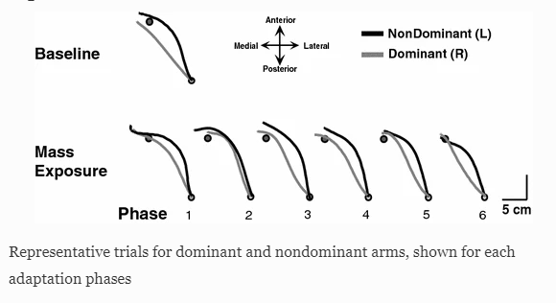
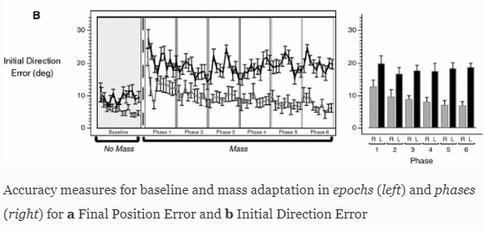
PoMs can be mediated by hand central dynamics
“It is concluded that although rotations were in general more variable at both proximal and distal joints of the nondominant (left) arm, the major cause of its decreased throwing accuracy was increased variability at the distal joints, i.e., in the timing of onset of finger extension. This may be due to a lack of precision in the commands from the right hemisphere to the left fingers in righthanded
throwers.”
https://link.springer.com/article/10.1007/s00221-006-0811-1

Slide 5
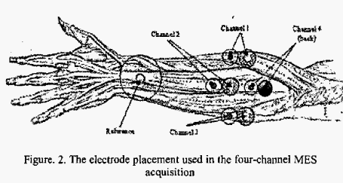
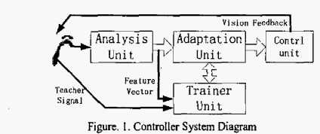
3 PoM have been identified in EMG data hinting at central coordination
“… EMG analyzing method, Ie., pre-activity phase, in activity phase, and post-activity phase…”
https://ieeexplore.ieee.org/stamp/stamp.jsp?tp=&arnumber=1499859

Slide 6
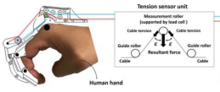
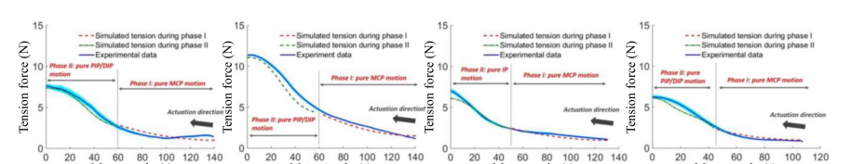
Finger-specific PoM mechanisms are linked to joint couplings
“…is found to possess two phases, namely, “pure MCP movement” and “pure PIP/DIP movement” phases [Fig. 15(a) and (e)]…”
https://journals.sagepub.com/doi/pdf/10.1007/s11552-013-9517-6

Slide 7
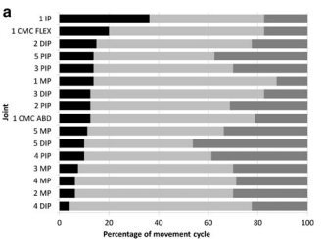
PoMs organization between joints in coordinated movement indicate (peripheral) task-oriented specialization in the hand
Lateral pinch phase durations… Joints are organized by relative length of the initiation phase. Gray bar, initiation; fine hatched bar, preshaping; hatched bar, pinch
https://journals.sagepub.com/doi/pdf/10.1007/s11552-013-9517-6

Slide 8
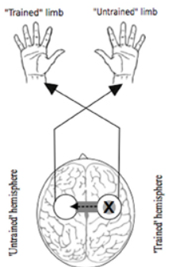
Targeting central origins can improve PoMs
“ In the case of rhythmic movements, MEPs evoked in the quiescent muscles of a static limb vary in accordance with the phase of motion of the opposite (moving) limb”
https://www.frontiersin.org/articles/10.3389/fnhum.2013.00397/full

Slide 9
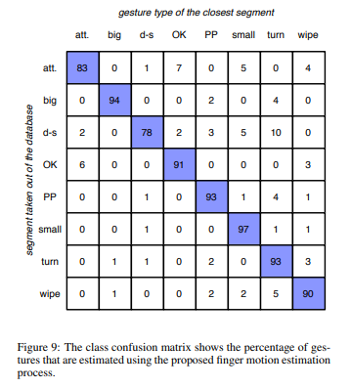
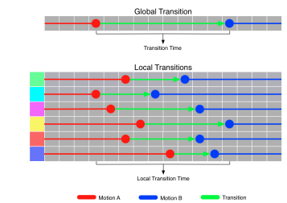

3 PoMs used for gesture classification
https://dl.acm.org/doi/pdf/10.1145/2788539.2788552

Slide 10
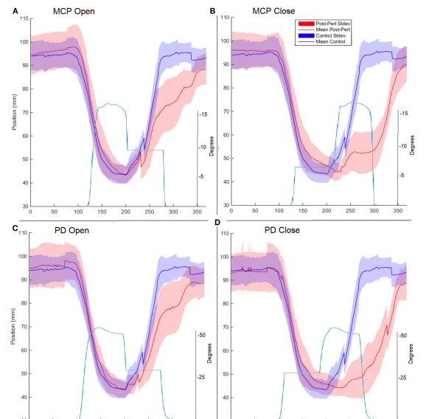
Central PoM dynamics can be altered by targeting peripheral PoM dynamics
“Phase of movement played a role… involuntary finger–thumb coupling was present during dynamic movement, with perturbation of the index finger impacting thumb activity. The degree of coupling modulated with the phase of motion…has shown evidence for neural coupling between neuromuscular units”
“These findings reveal a potential mechanism for direct intervention to improve poststroke hand mobility and provide insight on prospective neurologically oriented therapies”
https://www.frontiersin.org/articles/10.3389/fneur.2018.00084/full

Slide 11
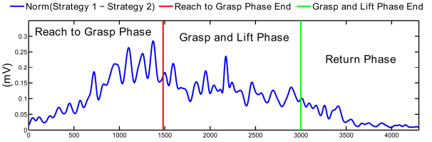
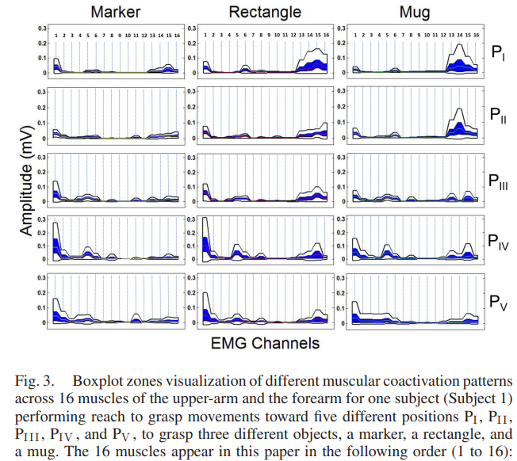

Slide 12
Proposed work
Build ML + RL
Train Gaussian Mixture Model (GMM) Network for low-latency PoM identification
Implement a Bayesian inference node for gesture classification from GMM
Validate
Stream test data
Characterize
Stream fatigue data

Slide 13
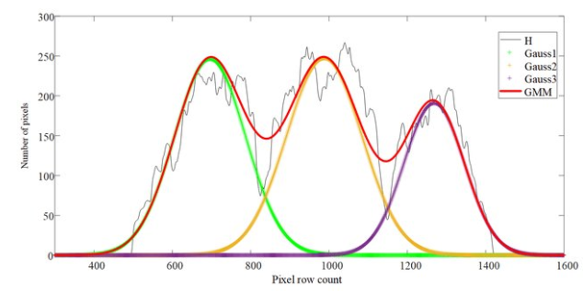
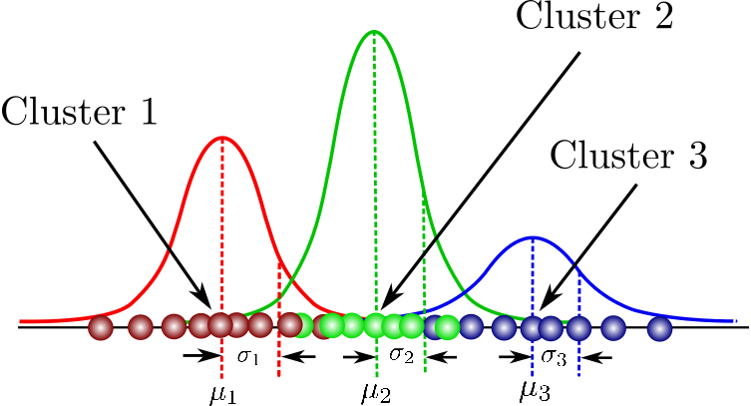
Identify centers of latent gaussians
https://www.researchgate.net/publication/339655220_Interlacing_Orchard_Canopy_Separation_and_Assessment_using_UAV_Images/figures?lo=1

Slide 14
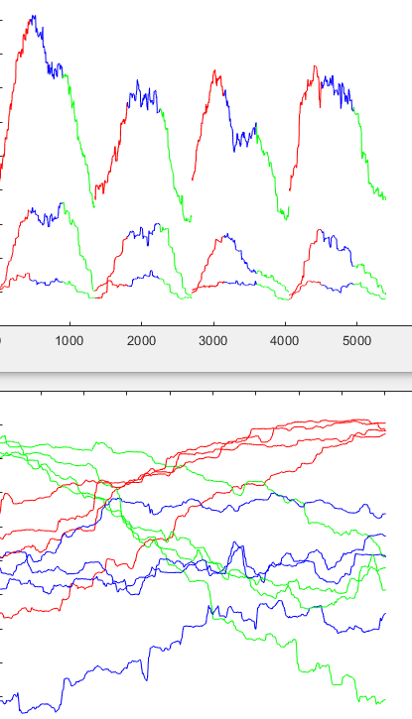
Identify centers of latent gaussians
Gesture repetitions:
#1 #2 #3 #4
Gaussian Distributions for 3 phases over 4 repetitions
Pre-shaping
Pinch
Release
Sensor 1
Sensor 2
Sensor 3

Slide 15
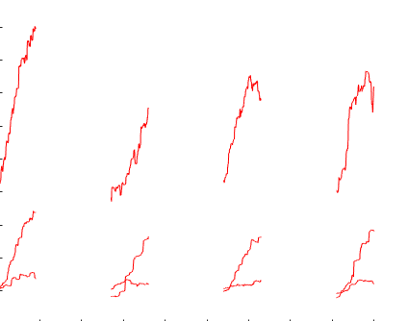
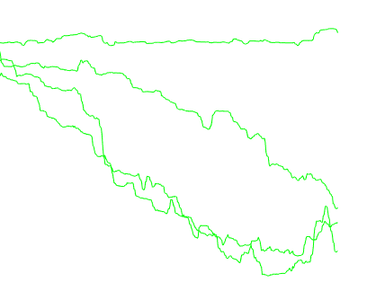
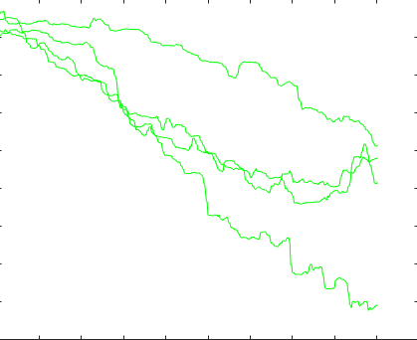

Slide 16
Learn to recognize latent gaussians

