Slide 1
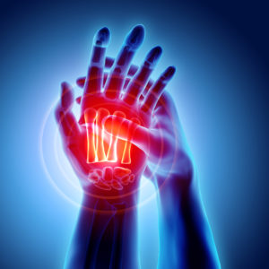
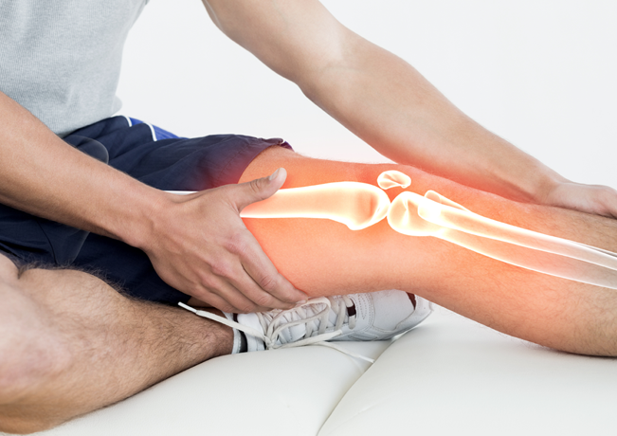
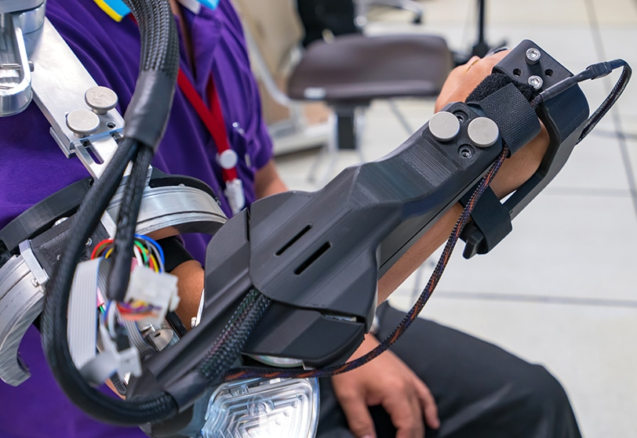
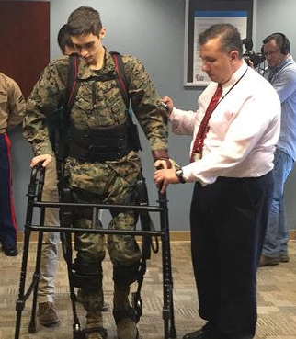
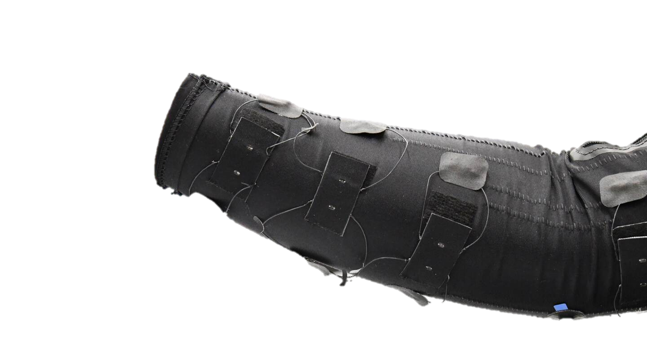
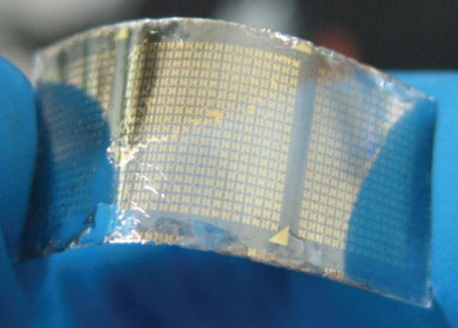
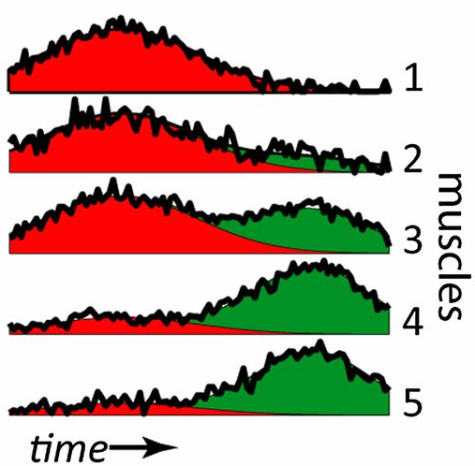
Team Work Makes the Dream Work!
Decoding Neuromuscular Patterns for Improved Human-Robot Interaction
Neuromuscular diseases are painful and debilitating
Robots can aid in physical therapy to alleviate pain and restore mobility
I’m developing a comfortable, low-cost sensing interface that uses machine learning to examine patient needs and facilitate robot-mediated therapy

