Slide 1
Neuromuscular Sensing for Control of Robotic Exoskeletons
Chad G. Rose
Avinash Baskaran

Slide 2
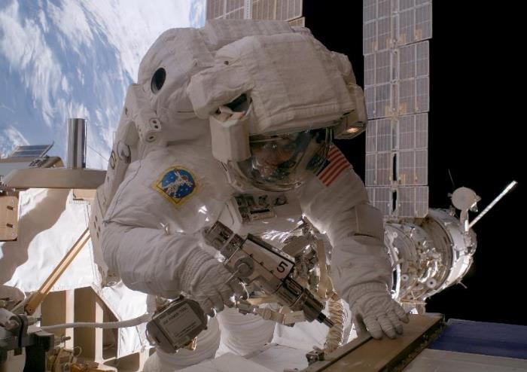
Motivation
Astronauts often experience hand fatigue and overuse injury in EVA settings due to the high stiffness of pressurized EVA gloves ^{[1]}.
Fig 1. Astronaut experiences hand muscle fatigue while operating a high-torque drill during EVA, leading her to lose control of the drill, which strikes and damages a nearby electrical connector. (figure reproduced from [2])

Slide 3
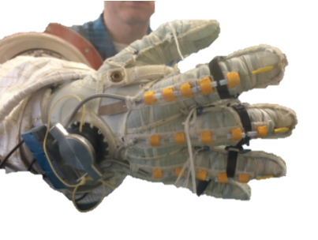
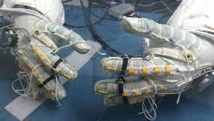
Motivation
Robotic exoskeletons for the hand have been proposed to help reduce astronaut neuromuscular effort while wearing stiff EVA gloves ^{[3]}.
Fig 2. NASA’s Space-suit RoboGlove (SSRG) is aa space-suit compatible robotic exoskeleton that has been explored for astronaut EVA assistance (figures reproduced from [3])

Slide 4
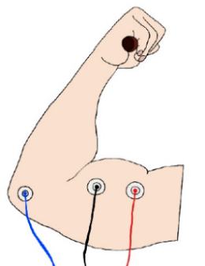
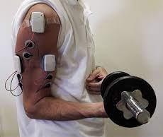
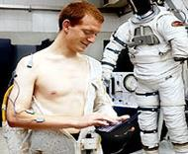
Motivation
Surface electromyography (sEMG), or direct sensing of muscle electrical activity from the skin surface, is desirable for exoskeleton control as it leads kinematic output, and can be worn comfortably under EVA suits.
[4]
Fig 3. Muscle activity can be detected by measuring electrical potentials at the skin surface; sEMG is a viable sensing modality for space suit exoskeleton control. However, commercial EMG systems are too bulky, expensive, and uncomfortable to be used in EVA settings, and no other EVA compatible sensing modalities have for feedback control of space-suit exoskeletons have been established

Slide 5
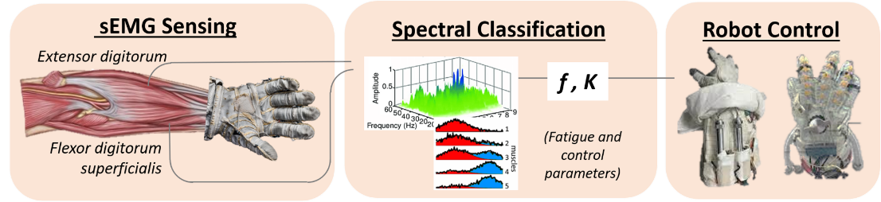
Scope of Work
The Alabama Space Grant Consortium has awarded a graduate fellowship to research and develop a novel EVA-compatible sEMG platform for control of robotic exoskeletons.
The proposed sensing platform will feature flexible sEMG electrodes fabricated using 3D printing as well as signal processing and wireless transmission via integrated circuitry
Fig 4. System-level diagram of proposed work, which entails developing a novel EVA-compatible sEMG sensor, using the sensor to determine muscle fatigue during dynamic muscle contractions, and using this fatigue detection system to control wearable robots

Slide 6
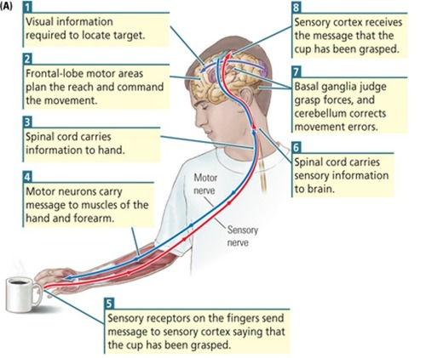
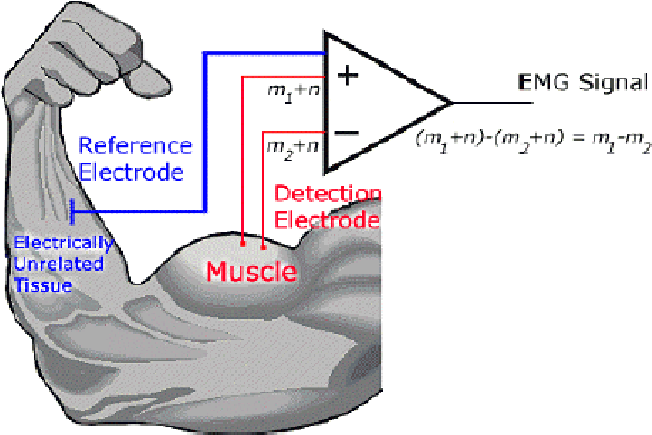
Background
Muscle activity occurs at frequencies between 20 and 500 Hz, and can be read from the skin surfaces as voltages between 50 µV and 10 mV ^{[9]}
Fig 4. Left: Diagram of human neuromuscular control, Right: Electrical principle of sEMG sensing
(figures reproduced from [10,11])

Slide 7
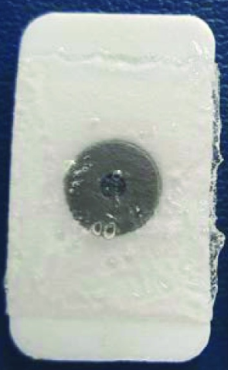
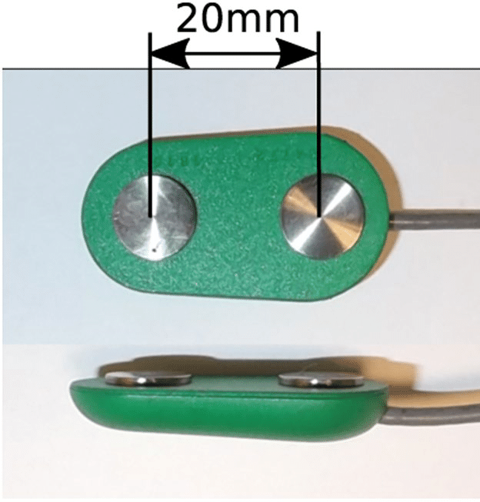
Background
sEMG Electrodes are commonly comprised of:
Exposed conductive pad composed of silver-silver chloride (Ag-AgCl) <= 10 cm² in area ^{[8]}
Clusters of conductive pads may be up to 20mm apart
Applicable/removable polymeric adhesive
Usually around 1 in² contact area ^{[8]}
Additionally, analog and digital filters (ie. RC band pass filtering, and amplification, as well as subject- and state-dependent normalization) are frequently employed to condition sEMG signals.
Fig 5. Common sEMG electrode construction, [8,12]

Slide 8
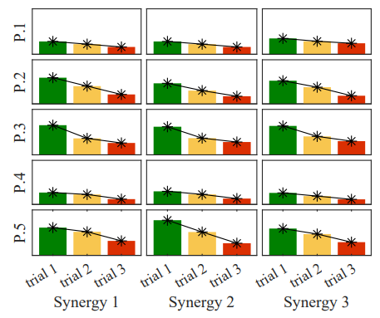
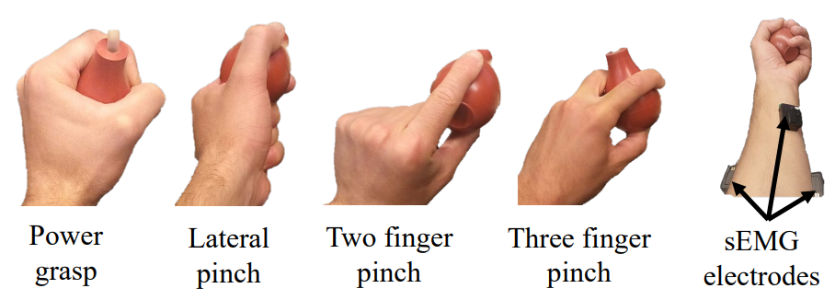


Task 1: Software for Fatigue Detection
We have completed task 1 by developing software to factor and analyze sEMG signals to quantify neuromuscular fatigue. These processes were validated in a pilot study with human participants (CoTS sEMG sensors were used).
(1)
(2)
(3)
Fig 5. An experimental trial was carried out in which participants performed ‘power grasp’ (ie. full handed squeeze) using an instrumented hand dynamometer with sEMG electrodes placed on the forearm. Non-negative matrix factorization (eqn 1.) satisfying the minimization of the Frobenius norm (eqn 2.) was carried out, and the results were weighted with Pearson correlation (eqn 3.). The study showed that the software method successfully detected neuromuscular fatigue from sEMG signals.

Slide 9
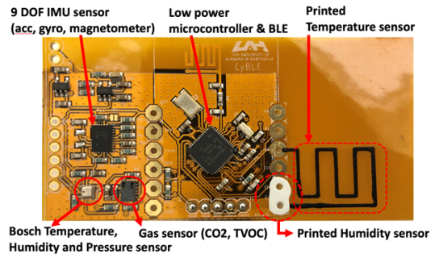
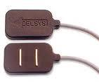
Task 2: Design and Fabricate EVA-compatible sEMG electrodes
In collaboration with MSFC, we hope to develop and obtain a novel EVA-compatible sEMG sensor package, featuring:
Silver (Ag), or silver-silver chloride (Ag-AgCl) electrode clusters
Multi-stage analog (RC) and digital filtering
Low power microcontroller and radio communication
[6]
[7]
Fig 6. Left: Sensor design inspired by flexible, EVA-compatible bio-sensor developed by Jovanov et al. Right: Consumer-grade sEMG electrode cluster, illustrating desired sensor functionality (figures reproduced from [6,7])

Slide 10
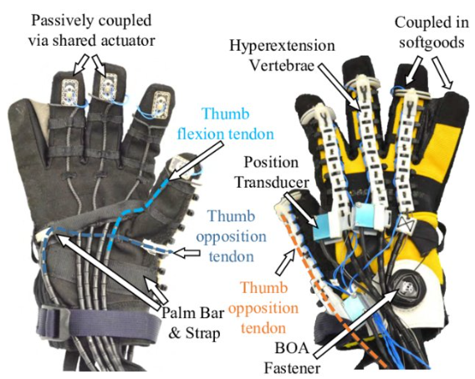
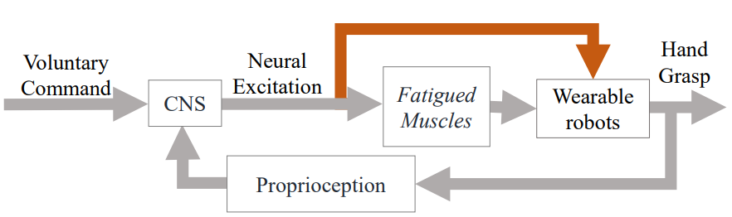
Task 3: Implementation in Robot Control
The sEMG sensing system developed in tasks 1 and 2 will be used to control the SeptaPose Assistive and Rehabilitative (SPAR) robotic glove in a validation experiment with human participants
sEMG sensing
[13]
Fig 5. Left: the SeptaPose Assistive and Rehabilitative (SPAR) robotic glove will be controlled via the paradigm shown in the figure on the left, where user intent (voluntary command) is sent to the central nervous system (CNS) to excite fatigued muscles, as well as inform robot motion via sEMG sensing.

Slide 11
References
https://ieeexplore.ieee.org/abstract/document/618265
https://airandspace.si.edu/exhibitions/outside-the-spacecraft/online/image-detail.cfm?id=9610
https://ttu-ir.tdl.org/bitstream/handle/2346/73043/ICES_2017_251.pdf
https://www.mdpi.com/2072-666X/12/1/64#cite
https://www.semanticscholar.org/paper/Garment-based-EMG-system-for-intra-spacesuit-Lee-Wang/c07dfc7dcc7ec283c1ceb616f74304dbb9156093
https://www.intechopen.com/chapters/40131
http://www.ece.uah.edu/~jovanov/papers/C2020_Jovanov_Aerospace.pdf
https://nvlpubs.nist.gov/nistpubs/jres/53/jresv53n5p283_a1b.pdf
https://www.sciencedirect.com/science/article/pii/S0003999307017480?via%3Dihub
https://www.researchgate.net/publication/324087226_The_Brain_on_Art_Auditory_Visual_Spatial_Aesthetic_and_Artistic_Training_Facilitates_Brain_Plasticity/figures?lo=1&utm_source=google&utm_medium=organic
https://www.semanticscholar.org/paper/Surface-electromyography%3A-Detection-and-recording-Luca/992836d36c1ae4b56314e8b15f087822a1995c93
https://www.researchgate.net/publication/337165548_A_calibrated_database_of_kinematics_and_EMG_of_the_forearm_and_hand_during_activities_of_daily_living/figures?lo=1
https://www.researchgate.net/publication/328647936_A_Hybrid_Rigid-Soft_Hand_Exoskeleton_to_Assist_Functional_Dexterity

