Slide 1
EMG designs
Avinash Baskaran

Slide 2
“Blank” sEMG sensor design
½” ⌀ Electrode pads
2” x 1” sensor housing
1.2” electrode
distance
Copper traces exiting
via 6”-12” ribbon cable

Slide 3
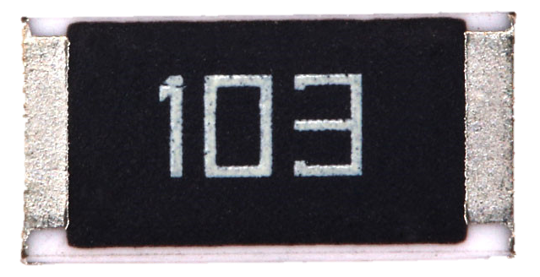
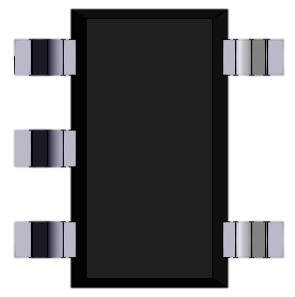
1. Signal Acquisition
Schematic:
1-1 Scale Model:
R
Vss⁺
Electrode
1
R
-
+
Op amp
R
V_acq
R
Electrode
2
Vss⁻
Reference Electrode

Slide 4
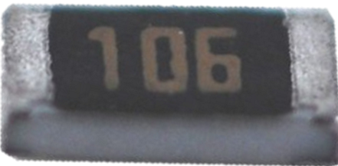
2. Amplification
Schematic:
Scale Model:
R
Vss⁺
R2
Electrode
1
R
-
+
Vss⁺
Op amp
-
+
R
Op amp
V_acq
R
V_acq
V_acq
R
Electrode
2
Vss⁻
Vss⁻
Reference Electrode

Slide 5
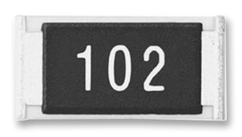
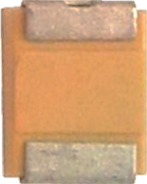
3. High-pass filter (20 Hz)
Schematic:
Scale Model:
R
Vss⁺
R2
R5
Electrode
1
R
-
+
Vss⁺
Vss⁺
Op amp
-
+
R
Op amp
R
V_acq
R5
Op amp
V_acq
C
Vfilt
R
Electrode
2
Vss⁻
Vss⁻
Vamp
Vss⁻
Reference Electrode

Slide 6
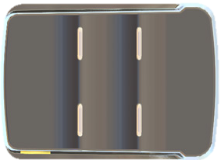
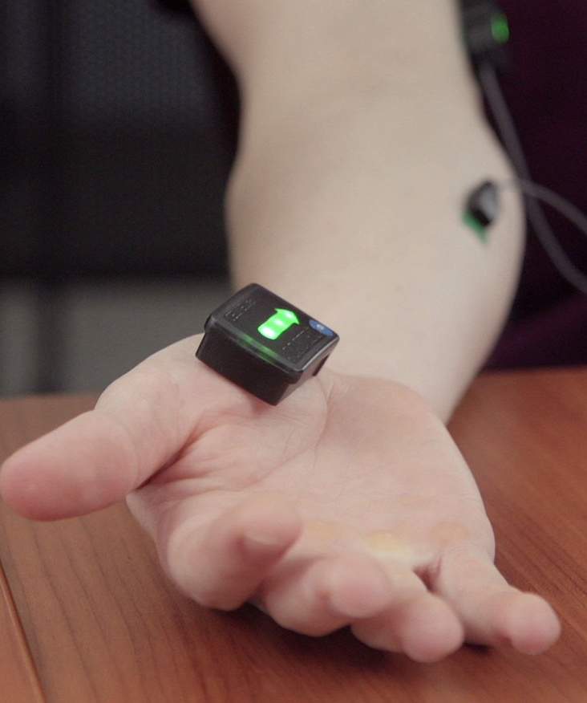
500% Scaled model
Delsys commercial EMG sensor (1” x 1.5” x 0.5”) shown for comparison

