Slide 1
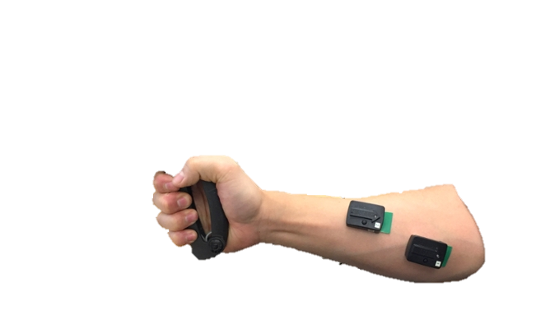

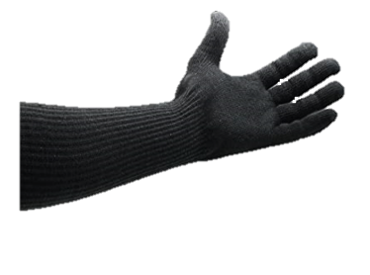
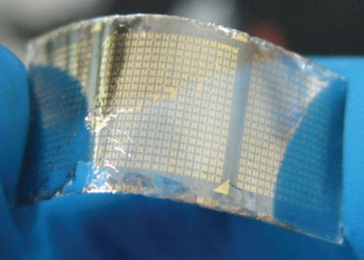
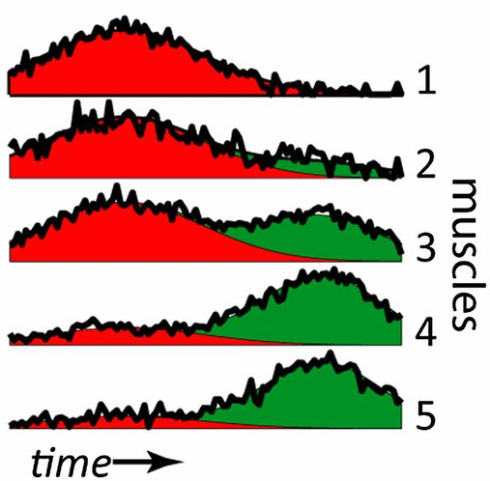
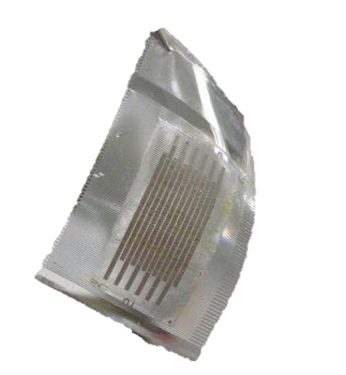
PROBLEM: Robot-mediated therapy requires bulky, expensive sensors
Industry standard sensors
> $10,000
Must self-apply, easy to damage, difficult to use
SOLUTION: A Low-cost wearable sensor interface (<$100)
(Low-cost 3D printed flexible electrodes
embedded in the garment)
Affordable, comfortable, native machine learning processing

Slide 2



