Slide 1
NASA MSFC Visit June 2022
Avinash Baskaran

Slide 2
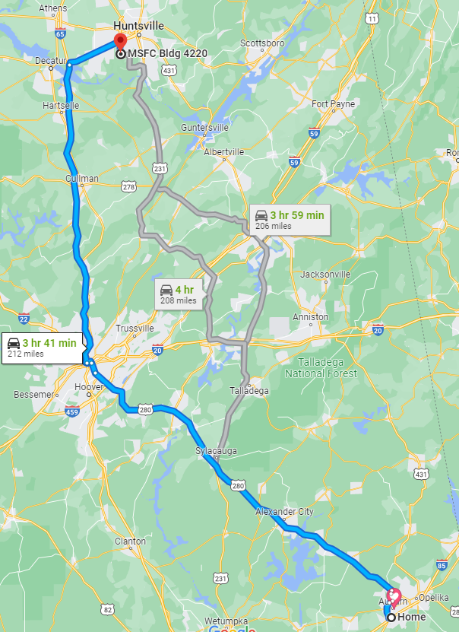
Auburn → Huntsville
I will be traveling to NASA Marshall Space Flight Center in Huntsville, AL, to collaborate with NASA ES33 research branch on a research fellowship project. This collaboration is requisite to satisfy the terms of the fellowship, and will allow me to reapply for funding renewal in the future. This travel will occur from 6:00am on June 11th to 8pm on June 15th, 2022.
Travel Details:
Distance: 210 Miles
Travel Time: 4 Hours

Slide 3
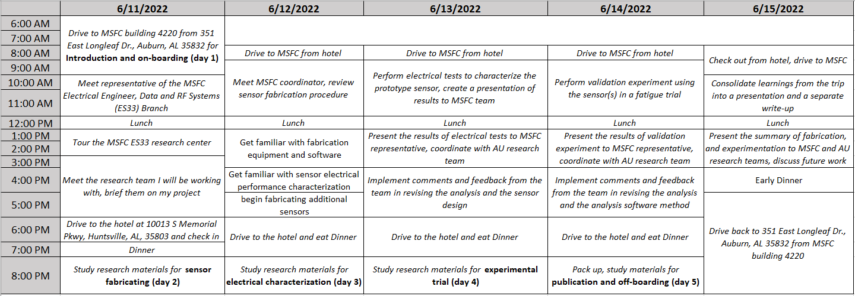
Agenda

