Slide 1

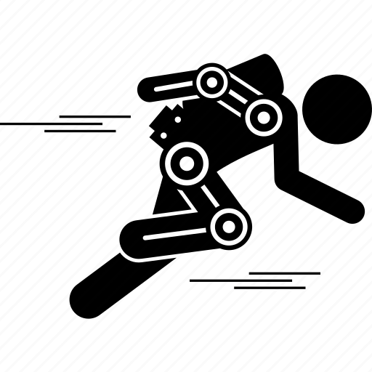
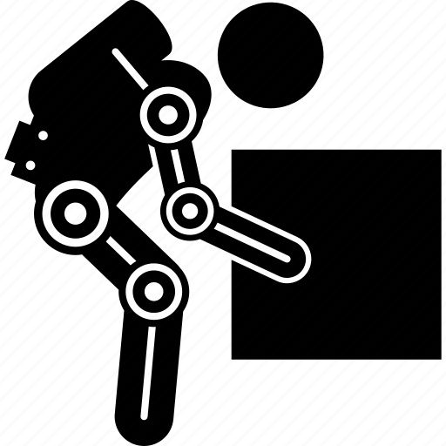
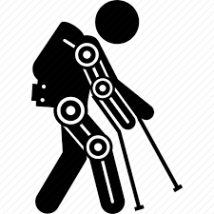
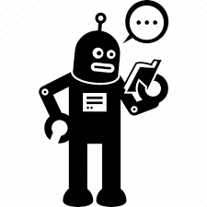
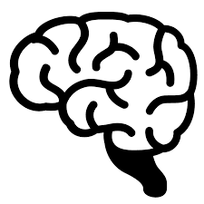
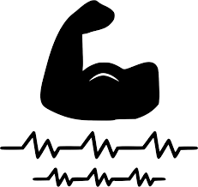

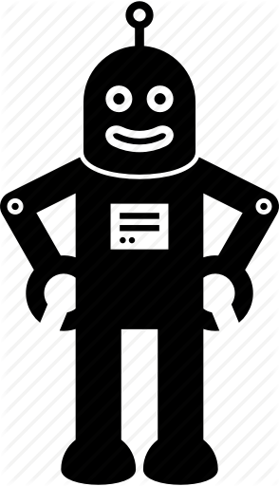
Team work makes the dream work!
Decoding Neuromuscular Patterns for Improved Human-Robot Interaction
Can robots become better helpers…
…by learning how we move?

Slide 2

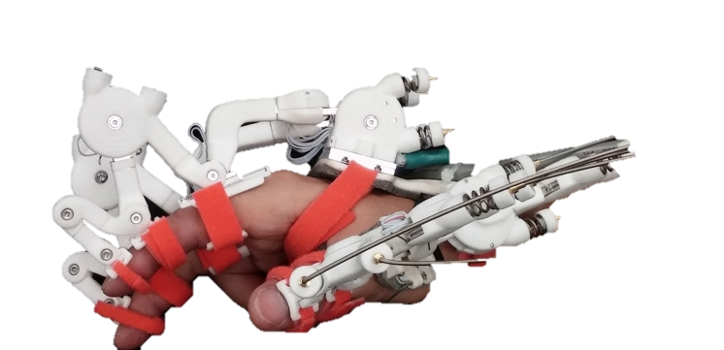
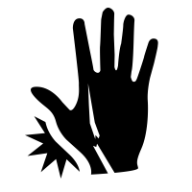

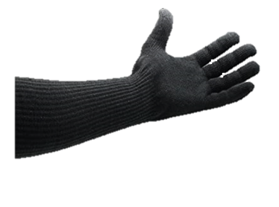
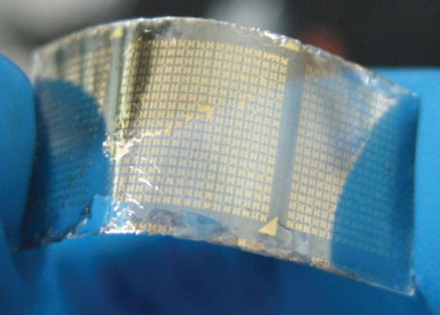
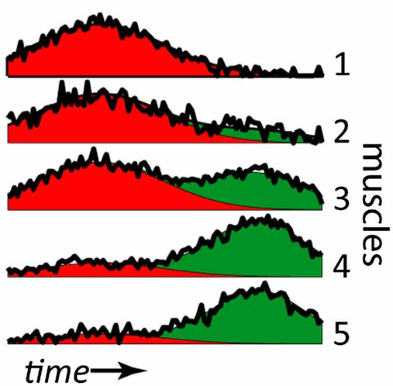
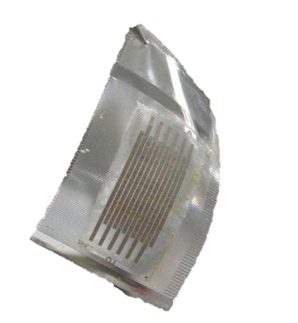
Can robots become healthcare helpers?
Decoding Neuromuscular Patterns for Improved Human-Robot Interaction
YES! With an affordable, comfortable, AI-empowered wearable interface
(Low-cost 3D printed flexible sensors embedded in the garment)
Low-cost, light-weight fabric construction
Aware of patient needs through machine-learning

Slide 3
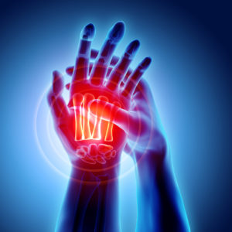
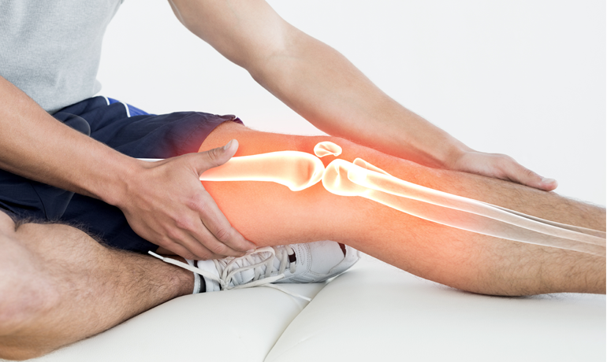
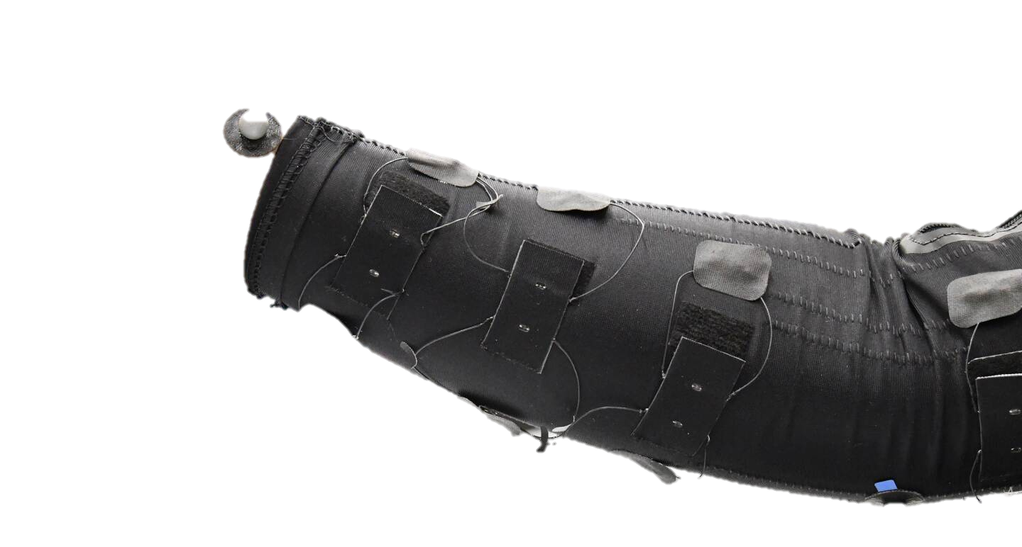
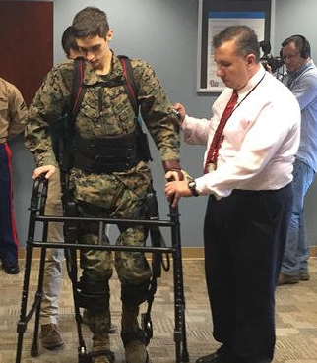
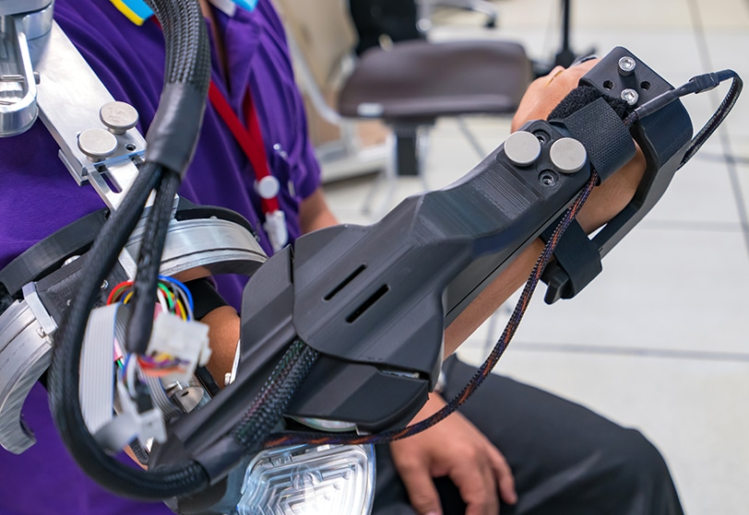
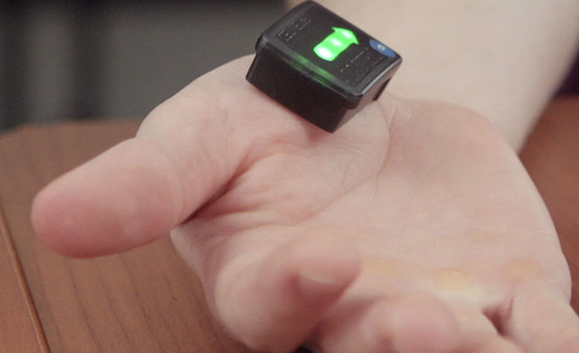
Team Work Makes the Dream Work!
Decoding Neuromuscular Patterns for Improved Human-Robot Interaction
Robots can facilitate physical therapy, but sensors are bulky and expensive
A novel, low-cost, AI empowered wearable interface
Industry standard sensors
> $10,000

Slide 4
Symptoms of Neuromuscular disease are painful and debilitating
With comfortable, low-cost sensors…
Robots could facilitate physical therapy to alleviate pain and restore mobility
MY RESEARCH: A novel, low-cost, AI empowered wearable interface to enable Robot-mediated therapy

Slide 5
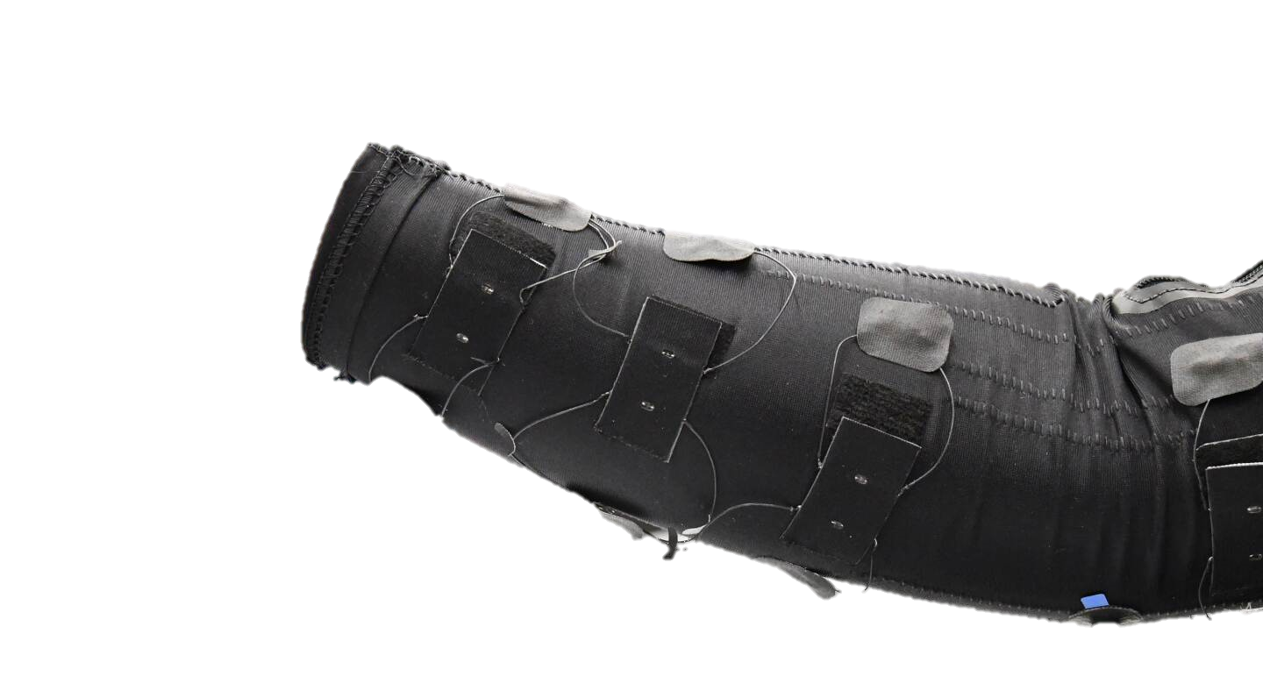
Team Work Makes the Dream Work!
Decoding Neuromuscular Patterns for Improved Human-Robot Interaction
Symptoms of Neuromuscular disease are painful and debilitating
Robots can aid in physical therapy to alleviate pain and restore mobility
I’m developing a comfortable, low-cost sensing interface that uses machine learning to examine patient needs and facilitate robot-mediated therapy

