Slide 1
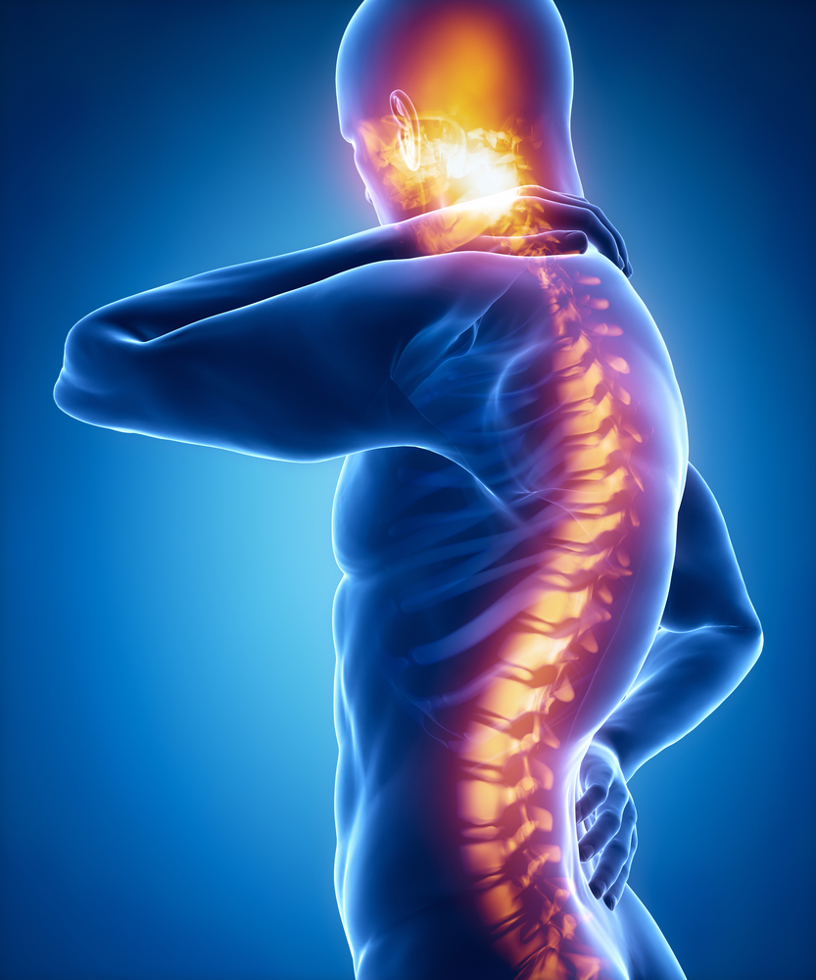
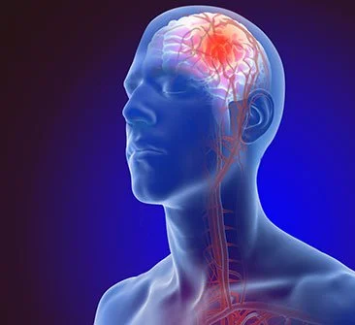
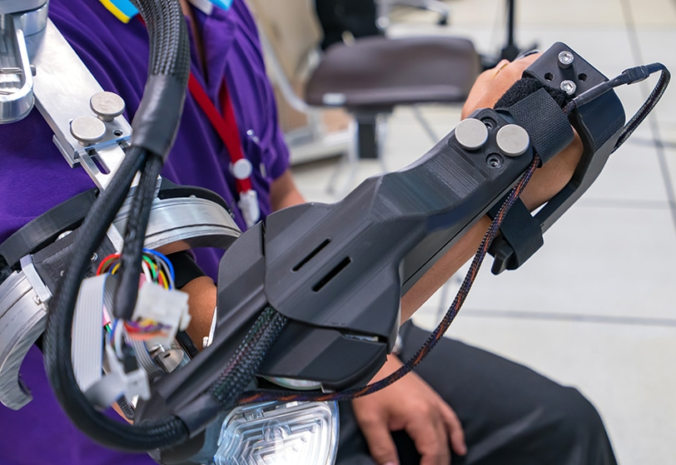
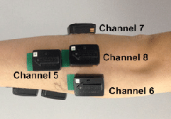
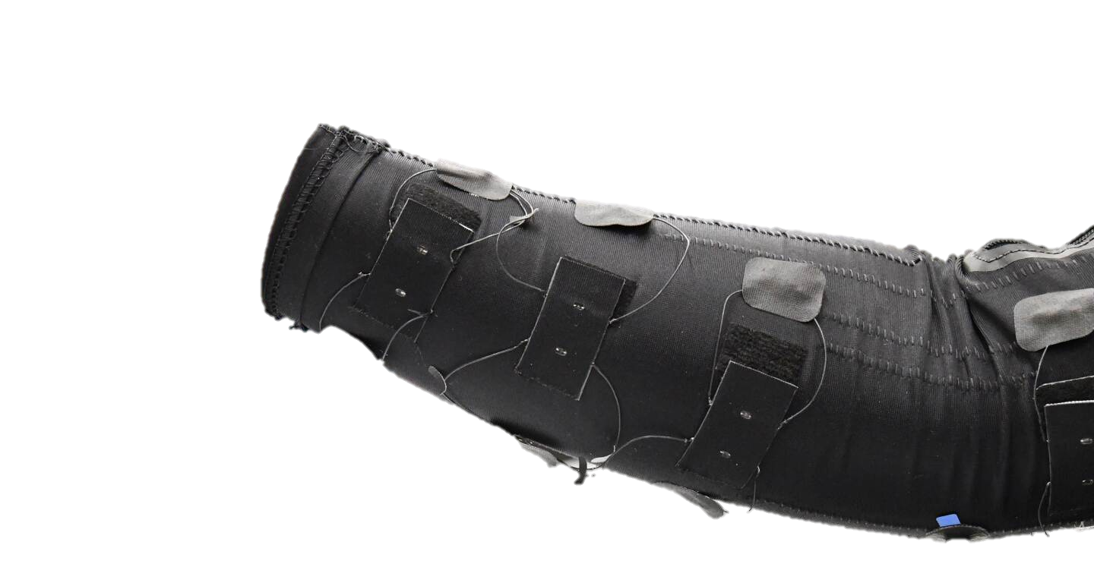
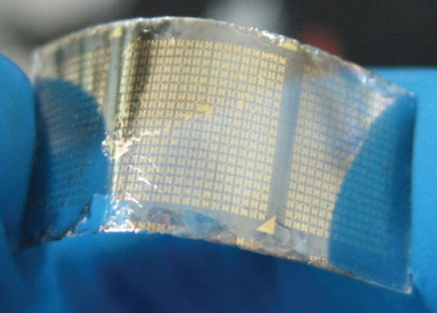
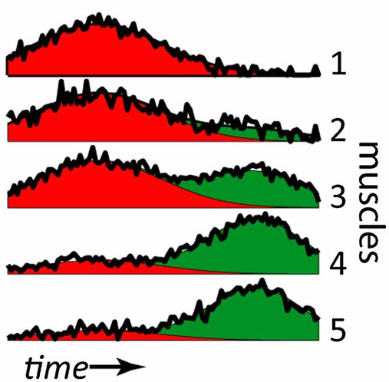
Team Work Makes the Dream Work!
Decoding Neuromuscular Patterns for Improved Human-Robot Interaction
Neuromuscular diseases are painful and debilitating
But sensors are currently too bulky and expensive
Robots can help!
I’m developing a comfortable, low-cost sensing interface that uses machine learning to examine patient needs and facilitate robot-mediated therapy

