Slide 1
Web Technologies II
PES University
Gadget Shop
Anup Bujurke 01FB16ECS066
Anusha Agarwal 01FB16ECS067
Avinash 01FB16ECS083

Slide 2
Technologies Used
-HTML,CSS,Javascript,PHP,Bootstrap
Database Used
-Sqlite3
Framework Used
-Flask
What was implemented
Predictive fetch and submission throttling and both supporting intelligent component

Slide 3
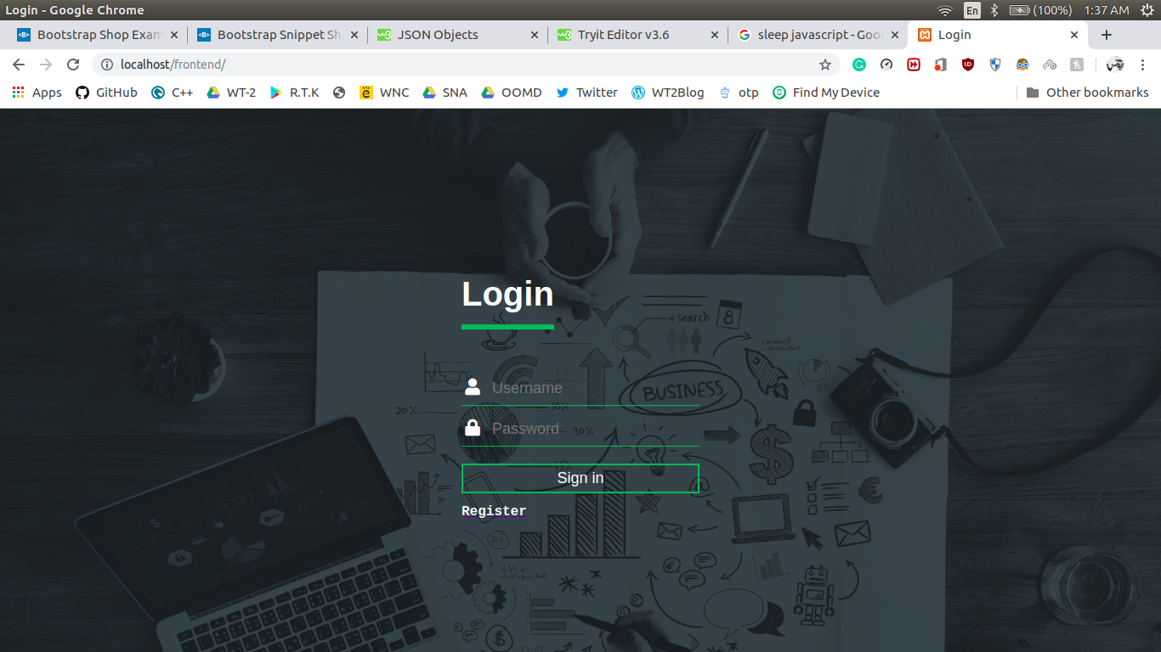
Components of the Website
Registration and Login Page:
-Uses APIs for registration
-Can login with phone number or email,taken care in backend.
-Makes a AJAX call to login API
- Same applicable for registration page point 1-3.

Slide 4
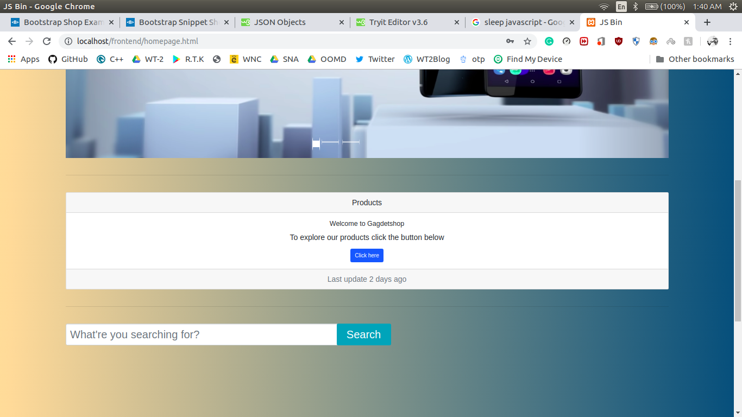
HomePage
-Uses submission throttling to search products.
-Products are ranked in the search result based on ratings.
-Products keep on adding and this can be seen by users i.e when was the new product added.

Slide 5
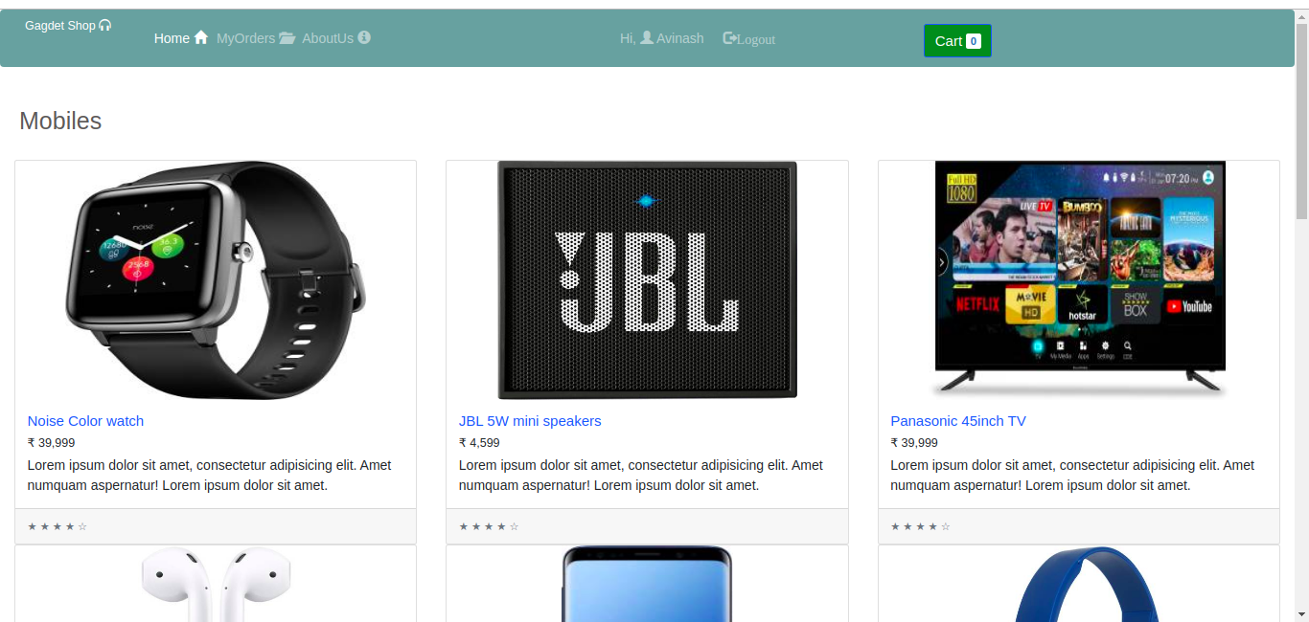
Products
-Here we have all the products available to purchase.
-Each product is loaded Dynamically when the user scroll down to end of the page.
Intelligent Component
-Keeps track of the last viewed component by the user and fetches new component based on this component.

Slide 6
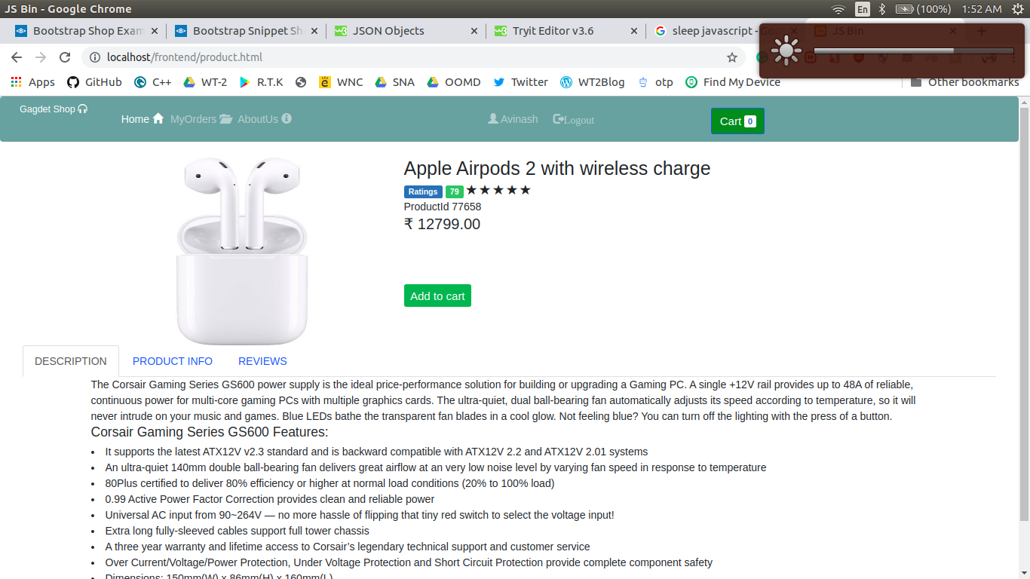
Product
-There is only on product page, this pages accesses value from local storage that was set by last page when this product was selected.
-Add to cart,user rating,number of users rated

Slide 7
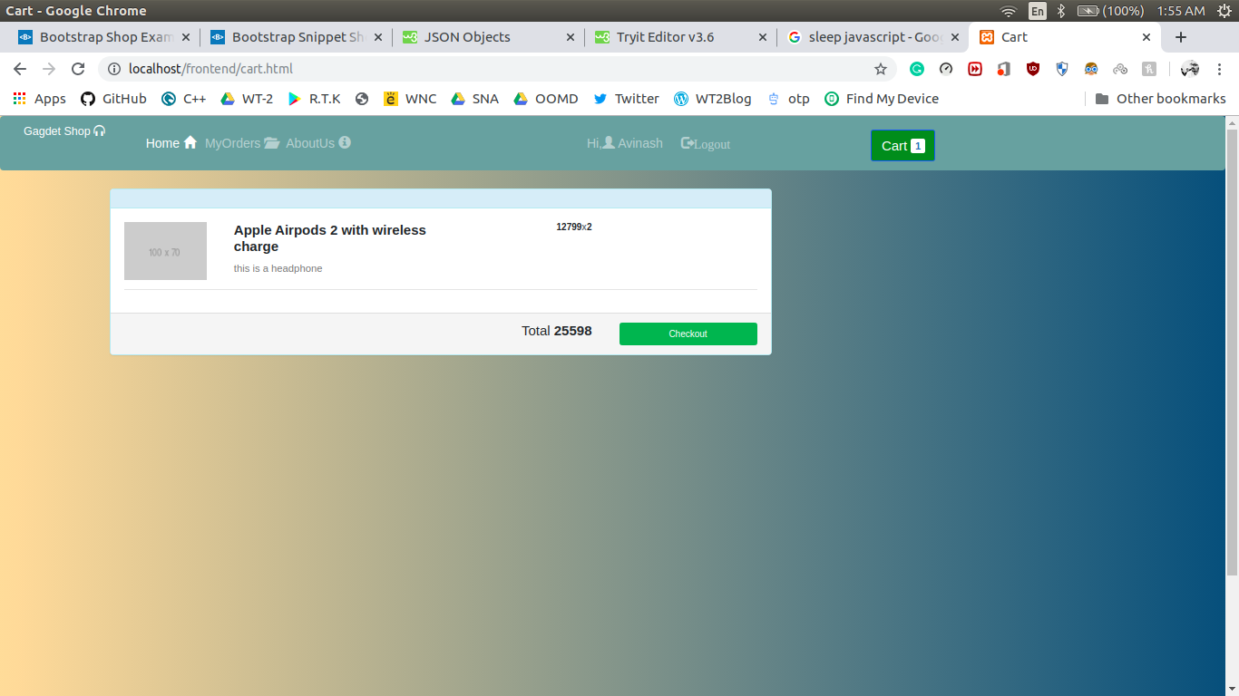
Cart
-Access cart details from database.
-Places an order and redirects to homepage
-Dynamically generated cart items depending on the number of cart items.

Slide 8
Thank You

