Slide 1

React State & Events
Building Interactive Components
You already know JSX, Components, and Props. Now let's bring them to life — with state to remember data and events to respond to users.
Use useState to manage dynamic data
Handle clicks, inputs, and form submissions
Render UI conditionally based on state
Build three real mini-projects from scratch

Slide 2

Why State Makes Components Interactive
Props flow one way — parent to child. But components also need to remember things: a counter value, a form field, a toggle. That's what state is for.
Props
State
Passed in from a parent. Read-only. Define configuration.
Managed internally. Mutable via setters. Drives re-renders.
Events
User actions that trigger state changes. Clicks, typing, submits.

Slide 3


The useState Hook
Breaking It Down
import { useState } from 'react';
function Counter() {
const [count, setCount] = useState(0);
return (
<button onClick={() => setCount(count + 1)}>
Count: {count}
</button>
);
}
useState(0)
Initial value is 0. Can be any type.
count
Current state value. Read it, don't mutate it.
setCount()
Updates state and triggers a re-render.

Slide 4



React Event Handling
React events mirror DOM events but use camelCase and pass functions, not strings.
onClick
onChange
onSubmit
Triggers on button or element click.
Fires on every input change. Use e.target.value.
Handles form submission. Always call e.preventDefault().
onClick={() => setCount(c + 1)}
onChange={(e) => setName(e.target.value)}
onSubmit={(e) => { e.preventDefault(); handleSubmit(); }}

Slide 5


Controlled Inputs & Form State
What Is a Controlled Input?
React state is the single source of truth for the input's value. The UI always reflects state.
function LoginForm() {
const [email, setEmail] = useState('');
return (
<input
value={email}
onChange={(e) => setEmail(e.target.value)}
placeholder="Enter email"
/>
);
}
The value prop ties the input to state. Without it, the input is uncontrolled.

Slide 6
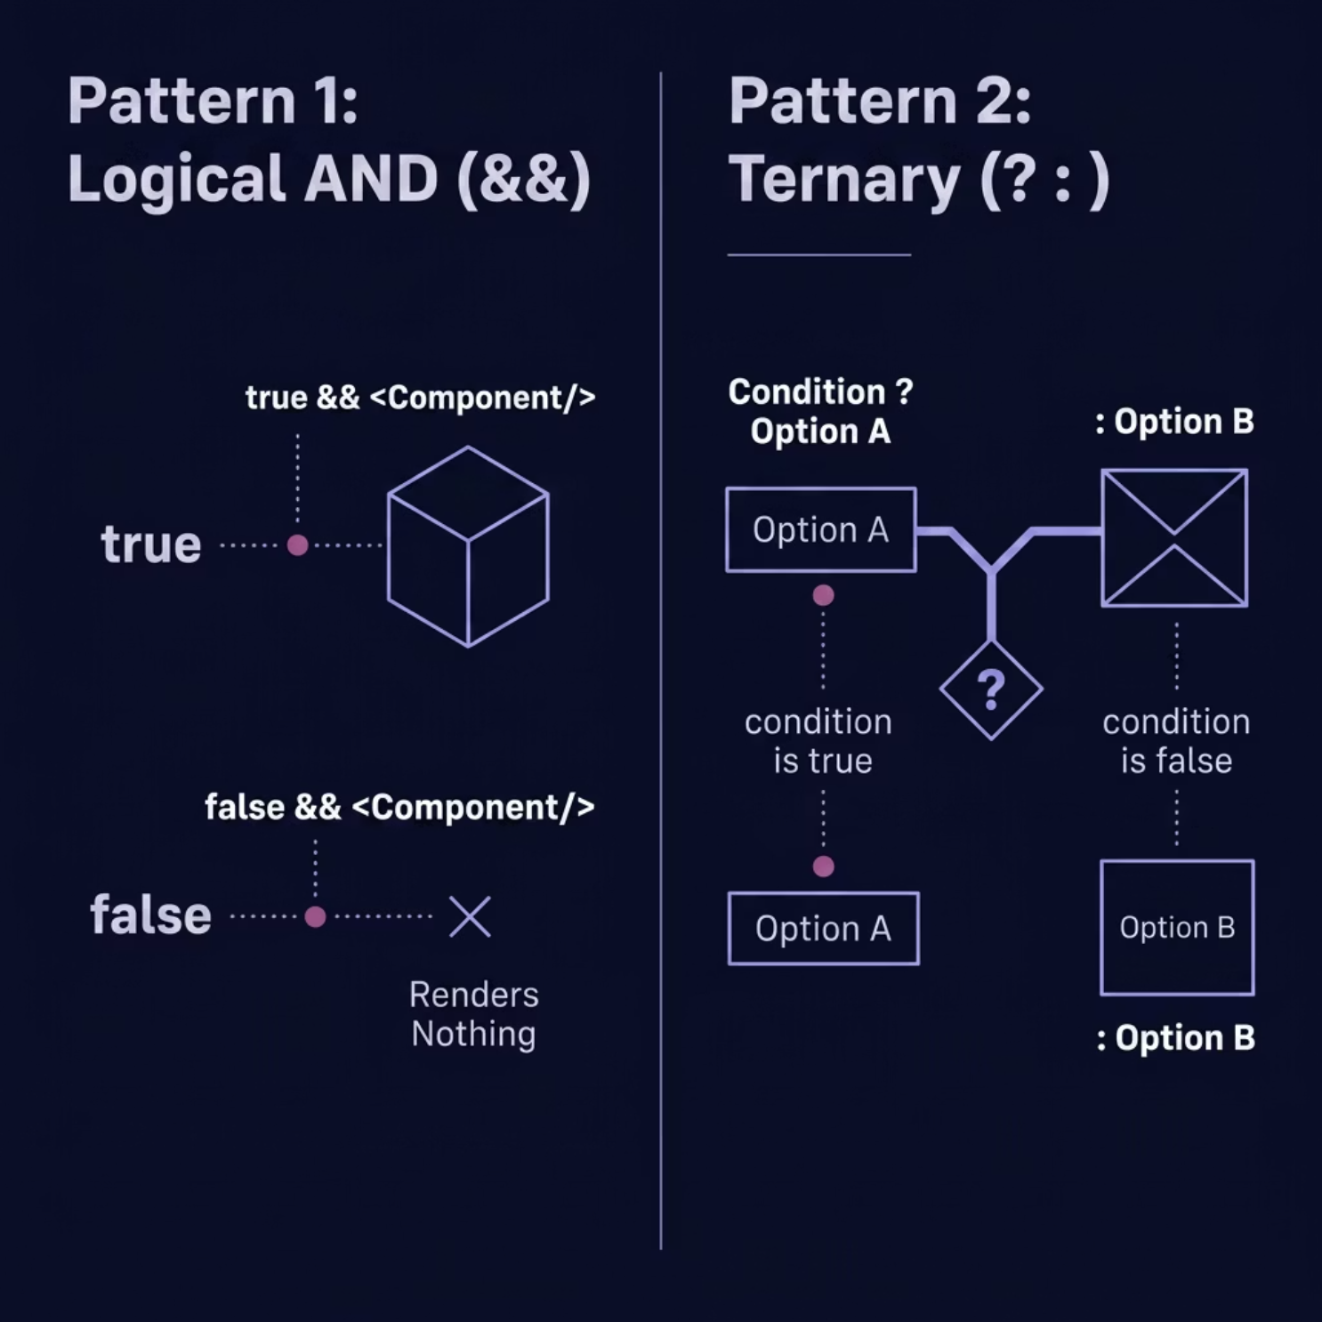
Conditional Rendering
Show or hide UI based on state using JavaScript expressions directly inside JSX.
Logical AND &&
Render right side only when left is true.
{isLoggedIn && <Dashboard />}
Ternary Operator ? :
Choose between two options.
{count > 0 ? <span>{count}</span> : <span>Zero</span>}

Slide 7


MINI PROJECT 1
🔢 Counter Application
What You'll Practice
function Counter() {
const [count, setCount] = useState(0);
return (
<div>
<h2>Count: {count}</h2>
<button onClick={() => setCount(count + 1)}>
+ Increment
</button>
<button onClick={() => setCount(count - 1)}>
− Decrement
</button>
<button onClick={() => setCount(0)}>
Reset
</button>
</div>
);
}
Initialize state with useState(0)
Update state with setCount() on button clicks
Read current state to display the live count
Use multiple event handlers in one component

Slide 8


MINI PROJECT 2
👁️ Toggle Visibility Feature
The Concept
A boolean state (true / false) controls whether content is shown. Click a button to flip the value.
function Toggle() {
const [isVisible, setIsVisible] = useState(false);
return (
<div>
<button onClick={() => setIsVisible(!isVisible)}>
{isVisible ? 'Hide' : 'Show'} Details
</button>
{isVisible && (
<p>Here are the hidden details!</p>
)}
</div>
);
}

Slide 9

MINI PROJECT 3
📋 User Form with Submit Handling
function UserForm() {
const [name, setName] = useState('');
const [submitted, setSubmitted] = useState(false);
const handleSubmit = (e) => {
e.preventDefault(); // Stop page reload
setSubmitted(true); // Update state
};
return (
<form onSubmit={handleSubmit}>
<input
value={name}
onChange={(e) => setName(e.target.value)}
placeholder="Your name"
/>
<button type="submit">Submit</button>
{submitted && <p>Thanks, {name}!</p>}
</form>
);
}
Controlled Input
Prevent Default
Feedback State
value + onChange keeps state in sync
e.preventDefault() stops the browser reload
A second state tracks submission and shows a message

Slide 10



Summary & Best Practices
1
State drives the UI
Never mutate state directly — always use the setter.
2
One source of truth
Keep form inputs controlled. State owns the value.
3
Keep state minimal
Derive values from existing state when possible.
4
Events are functions
Pass handlers as references, not strings. Use arrow functions for inline logic.
Next up: Explore useEffect to sync state with APIs and side effects!

