Slide 1
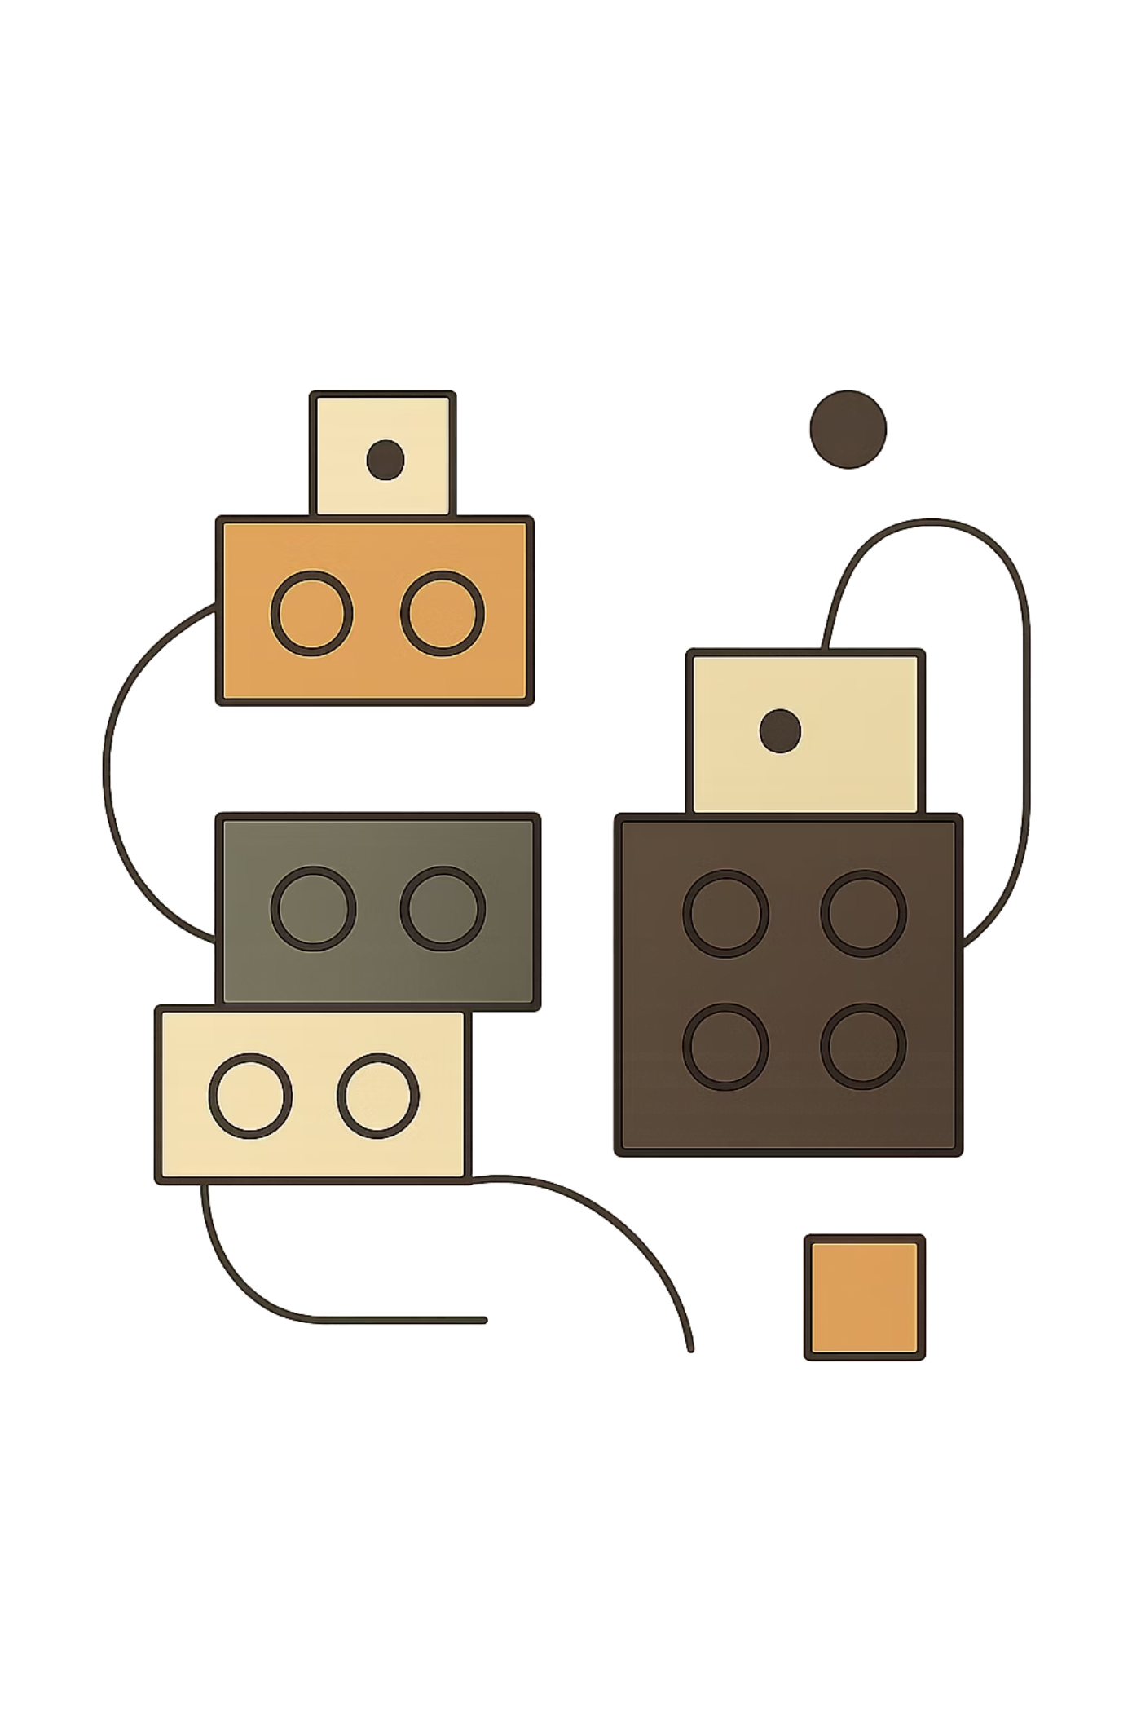
React Component Composition & Reusability
A practical, code-focused guide to building flexible, maintainable React applications — mastering composition, shared state, and reusable component design.
REACT TRAINING
FUNCTIONAL COMPONENTS
MODERN PATTERNS

Slide 2
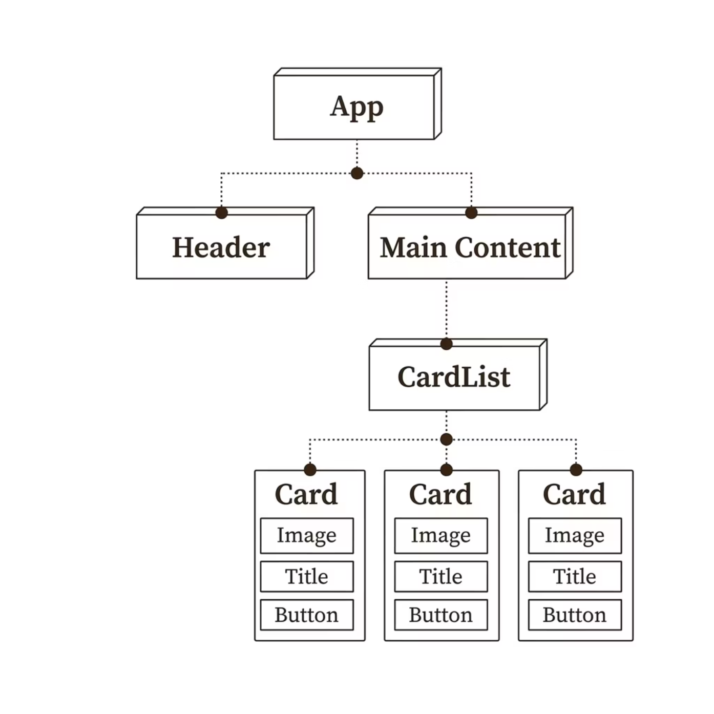

Introduction to Component Composition
Composition is React's core pattern: build complex UIs by combining small, focused components. Each piece is independent, testable, and reusable.
🧩 Reusability
🔬 Testability
📐 Maintainability
Write once, use everywhere
Isolated components are easy to test
Changes stay localized

Slide 3
The children Prop
Every React component receives a special prop — children — containing whatever is placed between its opening and closing tags. This is the foundation of flexible component design.
Defining a Component with children
How It Works
01
function Card({ children }) {
return (
<div className="card">
{children}
</div>
);
}
Parent passes JSX
Content between tags becomes children
02
Child receives it
Using the Component
Destructured from props like any value
03
<Card>
<h2>Hello, World!</h2>
<p>Any JSX goes here.</p>
</Card>
Rendered dynamically
Placed with {children} in the JSX

Slide 4


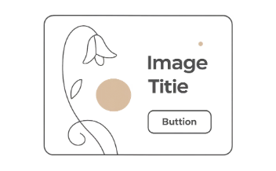

Real-World Use Cases for children
The children prop powers the most flexible patterns in React — from layout shells to interactive modals.
Layout Components
Modals
Cards
Wrappers
<Sidebar>
<NavItem />
</Sidebar>
<Modal>
<ConfirmDialog />
</Modal>
<Card>
<ProductInfo />
</Card>
<Section>
<FeaturedList />
</Section>

Slide 5
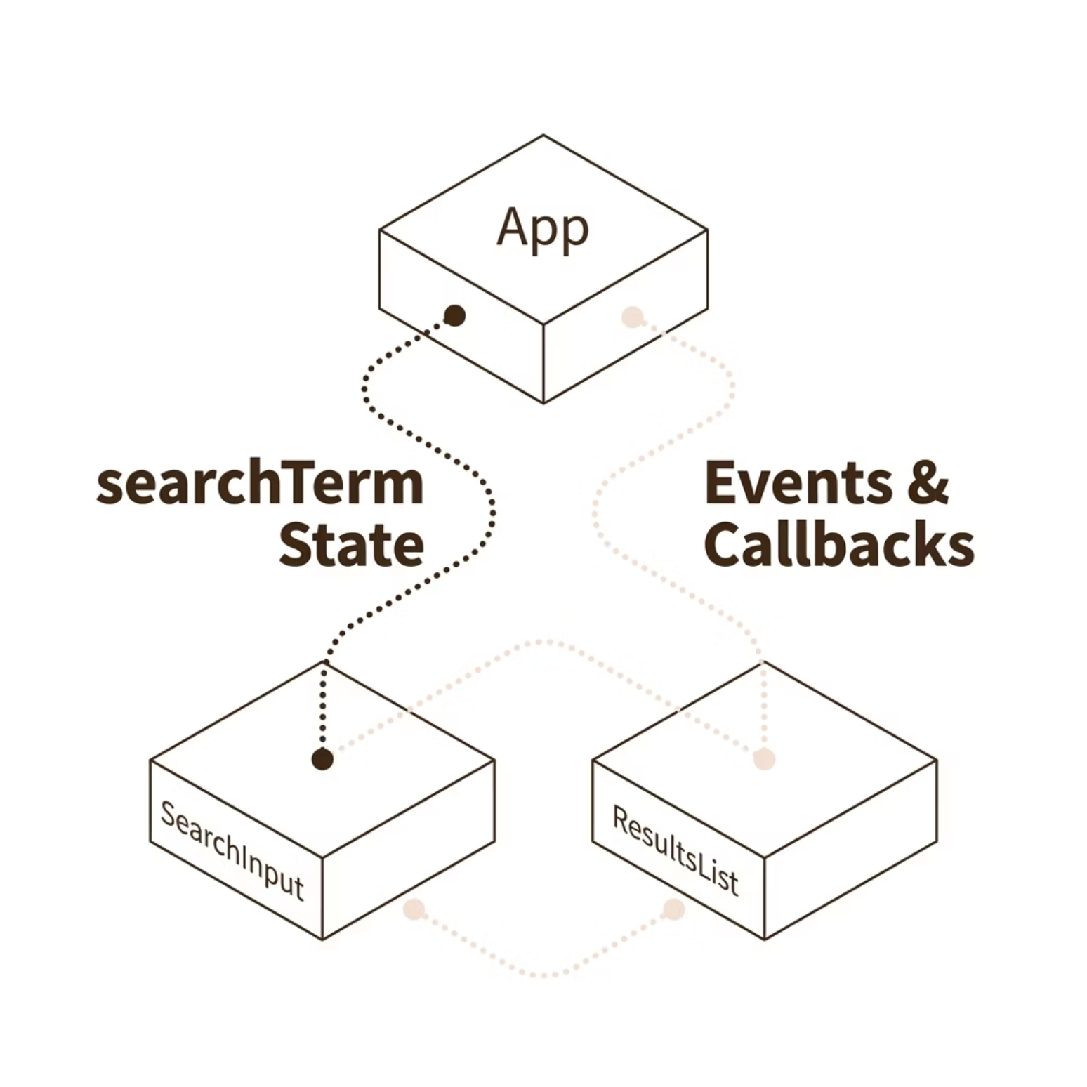

Lifting State Up
The Problem
Sibling components cannot directly share state. The solution: lift shared state to their common parent, then pass it down via props.
Pattern in Code
function App() {
const [term, setTerm] = useState("");
return (
<>
<SearchInput
value={term}
onChange={setTerm}
/>
<ResultsList search={term} />
</>
);
}
Rule of thumb: When two components need the same data, lift it to their nearest common ancestor.

Slide 6
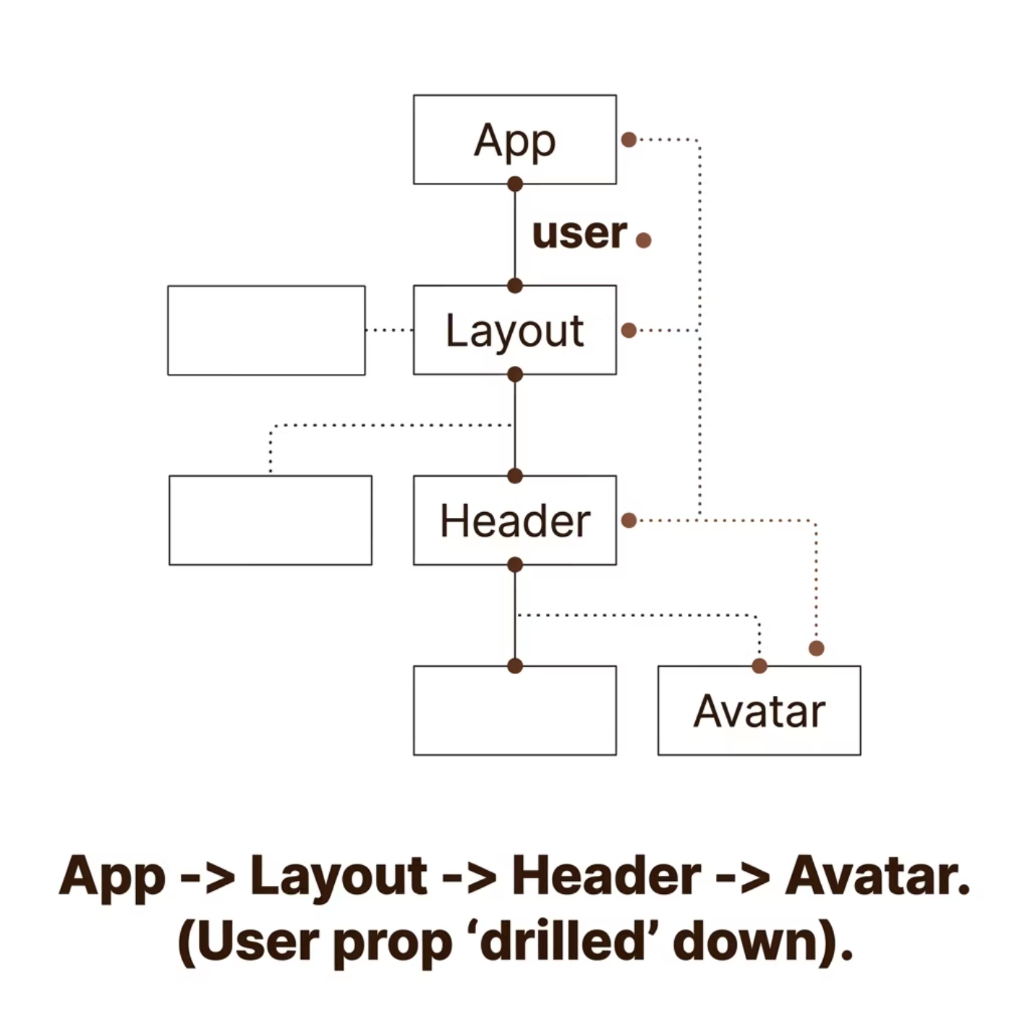

Prop Drilling
What Is Prop Drilling?
Passing props through multiple intermediate components that don't need them — just to reach a deeply nested child.
function App() {
const user = { name: "Alex" };
return <Layout user={user} />;
}
function Layout({ user }) {
return <Header user={user} />;
}
function Header({ user }) {
return <span>Hi, {user.name}</span>;
}
Smell: More than 2–3 levels of drilling signals a need for Context API or component restructuring.

Slide 7
Building Reusable Components
Design components with a clear API: accept props, render children, and stay flexible.
Reusable Button
Reusable Card
function Button({
children,
variant = "primary",
onClick
}) {
return (
<button
className={`btn btn-${variant}`}
onClick={onClick}
>
{children}
</button>
);
}
function Card({
title,
children,
footer
}) {
return (
<div className="card">
<h3>{title}</h3>
<div className="card-body">
{children}
</div>
{footer && (
<div className="card-footer">
{footer}
</div>
)}
</div>
);
}

Slide 8

Styling Components
Two dominant approaches in modern React — each with distinct trade-offs.
CSS Modules
Tailwind CSS
Scoped CSS files — no class name collisions.
Utility-first — styles live directly in JSX.
/* Card.module.css */
.card {
border-radius: 8px;
box-shadow: 0 2px 4px rgba(0,0,0,0.1);
}
/* Component */
import styles from './Card.module.css';
<div className={styles.card} />
<div className="
rounded-lg
shadow-md
p-4
bg-white
">
{children}
</div>
Tip: Use CSS Modules for component libraries, Tailwind for rapid UI development.

Slide 9

Hands-On Project: Reusable Card Component
Build a flexible Card component from scratch — supporting any content, styled with CSS Modules, and reused across scenarios.
Follow these four steps to go from a basic shell to a fully reusable, production-ready Card component.
Card.jsx
Card.module.css
import styles from './Card.module.css';
function Card({ title, children, footer }) {
return (
<div className={styles.card}>
{title && (
<h3 className={styles.title}>
{title}
</h3>
)}
<div className={styles.body}>
{children}
</div>
{footer && (
<div className={styles.footer}>
{footer}
</div>
)}
</div>
);
}
export default Card;
.card {
background: white;
border-radius: 12px;
box-shadow: 0 4px 12px rgba(0,0,0,0.08);
padding: 1.5rem;
max-width: 360px;
}
.title {
margin: 0 0 1rem;
font-size: 1.25rem;
color: #3E2513;
}
.body {
color: #555;
line-height: 1.6;
}
.footer {
margin-top: 1rem;
padding-top: 1rem;
border-top: 1px solid #eee;
}
Using the Card Component
Add Card.module.css
<Card
title="Product Card"
footer={<Button>Add to Cart</Button>}
>
<img src="/product.jpg" alt="Product" />
<p>A premium widget for your workflow.</p>
</Card>
<Card title="User Profile">
<Avatar src="/user.png" />
<p>Jane Doe · Software Engineer</p>
</Card>
Create Card.jsx
Compose in App.jsx
Extend with footer & image

Slide 10





Summary & Best Practices
Key takeaways to carry into every React project.
Compose, Don't Duplicate
Lift State Strategically
Avoid Deep Prop Drilling
Break UIs into small components combined via children.
Move shared state to the nearest common parent — no higher.
More than 2–3 levels? Reach for Context API or restructure.
Design Clear Component APIs
Style Consistently
Use props, children, and defaults for flexibility.
Pick CSS Modules or Tailwind — apply it uniformly.

