Slide 1

React Fundamentals for Beginners
A practical introduction to building modern UIs with React — components, JSX, props, and dynamic rendering — for developers with HTML, CSS, and JavaScript experience.
REACT · VITE · JSX · COMPONENTS

Slide 2

What Is React?
React is an open-source JavaScript library created by Facebook (Meta) in 2013 for building user interfaces. It uses a component-based architecture — your UI is a tree of small, reusable pieces that manage their own state and render independently.
Declarative
Component-Based
Describe what the UI should look like. React handles the updates.
Build UIs from isolated, reusable components — like LEGO blocks.
Cross-Platform
React powers web apps and mobile apps via React Native.

Slide 3
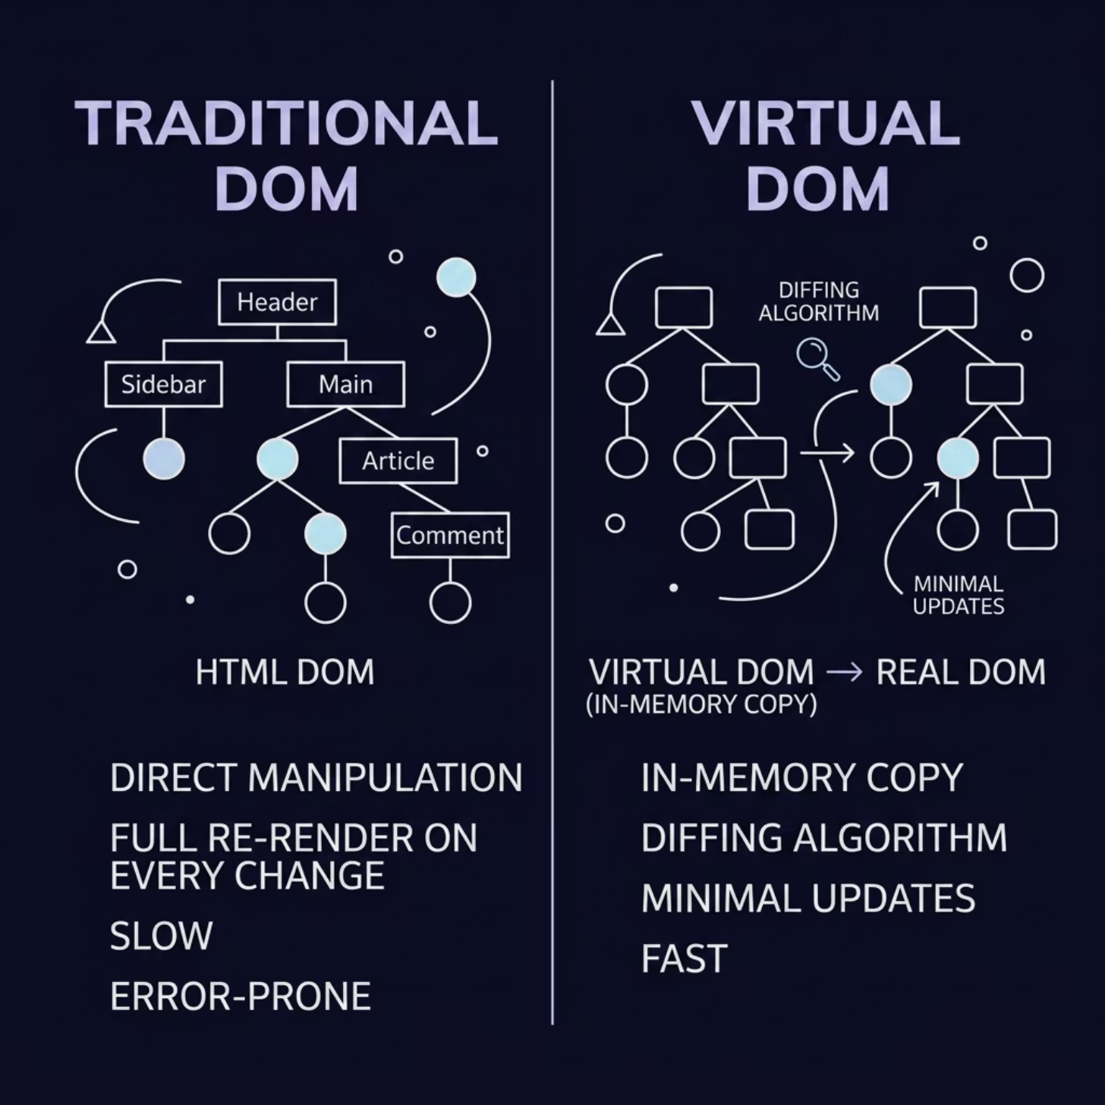

Why React? The Virtual DOM Advantage
Traditional DOM manipulation is slow and error-prone. React uses a Virtual DOM — a lightweight in-memory copy — to compute the minimum set of changes needed, then applies only those updates to the real DOM.
Rendering Lifecycle
State or props change
React creates a new Virtual DOM tree
Diffing algorithm compares old vs. new
Only the changed nodes update in the real DOM
Result: faster UIs with less manual optimization work.

Slide 4
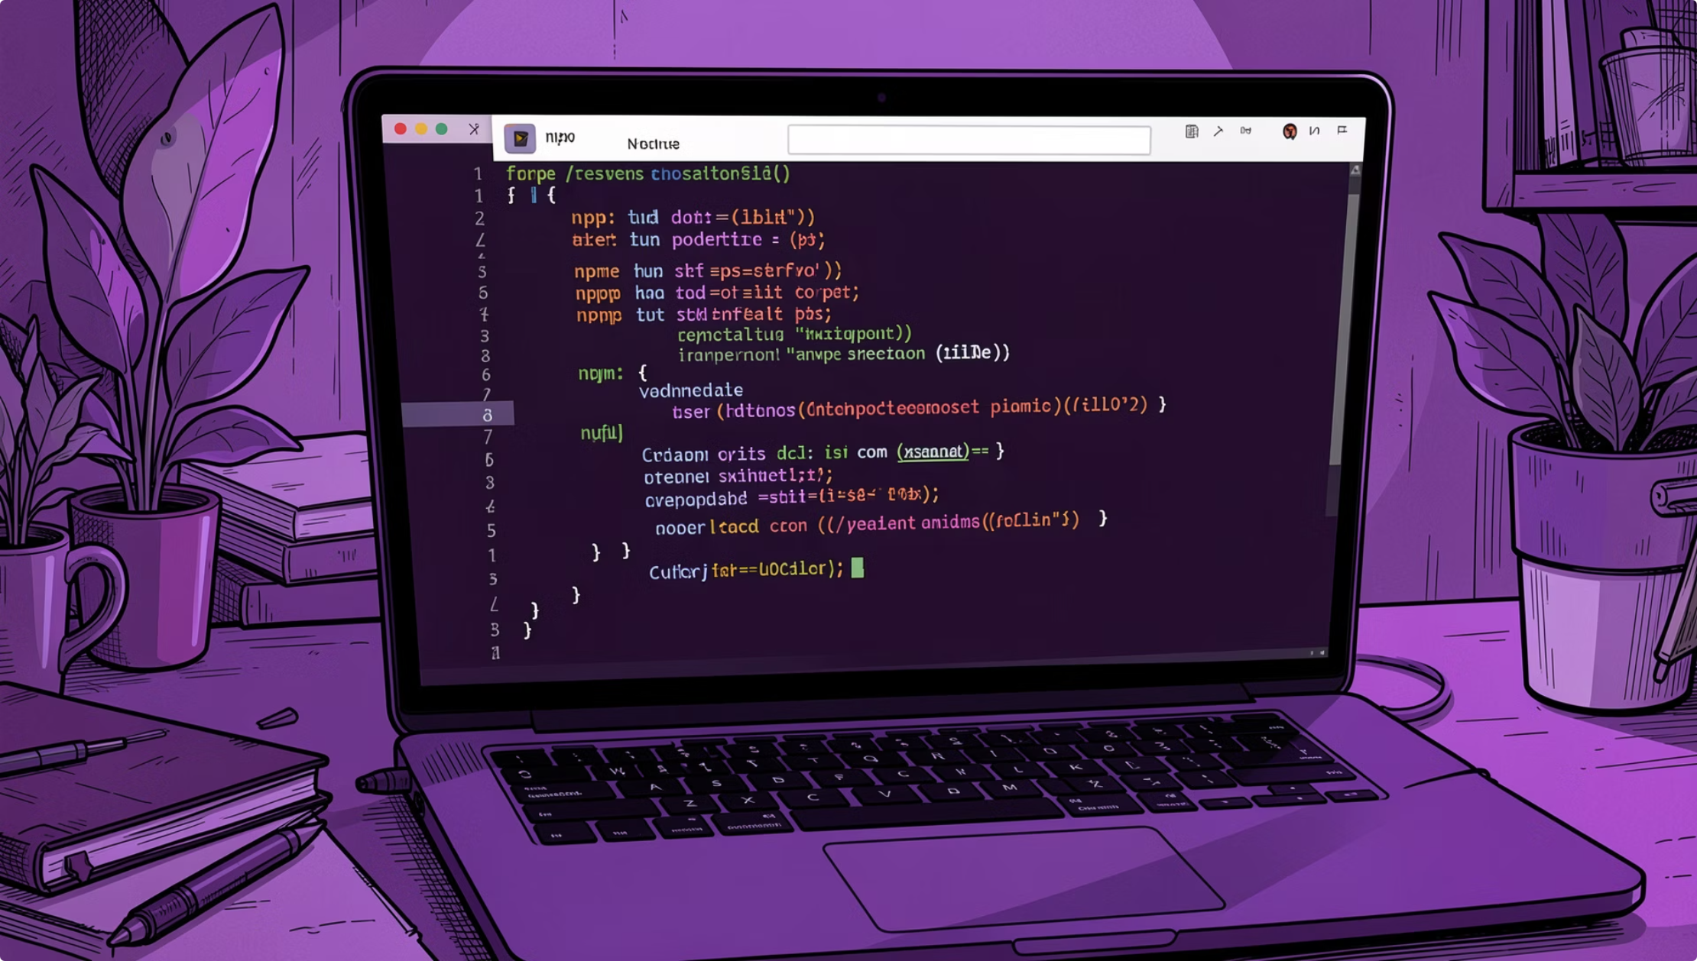
Setting Up React with Vite
Vite is the modern replacement for Create React App — faster startup, native ES modules, and a better developer experience.
Prerequisites
Install Node.js 18+ from nodejs.org, then run:
npm create vite@latest my-app
cd my-app
npm install
npm run dev
Project Structure
index.html — entry point
src/main.jsx — mounts React
src/App.jsx — root component
package.json — dependencies
Run npm run build for a production-ready bundle.

Slide 5

JSX Fundamentals
JSX is a syntax extension that lets you write HTML-like markup inside JavaScript. It compiles to React.createElement() calls under the hood.
JSX vs. HTML — Key Differences
function Greeting() {
const name = "Alex";
return (
<div className="card">
<h1>Hello, {name}!</h1>
<img src="avatar.png" />
<p>{2 + 2} items</p>
</div>
);
}
className instead of class
All tags must be closed: <img />
CamelCase attributes: onClick, tabIndex
Embed JS with curly braces: {name}
JSX expressions must return a single parent. Wrap siblings in <>...</> (Fragment).

Slide 6

Your First Functional Component
A functional component is a JavaScript function that returns JSX. Components must start with an uppercase letter and can be exported and imported across files.
Component Rules
// src/Welcome.jsx
export function Welcome() {
return (
<h1>Welcome to React!</h1>
);
}
// src/App.jsx
import { Welcome } from './Welcome';
function App() {
return (
<div>
<Welcome />
</div>
);
}
Name starts with uppercase: Welcome ✅
Always return JSX (or null)
One file = one component (convention)
Reuse anywhere: <Welcome />
Think of components as custom HTML tags that encapsulate their own UI logic.

Slide 7
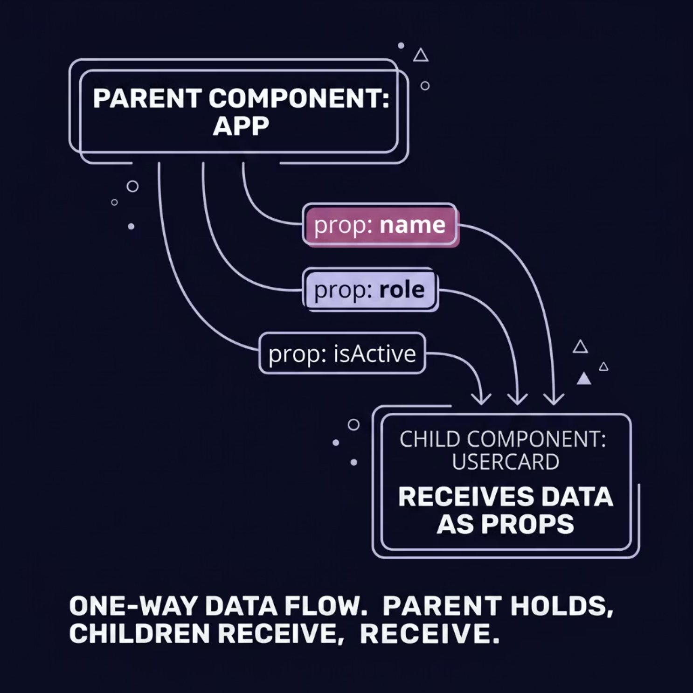
Props: Passing Data Between Components
Props (short for properties) are how data flows from parent to child. They are read-only — a child can never modify its own props.
Passing & Receiving Props
// Parent
<UserCard
name="Sam Rivera"
role="Developer"
isActive={true}
/>
// Child
function UserCard({ name, role }) {
return (
<div>
<h3>{name}</h3>
<p>{role}</p>
</div>
);
}
Destructure props in the function signature for cleaner code. Pass functions as props for child-to-parent callbacks.

Slide 8

Rendering Lists with map() and Keys
Use JavaScript's map() inside JSX to transform an array of data into an array of components. Each item needs a unique key prop so React can track it efficiently during re-renders.
Key Best Practices
function UserList() {
const users = [
{ id: 1, name: "Alex" },
{ id: 2, name: "Sam" },
{ id: 3, name: "Jordan" }
];
return (
<ul>
{users.map(user => (
<li key={user.id}>
{user.name}
</li>
))}
</ul>
);
}
Use a stable, unique ID — not the array index
Keys help React detect additions, removals, and reorders
Missing or duplicate keys cause subtle bugs
Using index as key is only safe for static, unsorted lists.

Slide 9

Hands-On Exercise
Build a UserCard component, pass user data via props, and render a list of users with map() and unique keys.
Create UserCard.jsx
1
Accept name, email, and role as props. Return a styled card with JSX.
Prepare User Data
2
In App.jsx, define an array of 3+ user objects with id, name, email, and role.
Render the List
3
Use map() to render a <UserCard /> for each user. Pass key={user.id}.
Stretch Goal
4
Add an isActive prop. Conditionally apply a CSS class or render an "Active" badge.

Slide 10

Summary & Next Steps
You now have the foundation to build real React apps. Here's what you've learned — and where to go next.
Virtual DOM
What to Learn Next
React's fast diffing engine minimizes real DOM updates.
useState
useEffect
JSX
Add interactive state to components
Handle side effects and data fetching
HTML-like syntax inside JavaScript with embedded expressions.
React Router
Components & Props
Multi-page navigation in a SPA
Reusable building blocks with one-way data flow.
List Rendering
Official docs at react.dev — the best free resource for learning React.
Dynamic UIs via map() and unique keys.

