Slide 1

React State Management & Advanced Interactivity
You've mastered the basics — Components, JSX, Props, and useState. Now it's time to level up: deeper state patterns, smarter event handling, advanced forms, and the architecture behind every reactive UI.
REACT · INTERMEDIATE
10 TOPICS

Slide 2
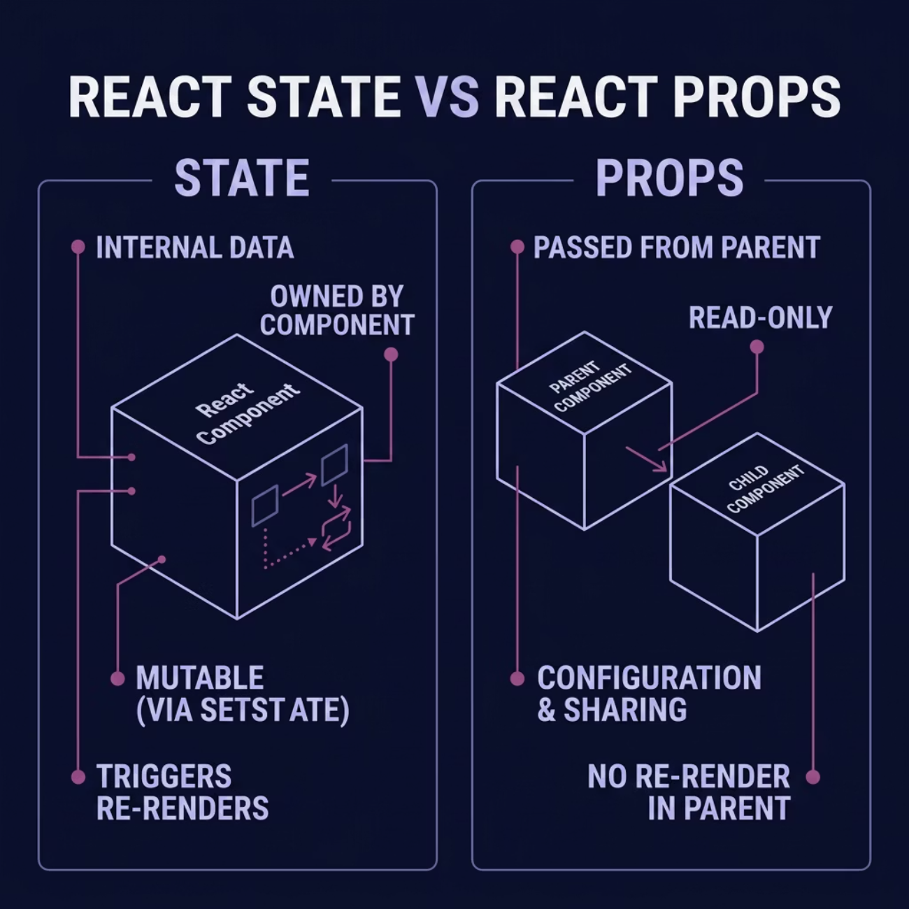

TOPIC 1
State vs Props: Knowing the Difference
React follows unidirectional data flow — props flow down, events flow up. State lives inside a component; props are received from a parent.
Use State When…
Use Props When…
The component owns and manages its own changing data — form inputs, toggles, counters.
Data is passed down from a parent — configuration, shared data, callbacks.

Slide 3
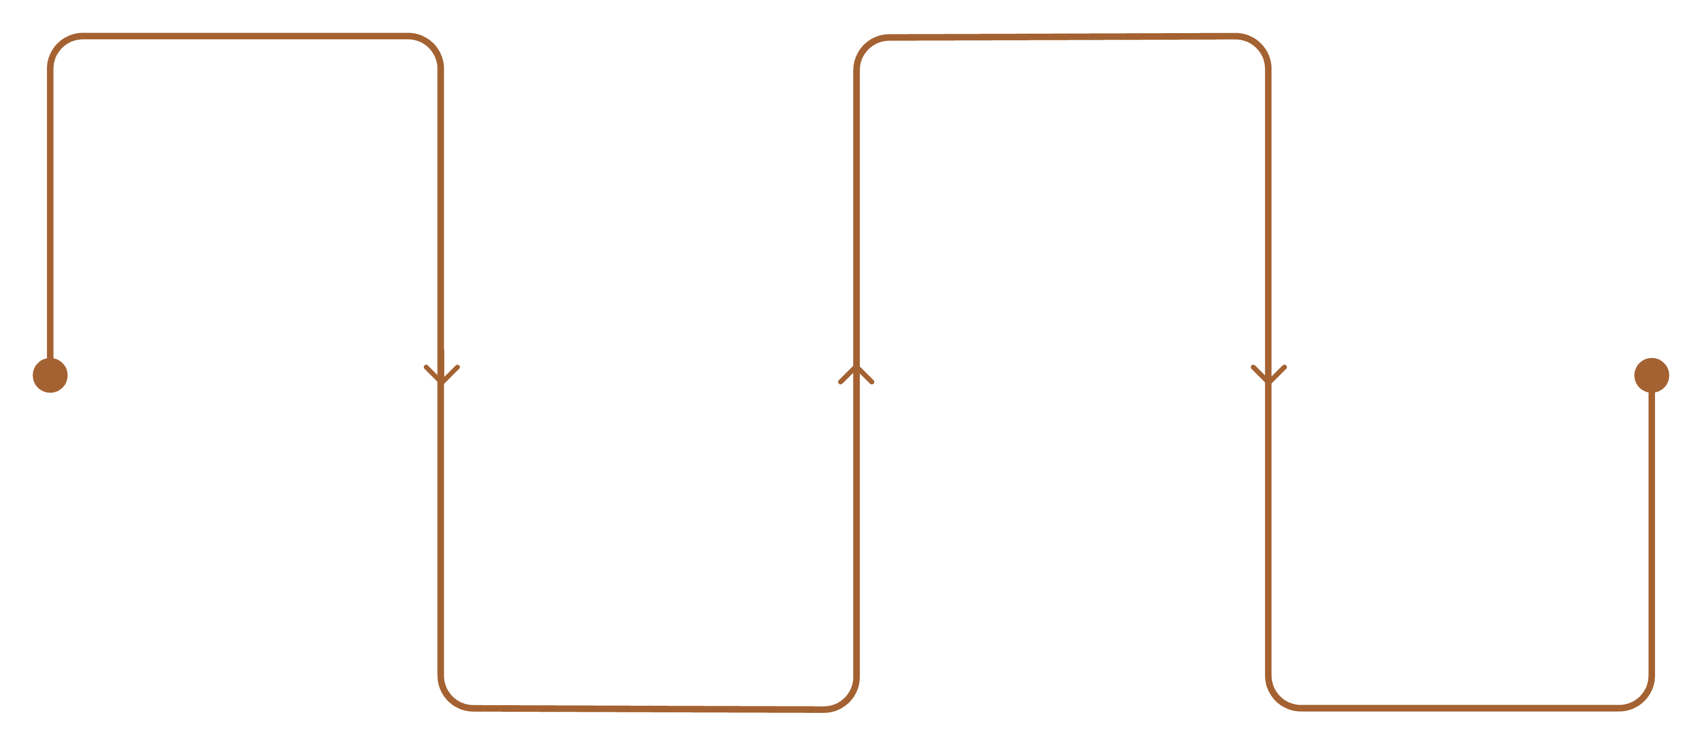
TOPIC 2
What Triggers a Re-Render?
Understanding when and why React re-renders is essential for writing efficient, predictable components.
State Update
Re-execute
Call setState or updater
Component function runs again
Schedule
Reconcile
React queues a re-render
VDOM diff and DOM update
Every setState call schedules a re-render. React batches updates for performance, and only re-renders components whose state or props have actually changed.

Slide 4
TOPIC 3
Advanced useState Techniques
Multiple State Variables
Functional Updates
Use separate useState calls for independent values. It keeps unrelated state isolated and easier to manage.
Use the functional form when new state depends on the previous value. It avoids stale updates when React batches changes.
Updating Objects
Updating Arrays
Create a new object instead of mutating the existing one. It helps React detect changes and prevents hidden bugs.
Return a new array for every change. It keeps list state predictable and ensures React re-renders correctly.
Code Examples
Multiple State Variables
const [name, setName] = useState('');
const [age, setAge] = useState(0);
Functional Updates
setCount(c => c + 1);
setCount(prev => prev + 1);
Updating Objects
setUser({
...user, name: 'New'
});
Updating Arrays
setItems([
...items, newItem
]);

Slide 5

TOPIC 4
React Synthetic Events
What They Are
React Synthetic Events are wrapper objects around native browser events. They give you a consistent event interface across different browsers, so event handling behaves predictably inside React components.
Why React Uses Them
React uses synthetic events to normalize browser differences and simplify event handling. This cross-browser compatibility helps ensure that the same code works reliably whether the event comes from Chrome, Firefox, Safari, or other environments.
Accessing Event Properties
You can read event data directly from the event object passed into your handler. Common patterns include e.target.value for form input values, e.preventDefault() to stop default browser behavior, and e.stopPropagation() to prevent an event from bubbling further.
Common Patterns
const handleChange = (e) => {
setName(e.target.value);
};
const handleSubmit = (e) => {
e.preventDefault();
saveForm();
};
const handleClick = (e) => {
console.log(e.type);
};

Slide 6

TOPIC 5
Passing Arguments to Event Handlers
Efficiently manage user interactions by passing specific data to your event handlers, ensuring your components respond dynamically to different inputs without re-rendering issues.
Correct Approach: Arrow Functions
Incorrect Approach: Direct Call
Wrap your handler call in an arrow function. This delays execution until the event is triggered, allowing you to pass arguments without immediate invocation during render.
Avoid directly calling the event handler in JSX with parentheses. This executes the function immediately when the component renders, not when the event occurs.
const handleItemClick = (itemId) => {
console.log(`Clicked item: ${itemId}`);
};
// In JSX:
<button onClick={() => handleItemClick(item.id)}>
Select Item
</button>
// In JSX (AVOID THIS!):
<button onClick={handleItemClick(item.id)}>
Select Item
</button>
Calling the function directly (e.g., onClick={myFunction(arg)}) will execute it on every render, not just on click. This can lead to bugs, performance issues, or even infinite loops.

Slide 7
TOPIC 6
Advanced Form Elements
Beyond text inputs — React handles all form elements through controlled components.
// Textarea
const [bio, setBio] = useState("");
setBio(e.target.value)}
/>
// Select dropdown
const [role, setRole] = useState("user");
<select
value={role}
onChange={(e) => setRole(e.target.value)}
>
<option value="user">User</option>
<option value="admin">Admin</option>
</select>
// Radio buttons
const [plan, setPlan] = useState("basic");
<label>
<input
type="radio"
name="plan"
value="basic"
checked={plan === "basic"}
onChange={(e) => setPlan(e.target.value)}
/>
Basic
</label>
<label>
<input
type="radio"
name="plan"
value="pro"
checked={plan === "pro"}
onChange={(e) => setPlan(e.target.value)}
/>
Pro
</label>
// Checkbox
const [subscribed, setSubscribed] = useState(false);
<input
type="checkbox"
checked={subscribed}
onChange={(e) => setSubscribed(e.target.checked)}
/>
// Multiple fields
const [form, setForm] = useState({ firstName: "", lastName: "" });
const handleChange = (e) => {
setForm({
...form,
[e.target.name]: e.target.value,
});
};

Slide 8
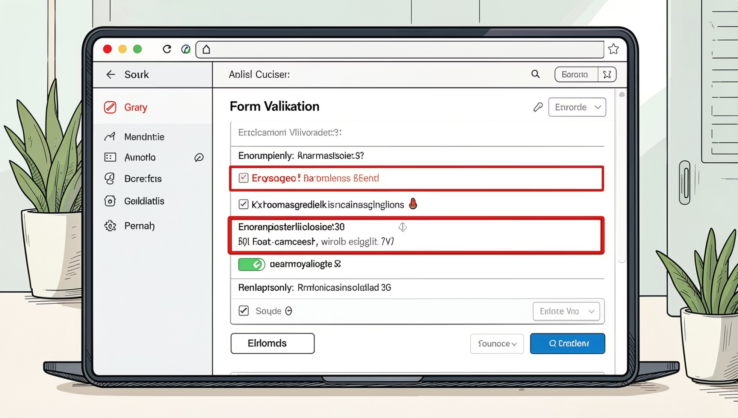

TOPIC 7
Form Validation with State
Validation Patterns
Store errors in state, validate on change or submit, and block invalid submissions.
Required Fields
Error State
Check value.trim() — flag empty strings.
Track errors per field: {`{ email: '', password: '' }`}
Prevent Submission
User Feedback
Return early if Object.values(errors).some(e => e) is truthy.
Show inline errors, disable the submit button until valid.

Slide 9
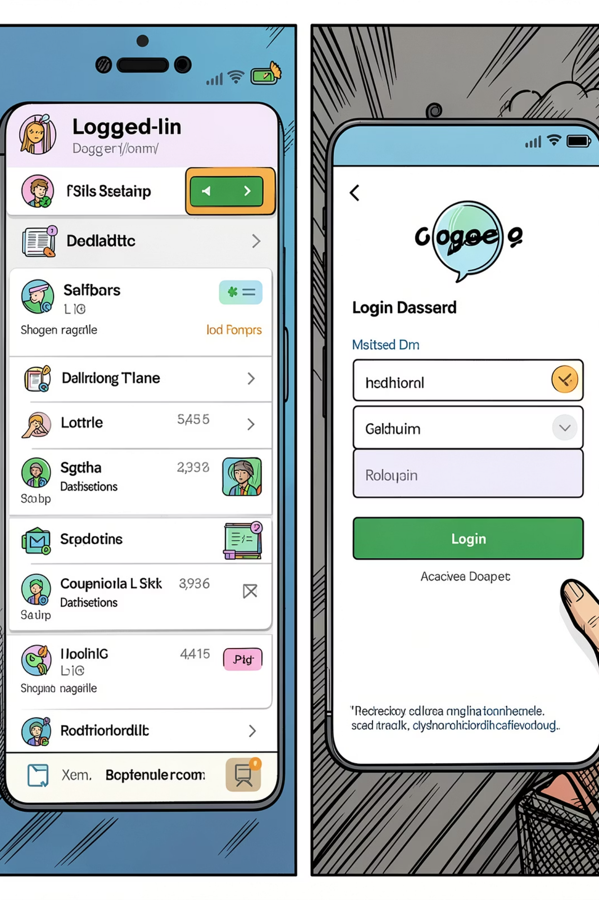


TOPIC 8
Advanced Conditional Rendering
if/else & Element Variables
Store JSX in a variable using standard if/else, then render it.
Return null
A component returning null renders nothing — ideal for hiding components.
Loading & Empty States
Check isLoading ? <Spinner /> : data.length ? <List /> : <Empty />
Auth-Based Rendering
Render <Dashboard /> or <Login /> based on isAuthenticated state.

Slide 10

TOPIC 10
Common Mistakes & Best Practices
⚠️ Mistakes to Avoid
✅ Best Practices
Derive state from props only when truly necessary
Keep state as close as possible to where it's used
Split complex state into multiple useState calls
Use useReducer for complex state logic
Profile with React DevTools to catch unnecessary re-renders
Direct Mutation
Never do state.name = 'new' — always create a new object or array.
Stale State
Use functional updates setCount(c => c + 1) when the new value depends on the old.
Uncontrolled Inputs
Mixing value and no onChange creates warnings — pick controlled or uncontrolled, not both.

Slide 11
TOPIC 11
React Code Example: Select Dropdowns & Form State
import { useState } from 'react';
export default function UserForm() {
const [formData, setFormData] = useState({
name: '',
email: '',
country: '',
subscribe: false
});
const [errors, setErrors] = useState({});
// Handle input changes
const handleChange = (e) => {
const { name, value, type, checked } = e.target;
setFormData(prev => ({
...prev,
[name]: type === 'checkbox' ? checked : value
}));
};
// Validate form
const validateForm = () => {
const newErrors = {};
if (!formData.name.trim()) newErrors.name = 'Name required';
if (!formData.email.trim()) newErrors.email = 'Email required';
if (!formData.country) newErrors.country = 'Select a country';
setErrors(newErrors);
return Object.keys(newErrors).length === 0;
};
// Handle submit
const handleSubmit = (e) => {
e.preventDefault();
if (validateForm()) {
console.log('Form submitted:', formData);
// Send to API
}
};
return (); }
This example demonstrates: State management with multiple fields, controlled components for all form elements, event handling with dynamic keys, validation with error state, and conditional rendering of error messages.

