Slide 1
Predictive Maintenance in Heavy Machinery: A Machine Learning Approach Using Vibration and Temperature Sensor Data
Avinash Desai (20032381)
Supervisor: Sajal Kaur Minhas
Module: B9DA113 APPLIED RESEARCH PROJECT (B9DA113_2425_TMD3)
August 2025

Slide 2
Research Question & Objectives
Primary Q: Can ML predict failures early to reduce downtime?
Objectives: build & compare models, handle imbalance, priorities recall, interpret features, recommend deployment.

Slide 3
Key Literature & Context
Azari et al. (2023): Transfer learning for PdM
Madasamy et al. (2023): IoT + ML for scalable PdM
Pavithra & Ramachandran (2021): Vibration analysis for faults

Slide 4
Data Description & Target
10,000 rows x 14 cols (sensor data + failure flags + Machine_failure)
Sensors: air_temp, process_temp, rotational_speed, torque, tool_wear. Type: L/M/H
Target: Machine_failure = OR of five failure modes
UDI | Product ID | Type | Air temperature [K] | Process temperature [K] | Rotational speed [rpm] | Torque [Nm] | Tool wear [min] | Machine failure
1 | M14860 | M | 298.1 | 309 | 1551 | 42.8 | 0 | 0
2 | L47181 | L | 298.2 | 309 | 1408 | 46.3 | 3 | 0
3 | L47182 | L | 298.1 | 309 | 1498 | 49.4 | 5 | 0
4 | L47183 | L | 298.2 | 309 | 1433 | 39.5 | 7 | 0
5 | L47184 | L | 298.2 | 309 | 1408 | 40 | 9 | 0
6 | M14865 | M | 298.1 | 309 | 1425 | 41.9 | 11 | 0
7 | L47186 | L | 298.1 | 309 | 1558 | 42.4 | 14 | 0
8 | L47187 | L | 298.1 | 309 | 1527 | 40.2 | 16 | 0
9 | M14868 | M | 298.3 | 309 | 1667 | 28.6 | 18 | 0
10 | M14869 | M | 298.5 | 309 | 1741 | 28 | 21 | 0

Slide 5
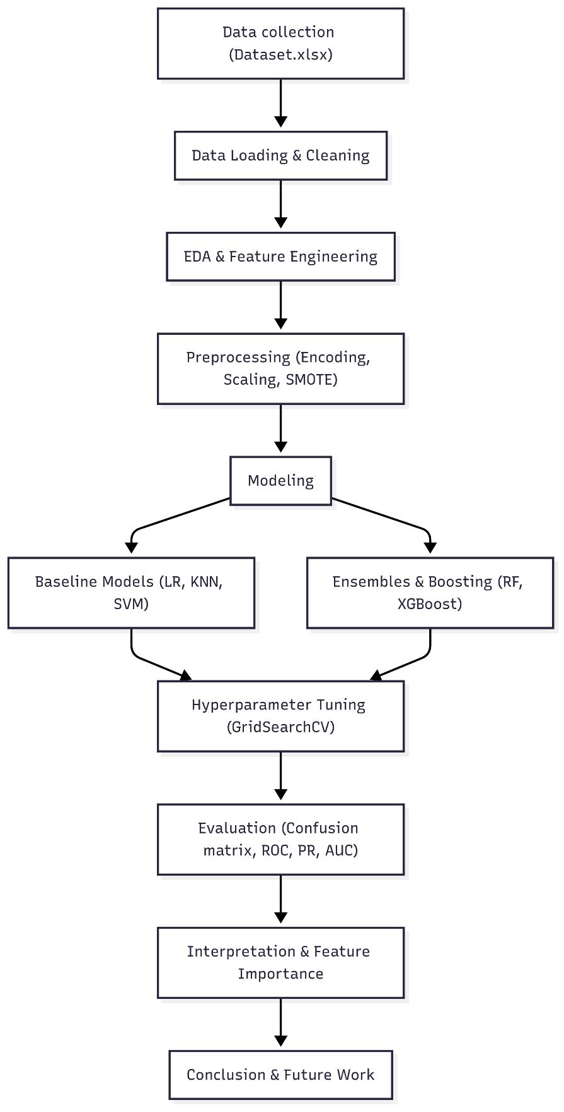
Methodology
Cleaning → Encoding → Scaling → Stratified split → SMOTE on train → CV + GridSearch
Evaluation metrics: confusion matrix, precision/recall, F1, ROC AUC; recall is priority

Slide 6
Models Evaluated
Logistic Regression (baseline)
Random Forest, XGBoost (ensembles)
SVM, KNN (kernel/distance)
K-Means (unsupervised diagnostic)

Slide 7
Hyperparameter Tuning & CV
GridSearchCV with StratifiedKFold; scoring ROC AUC, with recall constraints
Example grids: RF (n_estimators, max_depth), XGB (lr, depth)

Slide 8
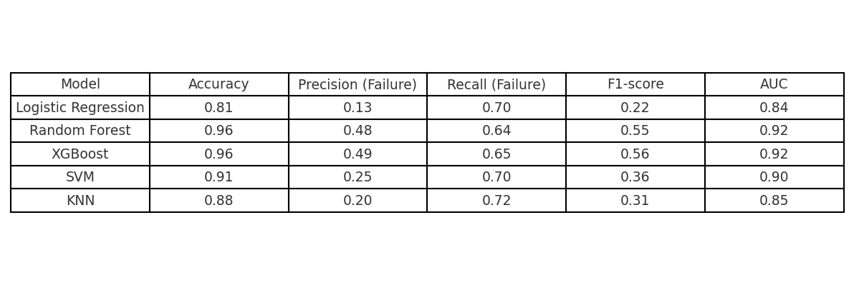
Results Summary
Summary of Accuracy, Precision (Failure), Recall (Failure), F1, AUC for each model
Recall prioritized — focus on models that detect failures reliably.

Slide 9
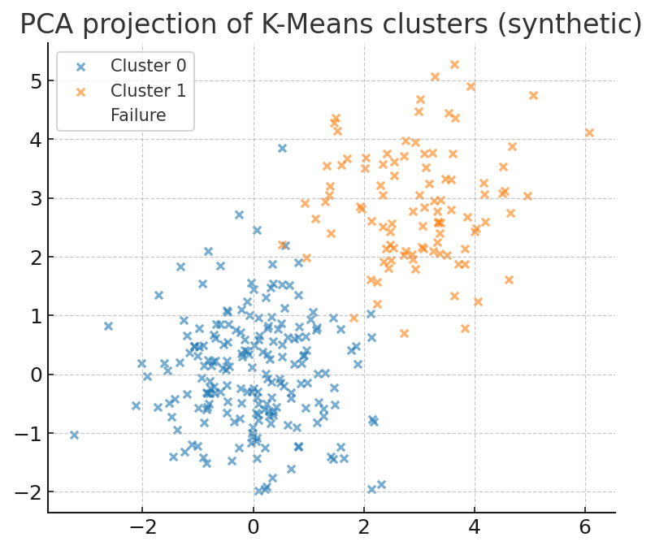
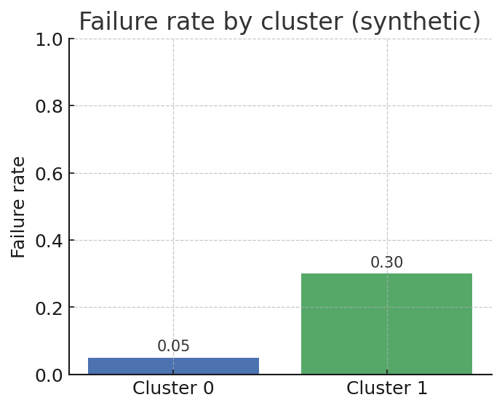
K-Means Diagnostic & Insights
K=2 clusters found; one cluster has higher failure concentration
Cluster labels can be used as features to increase recall or to prioritise inspections

Slide 10
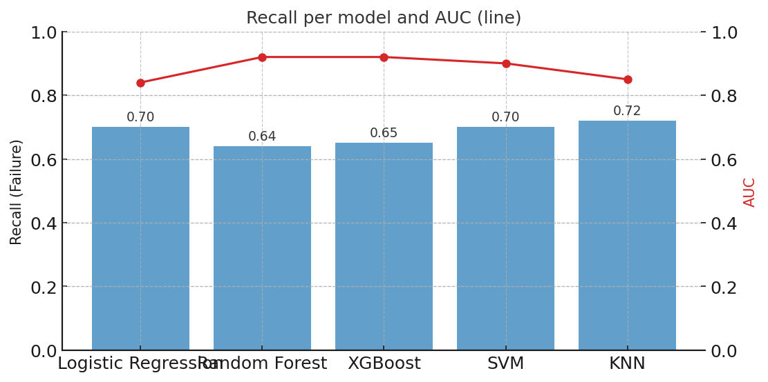
Model Comparison
KNN/SVM/LR show high recall but low precision (many false alarms)
XGBoost & RF: best trade-off with AUC ~0.92 and solid recall; recommended for deployment

Slide 11
References & Questions
Key refs: Azari et al. (2023), Madasamy et al. (2023), Pavithra & Ramachandran (2021)
Thank you — Questions?

