Slide 1
Welcome
Introduction to Cloud Basics
copyright of <<>>
Notes:
Presenter greets the students to course 1 and welcomes them to start the course with an instructor. Introduces themselves to the students by their name

Slide 2
Course Overview
copyright of <<>>
Expectations
Laptop and Materials
Format
Assignments
copyright of <<>>
Notes:
Mention that in this first session you would be going over the 4 broad topics listed
Expectations:
that students can have from the course
You have from the students with regards classroom setup and any protocols such as COVID, contacting instructors, timing on weekends
Laptop and Materials:
As we provide a preinstalled laptop, provide one to each of the students and ensure that they confirm they have these
Mention that the course material is available on the laptop and will also be found online and the location will be provided
Format:
Mention that the course would be instructor led and the student would be expected to bring the laptops to the classroom ( or virtual meeting)
The course would have illustrative videos, example code and description and take home assignments
Assignments:
Mention the need for assignments and why there will be assignments for students to complete at the end of every session. How assignments are as important as the classroom session.

Slide 3
Expectations
Overview of Concepts
Python Programming
Web Application
Application in Enterprise Cloud
copyright of <<>>
Notes:
Mention that the student can expect the following from this course
Mention that you will be giving an overview of the concepts of software development and standard industry practices with an emphasis on current industry trends and expectations
Mention that Students would need to learn and research these online via youtube and other sources to get familiar. Links will be provided in the firefox bookmarks as reference
Mention that Python would be the language used in the course and has become a very sought after skill in the market.
Mention that Web application is one of the areas in which there is an industry demand for jobs and the course would give a thorough understanding of the concepts of web development. The success of the course also depends on the student taking an active interest in researching the recommended topics
Mention that the course has been designed with Enterprise in mind and the practices and processes that complement software development will be explained in the course. Example: Code Validation, Deployment, Continuous Integration, Vulnerability checks and Security Analysis

Slide 4
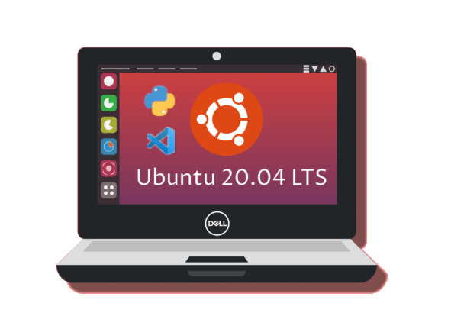
Laptop And Material
Laptop – preinstalled development tools
  Ubuntu OS
  VSCode
  Python 3+
  Postman
  Git
copyright of <<>>
Notes:
Instructor mentions that the laptop is provided with login credentials and one laptop may not match the configuration of the other exactly and is used as a development tool only.
The laptop has the bare minimum requirements to providing a learning environment and will have the software listed
Mention that no new software should be installed without instruction from the classroom instructor
Any new software installed may corrupt the courses. Any issues with the laptop would need to be reported to the instructor as soon as possible. Ex: Laptop does not boot with credentials, Software missing, Wifi issues
Mention that once the course is complete the laptop is for the student as a takeaway and can be used as a reference during a job search or further progress after the course completion

Slide 5


Laptop And Material
Ubuntu OS
  Linux Distro
  Developer Focused
  Industry Standard
  Required Familiarity
  Secure and Open Source
copyright of <<>>
Notes:
Instructor mentions that Ubuntu OS has been used as a base operating system. There is no dual boot into Windows or any other OS. This has been done deliberately to ensure that the student gets to experience and familiarize themselves with the most widely used OS (Linux) in the world
Explain how Unix and Linux are very similar but slightly different: https://www.wired.com/2016/08/linux-took-web-now-taking-world/
Explain the usage of Linux:
Android a version of Linux 73% of the cellphone market
In 2021, 100% of the world’s top 500 supercomputers run on Linux
Out of the top 25 websites in the world, only 2 aren’t using Linux
96.3% of the world’s top 1 million servers run on Linux
90% of all cloud infrastructure operates on Linux and practically all the best cloud hosts use it
Explain that considering the popularity and robustness of the OS, it is extremely valuable for a developer to be using a distro of Linux and make friends with the Penguin :)
Explain the Open Source nature of the Linux development:
https://github.com/torvalds/linux

Slide 6

Laptop And Material
VSCode
  Lightweight Dev Editor
  Intuitive and Easy
  Lots of Extensions
  Open Source and Well Supported
copyright of <<>>
Notes:
Explain that VSCode is a Microsoft developed Open Source editor first released on April 16, 2015.
It is a lightweight cross platform editor that increased productivity through auto complete, linting (code checking and indentation) and support for refactoring (explain refactoring)
Explain the Open Source nature and community contributions to VSCode supporting and building extensions and updates to VSCode itself.
Explain how VSCode has support for multiple languages such as Java, C, C++, Groovy, Go, Ruby and frameworks that are here and emerging
Explain the support for Python and the online resources for Python Development on VSCode
For more: https://code.visualstudio.com/learn/educators/python

Slide 7

Laptop And Material
Python
  Productivity
  Readability
  Wide range of applications
  Beginner to Advanced Usage
  Mature and Well Supported
copyright of <<>>

