Slide 1
Resort Ticket Price Prediction
Guided Capstone Project

Slide 2
Problem Identification
Problem Statement
What are the different ways Big Mountain resort can increase their revenue to compensate with the additional operating cost of $1,540,000 for installation of a new chair in the next year?
Does resort pricing strategy to charge a premium above the average make sense?
How can we attract the target audience.
Is there any facility that resort is not capitalizing as much as it should?
Context :-
Big Mountain Resort is a well equipped resort with various facilities but addition of chairs has increased their operating cost by $1,540,000 which will affect the profit margin.
To cope up with the expense we need to increase the revenue, which can be done analyzing the data in hand. Few points to start with are as follows:-
Does resort pricing strategy to charge a premium above the average make sense?
How can we attract the target audience.
Is there any facility that resort is not capitalizing as much as it should?

Slide 3
Context :-
Big Mountain Resort is a well equipped resort with various facilities but addition of chairs has increased their operating cost by $1,540,000 which will affect the profit margin.
To cope up with the expense we need to increase the revenue, which can be done analyzing the data in hand. Few points to start with are as follows:-
Does resort pricing strategy to charge a premium above the average make sense?
How can we attract the target audience.
Is there any facility that resort is not capitalizing as much as it should?
Criteria for Success:-
Reasonable changes in the pricing of tickets that will increase revenue.
Increase in the strength of target audience.
Improved capitalization of facilities.
Overall increase in Revenue.
Scope of Solution Space:- The marketing strategy and capitalization strategies will be applied to Big Mountain Resort to increase their revenue.
Constraints within Solution Space:- There may not be relevant data to answer marketing questions.
Data Source:-
CSV provided by Database Manager

Slide 4
Recommendation
Actual AdultWeekend Price is $81, whereas predicted price is $95.19 with $10.34 Mean Absolute Error.
Closing down 5 runs won’t affect revenue much but will reduce operating cost.
Increase the vertical drop by adding run to a point 150 feet lower down but requiring the installation of an additional chair lift to bring skiers back up, without additional 2 acre snow making coverage.
Increase the vertical drop by adding run to a point 150 feet lower down but requiring the installation of an additional chair lift to bring skiers back up, without additional snow making coverage.
Increase the longest run by 0.2 miles to boast 3.5 miles length, requiring an additional snow making coverage of 4 acres
Notes:
Actual AdultWeekend Price is $81, where as predicted price is $95.19 with $10.34 as MAE.
Closing down 5 runs as that won’t affect the revenue much.

Slide 5

Modeling Results and Analysis
RandomForestRegressor is used in the model.

Slide 6
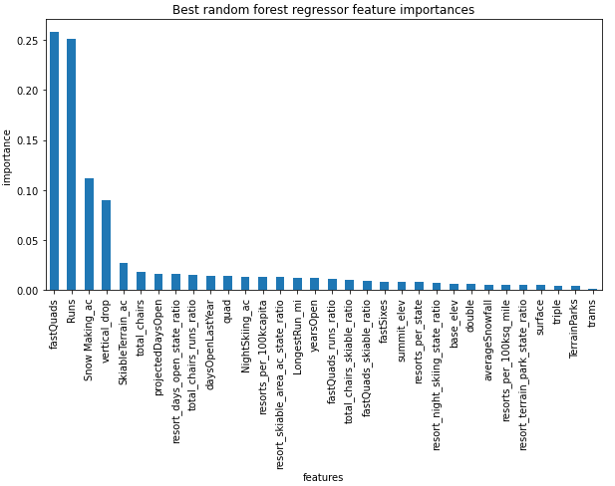
Top Features

Slide 7
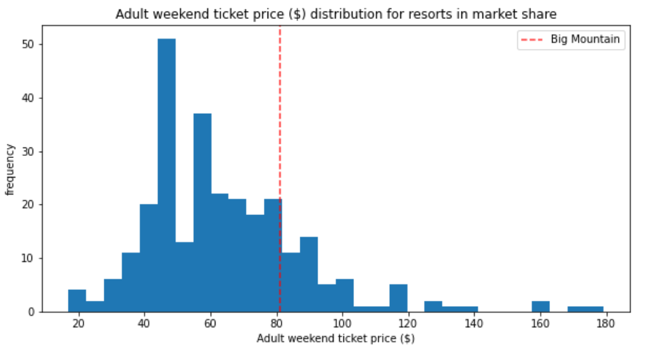
Adult Weekend Price

Slide 8
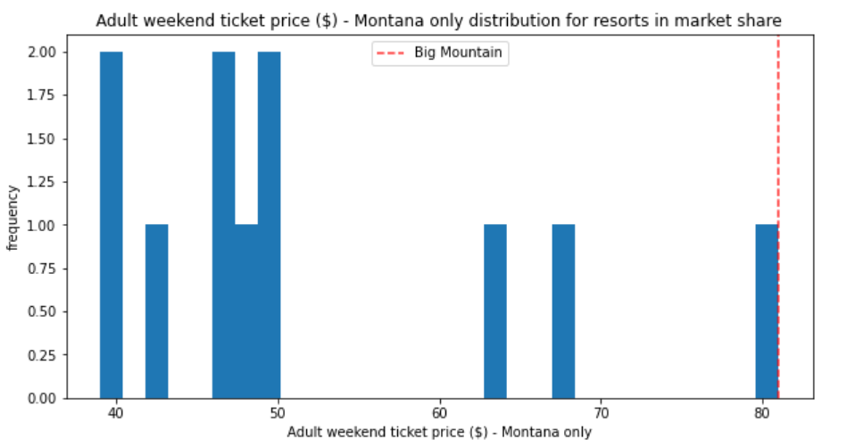

Slide 9
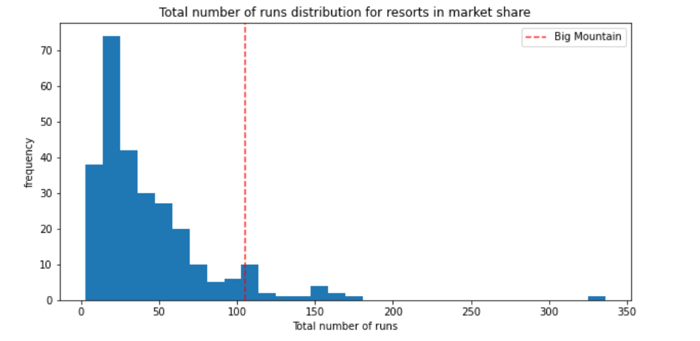
Number of Runs

Slide 10
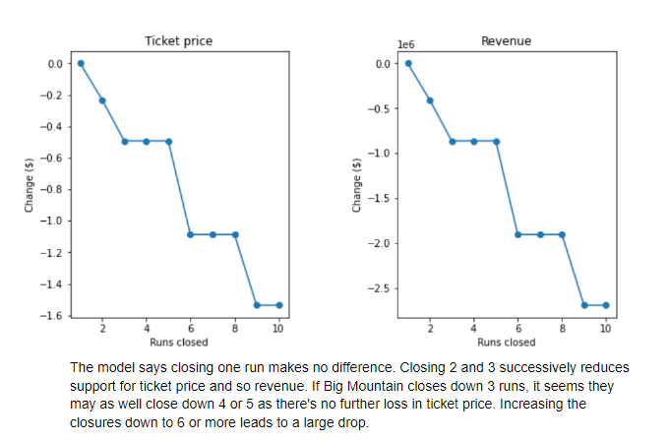

Slide 11


Increase Vertical drop without additional snow making
Increase Vertical drop with additional 2 Acre snow making

Slide 12
Increasing .2 miles on Longest run
There is no effect on the price of the ticket by increasing the run but can attract more customers.

