Slide 1
NVTX Profiler Notes
Avinash

Slide 2
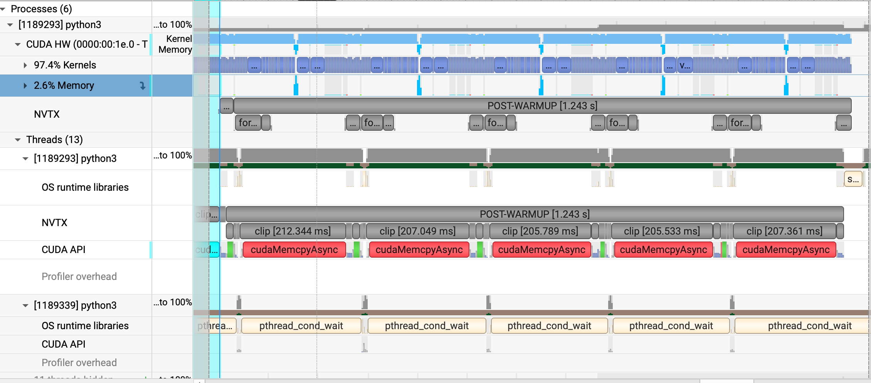
Gradient Clipping
CPU Blocked waiting for GPU

Slide 3
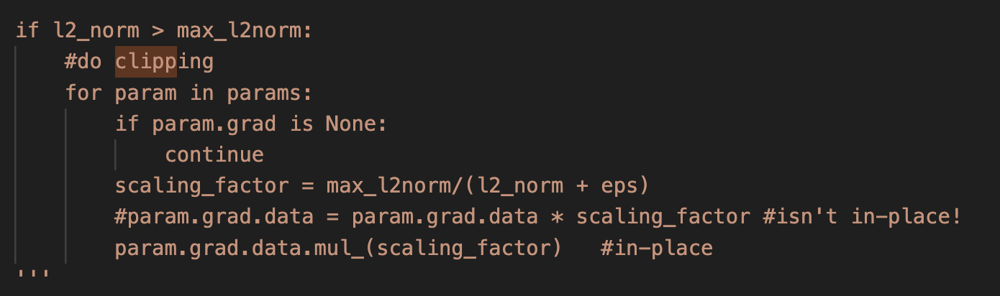
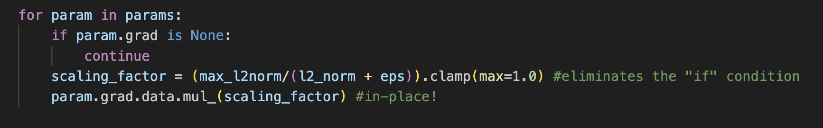
Gradient Clipping
Culprits:
math.sqrt (torch.tensor ([]))
Caused a GPU->CPU transfer
Replace with torch.sqrt (torch.tensor([]))
if l2_norm_sum < max_l2_norm_sum:
Caused a GPU -> CPU transfer
“if” comparison caused implicit sync() and CPU to stall
Fix: clamp() trick below

Slide 4
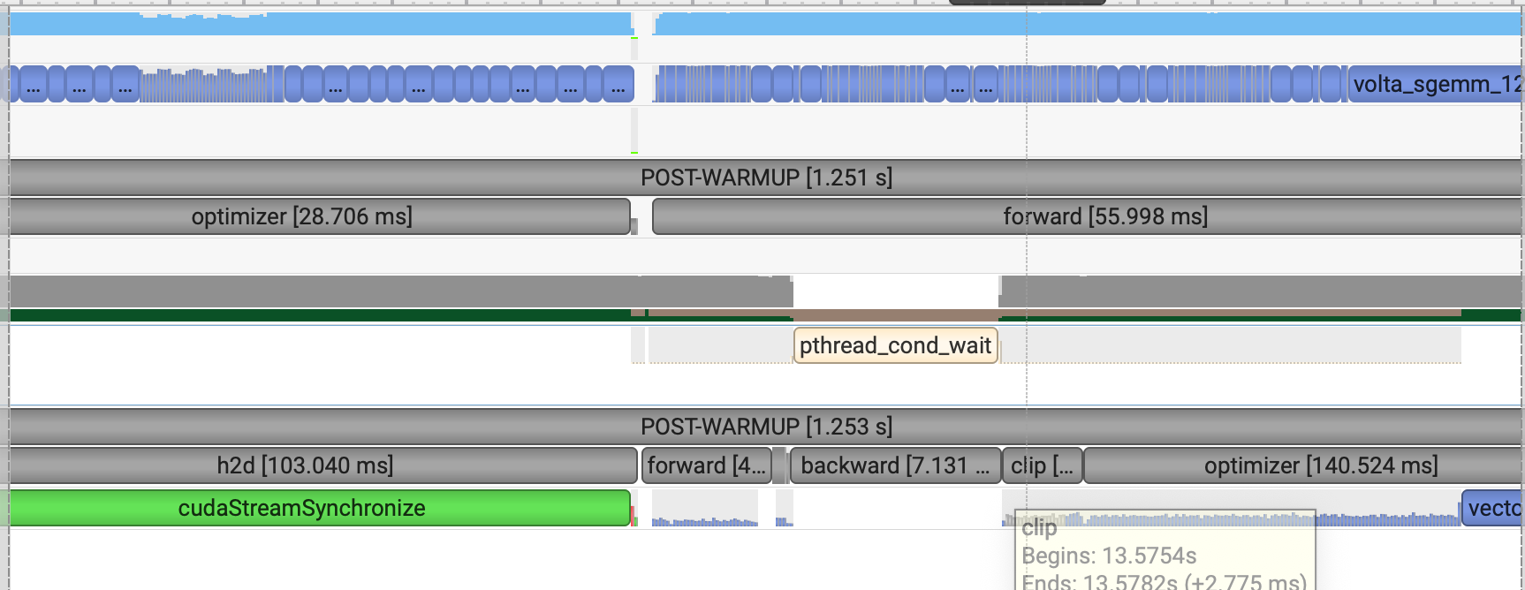
Gradient Clipping (Memcpy removed)

Slide 5
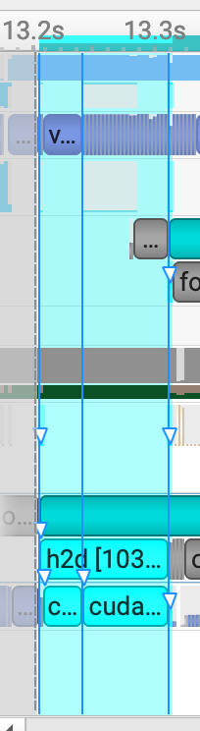
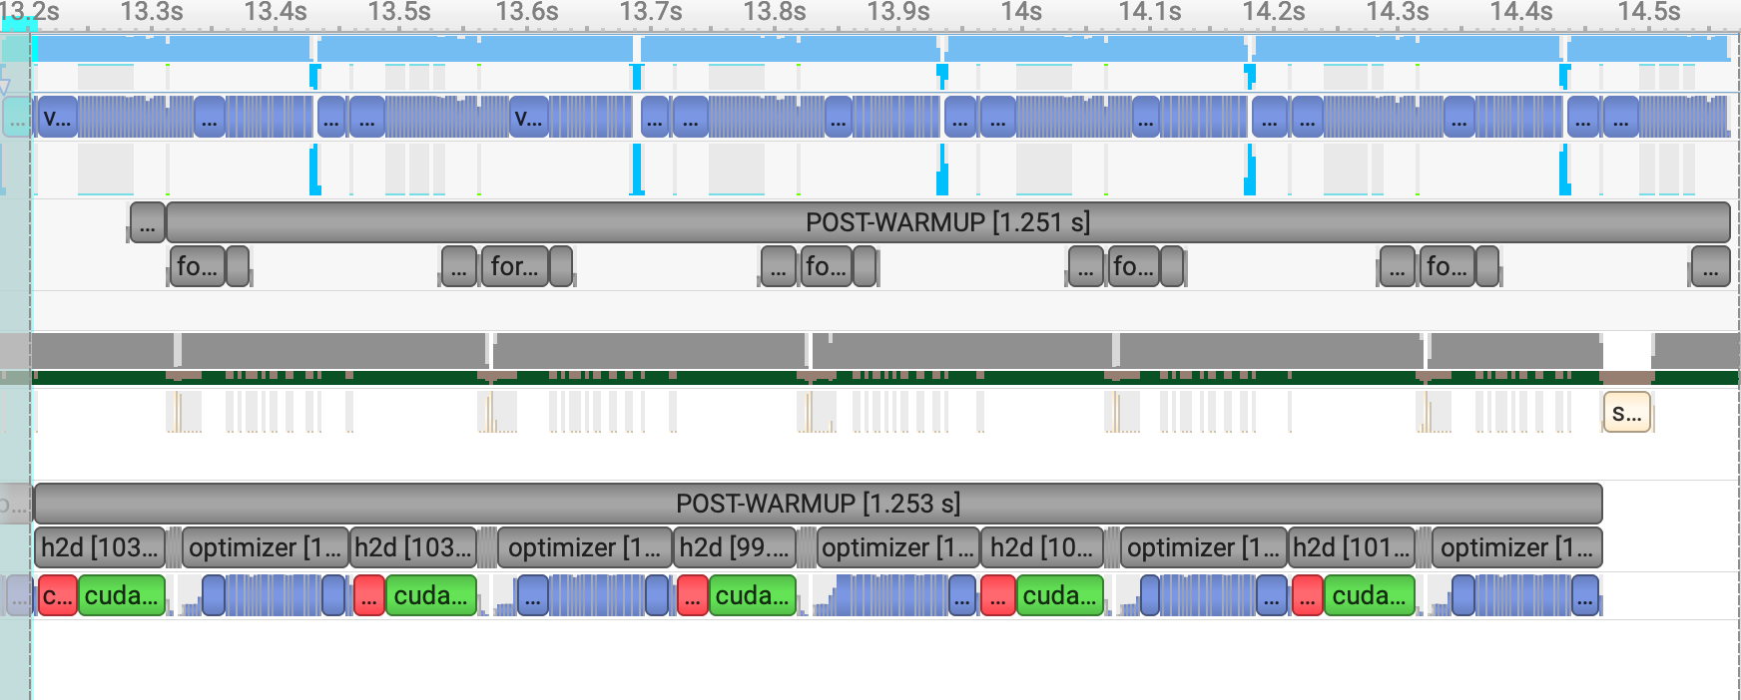
H2D Transfer of Batch
Note CPU and GPU
ending at the same time
Using pin_memory=True ensures that the DataLoader loads batches into pinned (page-locked) memory.
Allows the CUDA driver to perform asynchronous, high-throughput memory transfers (via DMA) to the GPU when .to(device, non_blocking=True) is used. Faster!
Otherwise Synchronous (and CPU blocks waiting for the batch transfer to complete).

Slide 6
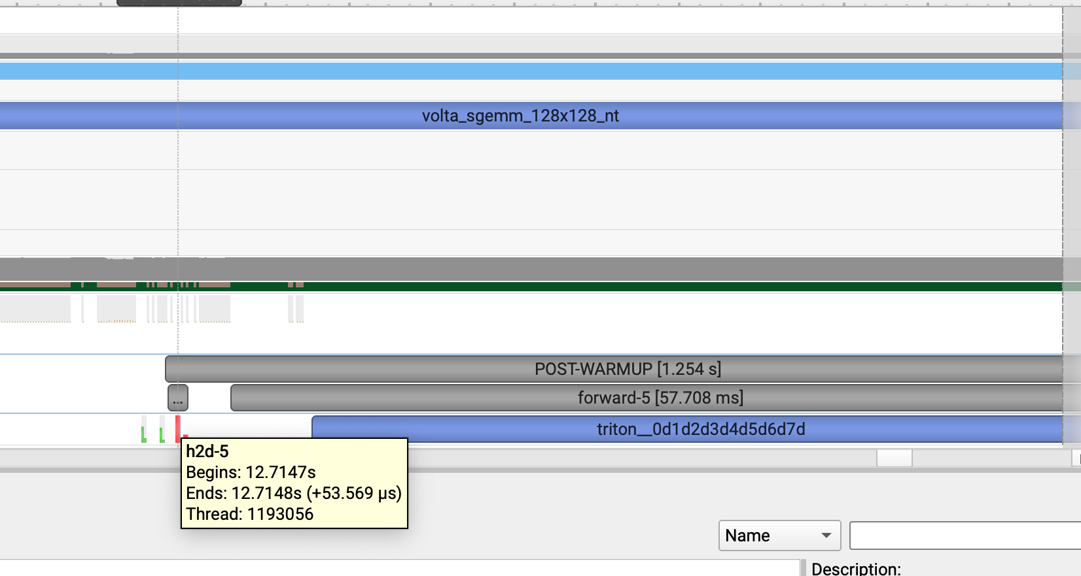
H2D Transfer of Batch
Asynchronous (CPU has returned immediately)
Notes:
The triton one is actually a torch compiled method. It is likely a cuda synchronize call because its ending overlaps with ending of h2d-5 on the GPU (not seen here)

Slide 7
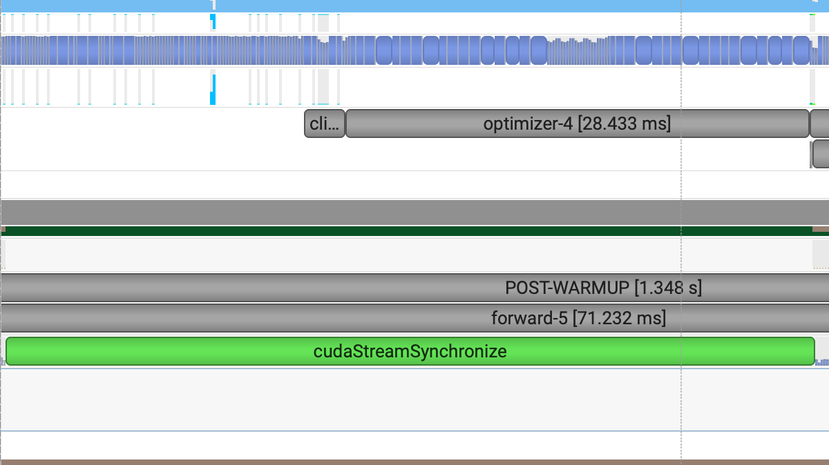
H2D Transfer of Batch
Even though x.to(device, non_blocking=True) is async, it:
Waits in line behind compute ops from the previous batch
Delays execution and overlap of next batch with the current one
Thus, the submission of work for batch N+1 is delayed until batch N’s work is done being submitted.
Notes:
This is a non Torch compiled screenshot

Slide 8
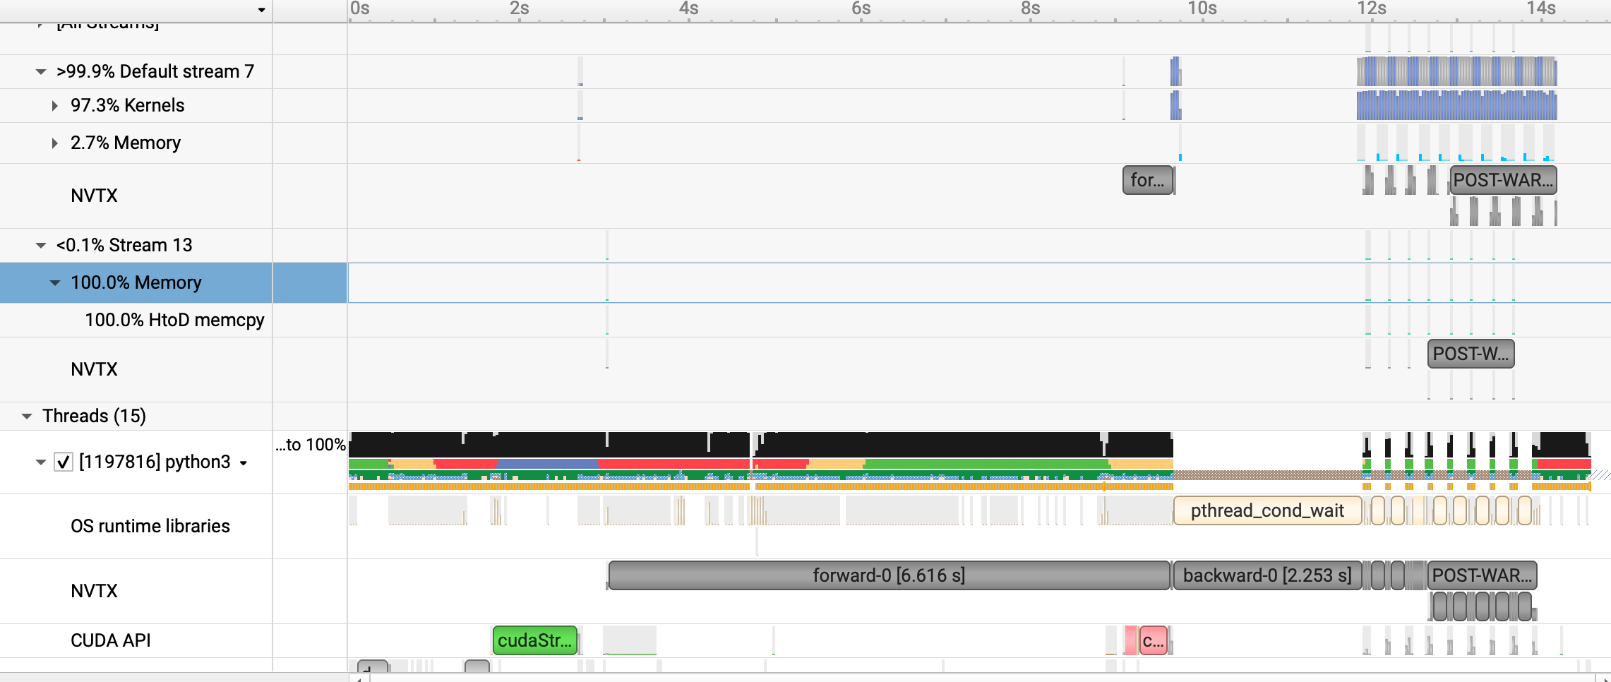
Streaming in CUDA
Helps overlap compute and memory transfer.
Useful when :
Memory transfer is slow because of slow interconnect or large data
Mask memory latency with compute
Compute time : 50 ms, Memory transfer time : 50ms
Without streaming : 50 + 50 = 100ms
With streaming : 0 (amortized by overlap in prior step’s compute) + 50 = 50ms
Compute time : 50 ms, Memory transfer time : 150ms
Without streaming : 150 + 50 = 200 ms
With streaming : 100 (50 amortized by overlap in prior step’s compute) + 50 = 150ms
Memory transfer and compute overlapping

Slide 9
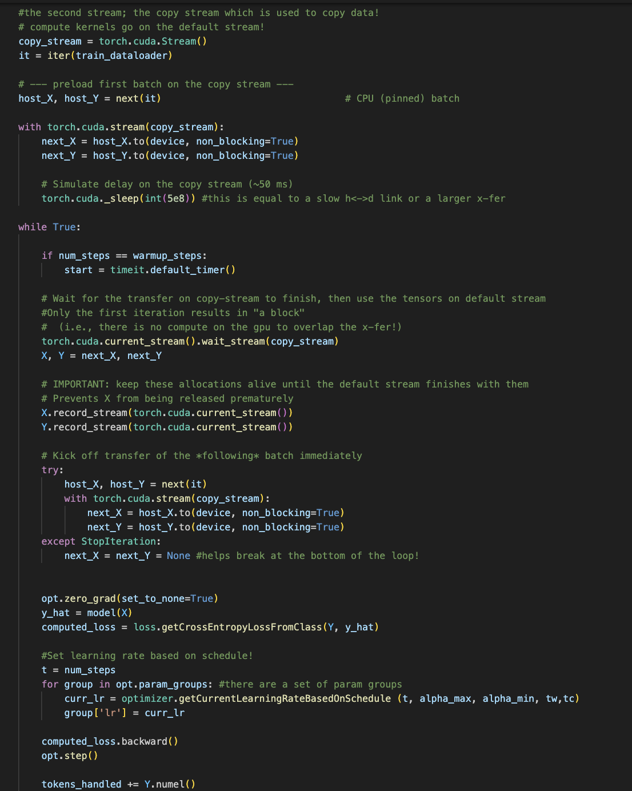

Streams in Cuda
Using two streams:
batch0 : copy stream of X, Y
while True:
ensure default stream waits for copy stream to finish d2h transfer to use X,Y
“record_stream” of X,Y to current stream so that it is not garbage collected* (Check notes)
batch1 : copy stream of Xnext, Ynext
call forward,backprop etc on default stream
break : when enough steps
Notes:
Basically, if X,Y are not recorded to be part of current stream, then the CPU after launching kernels that use (X,Y) will go ahead in its loop.
The ref count for X,Y will drop to 0 , and it will be sent for garbage collection, and cuda will be notified of the same.
However kernels have been launched on the default stream to use X,Y. (So cuda might garbage collect since (X,Y) were created on copy-stream initially and python ref count has dropped to 0.

Slide 10
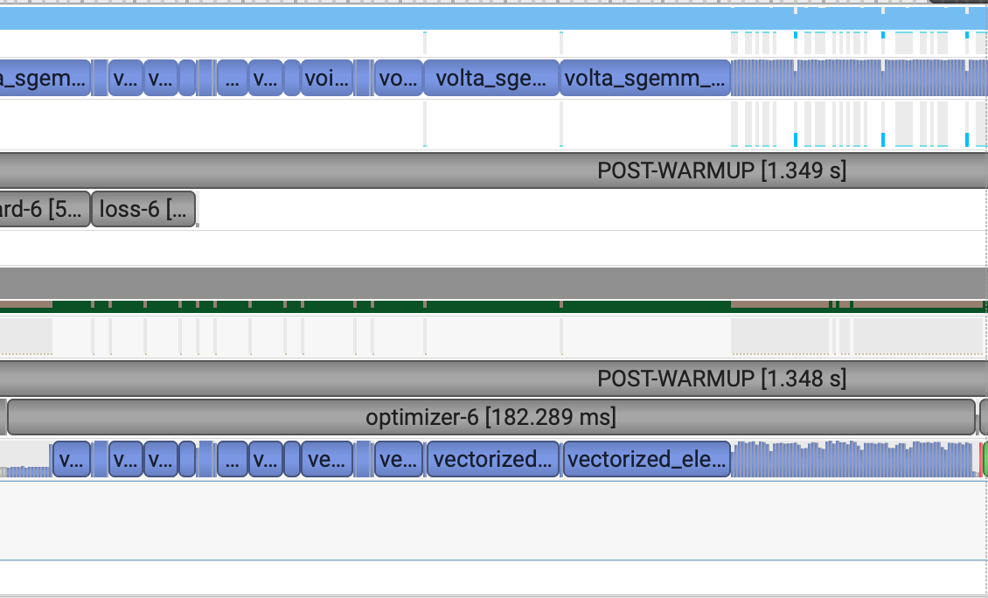
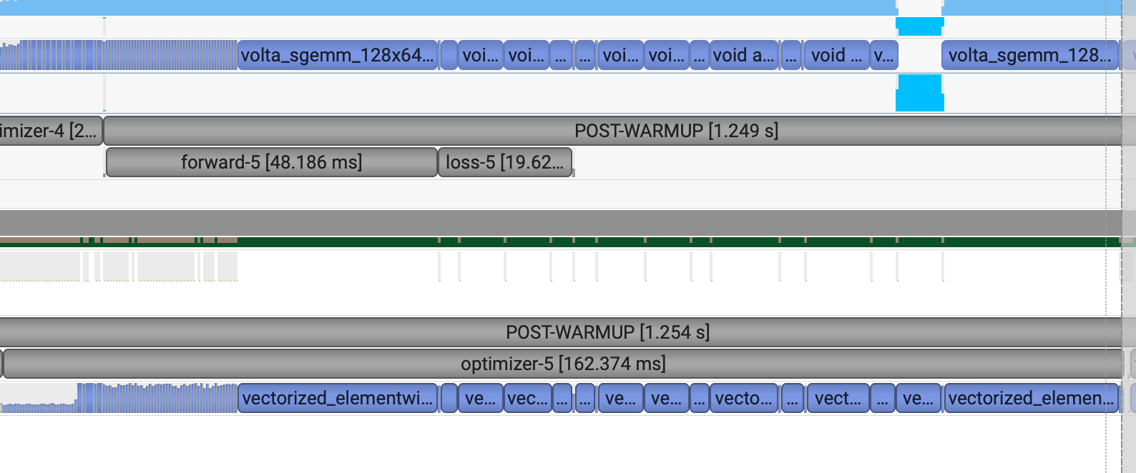
TorchCompile Benefits (Kernel Fusion)
No torch compile
Torch Compile
Custom AdamW had a series of small kernel launches – e.g., because of how first and second moments are computed.

Slide 11
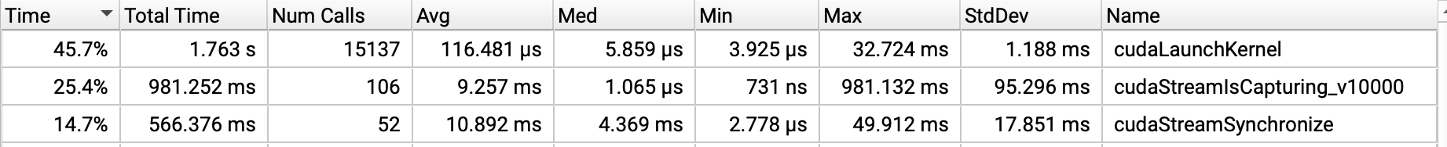
TorchCompile Benefits
No torch compile
Lesser kernel launches
StreamSynchronize:
Shows less stalling of host
Torch compile
Notes:
StreamSynchronize : blocks the CPU until all previously enqueued GPU work in that stream finishes.
While it’s active, the GPU is still busy, but the CPU is sitting idle waiting for the GPU to “catch up.”
Rule of thumb
You want this number low.
High → CPU idle, GPU underutilized.
Low → CPU keeps enqueueing work, GPU runs smoothly.
Without torch.compile: cudaStreamSynchronize = 566 ms → many little sync points, so the host keeps stalling.
With torch.compile: cudaStreamSynchronize = 0.417 ms → almost no blocking syncs.
That matches the intuition: compiling graphs removes lots of Python “stepping in,” so you get fewer sync boundaries.

Slide 12
DDP visualized

Slide 13
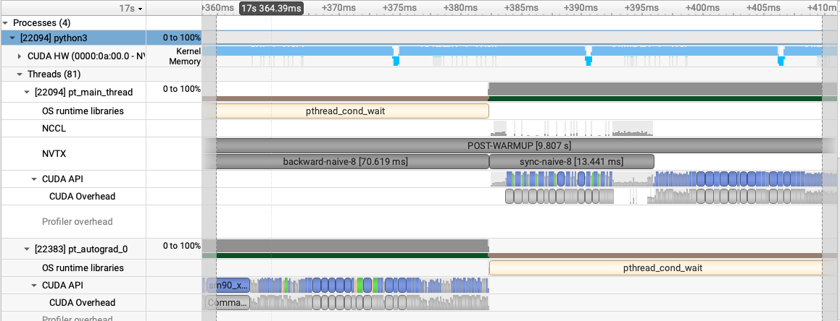
Naive
NCCL call happens during sync state after gradients are computed per node
Nodes all-reduce gradients computed on their batch
Each parameter’s gradient is all-reduced

Slide 14
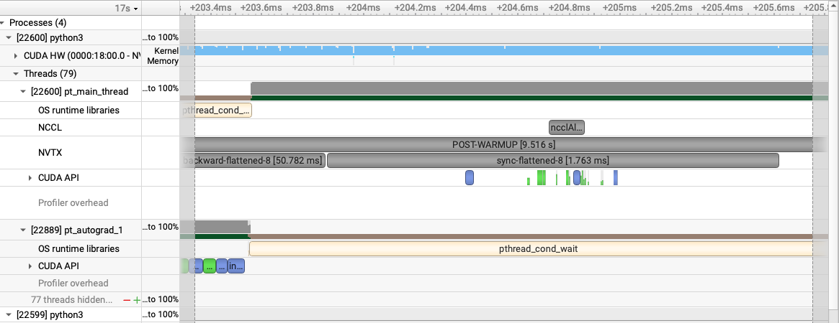
Flattened
NCCL call happens during sync state after gradients are computed per node
Nodes all-reduce gradients computed on their batch BUT
Each parameter’s gradient is all-reduced after flattening into one 1D tensor
Note that : 1 all-reduce call v/s multiple in Naive

Slide 15
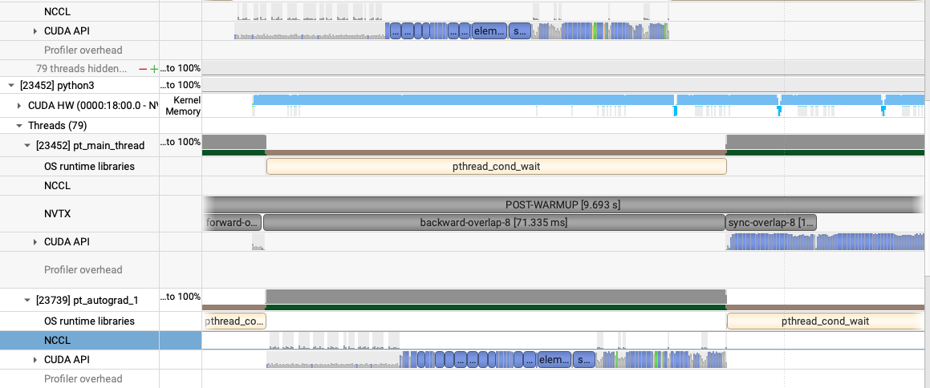
Overlap
NCCL calls happen as gradients are computed for each parameter.
Note that loss.backward() is issuing NCCL calls via hooks and not sync phase.
Sync is only waiting/checking to see if the async communications have finished.

Slide 16
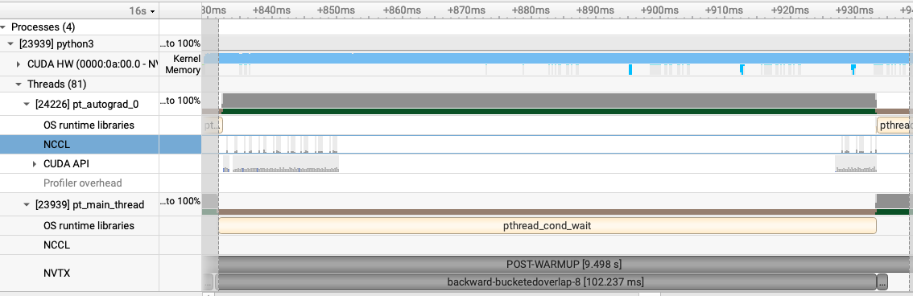
Bucketed Overlap
NCCL calls happen as gradients are computed for each parameter.
Note that loss.backward() is issuing NCCL calls via hooks and not sync phase.
Sync is only waiting/checking to see if the async communications have finished.
Difference with Overlap : NCCL calls are only issued when a certain bucketsize (10MB) gets filled
Therefore, lower number of network calls.
Notes:
If this visualization shows large network calls, it is an artefact of 10MB size which causes flushing. It gets mitigated if you use a higher bucket size.

