Slide 1

MULTI-CLASS CLASSIFICATION OF DIABETES USING MACHINE LEARNING TECHNIQUES
CS 403/603: Machine Learning-Project
Presented by
Avinash Bharti (PhD 2501101010)
Maha Janani M (MS 2504102003)
Rajesh Kanna (MS 2504101010 )
Chirki Sivaji (PhD 2501131008)
Anurag Raghuvanshi (PhD 2501105007)
13 NOVEMBER 2025
Young Faculty Research Seed Grant Proposal Dr. Lokesh Kumar Dewangan

Slide 2
CONTENTS
Introduction
Objectives and problem motivation
Dataset description
Dataset Pre-processing
Modal training process
Modal performance comparison
Conclusion
References
Machine Learning 2
Assistant Professor Grade II to I Dr. Lokesh Kumar Dewangan 4

Slide 3
PROBLEM MOTIVATION & OBJECTIVE
Diabetes cases are increasing rapidly worldwide. Therefore, making an early detection critical for prevention.
Traditional diagnosis often misses the prediabetes stage, delaying intervention.
Multiple clinical biomarkers contain important signals but they are difficult to interpret manually.
Objective: The objective of proposed work is to help in finding an easier, faster and better way of diagnosing the diabetes disease into multiple classes using machine learning approach.
The machine learning approach of diagnosis of diabetes can automate most of the process and as a result helping the doctors in saving a lot many more patients.
Machine Learning 3
Assistant Professor Grade II to I Dr. Lokesh Kumar Dewangan 4

Slide 4
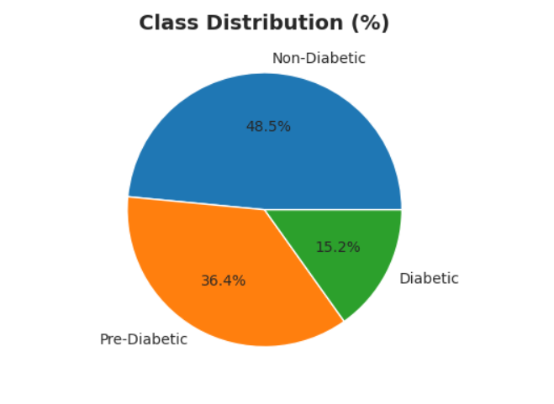
DATASET DESCRIPTION
TARGET CLASS
FEATURES
Gender
Age
Urea
Creatinine
HbA1c
Cholesterol
TG
HDL
LDL
VLDL
BMI
Diabetic
TOTAL SAMPLES
264
Non-Diabetic
Pre-Diabetic
Machine Learning 4
Assistant Professor Grade II to I Dr. Lokesh Kumar Dewangan 4

Slide 5
DATA PRE-PROCESSING
Data split 70% training & 30% testing
Training samples: 184
Testing samples: 80
Standard Scaler applied:
fit_transform() on training data
transform() on test data
Scaling ensures all features are on a similar range for ML model performance.
Machine Learning 5
Assistant Professor Grade II to I Dr. Lokesh Kumar Dewangan 4

Slide 6
MODEL TRAINING PROCESS
Four machine learning models initialized are,
Logistic Regression,
Random Forest,
Gradient Boosting &
SVM.
All models are trained on scaled training data.
Metrics calculated for each model are,
Accuracy,
Precision,
Recall &
F1-score.
5-fold Cross-Validation used to measure model stability and generalization.
Machine Learning 6
Assistant Professor Grade II to I Dr. Lokesh Kumar Dewangan 4

Slide 7
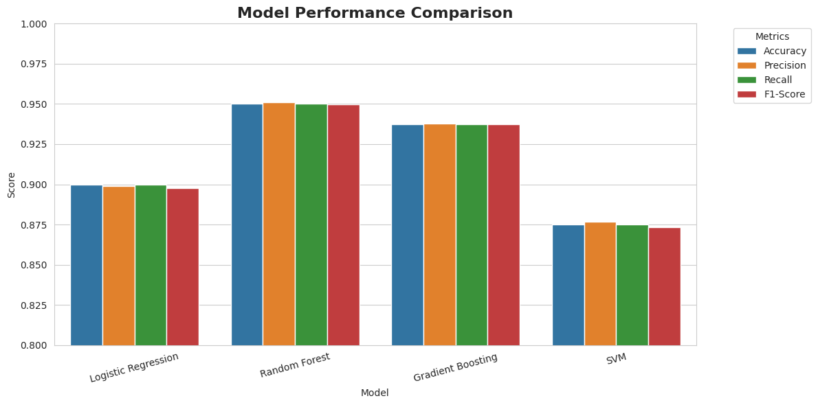
MODAL PERFORMANCE COMPARISON
Random Forest(Best Model)
Accuracy: 0.95 | F1: 0.95 | CV: 0.9836
Gradient Boosting
Accuracy: 0.94 | F1: 0.94 | CV: 0.9730
Logistic Regression
Accuracy: 0.90 | F1: 0.90 | CV: 0.8913
SVM (RBF Kernel)
Accuracy: 0.88 | F1: 0.88 | CV: 0.8315
Machine Learning 7
Assistant Professor Grade II to I Dr. Lokesh Kumar Dewangan 4

Slide 8
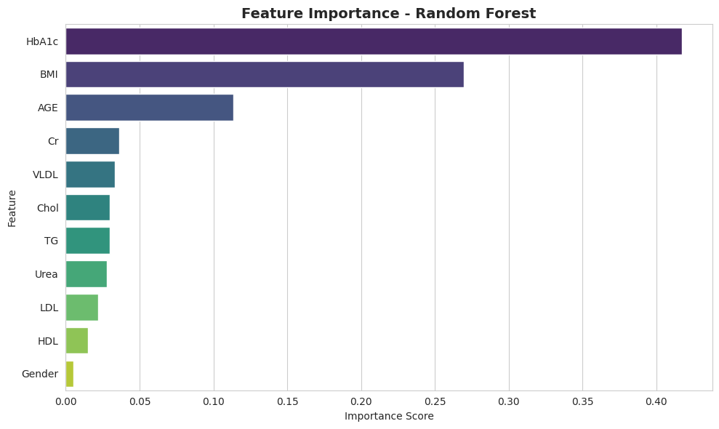
FEATURE IMPORTANCE
HbA1c – 0.4171 (strongest predictor of diabetes stage)
BMI – 0.2696
(second most important
metabolic indicator)
Age – 0.1137
(age increases diabetes
likelihood)
Moderate impact features
Cholesterol, Urea, VLDL, Creatinine,
TG, LDL.
Least impactful:
HDL.
Gender – 0.0053 (minimal influence)
Machine Learning 8
Assistant Professor Grade II to I Dr. Lokesh Kumar Dewangan 4

Slide 9
CONCLUSION
A multi class prediction can help doctors in approaching the treatment of diabetes disease for a better prognosis.
The output values show that the Random Forest is having better accuracy value than the other three models.
The overall accuracy of the Random forest is 95.00%, which is due to the of availability of HbA1c (the main factor in detection of diabetes).
A lot of suffering can be avoided by the detection and prevention of diabetes at an early stage.
Machine Learning 9
Assistant Professor Grade II to I Dr. Lokesh Kumar Dewangan 4

Slide 10

Thank You
Machine Learning 10
Assistant Professor Grade II to I Dr. Lokesh Kumar Dewangan 4

