Slide 1
SOLID Principles

Slide 2

Robert C martin a.k.a “Uncle Bob”

Slide 3
Single Responsibility Principle
There should not be more than one reason, for a class to change.
A class should handle only one responsibility

Slide 4
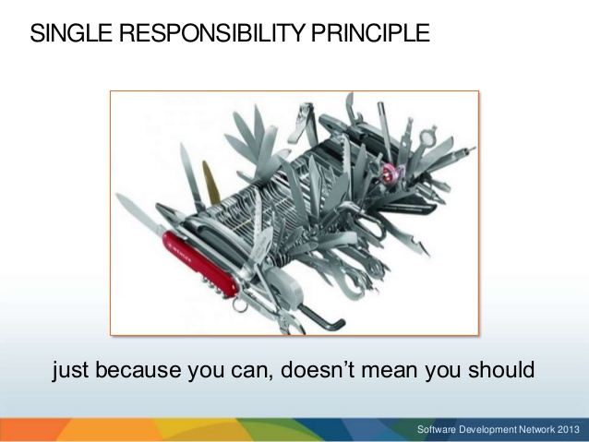

Slide 5
Cohesion and Coupling
Cohesion : How strongly related and focused are the functionalities of a module or class.
Coupling : Dependency of a module on other module or class.

Slide 6
Low Cohesion
GetResults
Input() Add() Display()

Slide 7
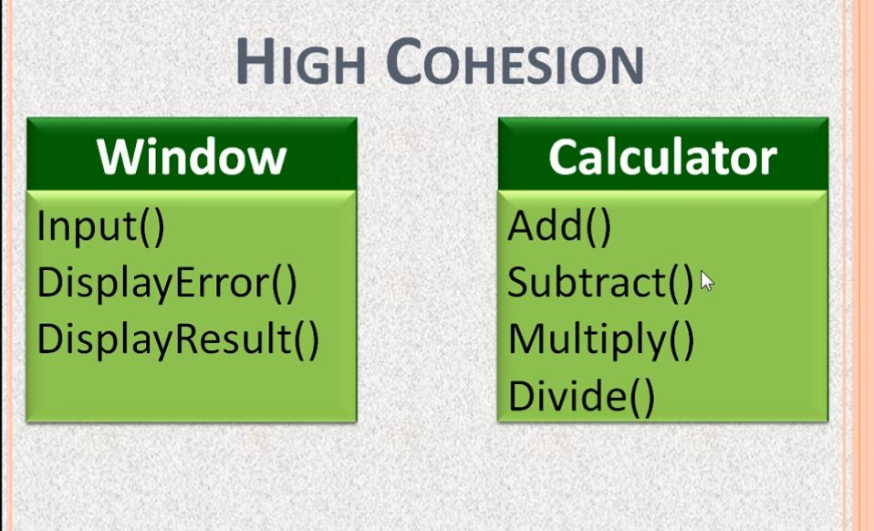

Slide 8
Strive for high cohesion and low coupling

Slide 9
Open/Closed Principle
Software entities (Classes,modules,functions etc.) should be open for extension, but closed for modification

Slide 10
Liskov Substitution Principle
A derived type should be able to replace the parent type without any exception or code changes.

Slide 11
Interface Segregation Principle
No client should be forced to depend on methods it does not use.

Slide 12
Dependency Inversion Principle
Higher level modules should not depend up on lower level modules, but rather on abstractions.
Abstractions should not depend on details. Details should depend up on abstractions.

