Slide 1
Container
Docker

Slide 2
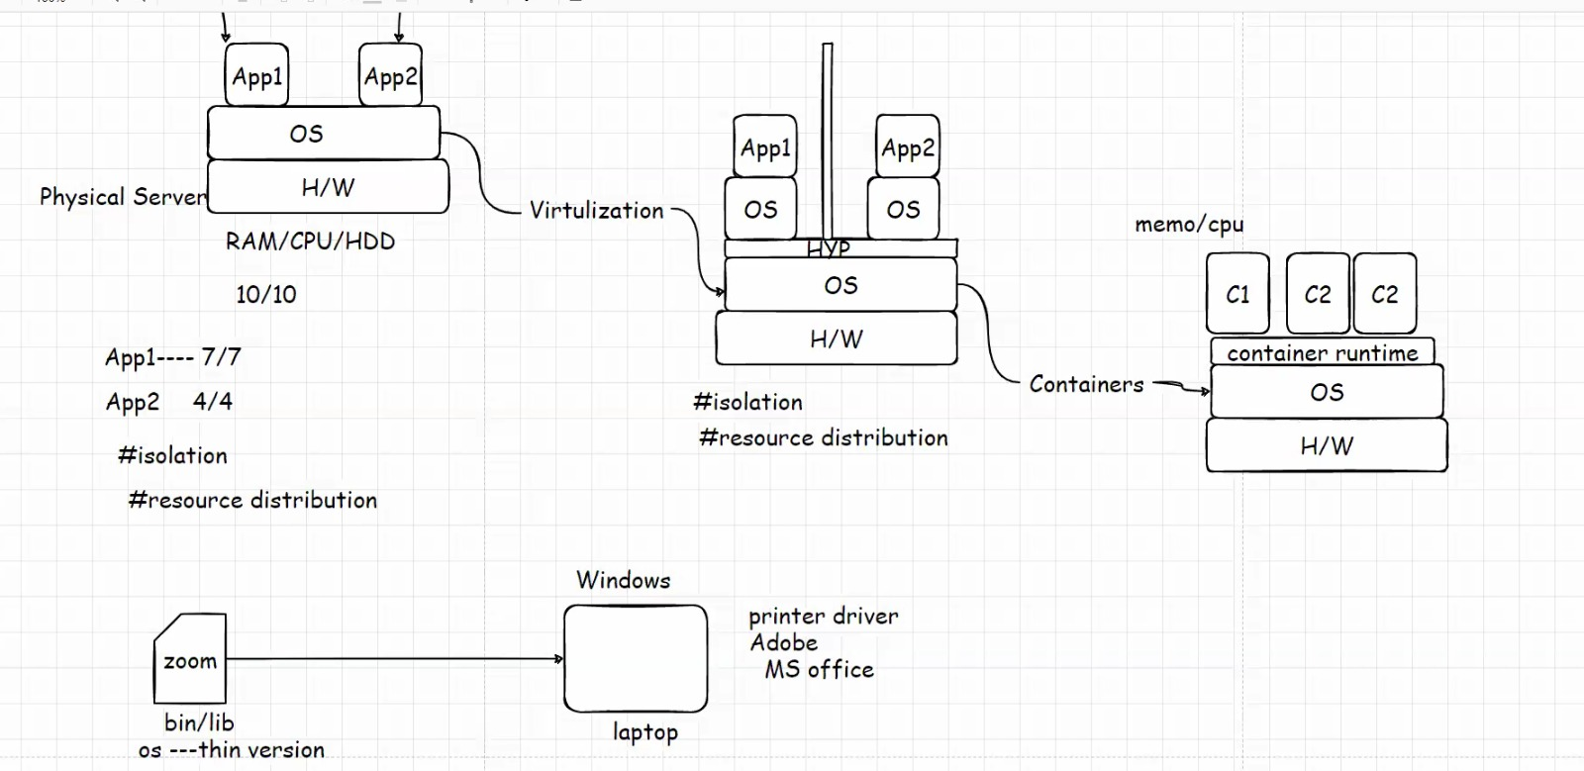

Slide 3
Difference between Traditional way of running application , virtualization and containerization.
In above picture we can see that in traditional way there is one physical server(hardware) and top of that one OS is there on top of OS there is different applications are running by team1 and team2 but the challenge is it is difficult to distribute the isolation(restricted to access)and fair distribution of resources (if the hardware consist of 10 GB RAM and 10 GB CPU , there will be chance that one can consume most of the resource and other might get shortage) but in case of virtualization on top of OS there is hypervisor where it distributes OS, equal resources to both server and also solve isolation problem where one server wont get to know about the other server and cant get access also . In case of containerization there will be containers running on OS so that applications get enough distributed resources without any extra space or other features this leads to avoiding of unnecessary space in OS.

Slide 4
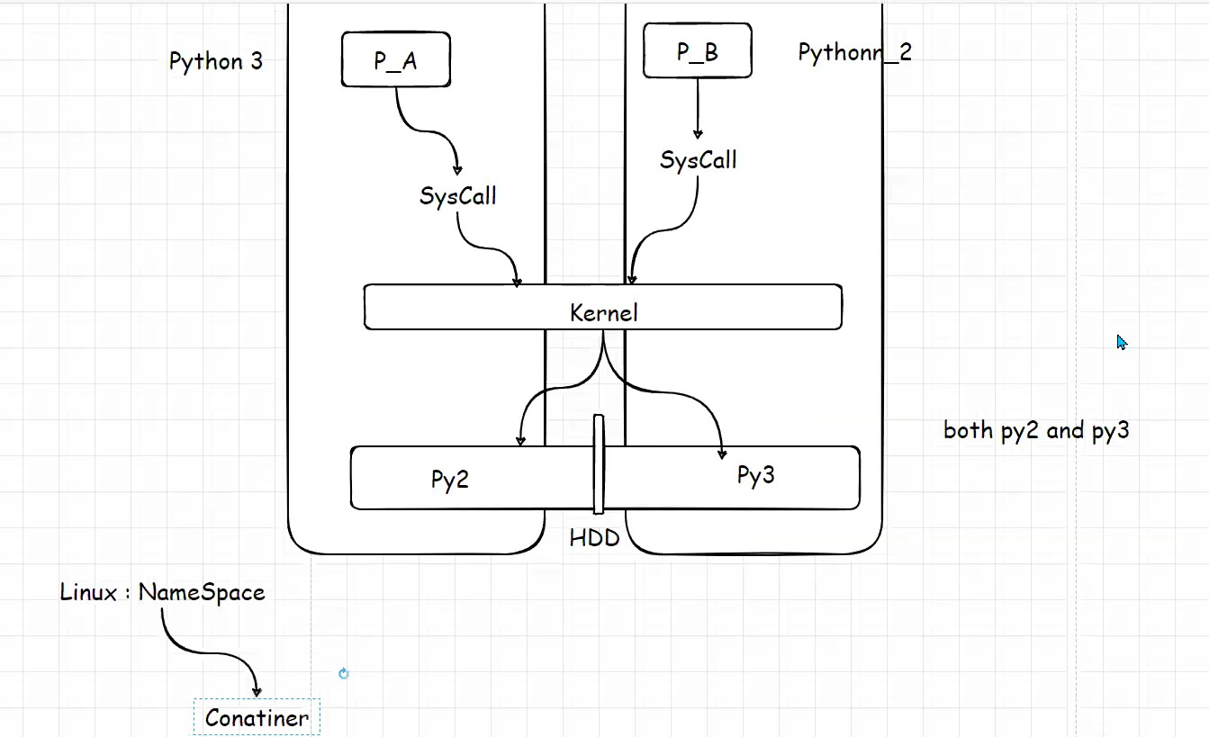

Slide 5
Definition of Container? How container is used while running application?
Container is nothing but a OS process which behaves like virtual machine because when we install docker(one of the container) in Linux then if we list the process and kill those process then container will not be there.
Usually there will be multiple applications running on OS while running there will be necessary of hardware for the applications in that case applications go for system calls in order to receive the necessary hardware and that call will be received by Kernal then pass it to hardware so that necessary hardware will be sent to applications ,here container will use namespace.
Note :System calls is a call where it will received from application by the Kernal so that it can help with the transfer of hardware.
Kernal : Kernal is core element which is bridge between the data processing and hardware.
Name space : Name space is one of the features in Linux which is used to partition of hardware in order to distribute the resources for different applications running on OS.

Slide 6
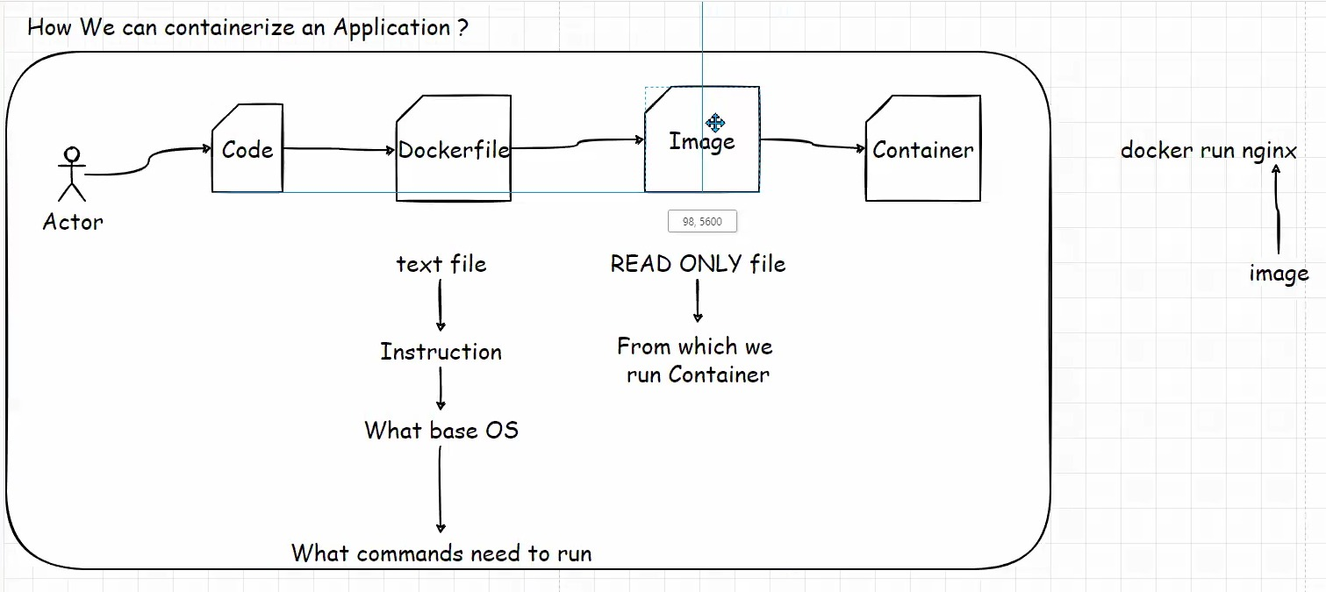
How can we containerize an application
Basically when developer push codes to git hub repository we need to prepare a docker file, from the docker file we need to create an image and we need to push that image into docker hub or any repository (it can be private or public or organization repo).

Slide 7
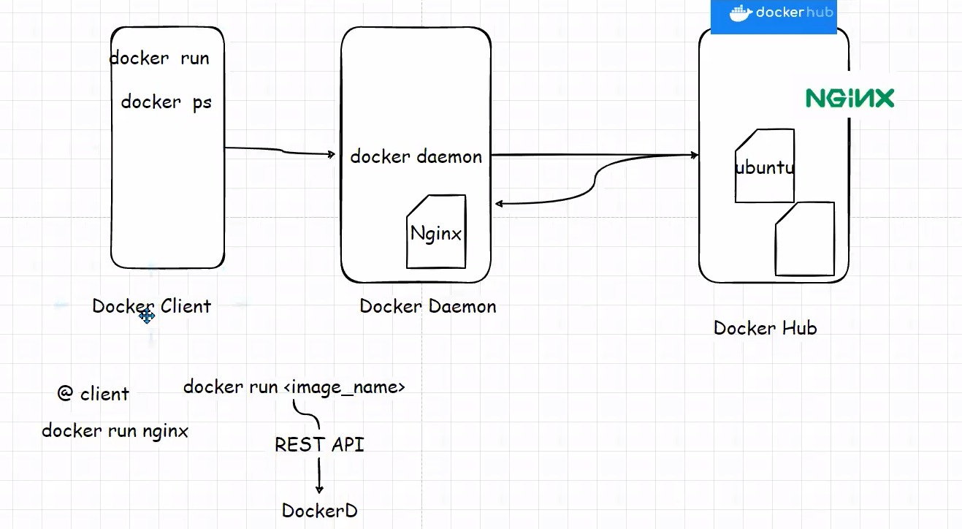
Docker
Docker has 3 components
1. Docker client is the place where we are running all the commands like docker ps, start, stop etc.
2.Docker daemon = The machine where we have installed docker and docker D is actually creating container by seeing Rest API (Where commands converted into API) and see in his machine where the images are there or not . if not it will pull images from docker hub
3.Docker Hub = Where the images are hosted.

Slide 8
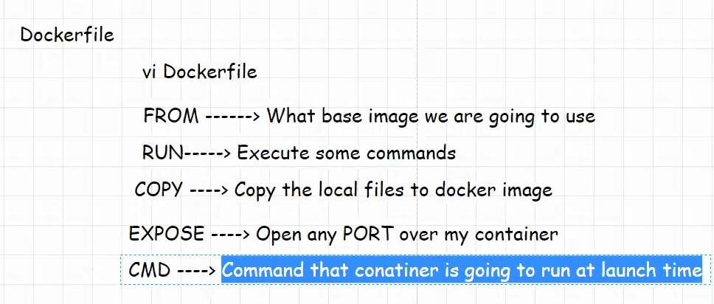
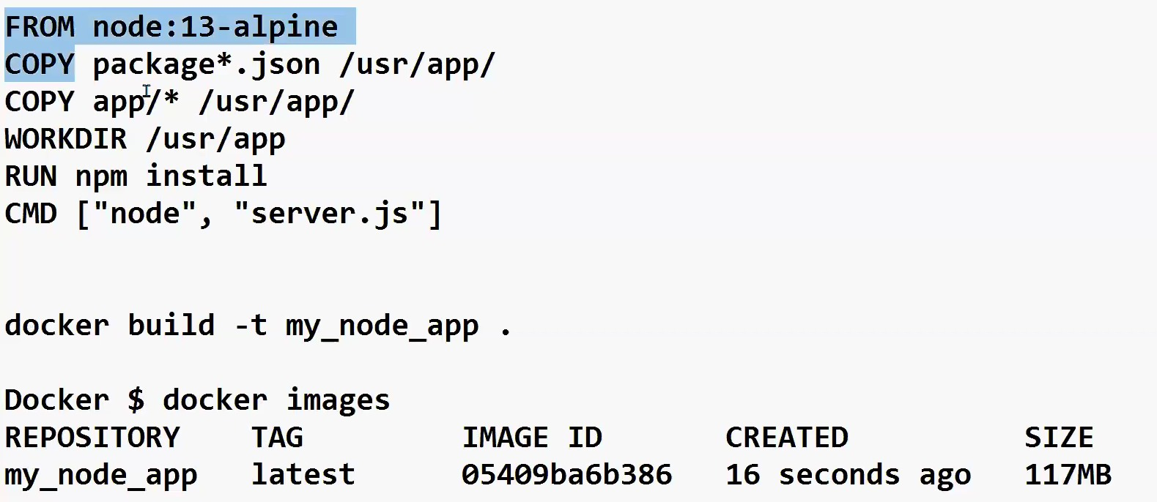

Slide 9
Docker File
Docker file is text file that contains instructions about how I am going to build my image
How to create a docker file
First we need to create a folder and clone repository
There are 4 steps to create a docker file
Step1: FROM : What base image we are going to use (it is based on application requirement and it can be docker hub) we need to copy the packages, and app which is required , along with that we need to give location that where it need to be copied (we need to create a working directory)
Step2: RUN : package manager name install (which is used to build my application)
When the container get started we need to start the Application so
Step3: CMD : CMD is used to execute commands when container is running (we need to mention one command in CMD so that it will start the commands)

Slide 10
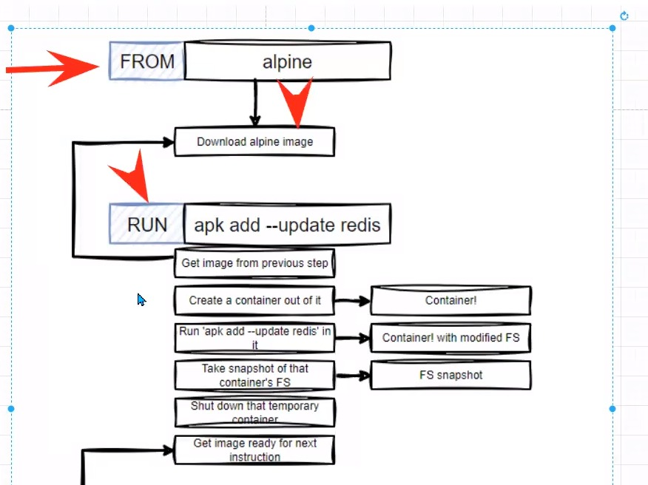
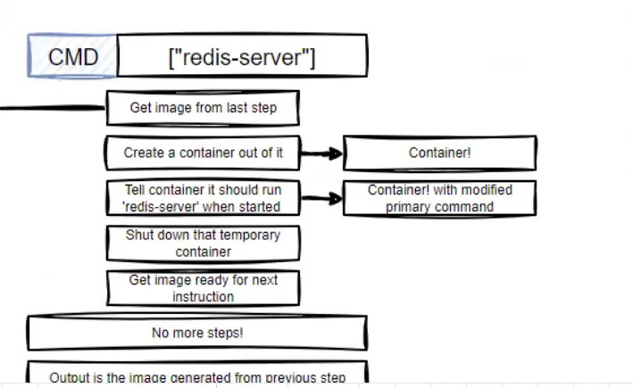
Notes:
Detailed information of how docker image is created

Slide 11
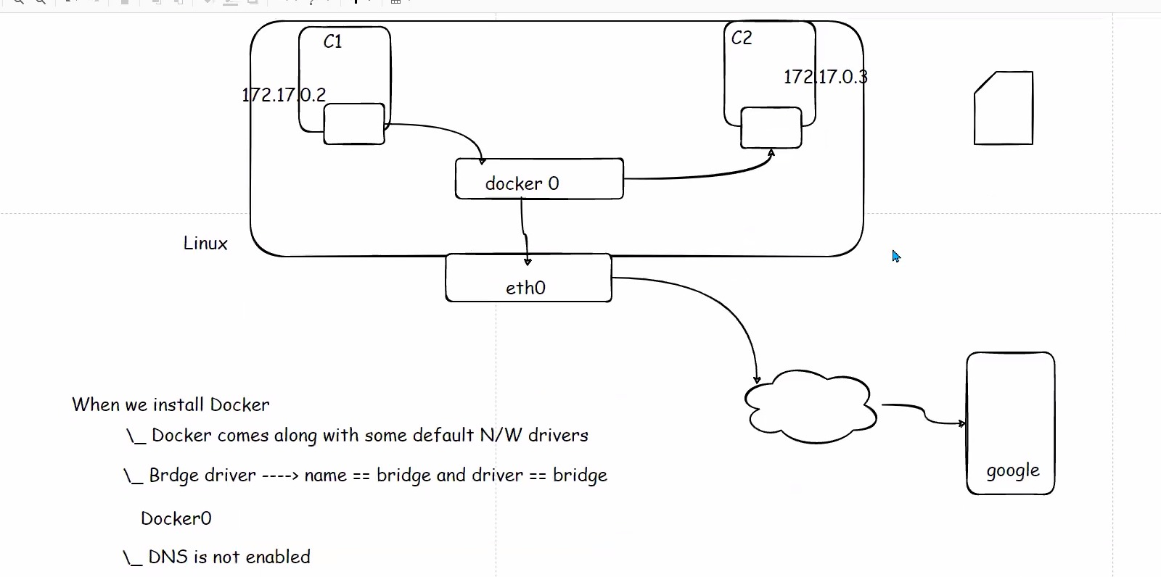
Docker Networking
Docker networking is nothing but an interface between two machines where it is created by default along with the machine we create .
As u can see in the picture inside the linux machine there will be 2 containers and when we create docker automatically the interface(docker0) is created where it will help those 2 containers to communicate with each other but it can be possible only when DNS is enabled because when we try to connect through the name of container rather than IP it will throw reject .

Slide 12
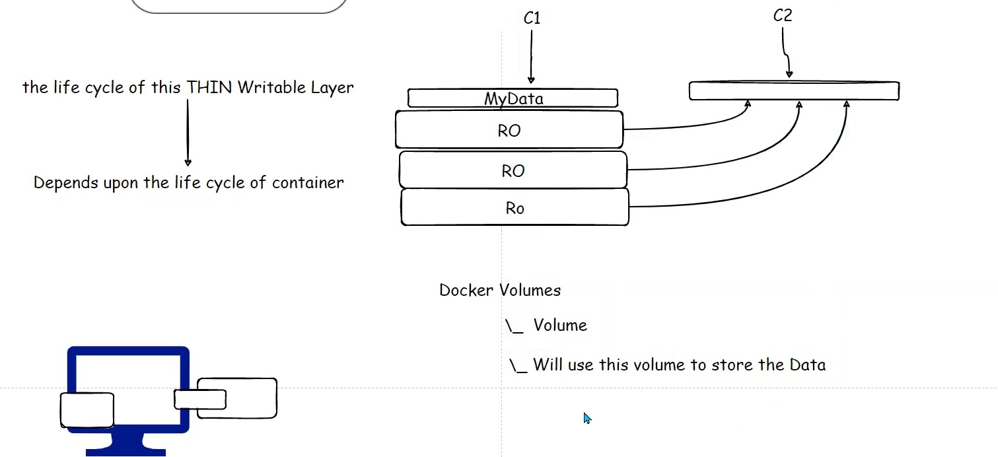
Volume
Volume is nothing but a storage which can keep independent from hardware.
When we store any data in any files when the file gets deleted automatically the data also get deleted so in that case in order to save the data we use volume
According to picture : when we create a container on hardware there will be thin writable layer will be created along with that which depends upon the lifecycle of container , in order to store my data , so when we delete files or container which contains some important data automatically the thin layer also gets deleted and we can never find the data . in order to resolve this issue we create a container using volume so that container's data will not be dependent on volume and even if we delete the files our data will be saved in volume.

Slide 13
Needs to learn
How to create docker file
We need to understand the backend process of creating an image
How to enable DNS.

