Slide 1

LEAF DISEASE DETECTION (Using TensorFlow and Keras)

Slide 2

Introduction to Leaf Disease Detection
Leaf disease detection using TensorFlow and Keras is a cutting-edge application of deep learning in agriculture. This technology utilizes neural networks to analyze leaf images, identify diseases, and provide early detection for plant health management. By harnessing the power of convolutional neural networks (CNNs), it offers a cost-effective and efficient solution to monitor crop health, increase yields, and mitigate crop damage. In this brief introduction, we'll explore the key principles and techniques that enable this innovative approach to agricultural sustainability.

Slide 3

Aim/Objective
Explore the power of TensorFlow and Keras in developing deep learning models for image classification tasks, with a focus on leaf disease detection and potraying the insights in a webpage.

Slide 4

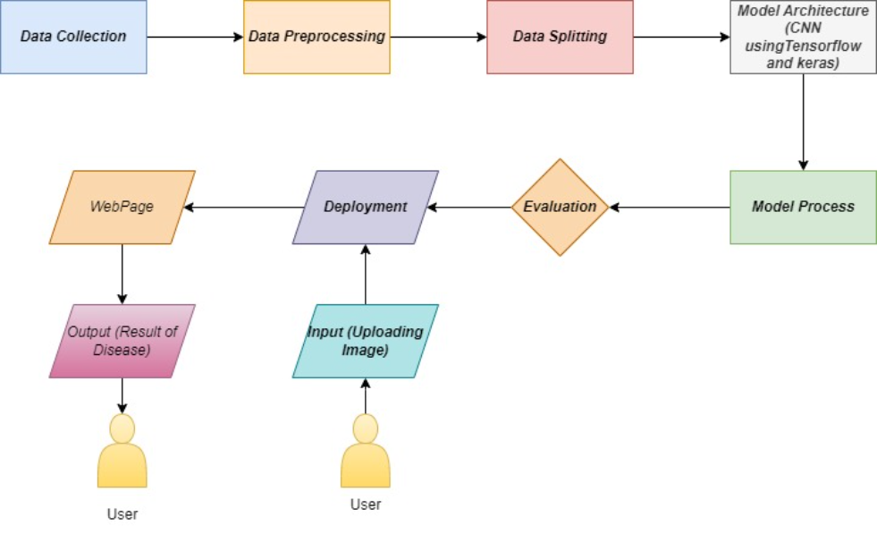
WorkFlow Of Methadology

Slide 5
Data Collection: Gathering a dataset of leaf images, including both healthy and diseased samples.(From Kaggle)
Data Preprocessing: Cleaning and preprocessing the images by resizing and normalizing them and Augment data for Diversity.
Data Splitting: Spliting the dataset into training and testing sets.(80:10:10)
Model Architecture: Designing a convolutional neural network (CNN) using TensorFlow and Keras.
Model Training: Training the model on the training data using appropriate loss functions and optimizers.
Evaluation: Evaluating the model's performance on the testing set using accuracy.
Deployment: Deploy the model for disease detection in the target environment.
User Interface: Developing a user-friendly interface for leaf image uploads.

Slide 6
Results and Inferences
High Accuracy in Disease Identification:
A well-trained model can achieve high accuracy in identifying leaf diseases, which is crucial for early detection and intervention.
Improved Crop Health Management:
Accurate disease detection enables farmers to implement timely measures, such as targeted pesticide application or removal of affected plants, which can lead to healthier crops and increased yields.
Reduced Crop Damage:
Early disease detection can help prevent the spread of diseases within a crop, reducing overall crop damage and economic losses.
Minimized Resource Usage:
Targeted treatments reduce the need for extensive use of pesticides or fungicides, leading to cost savings and environmental benefits.
Efficient Monitoring:
Automation of disease detection through machine learning allows for continuous and efficient monitoring of large agricultural areas, making it easier for farmers to track plant health.
Identification of Disease Trends:
Over time, the collected data can provide insights into disease prevalence, seasonal patterns, and geographical hotspots, aiding in long-term agricultural planning.
False Positives and Negatives:
The model may produce false positives (identifying healthy leaves as diseased) or false negatives ( failing to detect diseases in some leaves). Fine-tuning the model and adjusting the decision threshold can help reduce these errors.

Slide 7

Conclusion And Future Scope
Leaf disease detection using TensorFlow and Keras offers numerous benefits in agriculture, including early disease identification, improved crop health management, and reduced crop damage. However, the accuracy and effectiveness of the system depend on data quality, model architecture, and ongoing maintenance and improvement. The inferences drawn from the results can guide farmers and researchers in making informed decisions to safeguard crop health and optimize agricultural practices.

