Slide 1
Weather Application
Real-Time Weather Experience
Created by Avinash S

Slide 2
The Vision
Objective: Professional-grade dashboard experience.
Design: Glassmorphism, depth-layered backgrounds.
Aesthetics: Neon accents and high-fidelity transitions.

Slide 3
Modern Tech Stack
React.js (Vite) - For ultra-fast performance.
WeatherAPI.com - Advanced tier weather data.
Tailwind CSS & Vanilla CSS - Pixel-perfect layouts.
Framer Motion - Cinematic ambient effects.

Slide 4
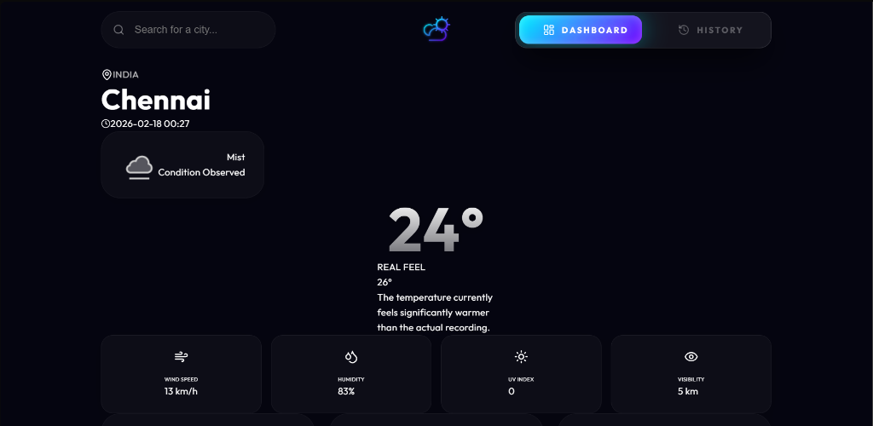
Core Functionality
Real-time search and discovery.
Horizontal dashboard ergonomics.
Live metrics (Wind, UV, Visibility).
Ambient background chemistry.

Slide 5
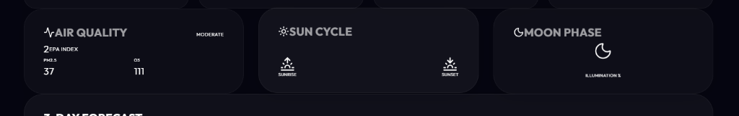
Environmental Analysis
EPA Pollutant scale (AQI) tracking.
Sunrise, Sunset, and Moon Phase illumination.
Regional Sports events integration.
Safety-first Weather Alert system.

Slide 6
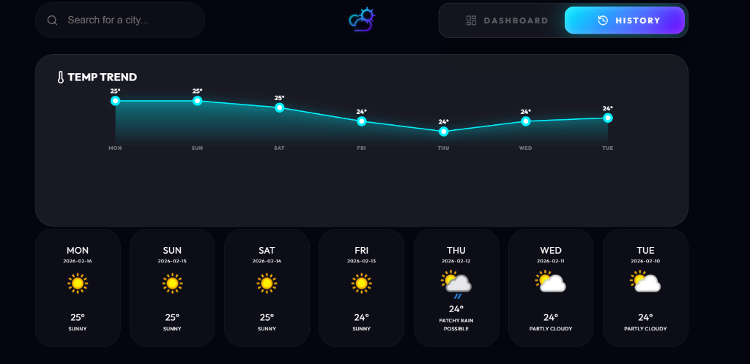
Visualizing Trends
High-definition SVG trend charting.
Non-scaling vector effects for sharp visuals.
7-day comprehensive history cards.
Interactive 3-day future outlook.

Slide 7
Final Results & Live URL
Successfully deployed on Vercel.
100% Feature Complete.
Clean, optimized production build.
Live URL : https://weather-application-delta-liard.vercel.app
GitHub : https://github.com/avinashmax/Weather-application

