Slide 1
DEEP-DIVE ANALYSIS
& Interactive Dashboarding
Intern: Avinash Nalla | ID: APSPL2632585
ApexPlanet Software Pvt. Ltd.
Task 3 — Deep-Dive Analysis & Interactive Dashboarding

Slide 2
KPI Definitions & Formulas
KPI 1: Total Revenue
KPI 2: Profit Margin %
KPI 3: Avg Order Value
Formula: SUM(Sales)
Formula: (SUM(Profit)/SUM(Sales))×100
Formula: SUM(Sales)/COUNT(DISTINCT Order ID)
$2,297,201
12.47%
$458.61
Measures overall business size and growth trajectory
Evaluates pricing strategy and operational efficiency
Indicates purchasing behavior and sales effectiveness
KPI 4: Customer Retention
KPI 5: Loss Order Rate
Formula: (Returning/Total Customers)×100
Formula: (Loss Orders/Total Orders)×100
~79.3%
~18.4%
Measures customer loyalty and satisfaction levels
Identifies proportion of value-destroying transactions

Slide 3
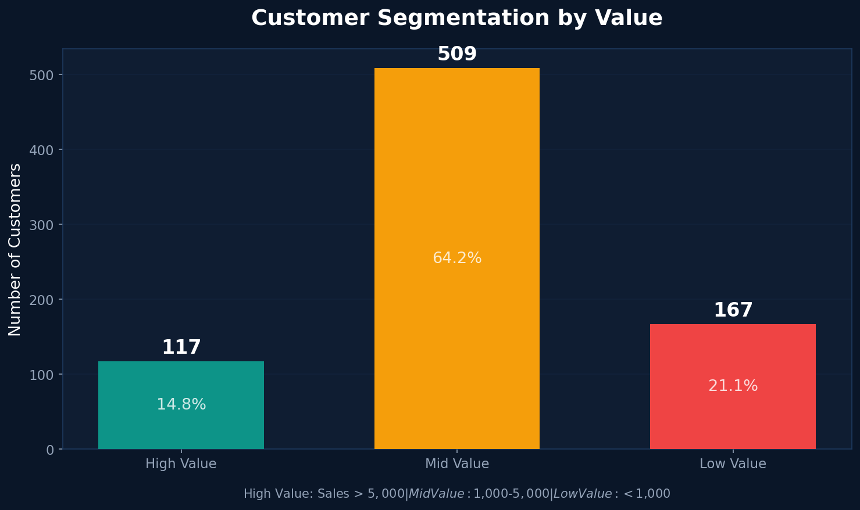
Customer Segmentation by Value
High Value
117 customers
14.8% of customers
> $5,000 total sales
Mid Value
509 customers
64.2% of customers
$1,000 – $5,000
Low Value
167 customers
21.1% of customers
< $1,000 total sales

Slide 4
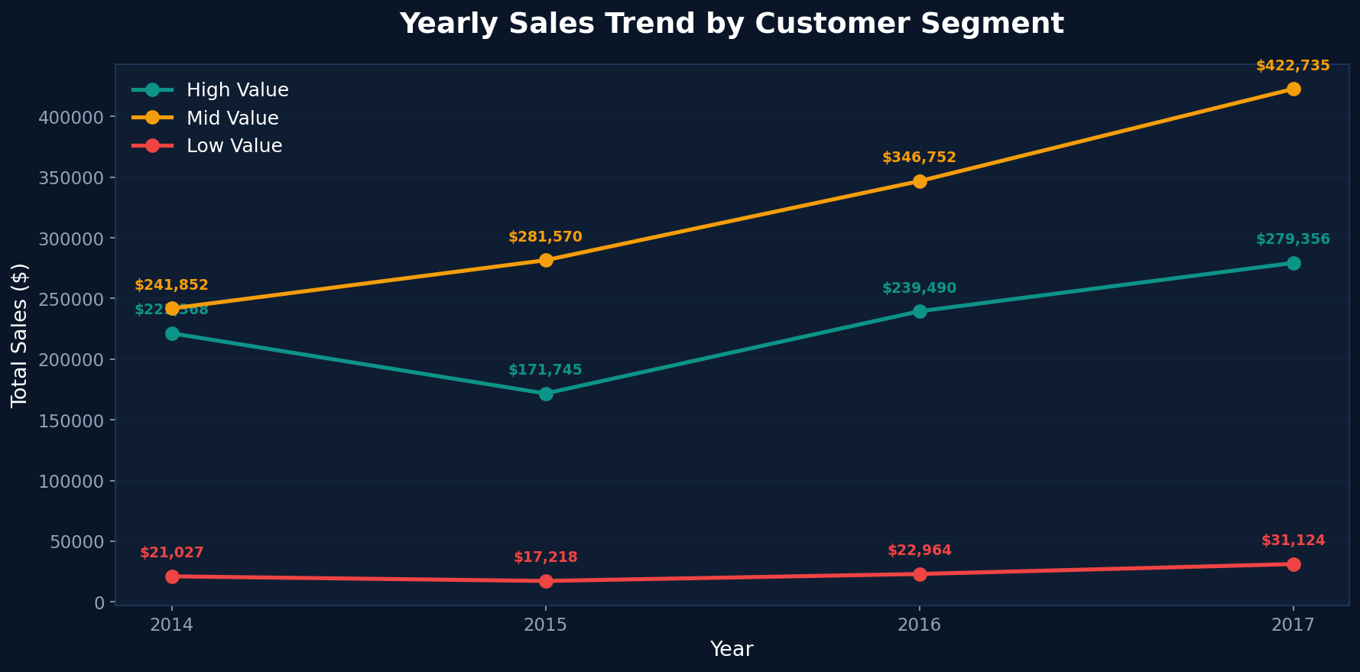
Yearly Sales Trend by Customer Segment
All three segments show consistent growth from 2014-2017, with High Value customers driving the majority of revenue acceleration.

Slide 5
Cohort Analysis — Customer Value Over Years
Year
Active Customers
Total Sales
Total Profit
Avg Sales/Customer
2014
627
$484K
$63K
$772
2015
634
$470K
$58K
$742
2016
661
$609K
$79K
$921
2017
693
$733K
$87K
$1,058
Key Trends: Active customer base grew 10.5% (627 to 693), while average revenue per customer increased 37% ($772 to $1,058), indicating both acquisition and value growth.
4-Year Revenue Growth
Customer Growth
Avg Value Growth
+51.4%
+10.5%
+37.0%

Slide 6
Top 10 High Value Customers
Rank
Customer Name
Total Sales
Total Profit
Orders
Profit Margin
#1
Sean Miller
$25,043
$-1,981
5
-7.9%
#2
Tamara Chand
$19,052
$8,981
5
47.1%
#3
Raymond Buch
$15,117
$6,976
6
46.1%
#4
Tom Ashbrook
$14,596
$4,704
4
32.2%
#5
Adrian Barton
$14,474
$5,445
10
37.6%
#6
Ken Lonsdale
$14,175
$807
12
5.7%
#7
Sanjit Chand
$14,142
$5,757
9
40.7%
#8
Hunter Lopez
$12,873
$5,622
6
43.7%
#9
Sanjit Engle
$12,209
$2,651
11
21.7%
#10
Christopher Conant
$12,129
$2,177
5
17.9%

Slide 7
Key Findings from Deep-Dive Analysis
1
Pareto Principle Confirmed
2
Consistent Growth Across All Segments
14.8% of customers (High Value segment) contribute to the majority of total revenue, validating the 80/20 rule in this business context. Focus retention efforts on these 117 key accounts.
All three customer value segments show year-over-year growth from 2014-2017. High Value segment growth is accelerating, indicating successful upselling strategies.
3
Low Value Churn Risk
4
Revenue Per Customer Rising
167 customers (21.1%) are in the Low Value segment with average total sales under $1,000. These customers need targeted engagement campaigns to move them into Mid Value territory.
Average revenue per customer increased 37% over 4 years ($772 to $1,058). Combined with 10.5% customer growth, this dual growth engine is highly positive for long-term sustainability.

Slide 8
Thank You!
Avinash Nalla
Intern ID: APSPL2632585
ApexPlanet Software Pvt. Ltd.
Task 3 — Deep-Dive Analysis & Interactive Dashboarding

