Slide 1
DATA STORYTELLING
& Statistical Validation
Intern: Avinash Nalla | ID: APSPL2632585
ApexPlanet Software Pvt. Ltd.
Task 4 — Data Storytelling & Statistical Validation

Slide 2
Business Problem Statement
Problem
The Superstore business faces profitability challenges with ~18.4% of orders generating losses. Management needs data-driven evidence to answer critical questions: Does discounting actually hurt profitability? Are there significant regional differences in sales performance? What actionable strategies can be implemented to improve the bottom line?
Objective 1
Validate whether discounts statistically reduce profit using rigorous hypothesis testing
Objective 2
Determine if regional sales differences are statistically significant or due to random chance
Objective 3
Provide evidence-based recommendations to improve business profitability

Slide 3
Dataset Recap — Key Numbers
Total Revenue
Total Profit
Total Orders
$2,297,201
$286,397
9,994
Sum of all sales
Net profit earned
Transactions analyzed
Profit Margin
Loss Orders
Customers
12.47%
~1,838
793
Overall margin
~18.4% of total
Unique buyers
Key Findings from Previous Tasks
• Task 1: Cleaned 21-column dataset, added 6 derived features, standardized text fields
• Task 2: Technology leads revenue ($836K); West region tops profit ($108K); 10 states show net losses
• Task 3: 117 High Value, 509 Mid Value, 167 Low Value customers; all segments growing YoY

Slide 4
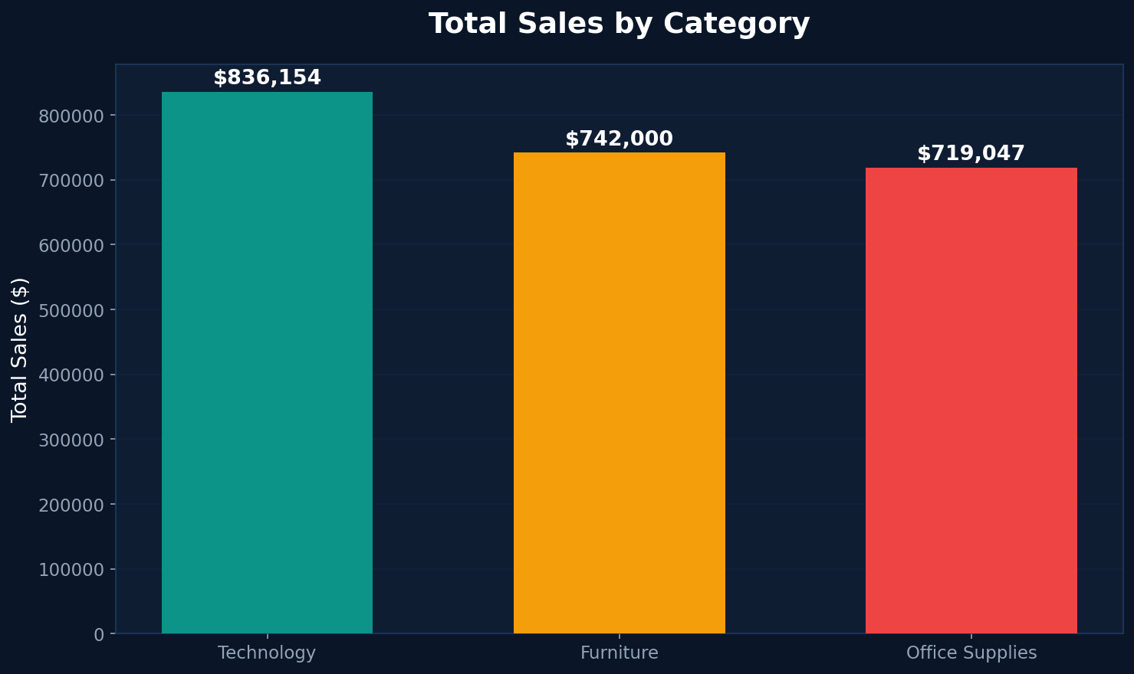
Finding 1: Technology Leads Revenue Generation
Technology
$836,154
36.4% of revenue
Lowest discount at 13%
Furniture
$741,999
32.3% of revenue
Highest discount at 17%
Office Supplies
$719,047
31.3% of revenue
Most items sold
Technology's premium pricing strategy works - highest revenue with lowest discounts. Replicate this approach for Furniture to improve margins.

Slide 5
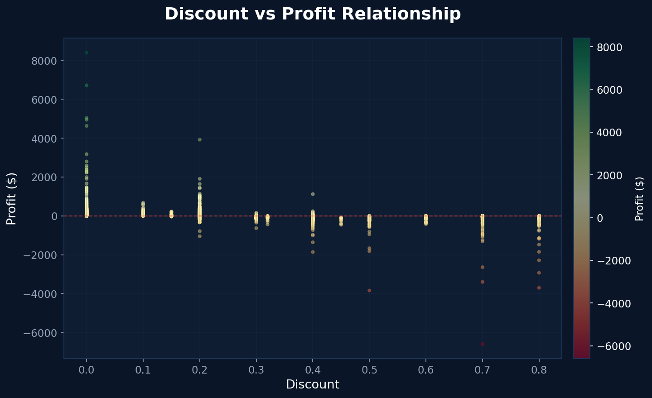
Finding 2: Discounts Significantly Hurt Profit
With Discount
-$6.66
Average profit per order
Without Discount
$66.90
Average profit per order
Profit Gap
$73.56
Discount costs per order
The scatter plot shows a clear negative relationship - as discount increases, profit drops. Discounted orders average -$6.66 loss vs $66.90 profit for full-price orders.

Slide 6
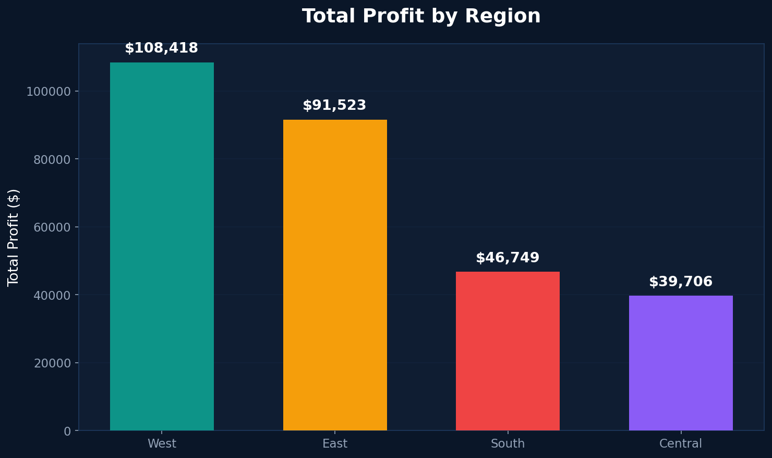
Finding 3: Regional Performance Gap
West
$108,418
3,203 orders
East
$91,522
2,848 orders
South
$46,749
1,620 orders
Central
$39,706
2,323 orders
Central region has 2,323 orders but only $39,706 profit - the lowest profit-per-order ratio. West generates 2.7x more profit despite similar volume.

Slide 7
Hypothesis Test 1: Discount vs Profit (T-test)
Test Setup
Results
Method: Independent Samples T-test
Avg Profit (Discounted)
-$6.66
Significance Level: α = 0.05
Avg Profit (No Discount)
$66.90
H0: No difference in profit between groups
T-statistic
15.7380
H1: Discounted orders have lower profit
P-value
4.36e-55 (< 0.05)
REJECT H0
Statistically significant difference confirmed (p is approximately 0)
Business Conclusion: Discounts significantly erode profitability. On average, each discounted order generates -$6.66 loss compared to $66.90 profit for non-discounted orders — a gap of $73.56 per order. With thousands of discounted orders annually, this represents substantial revenue leakage. Recommendation: Cap discounts at 20%, implement approval workflows for higher discounts, and shift to value-based promotions such as product bundling and loyalty programs.

Slide 8
Hypothesis Test 2: Region vs Sales (ANOVA)
Test Setup
Results
Method: One-Way ANOVA
F-statistic
0.8006
Significance Level: α = 0.05
P-value
0.4933 (> 0.05)
H0: No difference in mean sales across regions
Central avg sales
$222.47/order
H1: At least one region differs significantly
East avg sales
$238.34/order
Groups: East, West, Central, South
West avg sales
$226.49/order
FAIL TO REJECT H0
No statistically significant difference found (p = 0.493)
Business Conclusion: While total profit varies dramatically between regions (West=$108K vs Central=$39K), the average sales per individual order is NOT significantly different across regions. This means the profit gap is driven by ORDER VOLUME and DISCOUNT PATTERNS, not by per-order sales values. Recommendation: Focus regional improvement strategies on controlling discounts in underperforming regions (especially Central) and increasing order frequency rather than trying to increase individual order sizes.

Slide 9
Final Recommendations
1
Cap Discount Rates
2
Regional Discount Audit
Implement a maximum discount threshold of 20%. Require VP-level approval for any discount exceeding 15%. This single change could recover $73.56 per discounted order, potentially saving hundreds of thousands in annual profit leakage.
Since regional profit gaps are driven by discount patterns (not sales per order), conduct a deep audit of discount practices in Central and South regions. Standardize discount policies across all regions to eliminate inconsistencies.
3
Shift to Value-Based Promotions
4
Implement Real-Time Monitoring
Replace blanket discounts with customer-loyalty rewards, product bundling, and volume-based pricing tiers. This preserves perceived value while maintaining margins. Target the 167 Low Value customers with upgrade incentives.
Deploy a dashboard tracking loss order rate, discount levels by region/category, and profit margins by segment in real-time. Set alerts when loss rates exceed 15% in any region or category to enable proactive intervention.

