Slide 1
SUPERSTORE SALES
EDA & Business Intelligence
Intern: Avinash Nalla | ID: APSPL2632585
ApexPlanet Software Pvt. Ltd.
Task 2 — Exploratory Data Analysis

Slide 2
Dataset Overview
Total Orders
Unique Customers
Data Columns
Time Period
9,994
793
21
4 Years
Transactions analyzed
Across 3 segments
Original features
2014 – 2017
Dataset: Superstore Sales (Kaggle) - Retail transactions across the United States
Time Period: January 2014 to December 2017 (48 months of data)
Categories: 3 product categories (Furniture, Office Supplies, Technology) with 17 sub-categories
Geographic Coverage: 4 regions (East, West, Central, South) spanning 49 states and 531 cities
Customer Segments: Consumer (51.6%), Corporate (29.8%), Home Office (18.7%)
Shipping Modes: Standard Class, Second Class, First Class, Same Day
Revenue Range: Individual sales from $0.44 to $22,638
New Features Added: Days_to_Ship, Profit_Margin_%, Order_Year, Order_Month, Order_Month_Name, Is_Loss

Slide 3
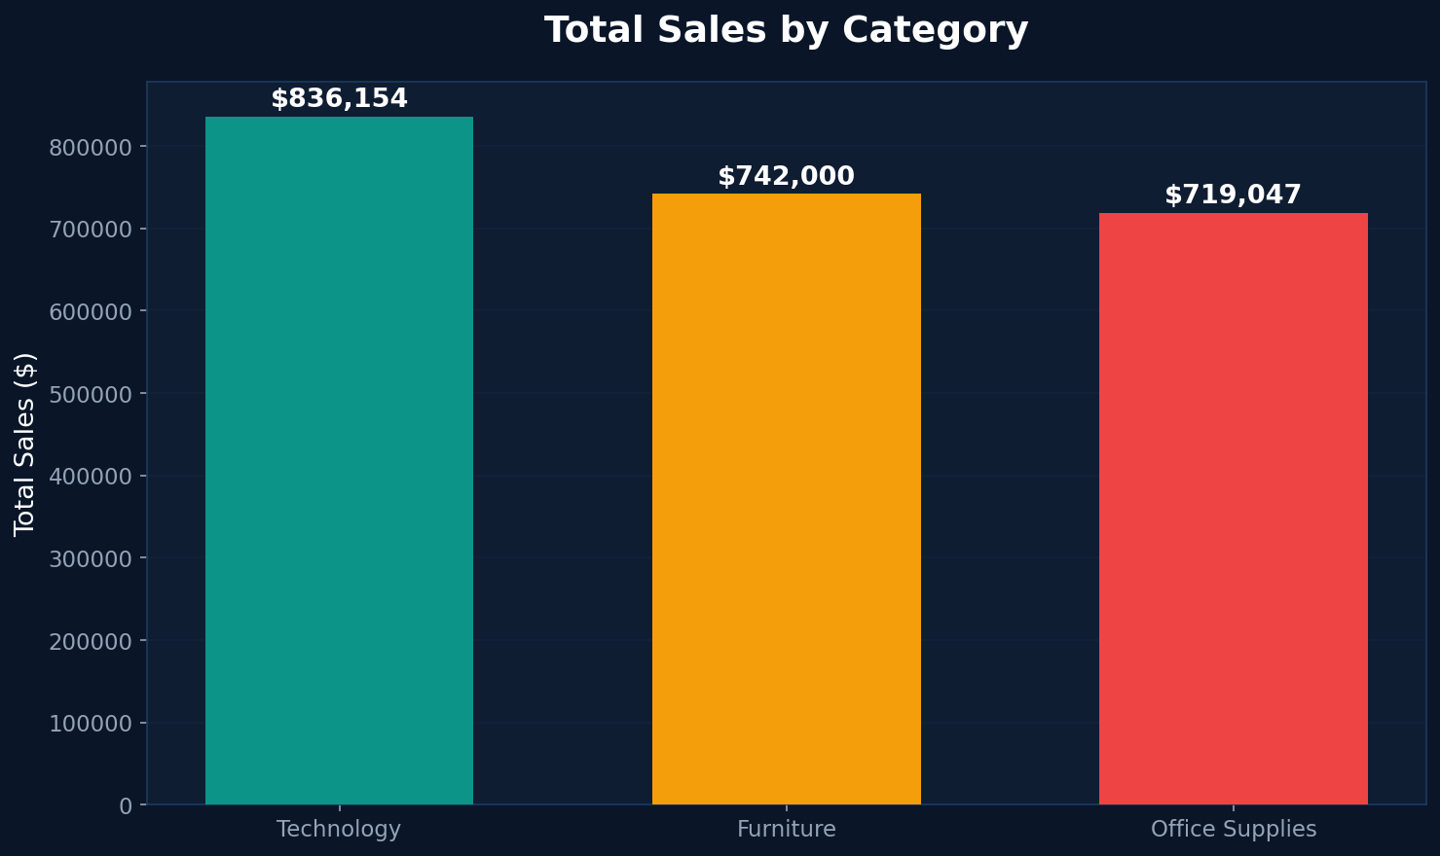
Sales by Category
Technology
$836,154
Highest revenue category
Furniture
$741,999
Second in sales volume
Office Supplies
$719,047
Lowest but most items
Technology leads revenue with $836K but has the lowest discount rate (13%), suggesting premium pricing strategy works effectively.

Slide 4
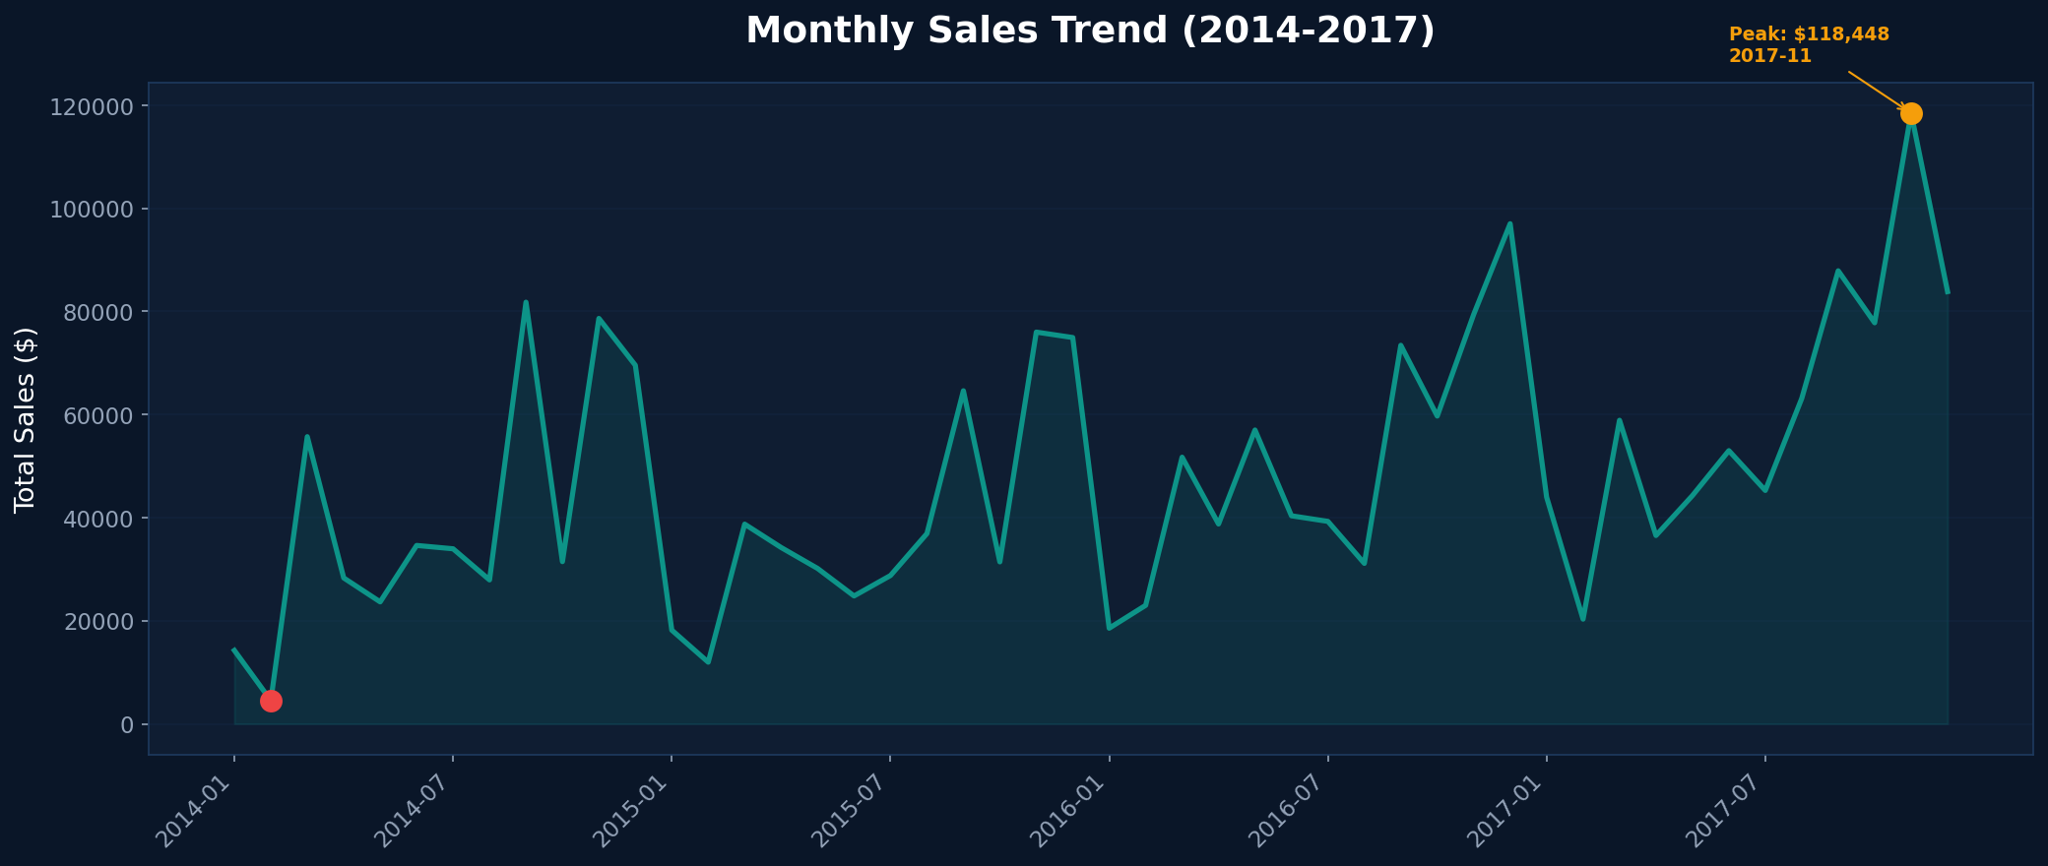
Monthly Sales Trend (48 Months)
Peak Month
$118,447
Nov 2017
Lowest Month
$4,519
Feb 2014
Avg Monthly
$47,941
--
YoY Growth
+48.7%
2014-2017
Sales consistently peak in Q4 (Oct-Dec) due to holiday season, with November 2017 recording the highest single-month sales at $118,447.

Slide 5
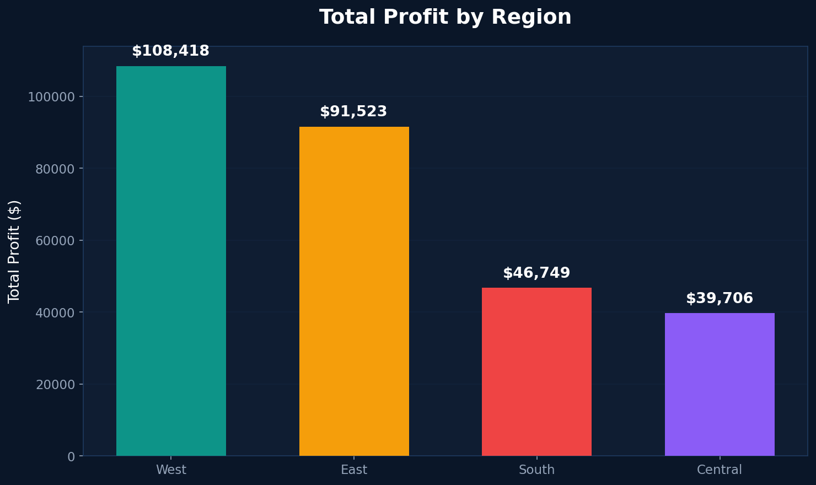
Profit by Region
#1 West
$108,418
37.8% of total profit
#2 East
$91,522
32.0% of total profit
#3 South
$46,749
16.3% of total profit
#4 Central
$39,706
13.9% of total profit
West and East regions together account for 69.8% of total profit. Central region underperforms despite having similar order volume.

Slide 6
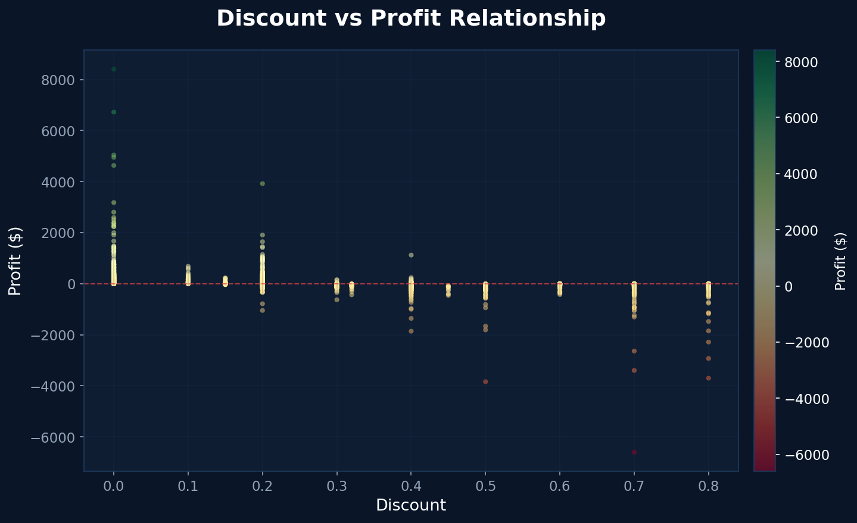
Discount vs Profit Analysis
Top Loss-Making States
Texas
-$25,729
Ohio
-$16,971
Pennsylvania
-$15,559
Illinois
-$12,607
North Carolina
-$7,490
Colorado
-$6,527
Tennessee
-$5,341
Arizona
-$3,427
Florida
-$3,399
Oregon
-$1,190
Higher discounts strongly correlate with negative profits. 10 states show net losses totaling -$98,240, requiring urgent pricing review.

Slide 7
SQL Business Intelligence Queries
Q1
Top 5 Products by Sales
Canon imageCLASS=$61,599 | Fellowes PB500=$27,453 | Cisco=$22,638
Q2
Monthly Sales Trend
48 months | Peak: Nov 2017=$118,447 | Low: Feb 2014=$4,519
Q3
Profit by Region
West=$108,418 | East=$91,522 | South=$46,749 | Central=$39,706
Q4
Customer Count by Segment
Consumer=409 | Corporate=236 | Home Office=148
Q5
Average Discount by Category
Furniture=17% | Office Supplies=16% | Technology=13%
Q6
States with Negative Profit
Texas=-$25,729 | Ohio=-$16,971 | Pennsylvania=-$15,559 + 7 more
Q7
Orders by Shipping Mode
Standard=5,968 | Second=1,945 | First=1,538 | Same Day=543

Slide 8
Customer Segmentation & Shipping Analysis
Customer Segments
Shipping Mode Distribution
Consumer
51.6%
Standard Class
59.7%
409 customers
$1,161,401 sales
5,968 orders
4-5 days avg
Second Class
19.5%
Corporate
29.8%
1,945 orders
3-4 days avg
236 customers
$706,146 sales
First Class
15.4%
Home Office
18.7%
1,538 orders
2-3 days avg
148 customers
$429,653 sales
Same Day
5.4%
543 orders
0 days

Slide 9
Key Insights & Recommendations
1
Optimize Discount Strategy
2
Focus on Underperforming Regions
High discounts (>20%) consistently lead to losses. Recommend capping discounts at 20% and implementing approval workflows for higher discounts. This could recover up to $98K in losses.
Central region generates only $39,706 profit vs West's $108,418. Investigate pricing, product mix, and local competition in Central states. Target Texas (-$25,729) for immediate intervention.
3
Leverage Technology Category
4
Capitalize on Seasonal Trends
Technology generates the highest revenue ($836K) with the lowest discount rate (13%). Expand technology product range and replicate this low-discount, high-value strategy to other categories.
Q4 consistently shows 40-60% higher sales than Q1. Increase marketing spend and inventory levels in September-October to maximize Q4 revenue. Consider early-bird promotions to extend the peak.

Slide 10
Thank You!
Avinash Nalla
Intern ID: APSPL2632585
ApexPlanet Software Pvt. Ltd.
Data Analytics Internship — Task 2: EDA & Business Intelligence

