Slide 1

Merkle Filter
Developed By:
Avinash Kukreja
Project Advisor:
Dr. Feng Yu

Slide 2

Introduction and Motivation
A cryptocurrency is a digital or virtual currency secured by cryptography, which makes it nearly impossible to counterfeit or double-spend.
In a world of digitization, cryptocurrencies have become an import digital asset based on a network that is distributed across many computers.
This decentralized structure allows them to exist outside the control of governments and central authorities but makes it more prone to attacks. Hence, making cryptocurrency more secure is beneficial idea.

Slide 3
Introduction To Blockchain
Any cryptocurrency needs to store its data and transactions in a secure way.
One of the ways some currencies store data is blockchain
As the name suggests, A blockchain database stores data in blocks that are linked together in a chain.
Blockchain technology is an advanced database mechanism that allows transparent information sharing within a business network.

Slide 4
Introduction:
For this project, we have made changes to the block structure to speed up the verification process of a transaction.
We have implemented a bloom filter along with Merkle Tree in the block to speed up the transaction verification process and make it more efficient.

Slide 5
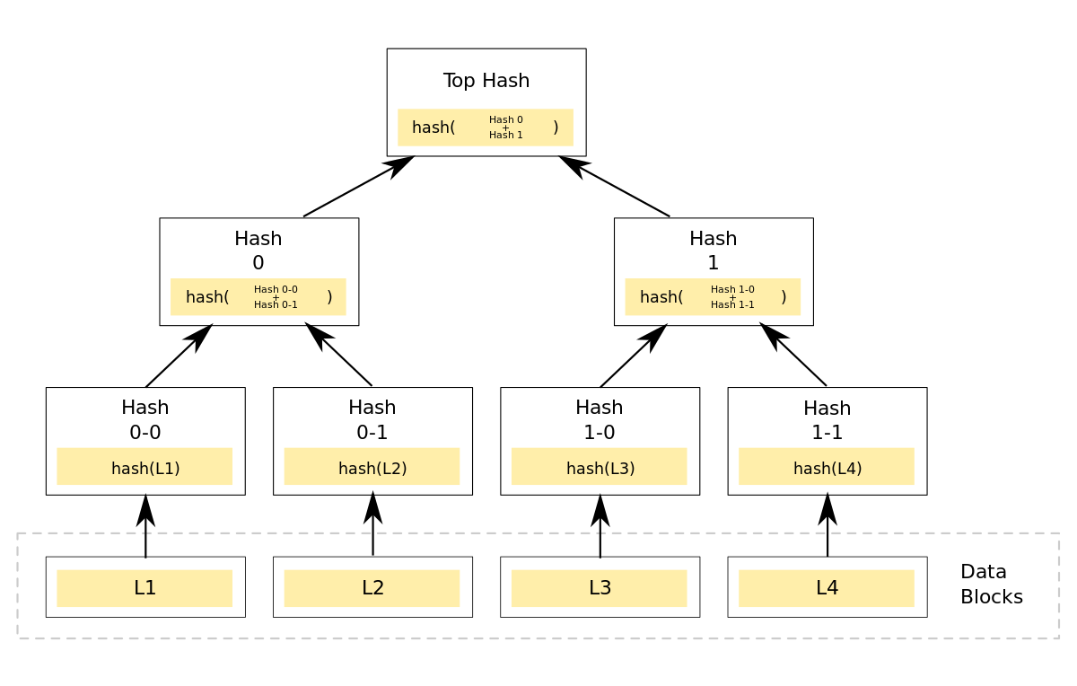
A Merkle tree is a tree type data structure used in which every "leaf" is labelled with the cryptographic hash of a data block, and every node that is not a leaf is labelled with the cryptographic hash of the labels of its child nodes.
What is a Merkle tree?

Slide 6
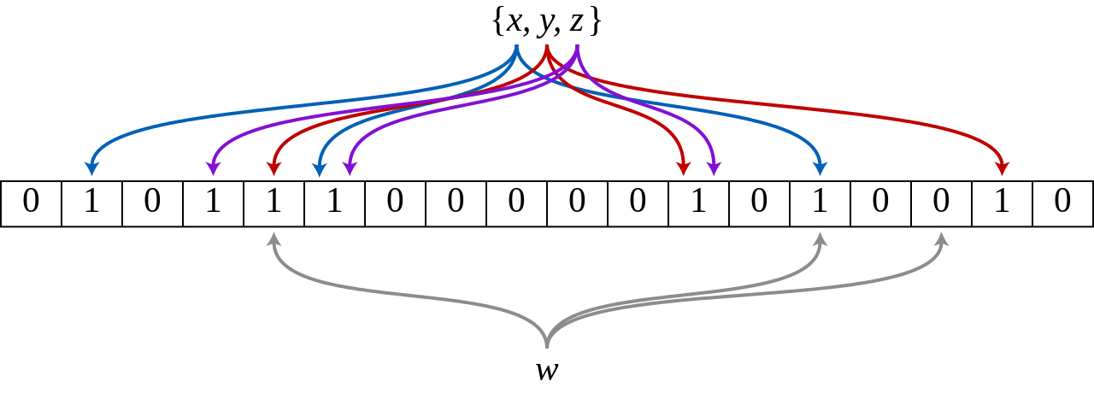
A bloom filter is a probabilistic data structure that is based on hashing. It is extremely space efficient and is typically used to add elements to a set and test if an element is in a set. Though, the elements themselves are not added to a set. Instead, a hash of the elements is added to the set.
What is a Bloom Filter?
It is a probabilistic data structure, i.e,
False positives are possible
but Negatives are guaranteed

Slide 7
Previous Work
In 2022, Pedersen in their experiment, ‘Non-Interactive and Information-Theoretic Secure Verifiable Secret Sharing’ performed an experiment each person can verify that he has received correct information about the secret without talking with other persons using bloom filters, merkle tree and accumulators.
In 2018, Ripon Patgiri and Malaya Dutta Borah wrote, ‘HEX-BLOOM: An Efficient Method for Authenticity and Integrity Verification in Privacy-preserving Computing ’ where they propose to replace the Merkle tree with HEX- BLOOM(hash, Exclusive-OR, and Bloom Filter) in order to reduce unnecessary network traffic for data verification.

Slide 8

Experiment Setup
For this project, we use the programming language rust.
Rust is a multi-paradigm, high-level, general-purpose programming language that emphasizes performance, type safety, and concurrency.
All the hashing performed in the experiment uses SHA-256 encoding.
SHA-256 is a hashing function that generates an almost-unique 256-bit (32-byte) signature for a text.

Slide 9
Experiment
First, we create a block structure to replicate an actual block in the block chain.
The root of the merkle tree in the block is the hash of the block.
In the block we add a bloom filter.
The block also contains:
the hash of the previous block to link the block in block chain.
The nonce to represent the complexity of the block
The timestamp to indicate the time/date the block was created.

Slide 10
Experiment
In this experiment, we have seven hashed transactions.
Next, Each transaction is added to the bloom filter and a merkle tree is constructed bottom-up from the transaction data.
While performing the transaction verification is where our combined data structure is used.
First, the transaction is searched in the bloom filter by hashing it and looking for the bits in bit array.
If found, that means it’s a probabilistic yes, next, it looks up the transaction in the leaves.
If found, next is constructs the tree up and matches the roots to guarantee the transactions were unchanged.

Slide 11
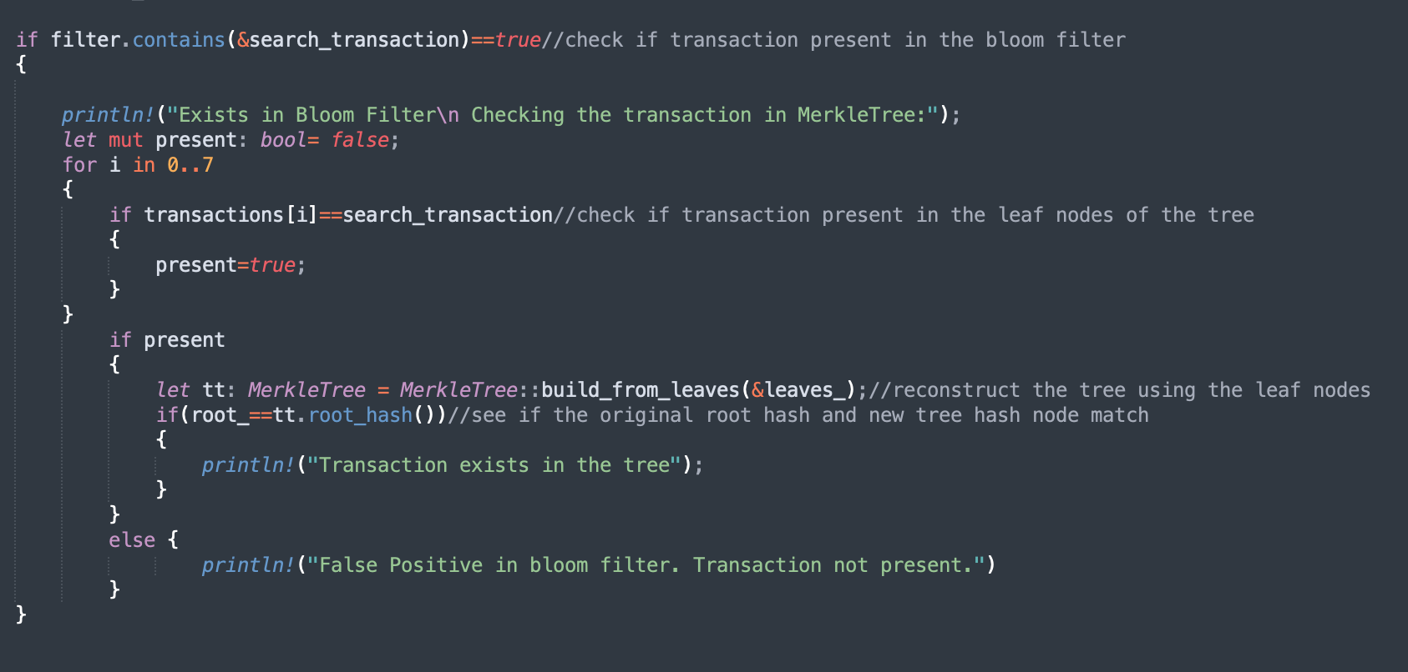
Code for performing transaction data:

Slide 12
Conclusion
The experiment seems to perform as expected with the transaction data.
For the transaction that doesn’t exist the programs stops at the bloom filter check saving CPU time.

Slide 13
Conclusion
In future, we plan to extend the current system:
Perform the experiment using real transaction data in large number.
Implement a chain of blocks with the modified structure.
Record upon the time the system saves by using the bloom filter first.
Experiment with the size of bit array in order to reduce false positive for the bloom filter.

Slide 14
THANK YOU

Slide 15
Links and References:
HEX-BLOOM: An Efficient Method for Authenticity and Integrity Verification in Privacy-preserving Computing at https://eprint.iacr.org/2021/773.pdf
Non-Interactive and Information-Theoretic Secure Verifiable Secret Sharing at https://medium.com/asecuritysite-when-bob-met-alice/bloom-filters-merkle-trees-and-accumulators-27bc2f7baf5a

