Slide 1
Bootstrap

Slide 2
What is Bootstrap
Most popular HTML, CSS and JavaScript framework for developing a responsive and mobile friendly website.
It is absolutely free to download and use.
It includes HTML and CSS based design templates for typography, forms, buttons, tables, navigation, modals, image carousels and many others.

Slide 3
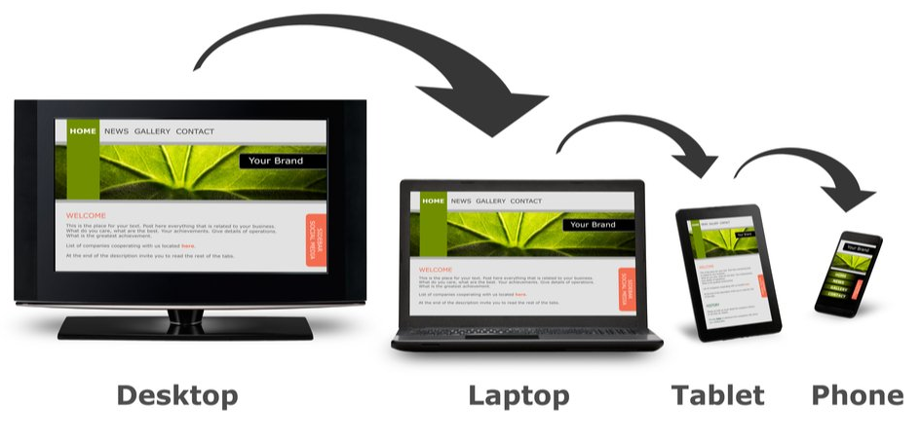
What is Responsive Website
A website is called responsive website which can automatically adjust itself to look good on all devices

Slide 4
Where to Get Bootstrap 5?
There are two ways to start using Bootstrap 5 on your own web site.
You can:
Include Bootstrap 5 from a CDN
Download Bootstrap 5 from getbootstrap.com

Slide 5
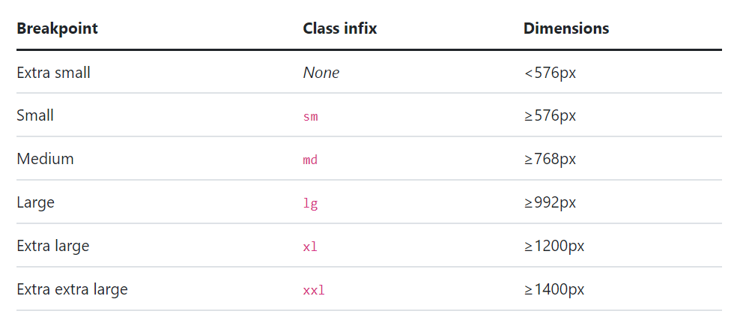
Breakpoints
Breakpoints are customizable widths that determine how your responsive layout behaves across device or viewport sizes in Bootstrap.

Slide 6
Bootstrap 5 Containers
Containers are the most basic layout element in Bootstrap and are required when using our default grid system
Bootstrap comes with three different containers:
.container, which sets a max-width at each responsive breakpoint
.container-{breakpoint}, which is width: 100% until the specified breakpoint
.container-fluid, which is width: 100% at all breakpoints

Slide 7
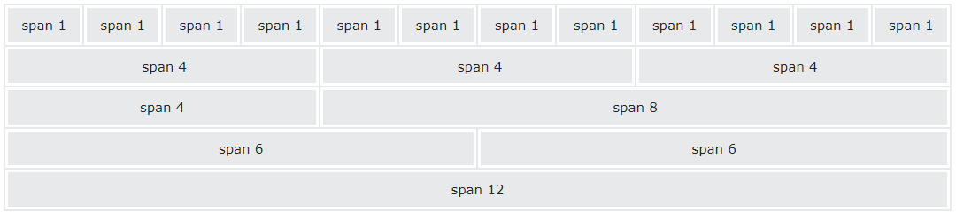
Bootstrap 5 Grid System
Bootstrap's grid system allows up to 12 columns across the page in a row.
Can group the columns together to create wider columns

Slide 8
Grid Classes
.col- (extra small devices - screen width less than 576px)
.col-sm- (small devices - screen width equal to or greater than 576px)
.col-md- (medium devices - screen width equal to or greater than 768px)
.col-lg- (large devices - screen width equal to or greater than 992px)
.col-xl- (xlarge devices - screen width equal to or greater than 1200px)
.col-xxl- (xxlarge devices - screen width equal to or greater than 1400px)

Slide 9
Bootstrap Typography
<h1> - <h6>
.display-1 to .display-6
<small>
<mark>
<abbr>
More

Slide 10
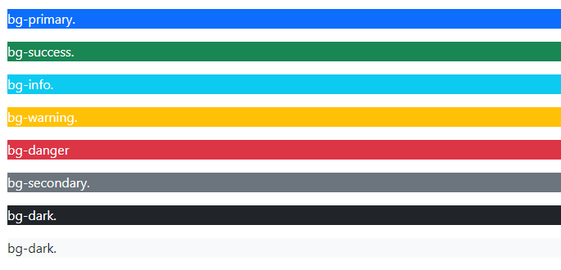
Bootstrap Colors

Slide 11
Bootstrap Table Classes
.table
.table-stripped
.table-bordered
.table-hover
.table-dark
.table-borderless
.table-responsive
example

Slide 12
Bootstrap Navbar
.navbar-brand for your company, product, or project name.
.navbar-nav for a full-height and lightweight navigation (including support for dropdowns).
.navbar-toggler for use with our collapse plugin and other navigation toggling behaviors.
Flex and spacing utilities for any form controls and actions.
.collapse.navbar-collapse for grouping and hiding navbar contents by a parent breakpoint.
Example

Slide 13
Bootstrap Form Classes
Example
form-control
form-text
form-control-lg
form-control-sm
form-control-color
form-select
form-select-lg (& sm)
Bootstrap Icons
Bootstrap cards

Slide 14
Bootstrap Utilities
Bootstrap provides some handful helper classes, for faster mobile-friendly development.
border
rounded
d-inline
d-block
d-flex
justify-content
float
overflow-auto
overflow-hidden
position
shadow
w-25
m1-m5 and p1-p5
mx and my
text-justify
Text-lowercase ( 3 )
font-weight-.......

