Slide 1
MALIGNANT COMMENT PREDICTION
By Avinash Patel

Slide 2

INDEX
Importing Dataset
Cleaning The Dataset
Visualization
Model Selection
Saving The Model

Slide 3
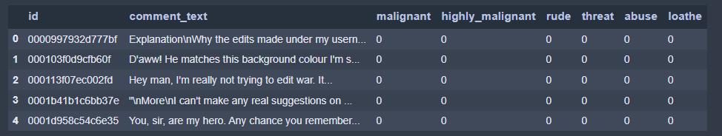
Importing Dataset
First step is to import the csv file into the Jupiter notebook.

Slide 4
After importing we check any of the columns have null values or not and also see some basic information's about all the columns.
Like number of unique variables in each columns.

Slide 5
Cleaning The Dataset
After some information about the dataset we are going to clean the columns individually.
Categorical Column: Two of the columns are categorical columns but we will convert all these columns into numerical columns as the models could not understand the string input so we have to feed the model integer input to work properly.
Columns:
For comment column: First I do the stemming for this columns to do so I used snowball stemmer because it is new and d other stemming quite well for huge data. Then I calculated the length of the comment for each row so that we could have a n idea that up to how much data we have cleaned so far. Then I moved on with the removal of punctuations , white spaces, special characters ,capital letters etc. After doing all these steps I calculated the length of comment for each row and find out that only 83% data is left , which means I have successfully cleaned 17% of data which is junk..

Slide 6
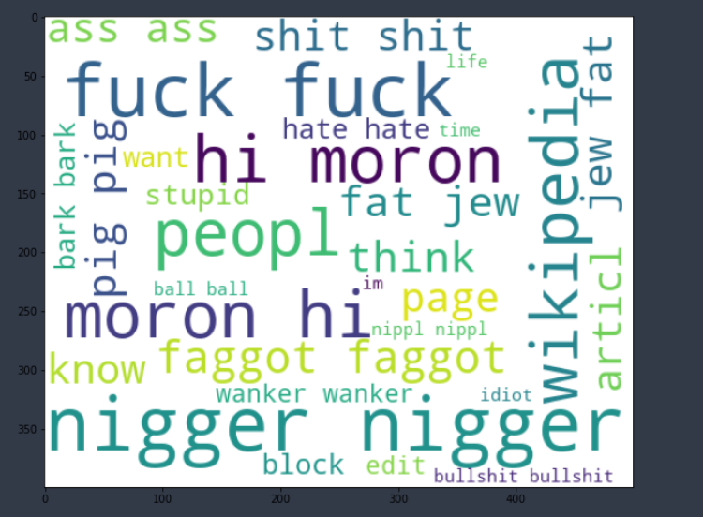
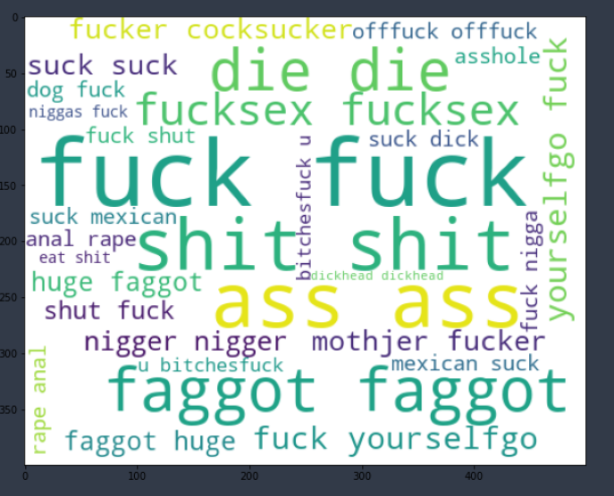
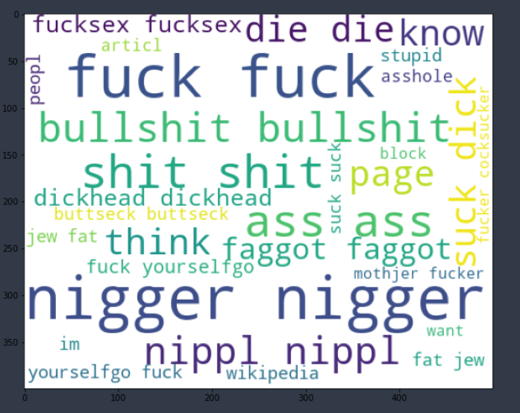
Visualization
WordColud:

Slide 7
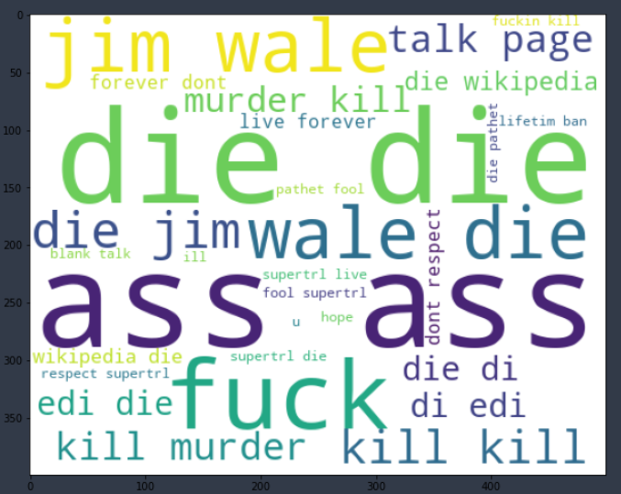
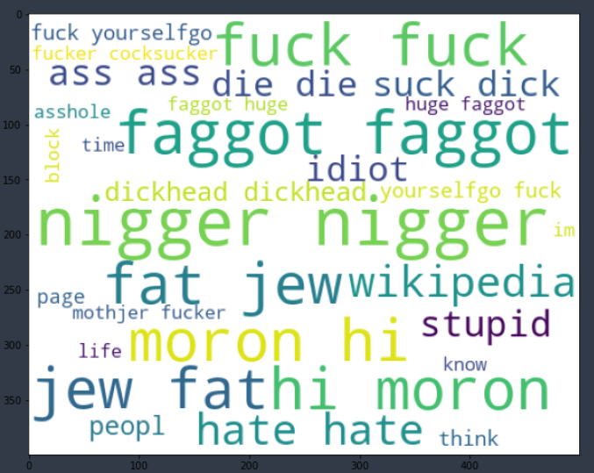
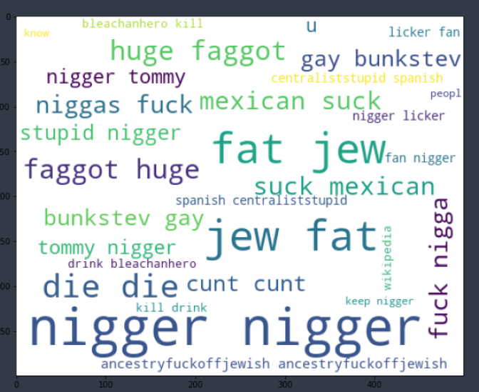

Slide 8
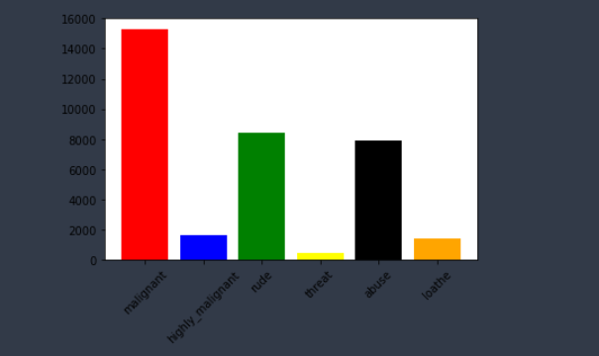
Bargraph:

Slide 9
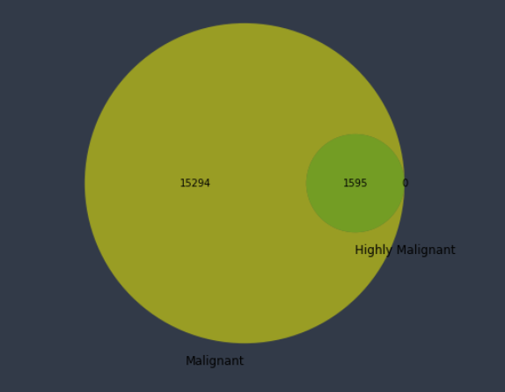
Pie Chart:

Slide 10
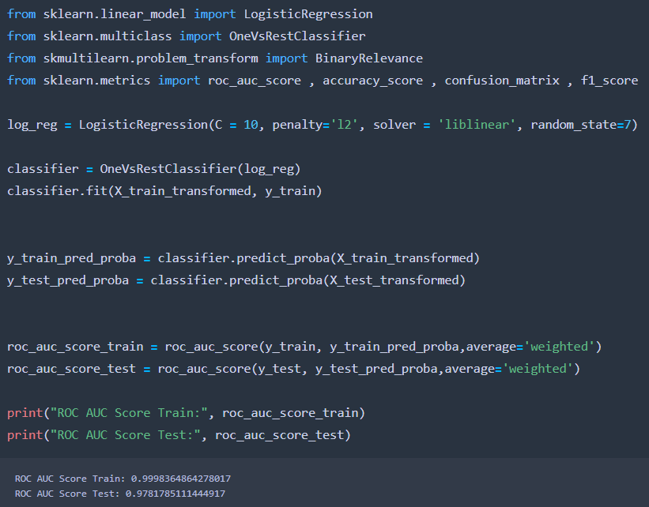
Model Selection
Now we will see some accuracy so that we can select the best fit model for our project.

Slide 11
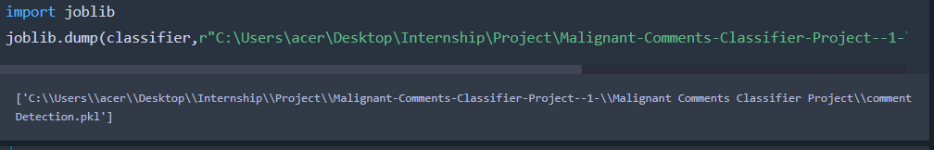
Saving The Model
The final job is to save the model which is done by Joblib library.

Slide 12
THANK YOU!!!

