Slide 1
FLIGHT PRICE PREDICTION
By Avinash Patel

Slide 2

INDEX
Importing Dataset
Cleaning The Dataset
Visualization
Skewness and Outlier Removal
Model Selection
Hyperparameter Tuning
Saving The Model

Slide 3
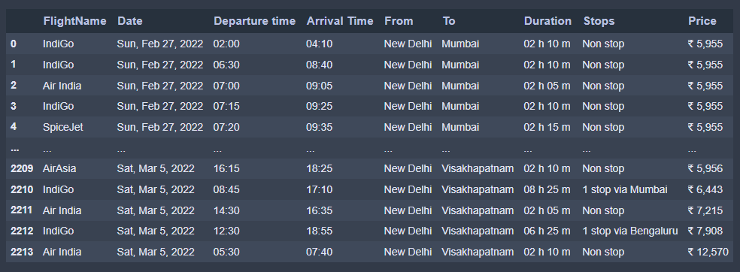
Importing Dataset
First step is to import the csv file into the Jupiter notebook.

Slide 4
After importing we check any of the columns have null values or not and also see some basic information's about all the columns.
Like number of unique variables in each columns.

Slide 5
Cleaning The Dataset
After some information about the dataset we are going to clean the columns individually.
Categorical Column: First of all I checked that how many of the column are categorical columns and how many of them are numerical columns. By doing so I find out that all the columns are categorical as all the columns contain some character which makes them categorical.
Columns:
For Treating Date column:This column has date which is separated by commas so I am going to separate this column into three separate columns named day, month and Dates.

Slide 6
For Stops column: This column has stops denoted as numbers of stops and for zero stops its denoted as no stops. So, I converted all the stops to there corresponding numbers and for no stops I put 0 as a value.
Treating Departure time and Arrival Time column: As these are constituted of timing for 24-hour clock. So, I converted these time spans to morning, night, afternoon and evening. I separated from hour 0 to 6 as night,6 to 12 morning,12-18 afternoon,18-24 evening.

Slide 7
Treating Price column:This column is good but with a single problem that is it contains a rupee symbol Infront of each and every amount so I removed all the rupee symbol and replaced with only the amount.

Slide 8
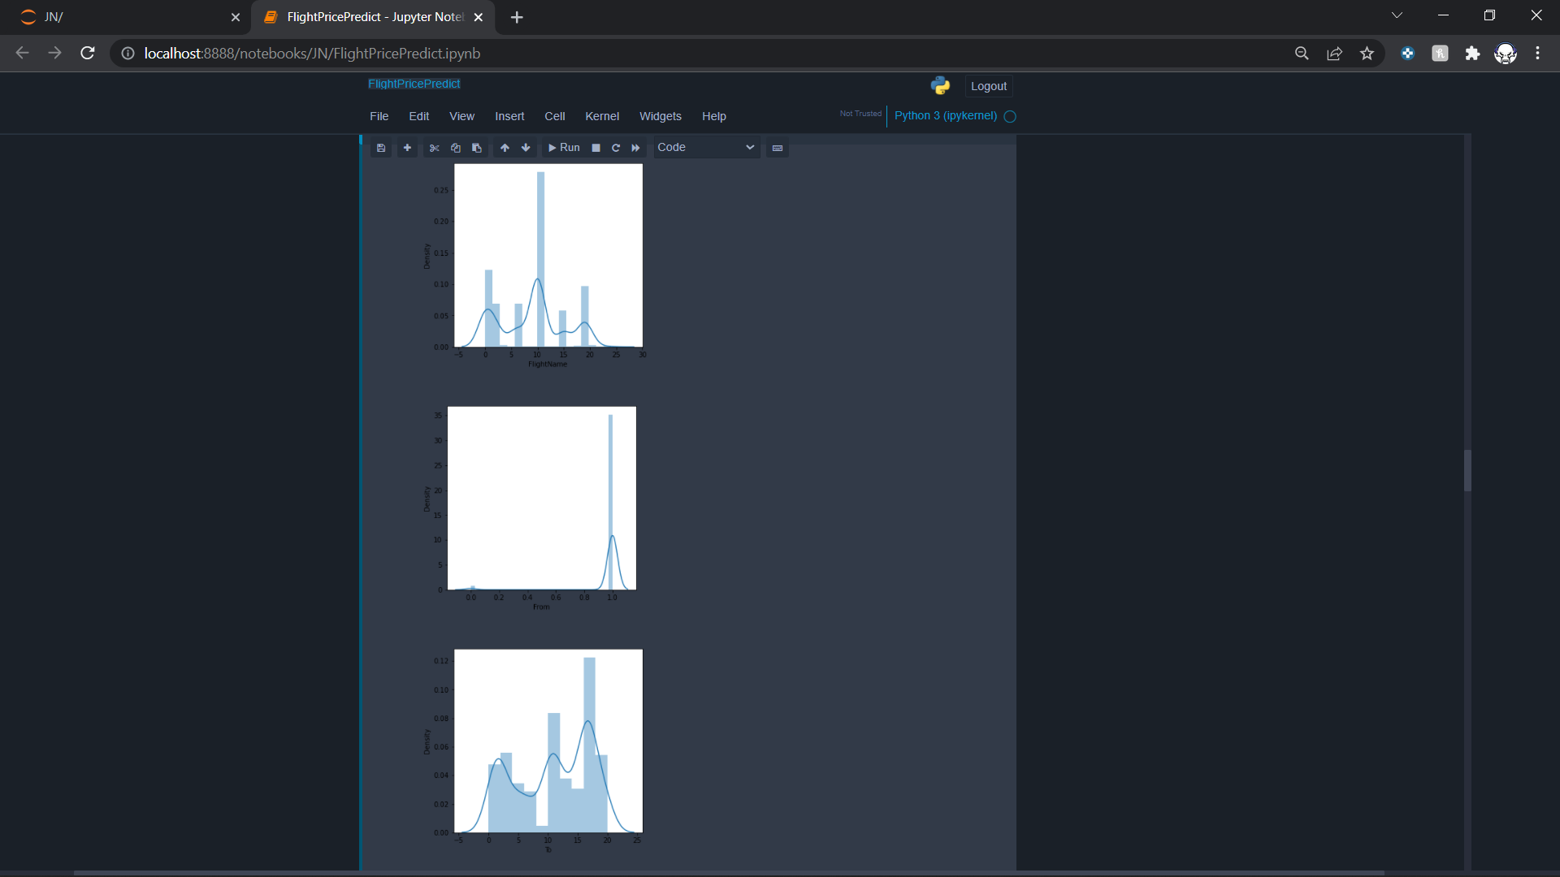
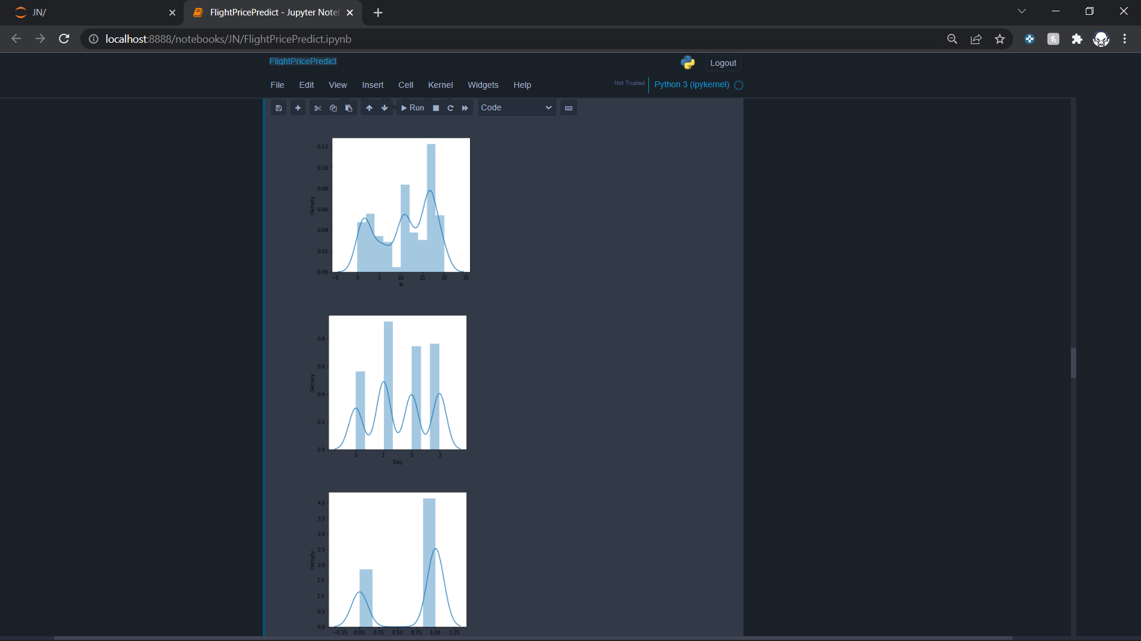
Visualization
Distplot:

Slide 9
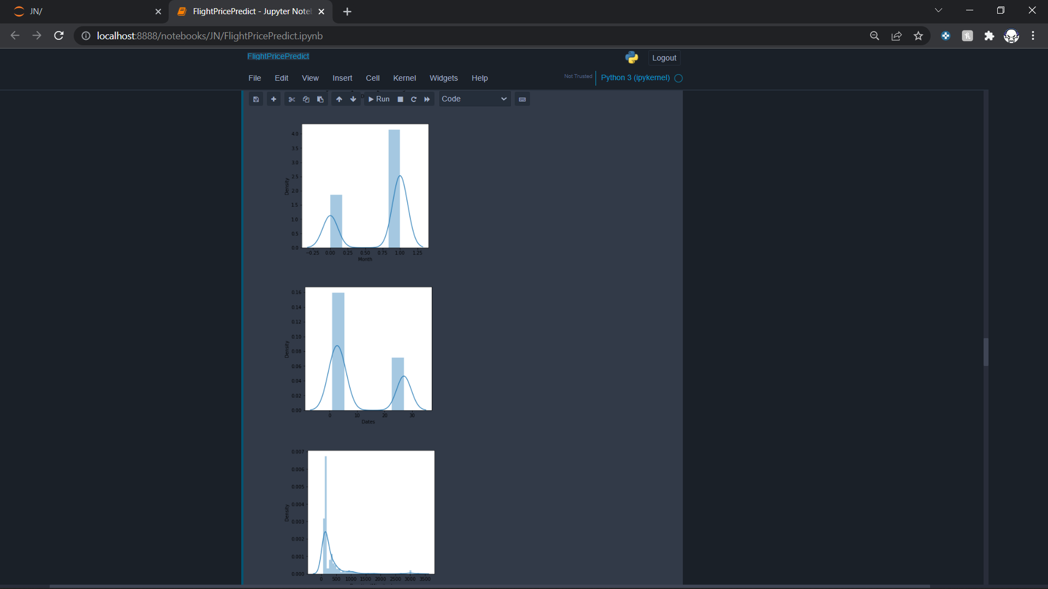
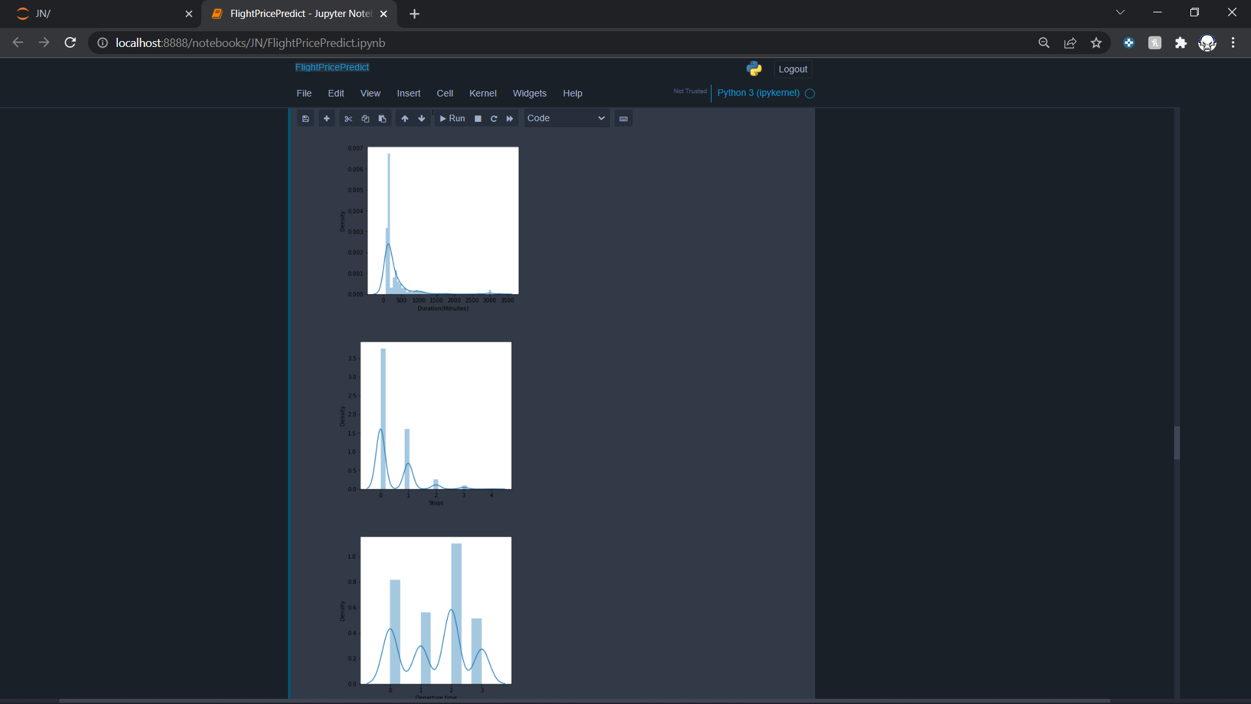

Slide 10
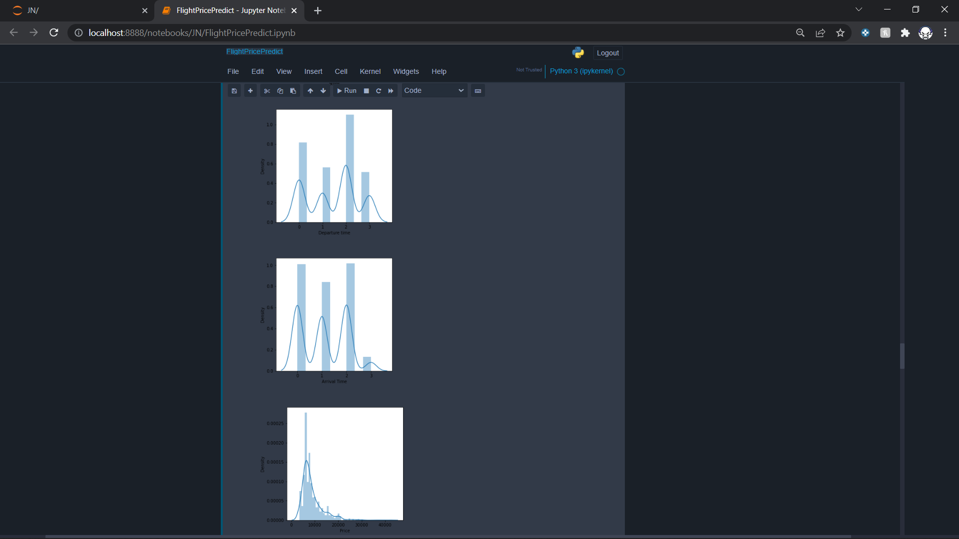
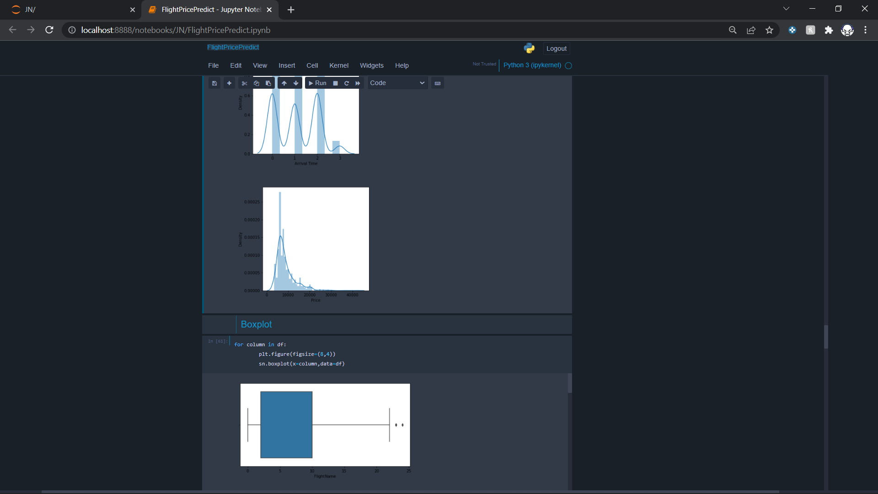

Slide 11
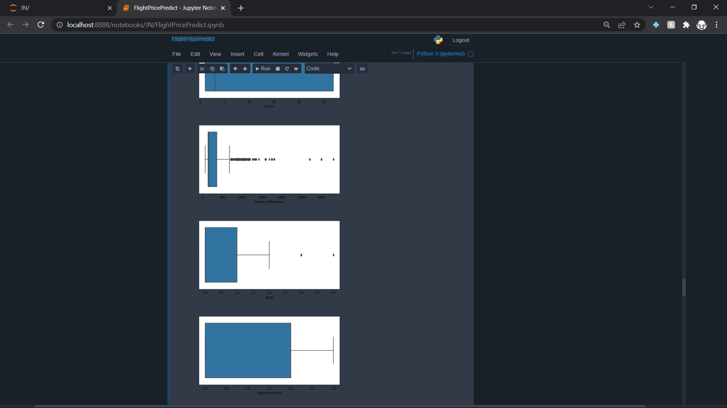
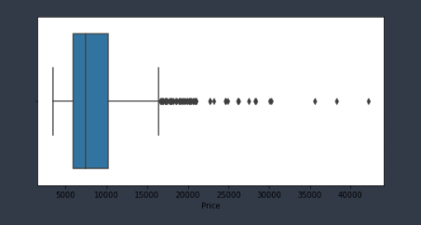
Boxplot

Slide 12
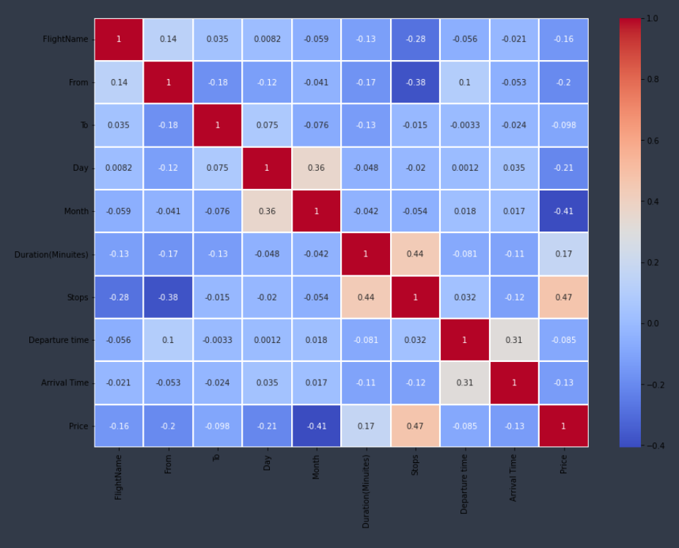
Heatmap

Slide 13
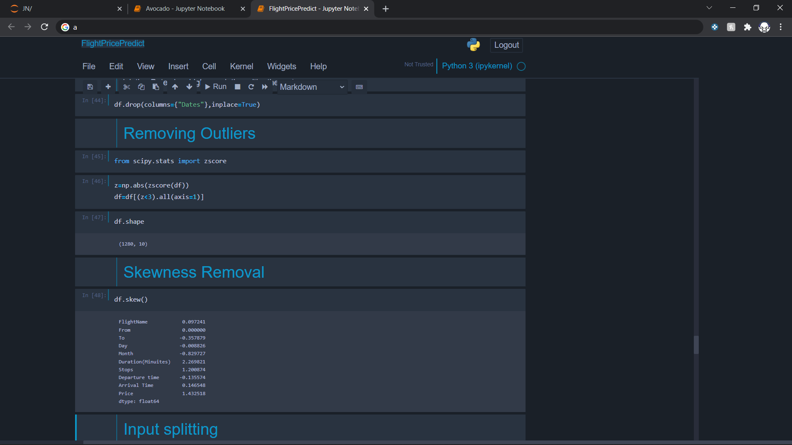
Skewness and Outlier Removal
Now we try to remove some outliers with z-score and then we remove some skewness from some columns.

Slide 14
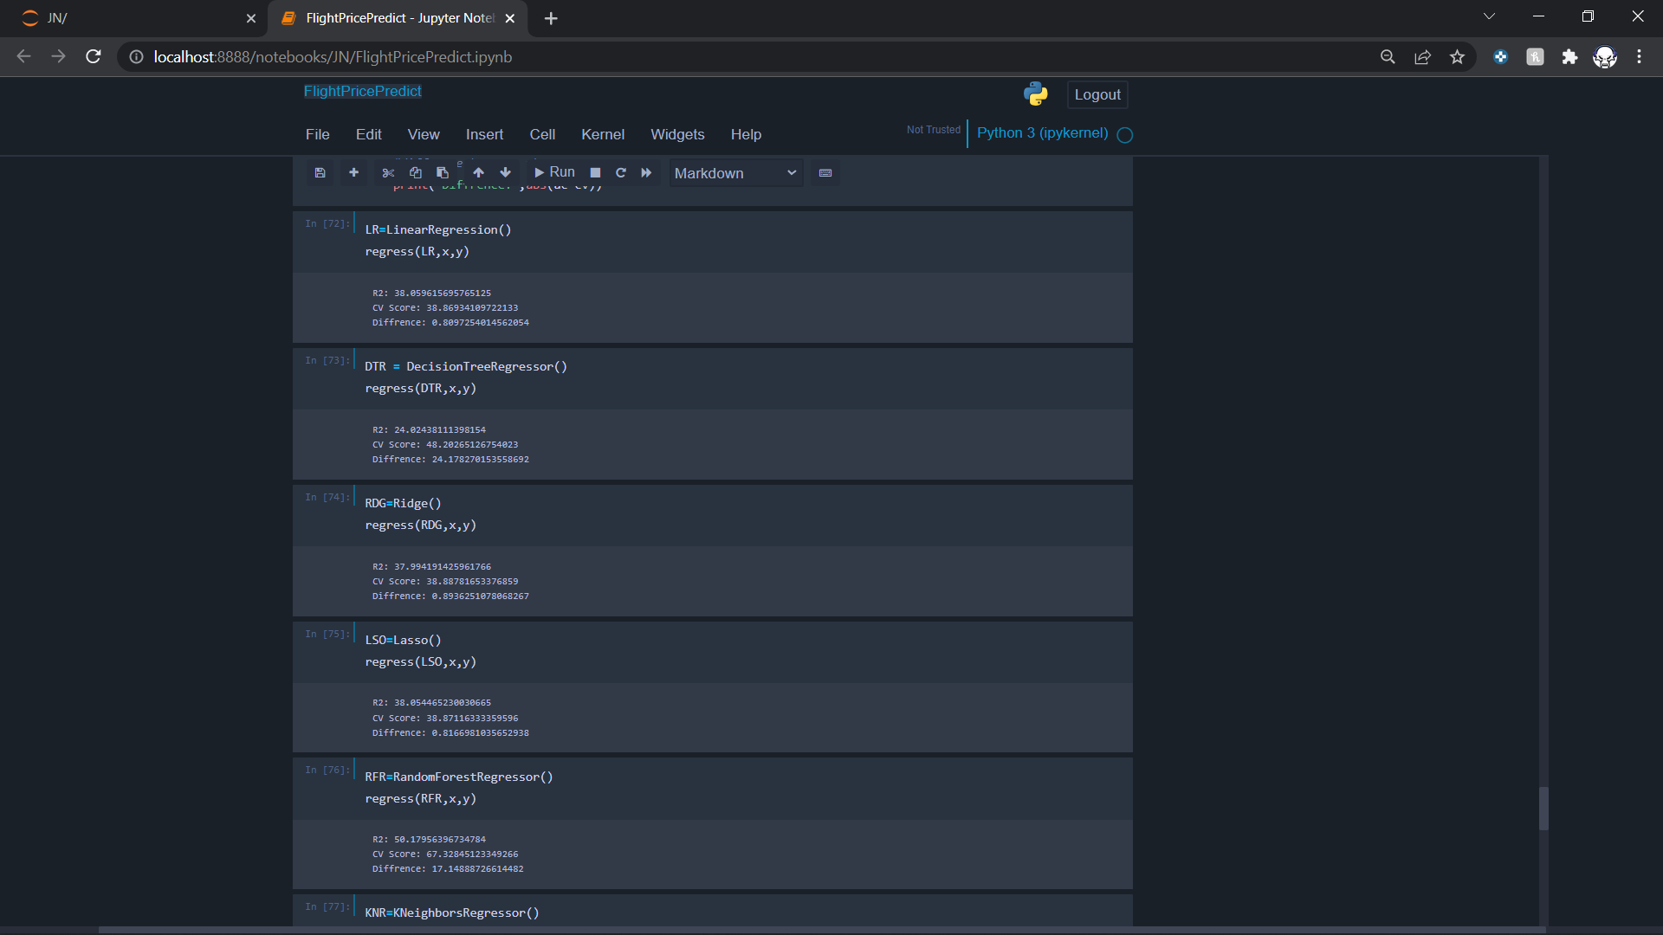
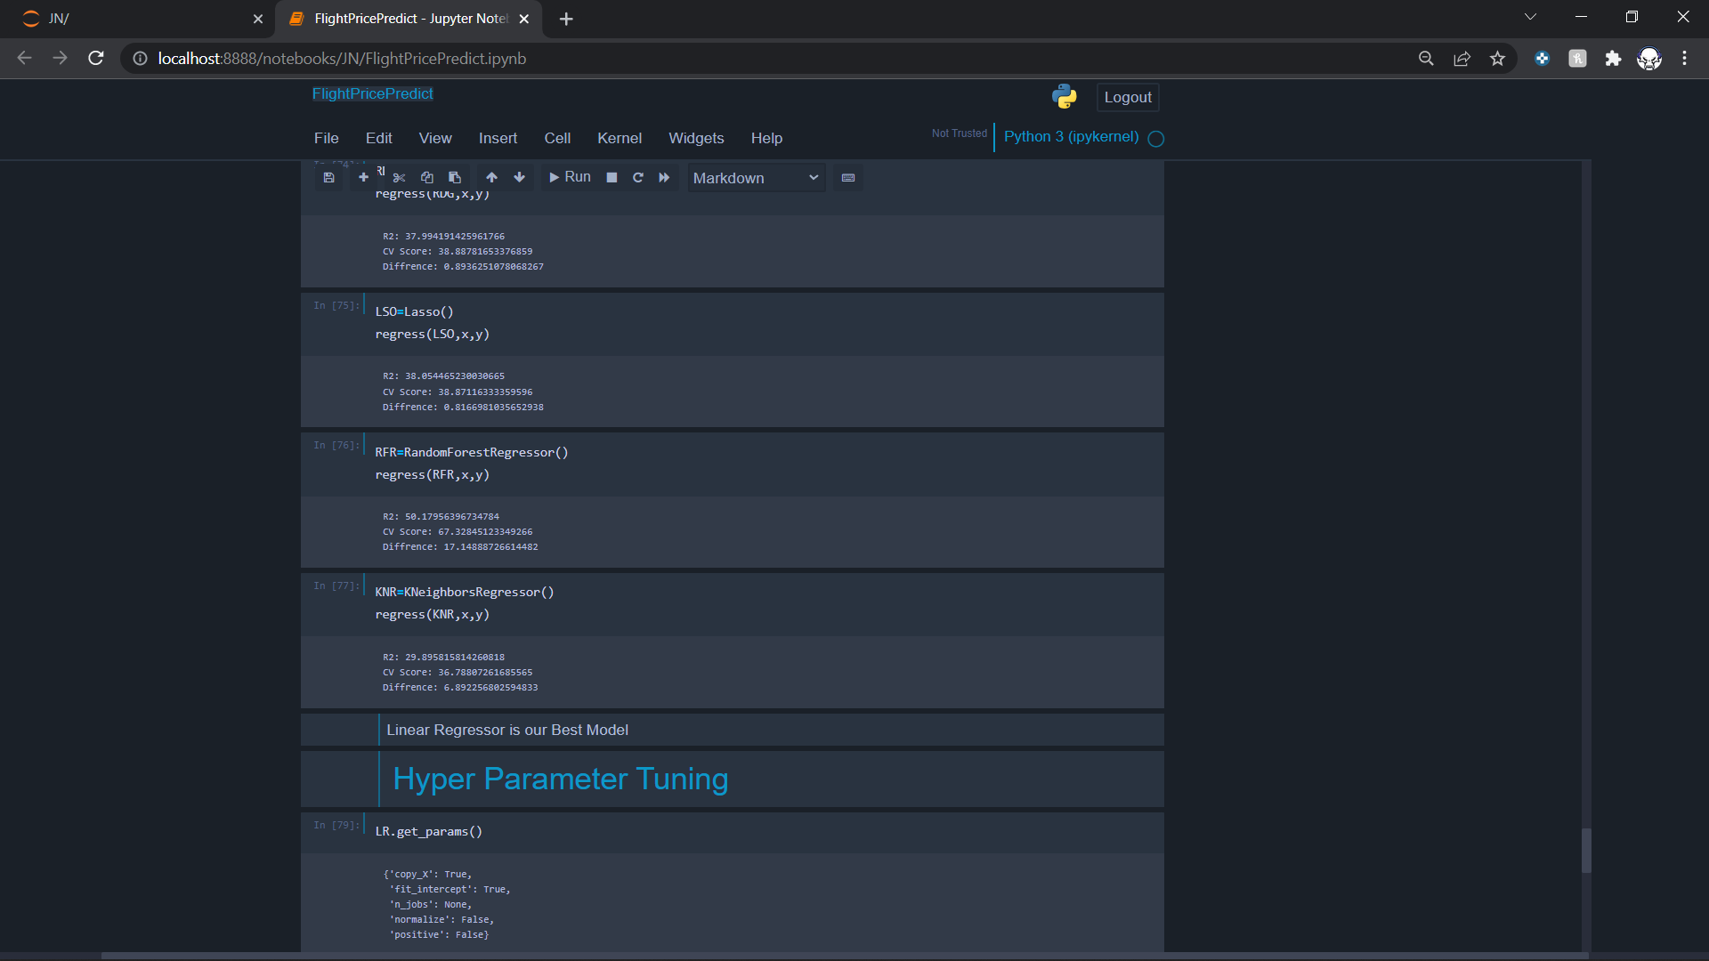
Model Selection
Now we will see some accuracy and cross validation scores of different model so that we can select the best fit model for our project.
Hence Linear Regressor has the lowest difference between accuracy and cross validation score.

Slide 15
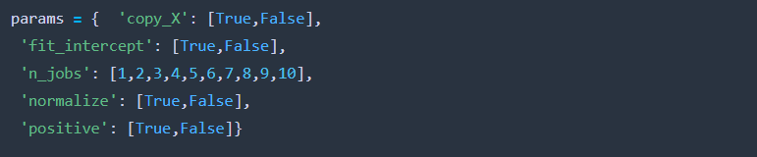
Hyperparameter Tuning
Now as we selected Linear Regressor as our model. Now we are going to tune its parameters to make the model a little better.
Parameters are:

Slide 16
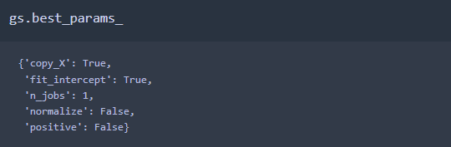
After doing the tuning we find out the following.
The Above parameters are the best parameter for this type of dataset for our model. So finally we fitted the data with these parameters.

Slide 17
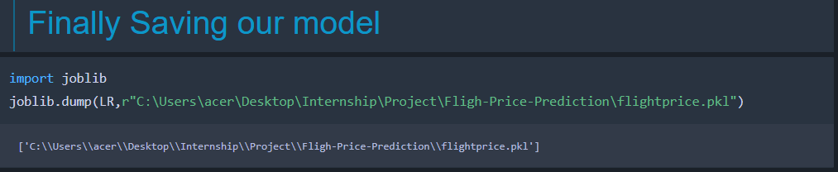
Saving The Model
The final job is to save the model which is done by Joblib library.

Slide 18
THANK YOU!!!

