Slide 1

Slide 1
Customer Retention Data Analysis
Power Point Presentation
By Avinash Patel

Slide 2
Slide 2
Problem Statement:
Customer satisfaction has emerged as one of the most important factors that guarantee the success of the online store. A comprehensive review of the literature, theories, and models have been carried out to propose the models for customer activation and customer retention. Five major factors that contributed to the success of an e-commerce store have been identified as service quality, system quality, information quality, trust, and net benefit. So, I have given a dataset of several rows and columns upon which I need to perform data analysis.
2

Slide 3
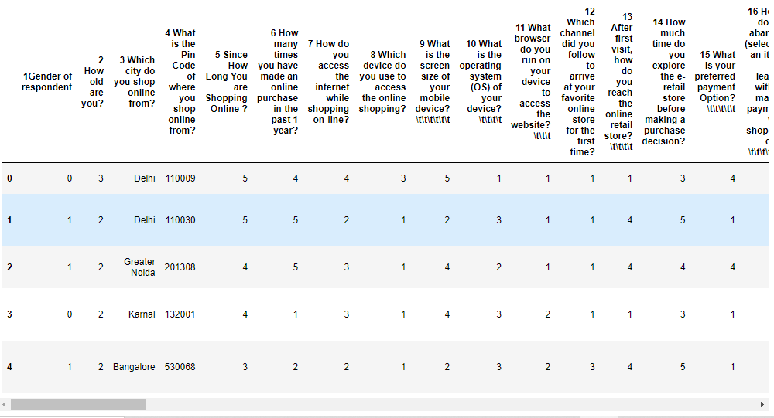
Dataset:
This dataset contains several columns few of them are shown here
3

Slide 4
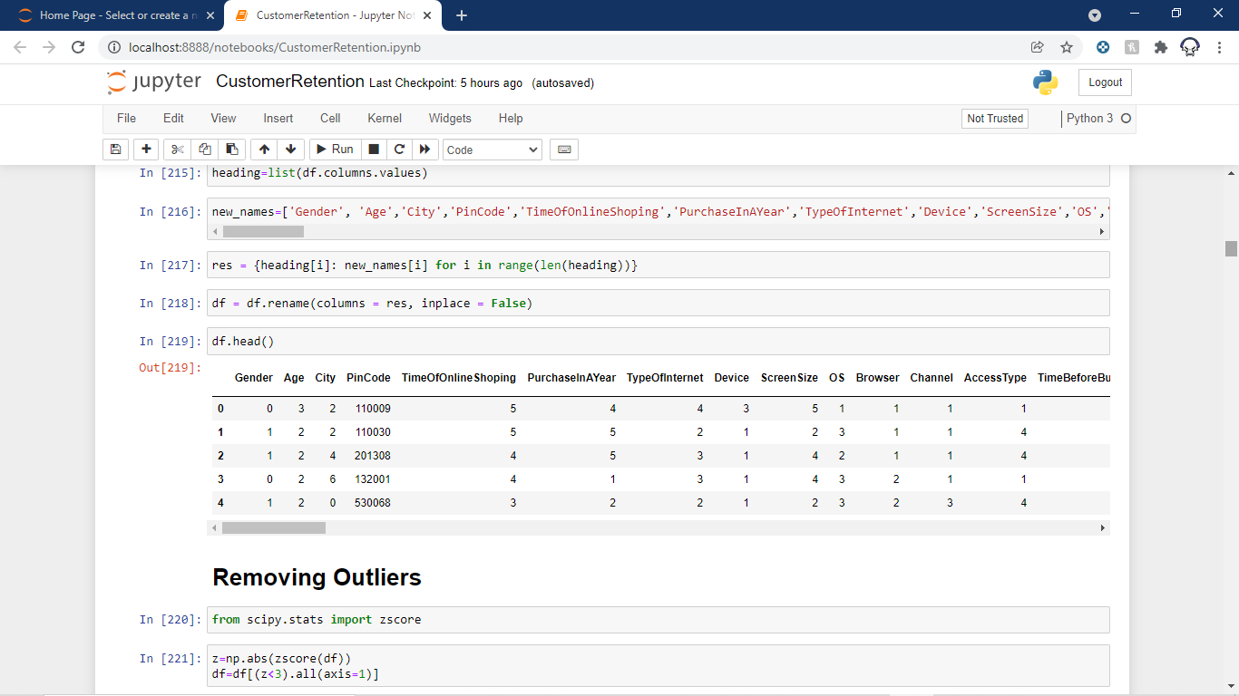
Problem With Column Names:
So as you can see all the columns have too large names. So our first order of business would be to reduce these column names to something more readable. So we perform some coding and changed all the column names.
The Changed names are:

Slide 5
Data frame Separation:
As the data frame is too large so I divided it into three categories to understand them a little better:
1 : Personal Dataset
2 : Agree or disagree Dataset
3 : Which Shopping Website Dataset

Slide 6
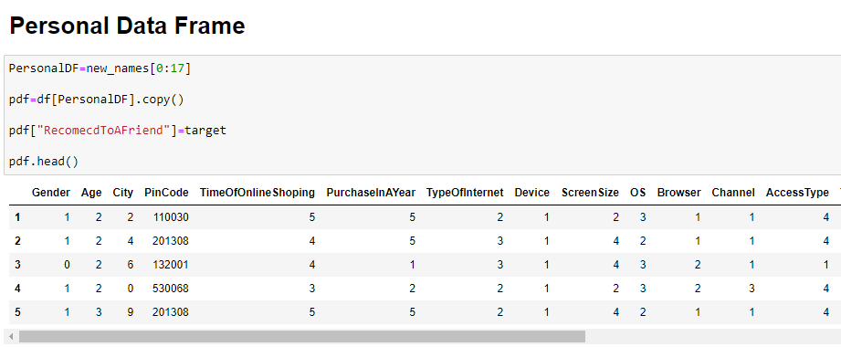
Personal Dataset:
This Dataset Contains Column’s from first to 17th column

Slide 7
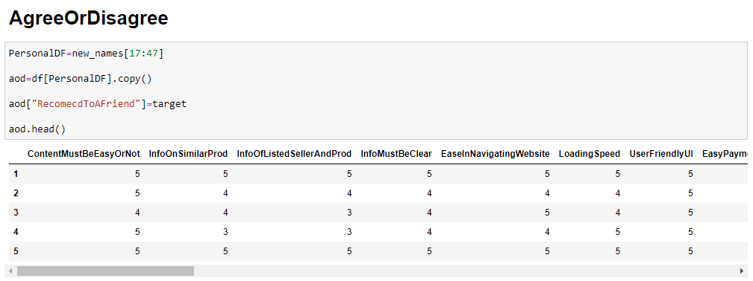
Agree or Disagree Dataset:
This Dataset Contains Column’s from 17th to 47th column

Slide 8
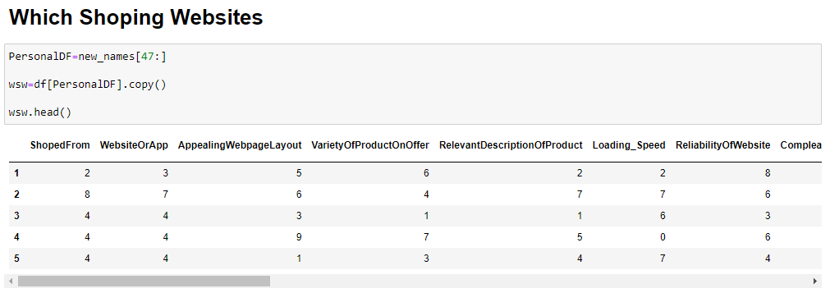
Which Website Dataset:
This Dataset Contains Column’s from 47th to last column

Slide 9
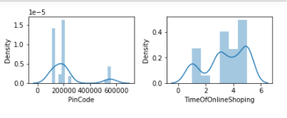
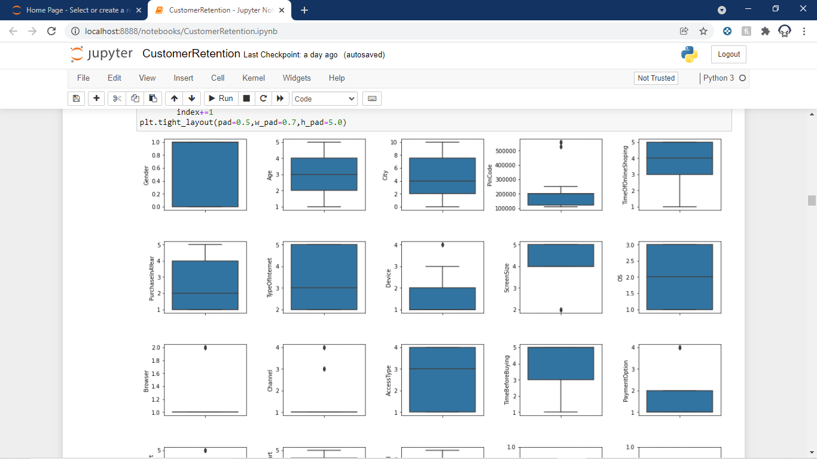
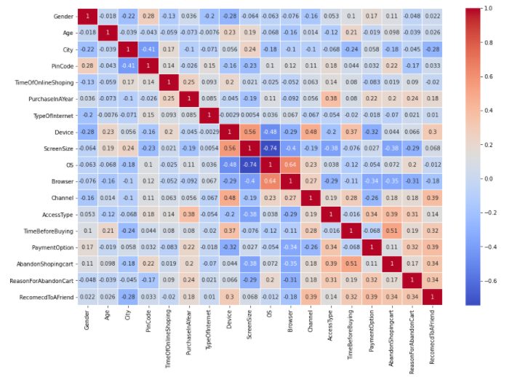
Analysing Dataframe:
Personal Dataset:
Step 1: Univariant Analysis
Plotting Boxplot And Distplot to analyze the outliers and the skewness.
Step 2: Bivariant Analysis
Finding The correlation and plotting a Heatmap the see the correlation between our target variable “Recommend to a friend” and other columns.
Step 3: Plotting Heatmap
Plotting Heatmap with the correlation.

Slide 10
Personal Dataset:
Step 4: Removing Columns
We will remove those columns which have a correlation with our target variable near zero.
Step 5: Removing Skewness
Removed Skewness from all columns which have a skew value of more than .5.
Step 6: Saving The data frame
Finally, we will save our dataset.

Slide 11
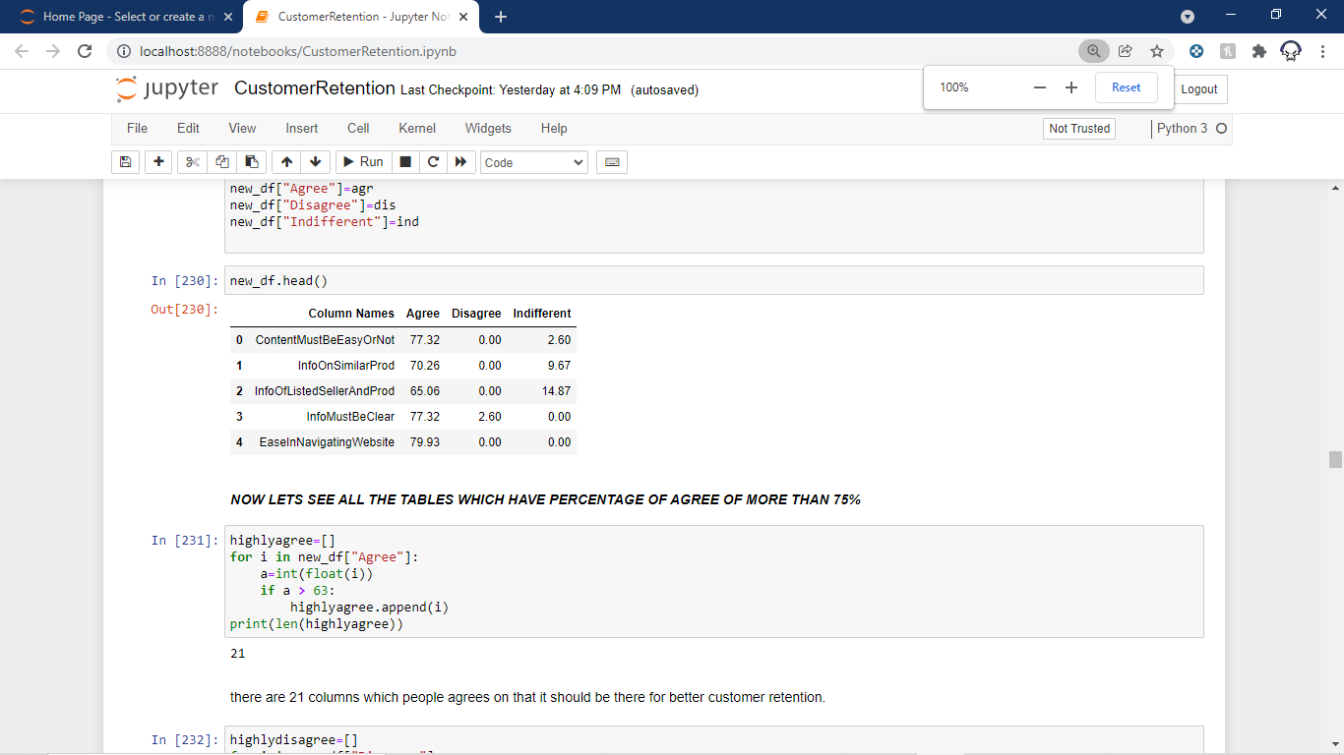
Agree or Disagree Dataset:
Step 1: Calculating Percentages of agree, disagree and Indifferent
We will write a program that takes all the data from each column and calculate how many agree, disagree or indifferent are there. On this basis, we will calculate the percentages of each and save them into a list.
Step 2: Making A Dataset for This
Now we will make a new dataset that contains four columns
1:All the column names
2:How much percentage of agree
3: How much percentage of disagree
4: How much percentage of Indifferent
Step 3: Taking the most agreed column
Now we will save only those columns on which people most agreed upon.

Slide 12
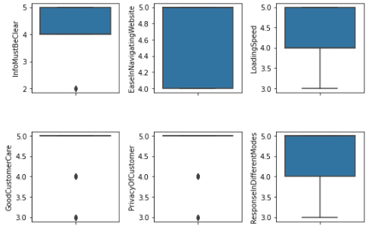
Agree or Disagree Dataset:
Step 4: Univariant Analysis
Plotting Boxplot And Distplot to analyze the outliers and the skewness.
Step 5: Removing Skewness
Removed Skewness from all columns which have a skew value of more than .5.
Step 6: Saving The data frame
Finally, we will save our dataset.

Slide 13
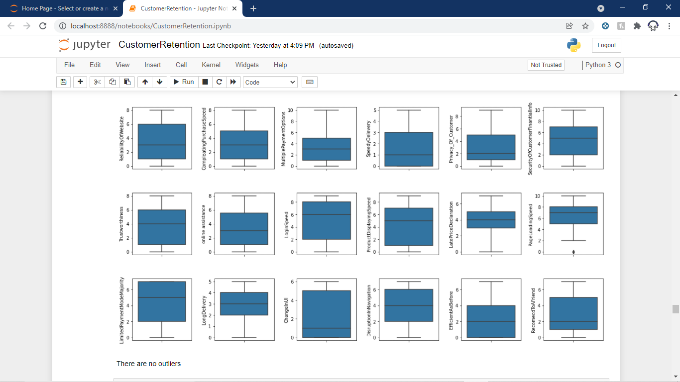
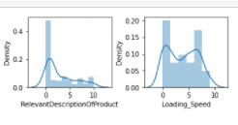
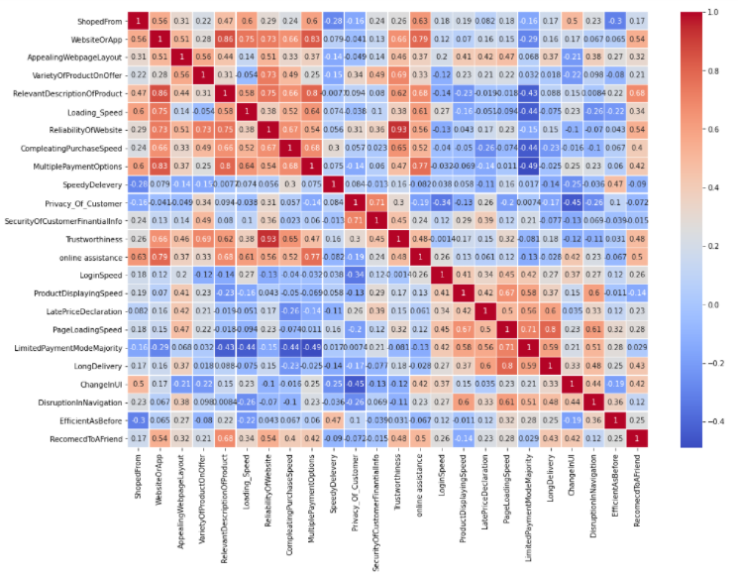
Which Website Dataset:
Step 1: Univariant Analysis
Plotting Boxplot And Distplot to analyze the outliers and the skewness.
Step 2: Bivariant Analysis
Finding The correlation and plotting a Heatmap the see the correlation between our target variable “Recommend to a friend” and other columns.
Step 3: Plotting Heatmap
Plotting Heatmap with the correlation.

Slide 14
Which Website Dataset:
Step 4: Removing Columns
We will remove those columns which have a correlation with our target variable near zero.
Step 5: Removing Skewness
Removed Skewness from all columns which have a skew value of more than .5.
Step 6: Saving The data frame
Finally, we will save our dataset.

Slide 15
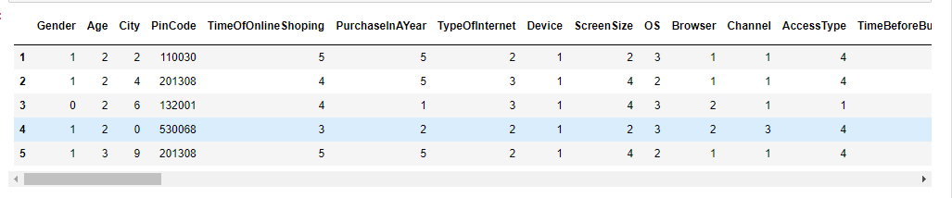
Merging all the separate dataset:
Now we will join all the three separate datasets to a single dataset to become one dataset that is free from most outliers and skewness

Slide 16
Thank You!!!

