Slide 1
IMAGE CLASSIFICATOIN
By Avinash Patel

Slide 2

INDEX
Importing Library
Organizing and Preprocessing
Importing the Model
Customizing the Model
Training the Model
Predicting the Test set
Saving the Model

Slide 3
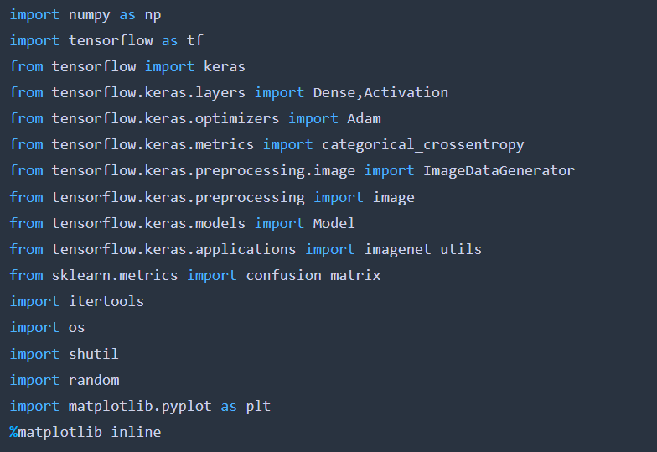
Importing Library
First step is to import all the necessary library into the Jupiter notebook.

Slide 4
Organizing and Preprocessing
First, I organized all the images into train, test and validation folders and the test and validation folder contains 20 and 16 images respectively and the rest of the images goes to the train folder.
After segregating all the data into these three folders I started with the initial pre-processing of the images because the mobile net model only takes inputs in a certain format.
Now I see the model for its layers and after some experimentation I concluded that only the last layer is required to remove and the I replaced the last layer with the 3-output layer which is required to predict out three classes saree, trouser and jeans.
After that I freeze all the layers up to 23 layers as we cannot spend so much resources to train lacks of datapoints so we are using a technique called transfer learning to reduce our work load as the previous layers have already been trained.
The finally I trained our data on our training set and passed validation data for validation score and then as we reached our 30 epoch the validation score is very close to our accuracy score that means the model is performing well and finally, I tested the model on our testing data and saved model as .h5 format which hierarchal format data.

Slide 5
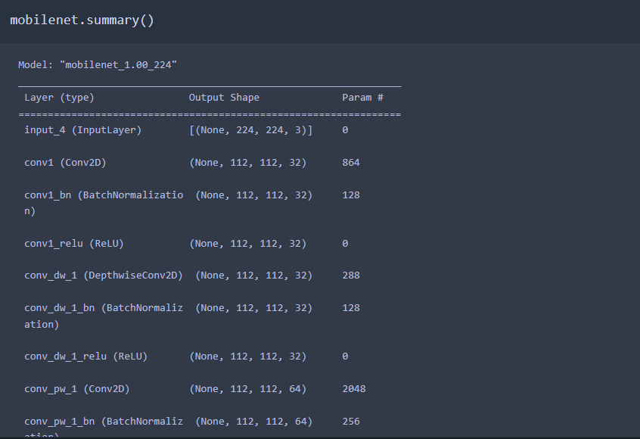
Importing the Model
Importing the Mobile net model

Slide 6
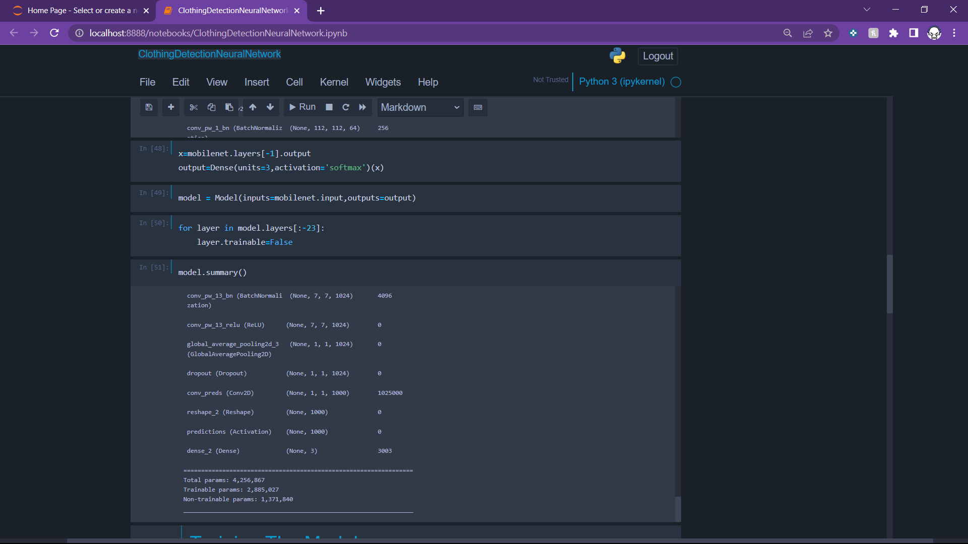
Customizing the Model
By a series of trial and error I freeze all the layers up to 23 layers as we cannot spend so much resources to train lacks of datapoints so we are using a technique called transfer learning to reduce our work load as the previous layers have already been trained.

Slide 7
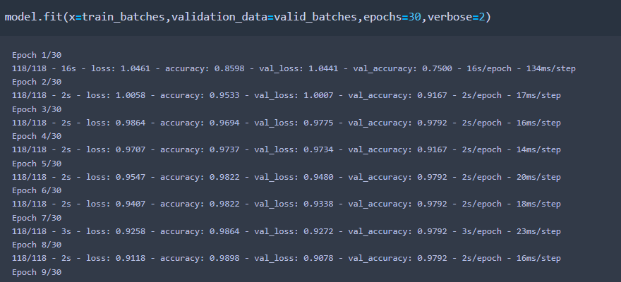
Training the Model
I have done 30 epochs to get an accuracy of 99 percent.

Slide 8
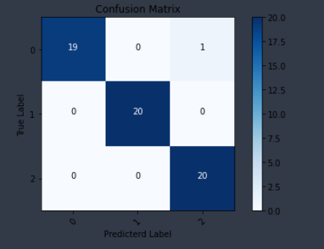
Predicting the Test set
Confusion Matrix
As you can see only one error is made by the model and the rest of the predictions are correct.

Slide 9
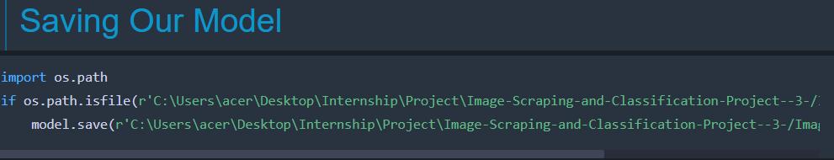
Saving the Model
Finally I saved my model into a h5 format that is a well known hierarchal format to store CNN models.

Slide 10
THANK YOU!!!

