Slide 1
GAN Prior Embedded Network (GPEN) for Blind Face Restoration in the Wild

Slide 2
Abstract
The Blind face restoration (BFR) from badly degraded face photos in the wild is a difficult one. Directly training a deep neural network (DNN) cannot frequently produce satisfactory results due to the high severity of the problem and the complicated unknown degradation. Existing methods generates over-smoothed restorations.
We propose a new technique for generating high-quality face images by first learning a GAN for high-quality face image production and embedding it into a U-shaped DNN as a prior decoder, and then fine-tuning the GAN prior embedded DNN with a set of synthesized low-quality face images.

Slide 3
Traditional Methods
Traditional methods demonstrate limited performance in practice
The following are some proposals in the recent years:
Blind image restoration and recognition method based on the sparse representation(2011).
Preprocessing scheme with low computational complexity (2011)
Algorithms to learn a prior on the spatial distribution of the image gradient for frontal images of faces (2000)
Deriving prior info from training set and computing a statistical model of each point-spread-function (PSF) cluster in the feature space (2009)

Slide 4
Existing Methods
Recent DNNs have shown superior results in variety of CV tasks, which includes Feed forward CNNs , conditional GAN and content loss.
The following are some methods which are in use:
Pix2PixHD (NVIDIA)
CGAN
Super-FAN
GFRNet
HiFaceGAN
The problem is that they don’t always produce best results and these methods generates over-smoothed restorations.

Slide 5
Proposed Method - GPEN
Learning a GAN for high quality face image generation
Embedding into U-shaped DNN as prior decoder
Fine-tuning the GNN prior embedded DNN with a set of synthesized low quality face images
This is easy to implement and can generate visually photo-realistic results.

Slide 6
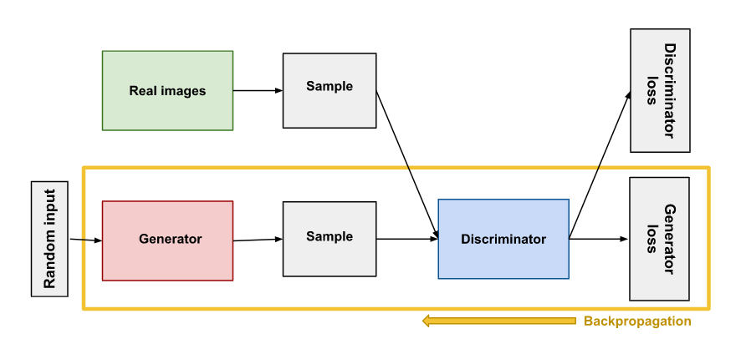
GAN

Slide 7
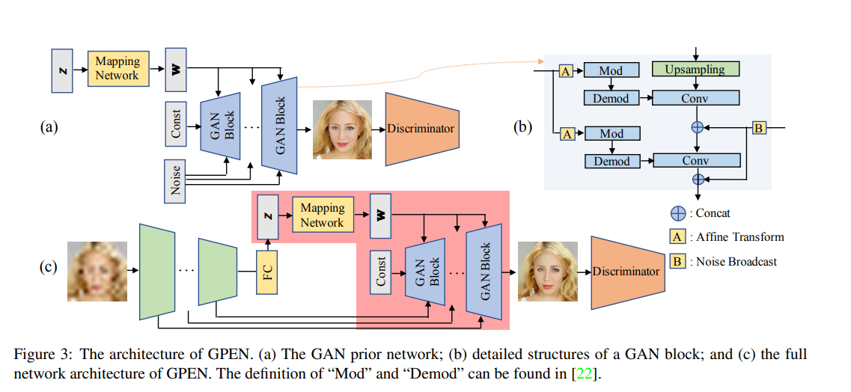
Architecture of GPEN

Slide 8
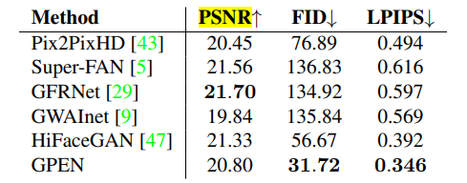
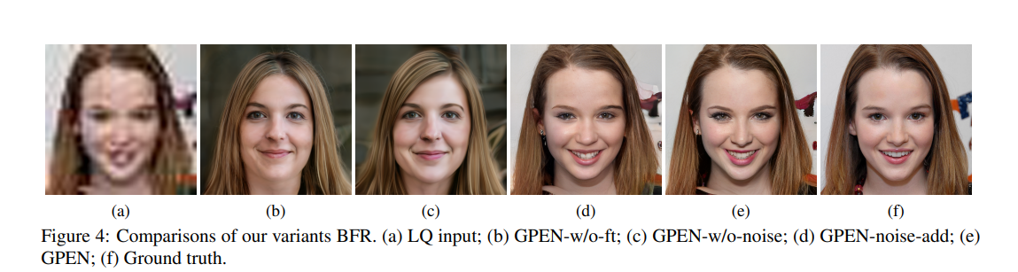
Results
The following metrics are used for comparisions: Peak signal-to-noise ratio(PSNR), FID and Learned Perceptual Image Patch Similarity (LPIPS)
GPEN tries to generate clear face images with realistic textures and details

Slide 9
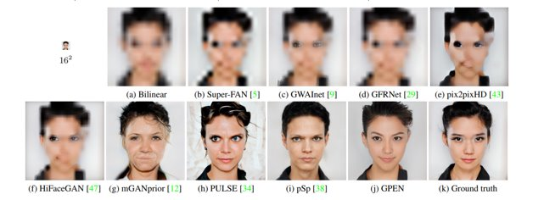
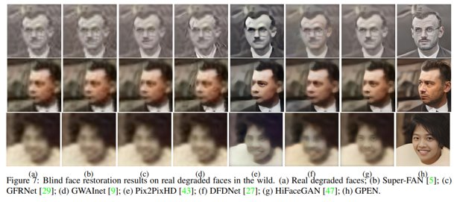

Slide 10
Conclusion
Fine-tuning the whole network with artificially degraded face images, our model learned to generate high quality face images from severely degraded ones.
Our extensive experiments on synthetic data and real-world images demonstrated that GPEN outperforms the latest state-of-the-art
The proposed method can also be applied to other tasks such as face inpainting and face colorization

Slide 11
Thank You

