Slide 1
Deep Q Network (DQN)
Avinash Ronanki (11012520)

Slide 2
Types of Machine Learning
Machine Learning
Supervised
Learning
Unsupervised
Learning
Reinforcement Learning
Task Driven
Data Driven
Learn from mistakes

Slide 3
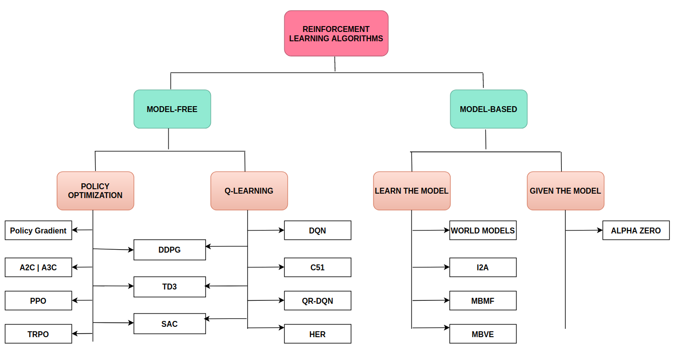
Algorithms
Figure [1]

Slide 4
Figure [1]

Slide 5
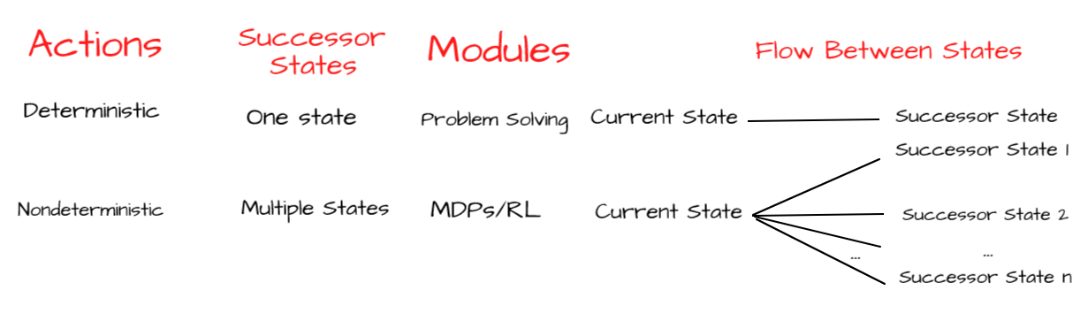
Markov Decision Process (MDP)
Deterministic
Nondeterministic
Markov Decision Process (MDPs) plays a vital role in nondeterministic search problems ,it deals with multiple successor states in an efficient way and it is mainly considered as offline planning and agents has full knowledge of the transitions and reward
Conditions Needs to be satisfied:
Discrete time process
MemoryLess
Figure [2]

Slide 6
What is Reinforcement Learning
•Learning from interaction with an environment to achieve some long-term goal that is related to the state of the environment
•The goal is defined by reward signal, which must be maximised
•Agent must be able to partially/fully sense the environment state and take actions to influence the environment state

Slide 7
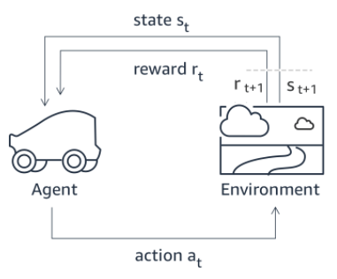
DeepRacer
Figure [3]

Slide 8
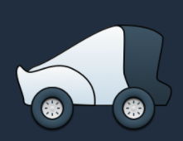
Agent
The agent simulates vehicle in the simulation
for training.More specifically, it embodies the neural network
that controls the vehicle, taking inputs and deciding actions.
Figure [4]

Slide 9
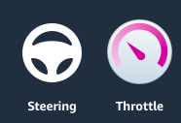
Action
An action is a move made by the agent in the current state.
an action corresponds to a move at a particular
speed and steering angle.
Figure [5]

Slide 10

State
A state represents a snapshot of the environment
the agent is in at a point in time
Figure [6]

Slide 11
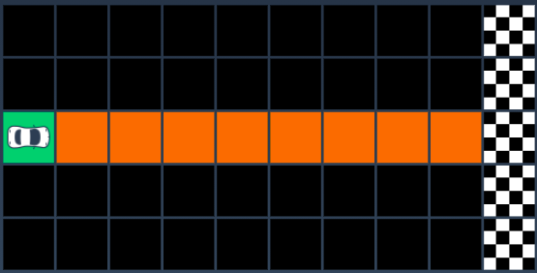
Environment
Environment: The world that an agent interacts with and learns from.
Gym is a toolkit for developing and comparing reinforcement learning algorithms
Figure [7]

Slide 12
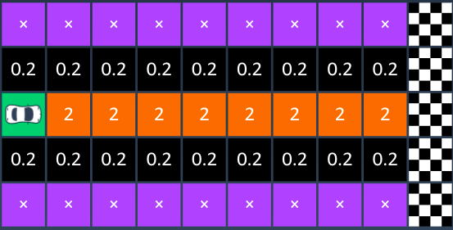
Reward
The reward is the score given as feedback to the agent when it takes an action in a given state.
Figure [8]

Slide 13
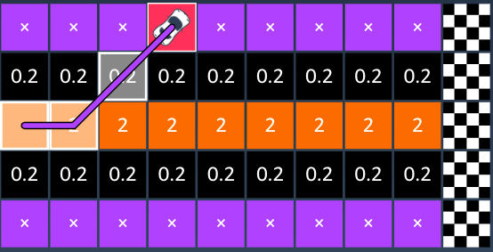
Episode
The vehicle will start by exploring the grid until
it moves out of bounds or reaches the destination.
In this episode, the vehicle accumulates a
total reward of 2.2 before reaching a stop state.
Figure[9]

Slide 14
How to Achieve Optimal Policy
Central goal of RL is to maximize the Reward. Which is can be achieved through Optimizing the policy.
What is a Policy?
The way of choosing actions in a given environment is know as policy, following are the ways
1.Exploration
2. Exploitation

Slide 15
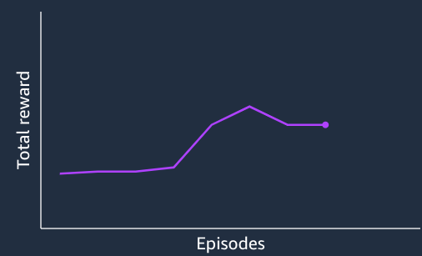
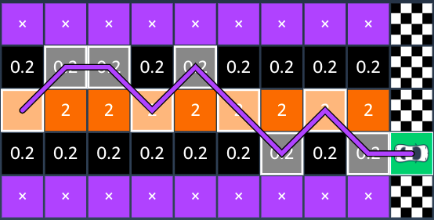
Exploration
As the agent gains more and more experience, it learns to stay on the central squares to get higher rewards.
Figure [10,11]

Slide 16
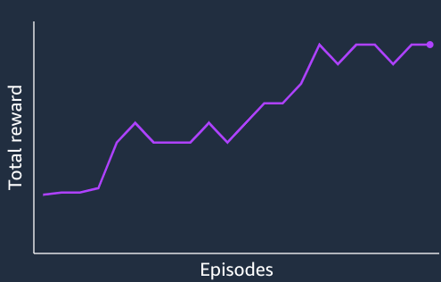
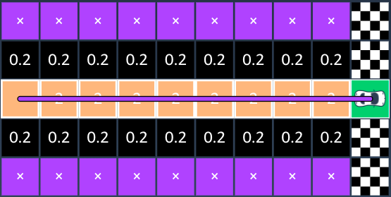
Exploitation
With more experience, the agent gets better and eventually is able to reach the destination reliably.
Figure [12,13]

Slide 17

Optimal Policy Function
Optimal Q function :
One fundamental property of q*
is that it must satisfy Bellman Equation
Maximum Q value for state action pair
achieves by value iteration
The optimal Policy can be achieved by :
Q learning ( Traditional RL)
Deep Q Learning (Neural Networks in RL)
Expected Reward
Eq [1]
Maximum Discounted Return

Slide 18
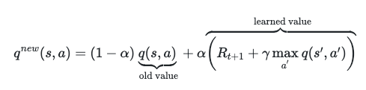
Q- learning and Limitations
Initially the q table values are set to be zero, Over the value iteration the q value is maximized
Trade off :
Epsilon greedy policy
Initially set to explore and over the period agent set to exploit. As the epsilon starts decaying
Learning Rate : Between 0 and 1 (alpha)
Max steps to take before stopping
Eq [2]

Slide 19
Q -value updation
Initialize all Q-values in the Q-table to 0
For each time-step in each episode:
Choose an action ( considering the exploration-exploitation trade-off).
Observe the reward and next state.
Update the Q-value function

Slide 20
Q-Table
Action/state | Left | Right | Center | Crash
s1 | 0 | 0 | 0 | 0
s2 | 0 | 0 | 0 | 0
s3 | 0 | 0 | 0 | 0
s4 | 0 | 0 | 0 | 0
Action/state | Left | Right | Center | Crash
s1 |  |  | 2
s2 | 0.2
s3 |  |  |  | -100
s4

Slide 21
Example
Figure[9]

Slide 22
Limitations Of Q-Learning With Value Iteration
Limited to small state spaces.
Performance will drop off in a more sophisticated environments.
Iterative value function will be computationally inefficient, perhaps infeasible.
Here comes the Function approximator to estimate the Q value function (Neural Networks)

Slide 23
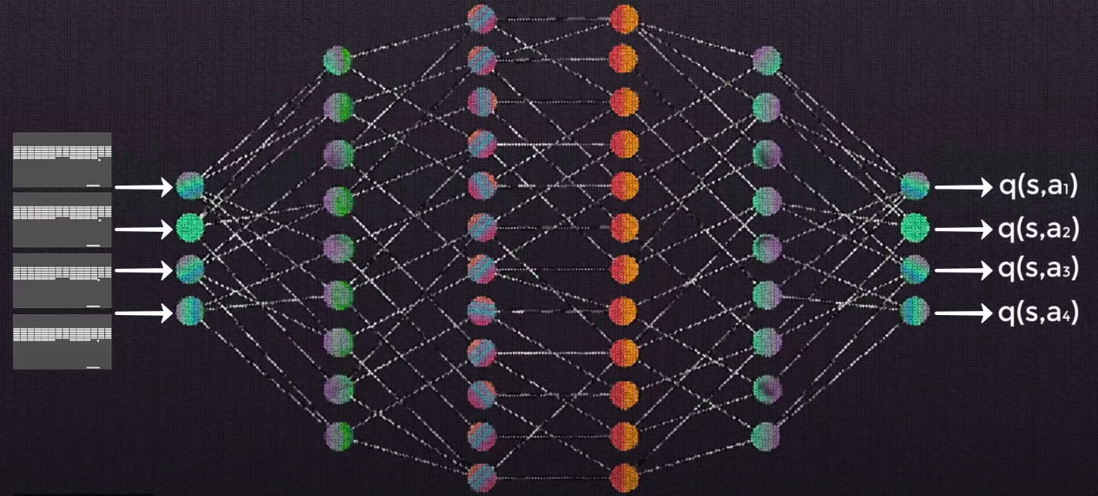
Deep Q Network
The objective of this network is to approximate the optimal Q-function, the optimal Q-function will satisfy the Bellman equation.
Figure [13]

Slide 24
Deep Q Network
The network would accept states from the environment as input
Rather than having a single frame represent a single input, we usually will use a stack of a few consecutive frames to represent a single input in respective orders. (gray scale, cropping, scaling )
Many deep-Q networks are purely just some convolutional layers, followed by some non-linear activation function, and then the convolutional layers are followed by a couple fully connected layers.
The output layer will be a fully connected layer, and it will produce the Q-value for each action that can be taken from the given state that was passed as input.

Slide 25
Training A Deep Q-Network With Replay Memory
Initialize replay memory capacity. s(D) = N
Initialize the policy network with random weights. ( q)
Clone the policy network, and call it the target network. (q*) (avoid instability) (update the W at random T)
For each episode:
Initialize the starting state.
For each time step:
Select an action.
Via exploration or exploitation (EGP)
Execute selected action in an emulator.
Observe reward and next state.
Store experience in replay memory. (s4, a4, r5, s5)
Sample random batch from replay memory. (break down the correlation)
Preprocess states from batch.
Pass batch of preprocessed states to policy network.
Calculate loss between output Q-values and target Q-values. (approximate q*)
Requires a pass to the target network for the next state (s5) = q*
Gradient descent updates weights in the policy network to minimize loss.
After x time steps, weights in the target network are updated to the weights in the policy network.

Slide 26
References
Image Sources :
1.https://medium.com/datadriveninvestor/reinforcement-learning-an-interactive-learning-b1fa29166fc8
Figure [1]
2. https://medium.com/datadriveninvestor/reinforcement-learning-an-interactive-learning-b1fa29166fc8
Figure [2]
3. https://d2k9g1efyej86q.cloudfront.net/
Figure [3]
4. https://d2k9g1efyej86q.cloudfront.net/
Figure [4]
5.https://d2k9g1efyej86q.cloudfront.net/
Figure [5]

Slide 27
References
6. https://d2k9g1efyej86q.cloudfront.net/
Figure [6]
7. https://d2k9g1efyej86q.cloudfront.net/
Figure [7]
8.https://d2k9g1efyej86q.cloudfront.net/
Figure [8]
9. https://d2k9g1efyej86q.cloudfront.net/
Figure [9]
10. https://d2k9g1efyej86q.cloudfront.net/
Figure [10]

Slide 28
References
11. https://d2k9g1efyej86q.cloudfront.net/
Figure [11]
12. https://d2k9g1efyej86q.cloudfront.net/
Figure [12]
13.https://deeplizard.com/learn/video/wrBUkpiRvCA
Figure [13]
14. Mnih, Volodymyr, et al. "Playing atari with deep reinforcement learning." arXiv preprint arXiv:1312.5602 (2013).
15. https://pytorch.org/tutorials/intermediate/reinforcement_q_learning.html
16. https://www.tensorflow.org/agents/tutorials/0_intro_rl

Slide 29
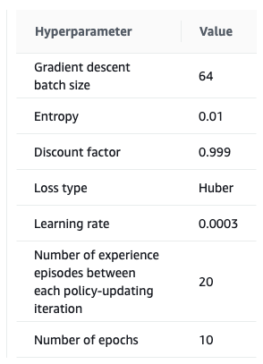
Additional slides

Slide 30
Model Free and Model Based Learning
Policy:
The way of choosing actions in a given environment is know as policy
Model Based learning :(Exploiting)
We assume the we have concrete knowledge of MDP.
Means we know the values of set of states, action , state transition probabilities and the Reward function for any state
Defined policy
Model Free Learning : (Exploration)
We assume we have no knowledge of the MDP
Random policy

Slide 31
https://medium.com/datadriveninvestor/reinforcement-learning-an-interactive-learning-b1fa29166fc8
Figure [3,4,5,6,7,8,9,10,11,12]
https://aws.amazon.com/deepracer/getting-started/
https://d2k9g1efyej86q.cloudfront.net/
https://docs.aws.amazon.com/deepracer/latest/developerguide/what-is-deepracer.html
Eq [1,2]
https://arxiv.org/pdf/1312.5602.pdf
Figure[13]
https://deeplizard.com/learn/video/wrBUkpiRvCA
https://pytorch.org/tutorials/intermediate/reinforcement_q_learning.html
https://www.tensorflow.org/agents/tutorials/0_intro_rl

