Slide 1
Docker

Slide 2
Virtualization vs Containerization
Virtualization
Creation of a virtual rather than actual version of something, such as an operating system, a server, a storage device or network resources.
Containerization
A lightweight alternative to full machine virtualization that involves encapsulating an application in a container with its own operating environment.

Slide 3
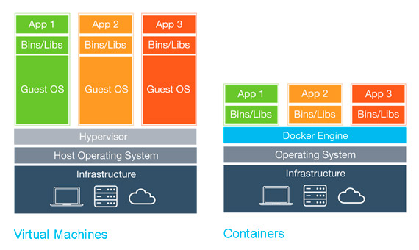
Virtualization vs Containerization

Slide 4
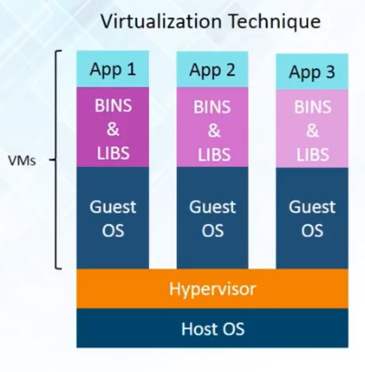
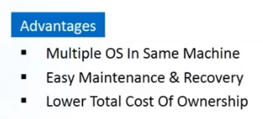
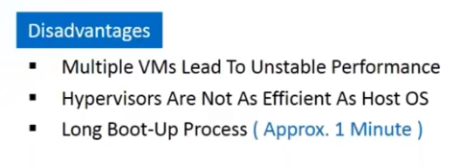
Virtualization

Slide 5
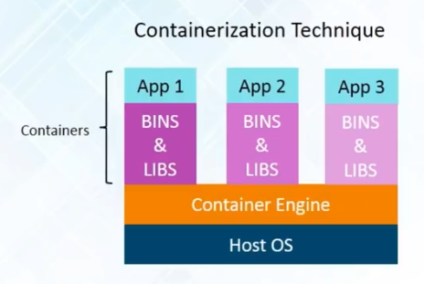
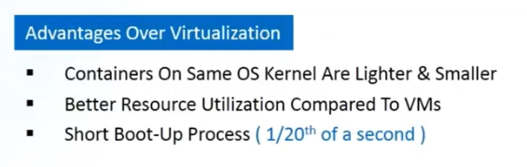
Containerization
Notes:
Technique to bring virtualization to OS level
Virtualization brings abstraction to hardware
Containerization brings abstraction to software
5

Slide 6
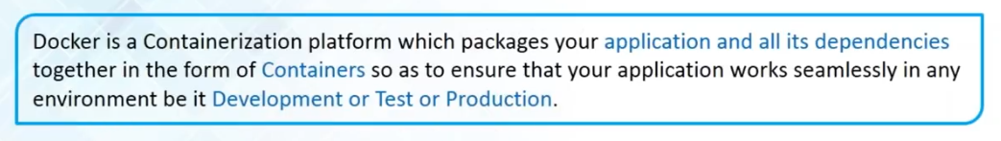
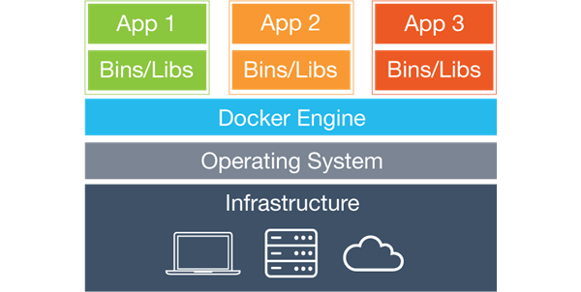
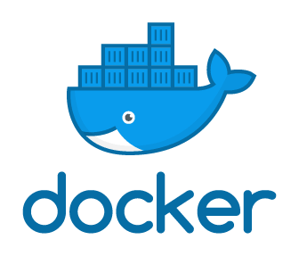
Docker

Slide 7
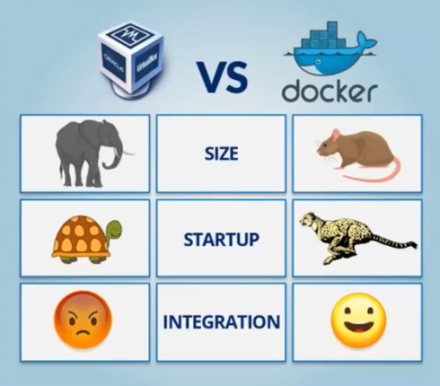
VM vs Docker

Slide 8
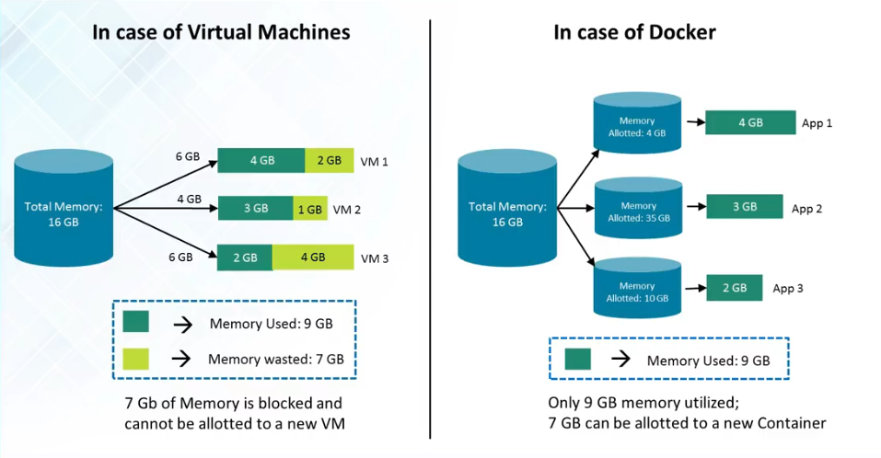
VM vs Docker

Slide 9
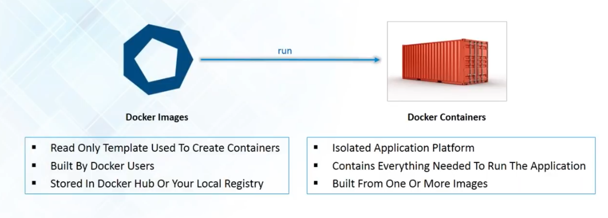
Docker images & containers

Slide 10
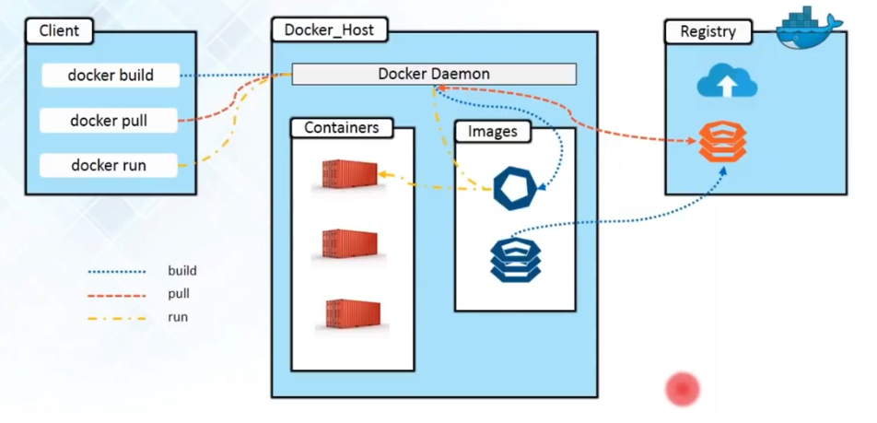
How Docker Works

Slide 11
Docker Components
Docker Engine − It is used for building Docker images and creating Docker containers.
Docker Hub − This is the registry which is used to host various Docker images.
Docker Compose − This is used to define applications using multiple Docker containers.

Slide 12
Installation
Easiest way to get Docer installed is
tulik.github.io/devops-docker/2018/01/10/installing-docker-on-ubuntu-5-steps/#1-uninstall-current-version-of-docker

Slide 13
Docker Commands
To pull docker image from the Docker hub:
$ docker pull image-name:tag
To run the image:
$ docker run image-name:tag
$ docker run image-id
To list down all the images in our system:
$ docker images
To list down all the running containers:
$ docker ps
To list down all the containers (even if they are running or not) :
$ docker ps –a

Slide 14
Docker Commands
$ docker info
$ docker pull (from hub.docker.com)
$ docker images
$ docker images –q
$ docker run hello-world
$ docker ps
$ docker ps -a
$ docker stats containerId
$ docker history image
imageId or imageName
$ docker stop containerId
kill, log, pause, etc
$ docker rm containerId
$ docker rmi imageId

Slide 15
Docker Run Command
$ docker run
$ docker run <image>
$ docker run –name=<customname> <image>
$ docker run –rm <image>
$ docker run –d <image>
$ docker run –it <image>
$ docker run –p host:container <image>

Slide 16
Docker Build Image
docker build -t ImageName:TagName dir
docker build -t demoimage:0.1 .
-t: is to mention a tag to the image
ImageName: This is the name you want to give to your image.
TagName(Optional): This is the tag you want to give to your image.
dir: The directory where the Docker File is present.

Slide 17
Dockerfile
#This is a sample Image
FROM ubuntu
MAINTAINER author/developer/maintainer-NAME
RUN apt-get update
RUN apt-get install –y nginx
CMD ["echo”,”Image created”]

Slide 18
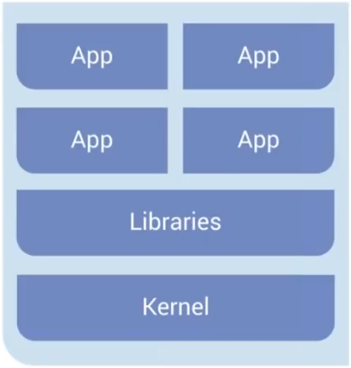
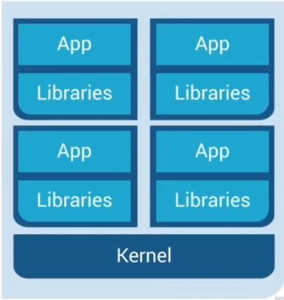
Docker
Older way: Application on Host
New way: Deploy Container

Slide 19
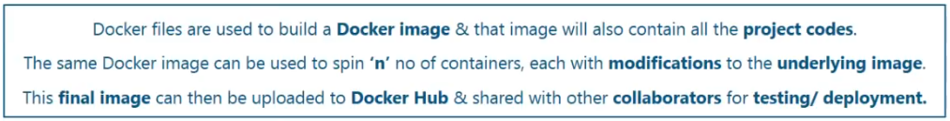
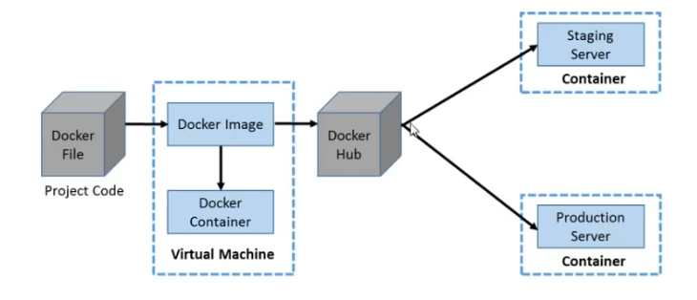
Container

Slide 20
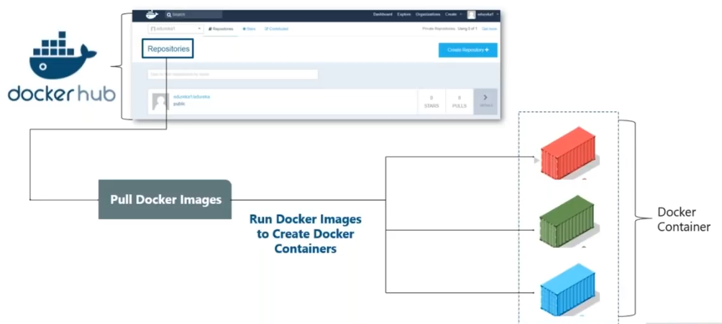
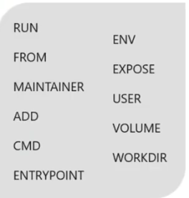
Container

Slide 21
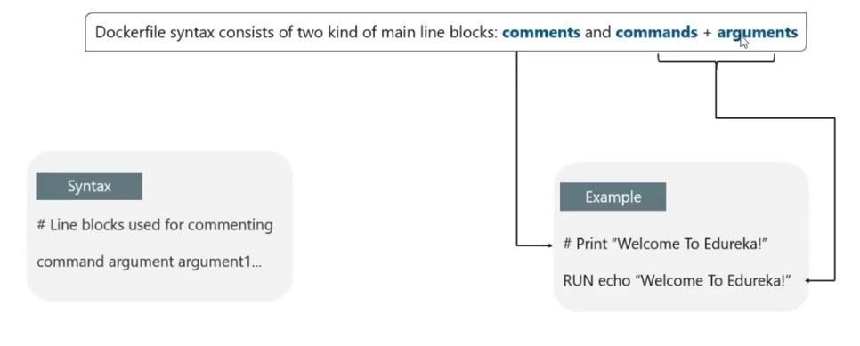
Dockerfile Syntax

Slide 22
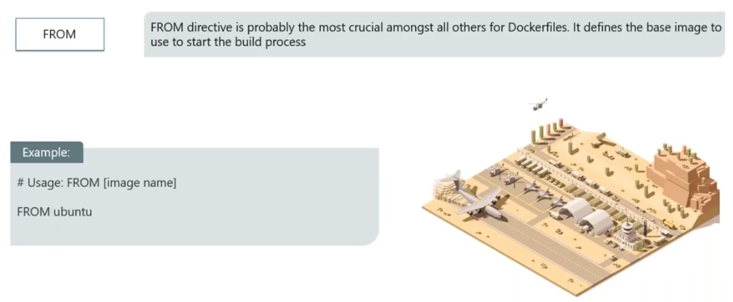
Dockerfile Command: FROM

Slide 23
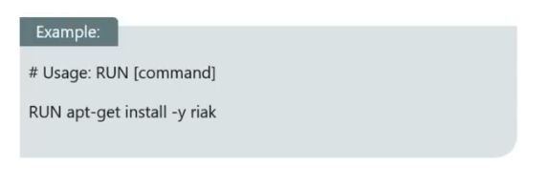
Dockerfile Command: RUN

Slide 24
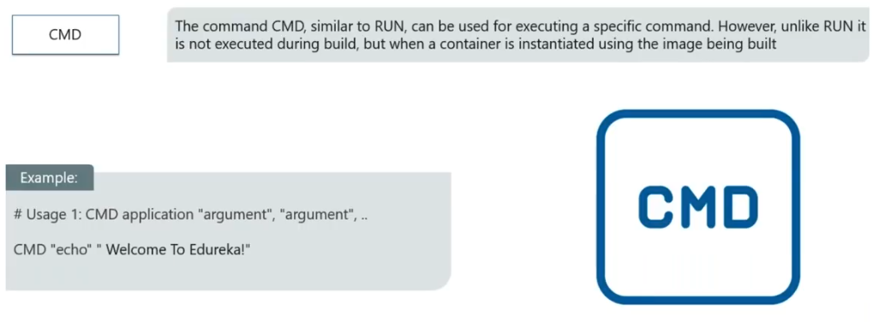
Dockerfile Command: CMD

Slide 25
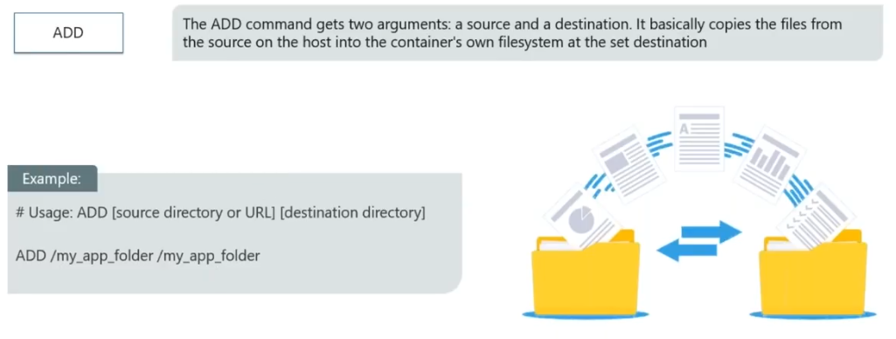
Dockerfile Command: ADD

Slide 26
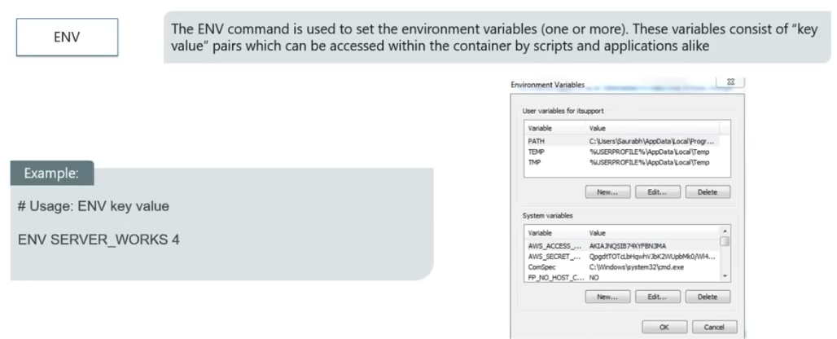
Dockerfile Command: ENV

Slide 27
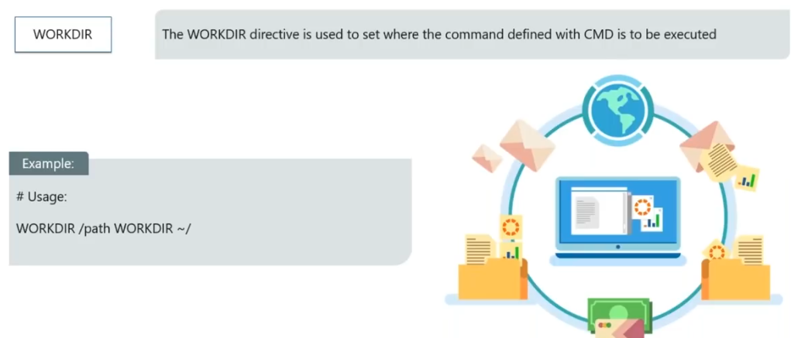
Dockerfile Command: WORKDIR

Slide 28
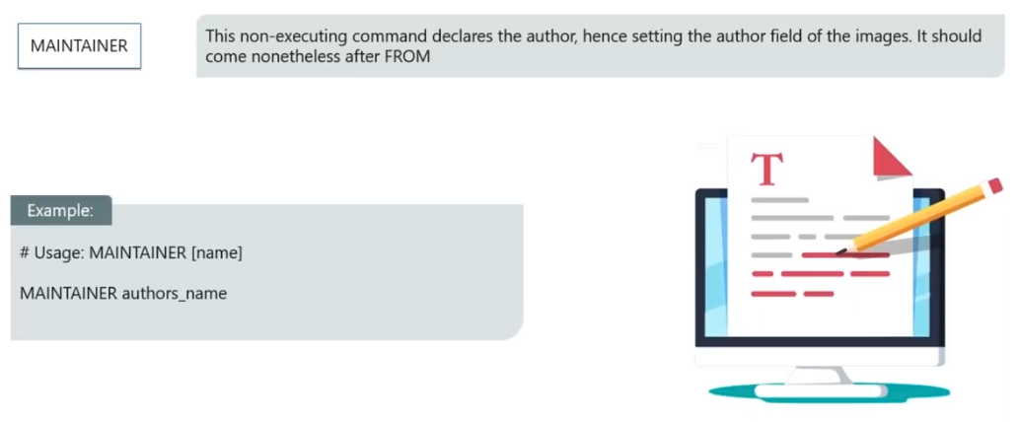
Dockerfile Command: MAINTAINER

Slide 29
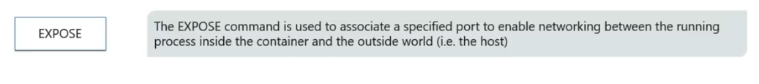
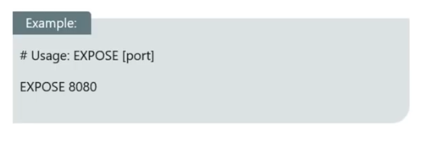
Dockerfile Command: EXPOSE

Slide 30
Docker Hub
Upload your demoimage to docker public repository
Get login in docker hub account and create a public repository.
Make sure visibility is public
make a note to pull command
docker pull java276/demorepo
Open terminal and get login to tag your image i.e. demoimage
docker login
java2786
pwd
docker image
docker tag imageId RepositoryName
docker tag ab0c1d3744dd java2786/demorep:1.0
.

Slide 31
Docker Hub
PUSH
docker push RepositoryName:v
go back to the Docker Hub page and go to your repository, you will see the tag name in the repository.
Try to pull this repo now
docker pull java2786/demorepo:1.0
already exists

Slide 32
Docker with Jenkins
go to browser and login to docker hub. find jenkins repository.
docker pull jenkins
Find the exposed ports
docker inspect Container/Image
docker inspect jenkins
Run jenkins
docker run -p 8080:8080 -p 50000:50000 jenkins

Slide 34
Container
Docker compose is used to run multi-container applicatioin
Each container will run a standalone application and it can communicate with other containers present in same host
Ex: MEAN stack application using different containers
Mongo
Express
Angular
Node

Slide 35
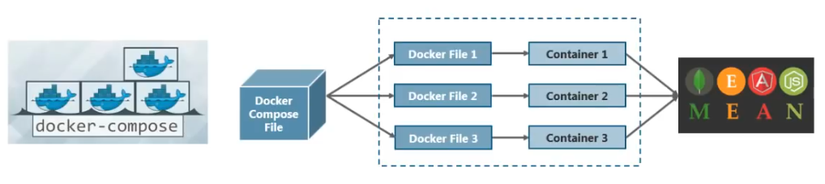
Container

Slide 36
Get Ready
https://www.docker.com/get-started
Create a folder mean-stack-app
Create a file named as “docker-compose.yml”
Create angular-app
Place it in mean-stack-app folder
Create a file named as “Dockerfile”
Create express-app
Place it in mean-stack-app folder
Create a file named as “Dockerfile”
For MongoDB use image placed at docker hub

Slide 37
docker-compose.yml
# docker-compose.yml
version: '3.0' # specify docker-compose version
# define the services/containers to be run
services:
angular: # name of the first service
build: './angular-app' # specify the directory of the Dockerfile
ports:
- 4200:4200 # specify port mapping
express: # name of the second service
build: './express-app' # specify the directory of the Dockerfile
ports:
- 3000:3000 # specify port mapping
database: # name of the third service
image: 'mongo' #specify image to build container
ports:
- 27017:27017 # specify port forwarding

Slide 38
Dockerfile in angular-app
FROM node:6
RUN mkdir -p path/to/run/app
WORKDIR path/to/run/app
COPY package.json path/to/run/app
RUN npm cache clean
RUN npm install
COPY . path/to/run/app
EXPOSE 4200
CMD ["npm", "start"]

Slide 39
Dockerfile in express-app
FROM node:6
RUN mkdir -p path/to/run/app
WORKDIR path/to/run/app
COPY package.json path/to/run/app
RUN npm cache clean
RUN npm install
COPY . path/to/run/app
EXPOSE 3000
CMD ["npm", "start"]

Slide 40
Run containers
Open terminal and go to inside mean-stack-app
Here we need to execute docker-compose.yml file and command for this is
$ docker-compose up

