Slide 1

PQR – RF Module
STARTER GUIDE

Slide 2
Content
How to Log In
Getting an account for the PQR
GUI Overview (Main Page and RF Module Page)
Entering Report
Viewing Reports
Modifying Reports
Downloading Records
Appendix A – PMCS Workgroup Members

Slide 3
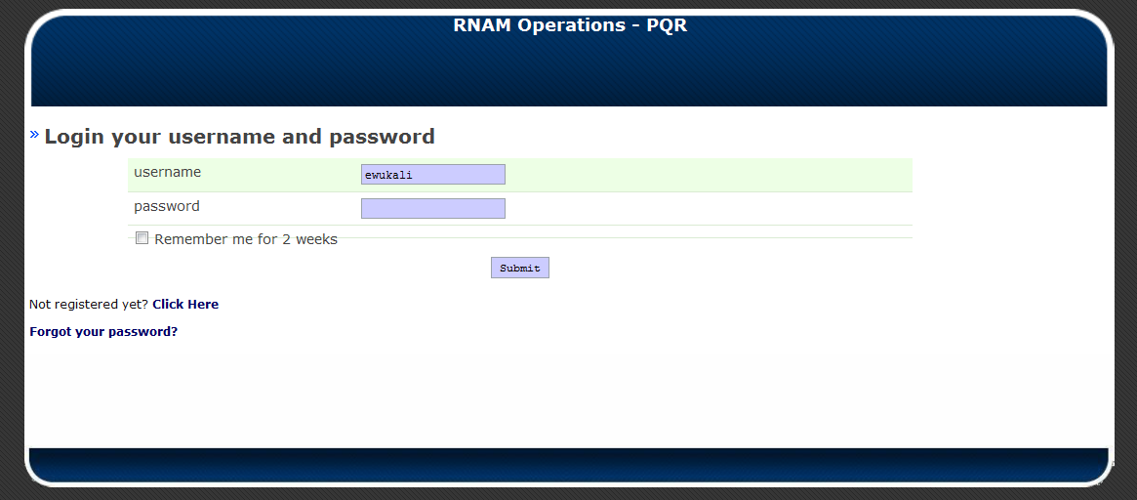
PQR Log in
Link: http://138.85.162.107/pqr/trunk/source/working/index.php/users/dashboard

Slide 4
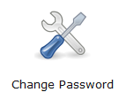
Account
To request an account to the PQR tool, contact a PQR developer or the line manager from your area listed in the PMCS Workgroup (Appendix A)
You will receive an email from IRT Administrator asking that you open a link to activate your account
By default, the login credentials are:
  Username: <your signum>
  Password: password
Once you are able to login to the tool, you can change your password in the main menu

Slide 5
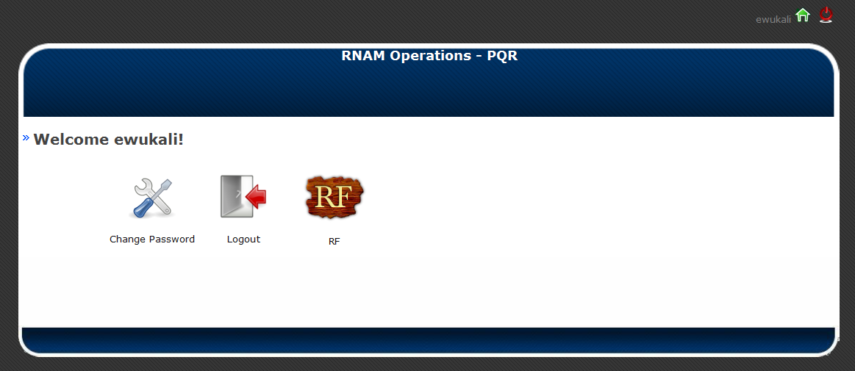
PQR Main Page
Return to PQR Main Page
Change password
RF Tool login page

Slide 6
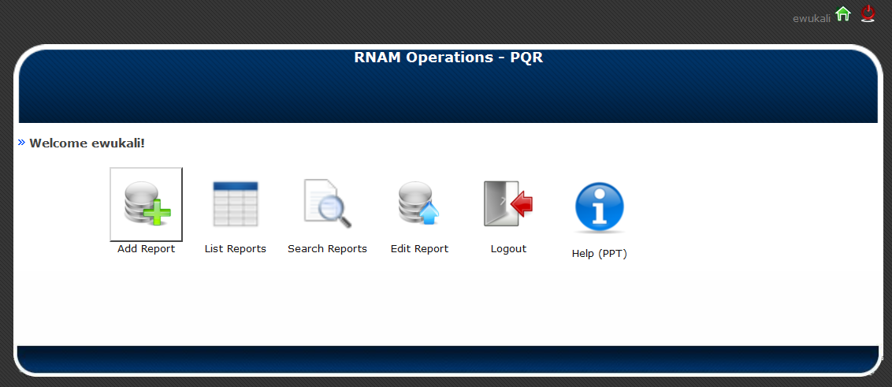
RF Module Main Page
User Guide
Search reports by criteria, View/edit/delete reports and download content to excel file
Enter new report
View/edit/delete reports and view/add feedback

Slide 7
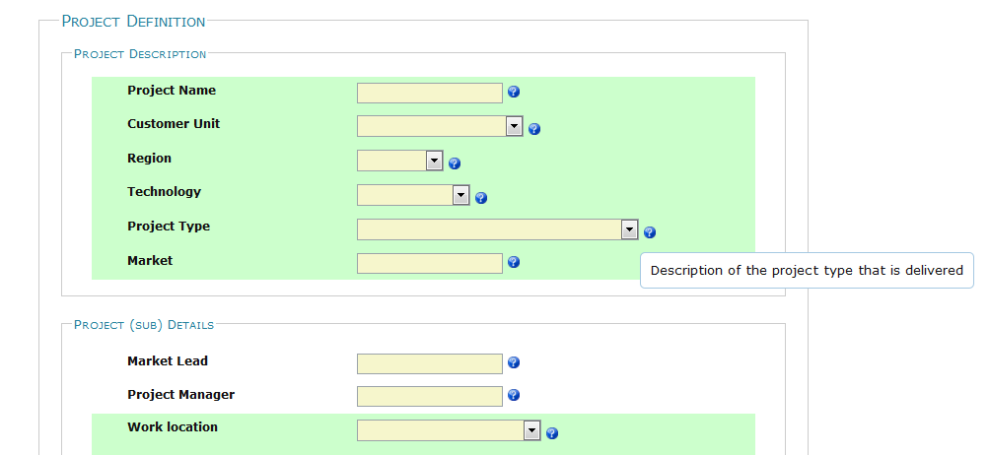
Adding A report
Select Add Report from the main page
Fill out fields. The following pages of this presentation outline the field descriptions. You can also mouse over the Question Mark Icon next to the field for more details

Slide 8
Project Reporting Fields
– Project Definition
Project Description
  Project Name: full name of project, up to 150 characters
  Customer Unit
  Region
  Technology
  Project Type: Description of the project type that is delivered
  Market: Full name of market up to 150 characters
Project (Sub) Details
  Project Lead: Lead Engineer name (not mandatory)
  Project Manager: (not mandatory)
  Work Location: Work location of the Ericsson team
  Sub Project Name: Variable describing the project, cluster, mini-cluster, site name etc (eg. Cluster 1, River Walk Area)
  Sub Project Status: Open - on-going projects, Closed - completed
Additional Engineers: other team members on project

Slide 9
Project Reporting Fields
– Project INPUTS
Input Verification
  Are the project inputs/checklists available and accurate?
    Y/N: Check if all the project inputs are available and accurate
  Is the SOW available and correct?
    Y/N: Check if all the Scope of Work is available and accurate
  Was the NW available at project start
    Y/N: Check if all the network code was available at the project initiation
  Do you have access to the project budget (TPR)?
    Y/N: Check if the engineer know how many hours or cost can be spend on this project
  Are > 90% of the engineers qualified for the job?
    - Y/N: Check what percentage of the engineers know how to execute the project (trained)
Milestones / Dates
  Project Start Date: Start date of the project
  Initial Planned Delivery Date (based on SOW): The initial expected delivery date at the start of the project

Slide 10
Project Reporting Fields
– PROJECT Deliverables
Recommendations and Implementations
  Number of change recommendations (0=none): Total changes recommended to the customer (tilts, neighbors, etc)
  No. of recommendations rejected from final/close-out report: Total changes recommended that the customer rejected at the end of the project
  Total of number of accepted changes not implemented: Total changes recommended that the customer accepted but not implemented
SOW/Delivery Date Adjustment & Tracking
  Total number of SOW adjustments (0=none): Total number of times that the scope of work was adjusted on the project (timelines, deliverables, process etc.)
  Project Approved Delivery Date
  Total number of Delivery Date adjustments (0=none): Total number of times that the Delivery Date was adjusted on the project
  Actual delivery date: Actual Delivery Date when the project was handed over to the customer

Slide 11
Project Reporting Fields
– PROJECT Deliverables
Delivery Review
  Did we meet the project SOW & expectations?: Y/N - Description if the project deliverables were accurate per the definition of the SOW
  Was the project approved by the customer when formally presented (on time)?: Y/N - Description if the project deliverables were accepted by the customer during the project close out

Slide 12
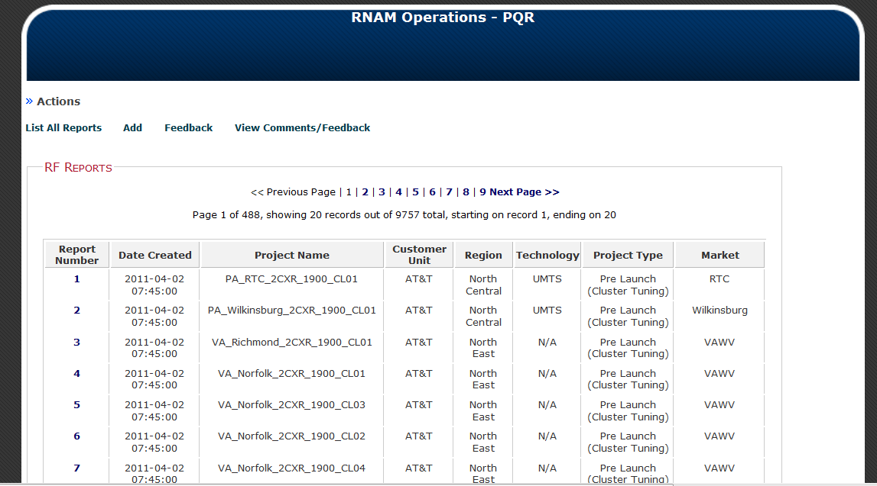
List Reports View
Add/View Tool Feedback
Select Report Number to view individual report

Slide 13
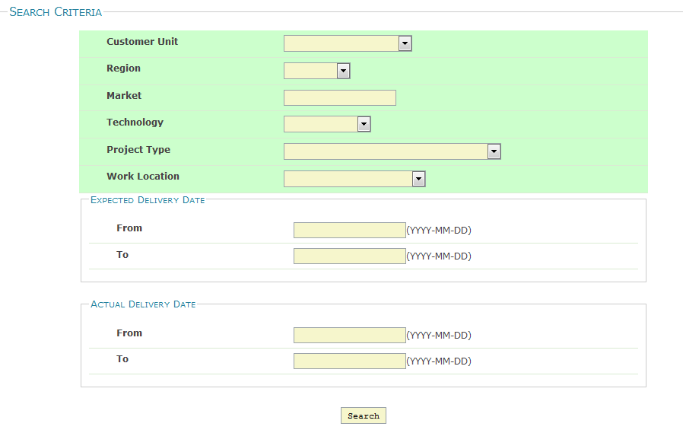
Search Reports View
Search Criteria (leave blank to see all reports)

Slide 14
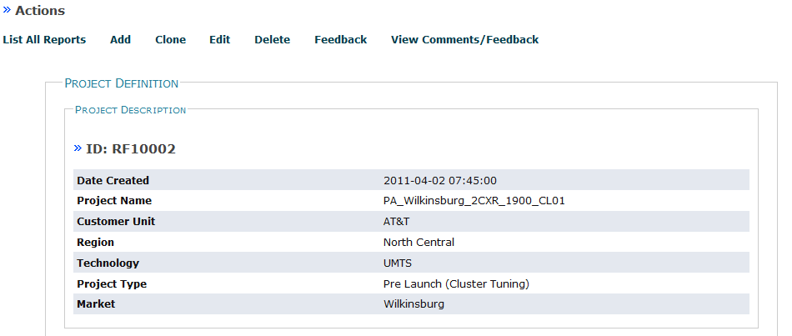
To Clone A Report
**Helpful if entering similar projects**
Search or find the report you would like to clone and open the report
Select Clone. Make note of the new report number
Open the new report and select Edit. Make changes and save

Slide 15
To delete a report
Search or find the report you would like to clone and open the report
Select Delete

Slide 16
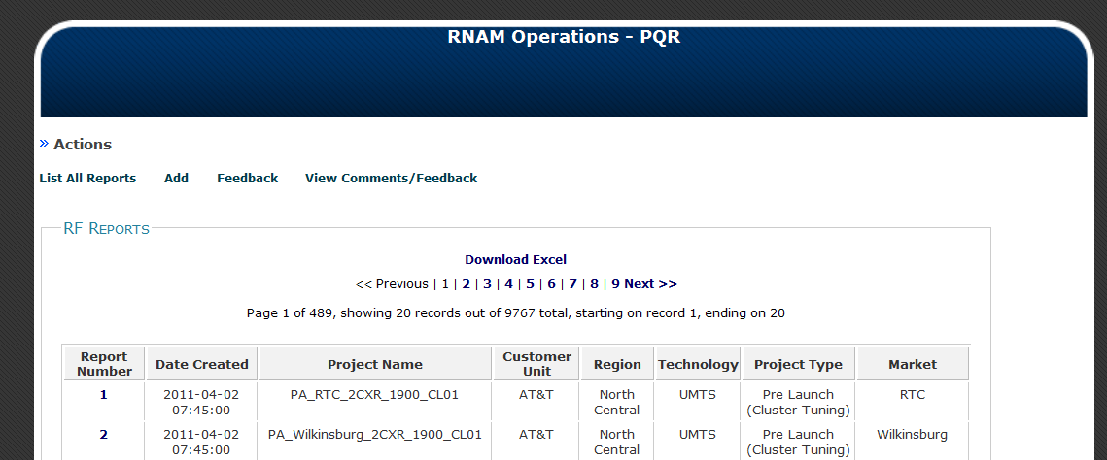
To Download reports to excel
Select Search Reports from the main page
(optional) Select search criteria and select the Search button
Select Download Excel

Slide 17
Appendix A - PMCS Workgroup
NAME | GROUP | MANAGER
Dante Lopez | CDMA/LTE RAN (Design Subgroup) | Robin Lewis
Franz De Waal | CDMA/LTE RAN (Optimization Subgroup) | Robin Lewis
Jaimin Patel | IRT Development Team | Dipak Praminak
Julio Velo | WCDMA/GSM RAN (Optimization Subgroup) | Kris Harrison
Kate Lintag | E2E Network Eng. | Claudio Marino
Kris Harrison | Head of WCDMA/GSM RAN | Hal Thomas
Leonard Yager | Project Management | Holly Binns
Moiz Bhukhiya | IRT Development Team | Reed Hutchison
Mohammad Mustafa | CDMA/LTE RAN (Tuning Subgroup) | Robin Lewis
Naeem Khan | WCDMA/GSM RAN (Tuning Subgroup) | Kris Harrison
Robin Lewis | Head of CDMA/LTE RAN | Hal Thomas
Zafar Naqvi | WCDMA/GSM RAN (Design Subgroup) | Kris Harrison

Slide 18


