Slide 1

DETECTION AND MITIGATION OF FLOW TABLE FLOOD ATTACK IN SDN ARCHITECTURE
Presentation
by
VISHAL KUMAR
B200059CS
BACHELOR OF TECHNOLOGY in
COMPUTER SCIENCE AND ENGINEERING
Under the Supervision of
Prof. Mahesh Chandra Govil
Department of Computer Science and Engineering National Institute of Technology Sikkim Ravangla-737139,
Sikkim, India

Slide 2

1
10th October 2023
Table of Contents
Introduction
Motivation
Problem Statement
Literature Review
Proposed Methodology
Implementation
Results
Improvements
Conclusions
Future Work
References

Slide 3
2
10th October 2023
INTRODUCTION
In Software-Defined Networks (SDNs), packet movement follows a distinct sequence.
Packets are initially received, and the controller determines the route based on policies.
The controller then installs flow rules in switches, guiding packet forwarding.
Subsequent packets traverse the established path, with the controller adapting routes
dynamically as network conditions change, ensuring efficient and flexible data transmission.
In a Flow Table Flood attack, attacker overwhelm the flow tables by flooding them with a high volume of bogus flow requests. This exhausts the limited resources of SDN switches, causing legitimate flow entries to be displaced. Consequently, network performance degrades, and critical services may be disrupted.

Slide 4
Introduction
Motivation
Problem Statement
Literature Review
Proposed Methodology
Implementation
Results
Improvements
Conclusions
Future Work
References
10th October 2023
MOTIVATION
In Software-Defined Networks (SDNs), packet movement follows a distinct sequence.
Packets are initially received, and the controller determines the route based on policies.
The controller then installs flow rules in switches, guiding packet forwarding. Subsequent packets traverse the established path, with the controller adapting routes
dynamically as network conditions change, ensuring efficient and flexible data transmission.
In a Flow Table Flood attack, malicious actors overwhelm the flow tables in Software-Defined Networks (SDNs) by flooding them with a high volume of bogus flow requests. This exhausts the limited resources of SDN switches, causing legitimate flow entries to be displaced. Consequently, network performance degrades, and critical services may be disrupted. Attackers exploit vulnerabilities in the SDN controller's handling of flow table entries, impairing network functionality and potentially facilitating further cyber threats.

Slide 5
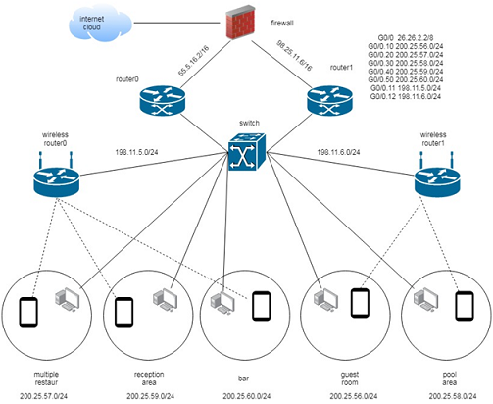
10th October 2023
TRADITIONAL NETWORK

Slide 6
10th October 2023
SOFTWARE DEFINED NETWORKING
Software-Defined Networking (SDN) revolutionizes the network architecture, making use of a more dynamic and software-driven approach.
Traditional networks heavily rely on dedicated hardware devices for routing and switching, whereas SDN centralizes network control and management, reducing the dependence on individual hardware components.
In SDN, the traditional routers and switches are replaced with software controllers, which have a global view of the network and can dynamically adjust routing and traffic management. This flexibility allows for more efficient and adaptable network configurations, a departure from the static nature of traditional networks.

Slide 7
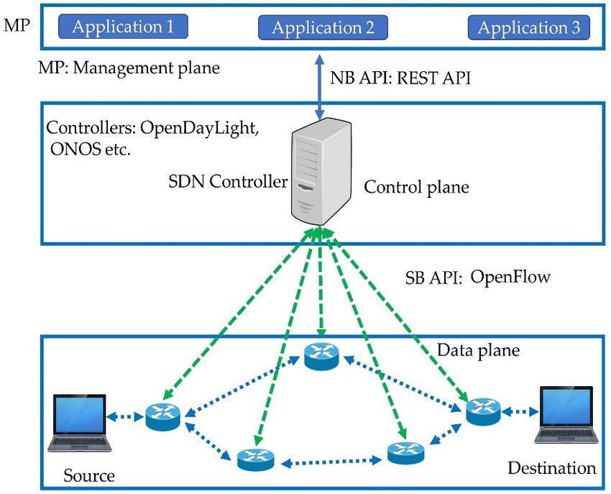
10th October 2023
SOFTWARE DEFINED NETWORK

Slide 8
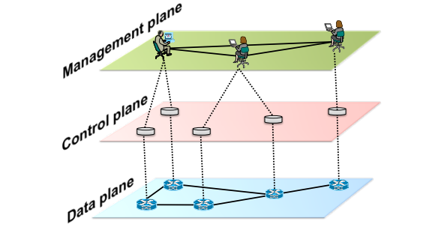
10th October 2023
SDN ARCHITECTURE
Computer networks can be divided in three planes of functionality: the data, control and management planes.
The data plane corresponds to the networking devices, which are responsible for (efficiently) forwarding data.
The control plane represents the protocols used to populate the forwarding tables of the data plane elements.
The management plane includes the software services, such as SNMP-based tools , used to remotely monitor and configure the control functionality.

Slide 9
10th October 2023
SDN ARCHITECTURE
We define an SDN as a network architecture with four pillars:
The control and data planes are decoupled. Control functionality is removed from network devices that will become simple (packet) forwarding elements.
Forwarding decisions are flow-based, instead of destination-based
Control logic is moved to an external entity, the so-called SDN controller or Network Operating System (NOS). The NOS is a software platform that runs on commodity server technology and provides the essential resources and abstractions to facilitate the programming of forwarding devices based on a logically centralized, abstract network view.
The network is programmable through software applications running on top of the NOS that interacts with the underlying data plane devices.

Slide 10
10th October 2023
ISSUES WITH SDN
Security of the Controller: The SDN controller is a critical component, and if not properly secured, it can be exploited by attackers, potentially allowing unauthorized access to network devices.
Vulnerabilities in Software Components: SDN heavily relies on software, which may contain vulnerabilities and bugs. Exploiting these vulnerabilities can lead to unauthorized control or network disruptions.
Complex Configurations and Misconfigurations: SDN configurations can be complex, and misconfigurations can lead to network outages or create security weaknesses. Ensuring proper configurations and conducting regular audits is crucial.
Lack of Standardized Security Measures: SDN lacks universally accepted security standards, making it essential for organizations to develop their own security policies. The absence of standardized practices can result in varied levels of security across different SDN implementations.

Slide 11
10th October 2023
SECURITY & SDN
Security threats can be broadly classified into two categories :
First set of issues are common to both traditional network as well as SDN .
Resource Exhaustion Attacks:
UDP Flood: Attackers flood the network with a high volume of User Datagram Protocol (UDP) packets, which can lead to resource exhaustion in SDN switches or the SDN controller.
ICMP Flood: An attack that sends a massive number of Internet Control Message Protocol (ICMP) echo requests (ping) to overwhelm network devices and affect their responsiveness.
Amplification Attacks:
DNS Amplification: Attackers send DNS queries with spoofed source IP addresses to DNS servers. The responses generated by the DNS servers are larger than the queries, leading to amplified traffic that can overwhelm the target.
NTP Amplification: Similar to DNS amplification, attackers use Network Time Protocol (NTP) servers to generate amplified traffic.

Slide 12
10th October 2023
SECURITY & SDN
Layer 7 Application Layer Attacks:
HTTP Flood: Attackers send a large volume of HTTP requests to a web server, aiming to consume server resources and disrupt access for legitimate users.
Slowloris: This attack targets web servers by keeping numerous connections open but sending partial HTTP requests, consuming server resources and making the server unable to serve other clients.
Broadcast Storms:
Attackers can initiate broadcast storms by flooding the network with broadcast traffic, causing congestion and service disruption in SDN.
Traffic Redirection:
Attackers can manipulate flow rules in SDN switches to redirect traffic to unauthorized destinations or to create traffic loops.
Resource Starvation:
Attackers may employ techniques to starve resources such as CPU, memory, or bandwidth in network devices, leading to performance degradation.

Slide 13
10th October 2023
SECURITY & SDN
Another set of attacks are specific to SDN :
SDN-Specific Attacks:
Flow Table Exhaustion: Attackers attempt to overload the flow tables in SDN switches by creating a large number of unnecessary flow entries. This can disrupt network operations. E.g. Flow entry flooding.
Control Plane Overload: Attackers target the SDN controller with an excessive number of control plane requests, causing it to become unresponsive and impacting network management.

Slide 14
10th October 2023
LITERATURE SURVEY
S.NO | AUTHOR | TITLE | SPECIFICATION | LIMITATION
1 | Zhoou et al., 2018 [5] | Exploiting the vulnerability of flow table overflow in software-defined network: Attack model, evaluation, and defense | The paper introduces a novel inference attack, achieving an 80% or higher accuracy in inferring network parameters, and suggests two defense strategies | Narrow focus on a specific vulnerability, potential lack of universal applicability for proposed defense strategies, and a need for real-world validation.
2 | Nader et al., 2019 | Security of Software Defined Networks (SDN) Against Flow Table Overloading Attack | The paper proposes an algorithm based on entropy variation to detect and prevent flow table overloading attacks in SDN. | The algorithm relies solely on destination IP to calculate entropy as a detection feature.
3 | Cao et al., 2023 | The attack: Overflowing SDN flow tables at a low rate | The paper introduces the LOFT attack, a low-rate flow table overflow attack in SDN, demonstrating feasibility in a real testbed. It proposes LOFTGuard as a lightweight defense system. | While effective, LOFT- Guard introduces a small overhead; the impact on diverse SDN environments and scalability may require further exploration

Slide 15
10th October 2023
LITERATURE SURVEY
S.NO | AUTHOR | TITLE | SPECIFICATION | LIMITATION
4. | Shen et al., 2023 [7] | Flow table saturation attack against dynamic timeout mechanisms in SDN | The paper analyzes flow table management mechanisms, proposes an advanced flow table saturation attack exploiting dynamic timeouts, and conducts extensive experiments, showcasing its effectiveness and stealth. | The research focuses on a specific aspect of flow table management; broader implications and countermeasures beyond dynamic time- outs may warrant further exploration.
5 | Xie et al., 2023 [8] | The paper addresses the threat of low-rate DoS (LDoS) attacks causing flow table overflow in SDN. It introduces SAIA, a detection and defense mechanism, showcasing lightweight deployment and effective mitigation | The paper proposes an algorithm based on entropy variation to detect and prevent flow table overloading attacks in SDN. | The proposed SAIA mechanism might face challenges in predicting flow table overflow accurately.

Slide 16
10th October 2023
MOTIVATION & OBJECTIVE
Flow entry flooding attacks are a serious threat to software-defined networks (SDNs). These attacks can overwhelm the SDN controller and cause the network to become unresponsive. This can have a devastating impact on businesses and organizations that rely on SDNs.
There is a need for research into new and effective ways to prevent and mitigate flow entry flooding attacks.
Flow entry flooding attacks are a relatively new type of attack, and there is still much to learn about how to prevent and mitigate them.
Flow entry flooding attacks can have a significant impact on businesses and organizations.

Slide 17
10th October 2023
FUTURE WORK
Implementation of existing algorithms : Performing attacks on Mininet simulator and observe the possible security vulnerabilities.
Flow Entry Monitoring: Continuously monitor flow table entries for unauthorized or suspicious changes.
Access Control: Implement strict access control policies to restrict who can modify flow entries.
Anomaly Detection: Use anomaly detection mechanisms to identify abnormal flow entry patterns or behavior.
Controller Authentication: Ensure strong authentication for SDN controllers to prevent unauthorized access.
Flow Entry Whitelisting: Maintain a whitelist of approved flow entries and block any unauthorized ones.

Slide 18
10th October 2023
REFERENCE
Kreutz, Diego, Fernando MV Ramos, Paulo Esteves Verissimo, Christian Esteve Rothenberg, Siamak Azodolmolky, and Steve Uhlig. "Software-defined networking: A comprehensive survey." Proceedings of the IEEE 103, no. 1 (2014): 14-76.
F. Hu, Q. Hao and K. Bao, "A Survey on Software-Defined Network and OpenFlow: From Concept to Implementation," in IEEE Communications Surveys & Tutorials, vol. 16, no. 4, pp. 2181-2206, Fourthquarter 2014, doi: 10.1109/COMST.2014.2326417.
S. Scott-Hayward, S. Natarajan and S. Sezer, "A Survey of Security in Software Defined Networks," in IEEE Communications Surveys & Tutorials, vol. 18, no. 1, pp. 623-654, Firstquarter 2016, doi: 10.1109/COMST.2015.2453114.
https://opennetworking.org/sdn-resources/customer-case-studies/openflow/
https://opennetworking.org/sdn-resources/customer-case-studies/openflow/
https://ryu-sdn.org/

Slide 19
10th October 2023
THANK YOU

