Slide 1
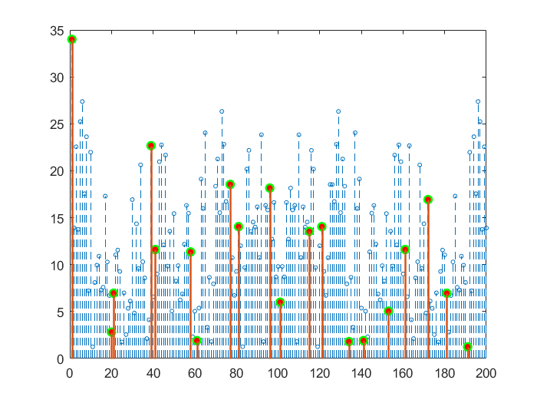
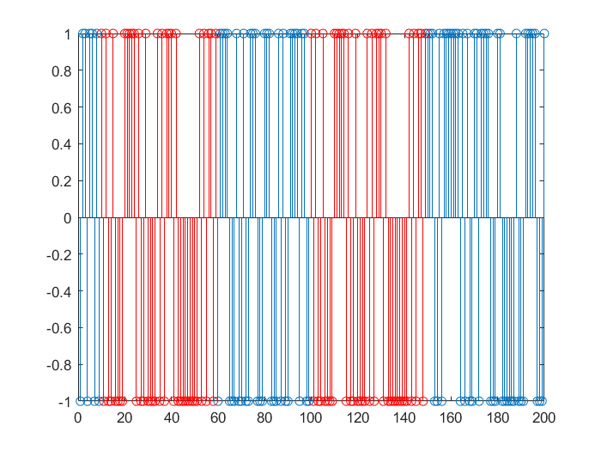
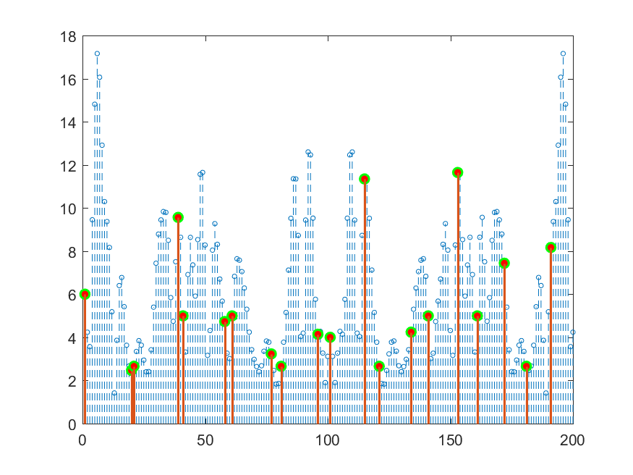
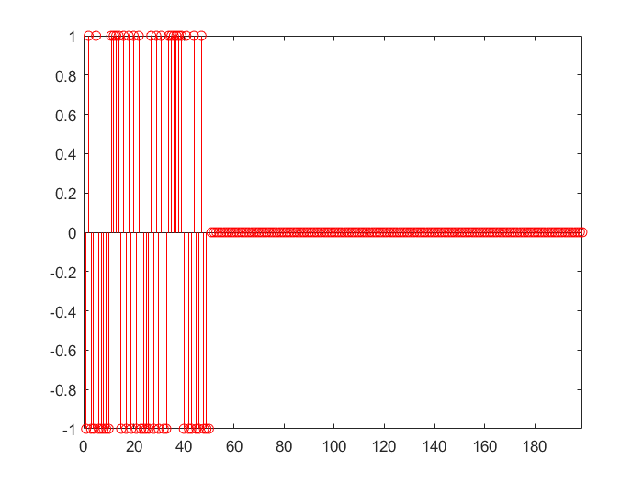
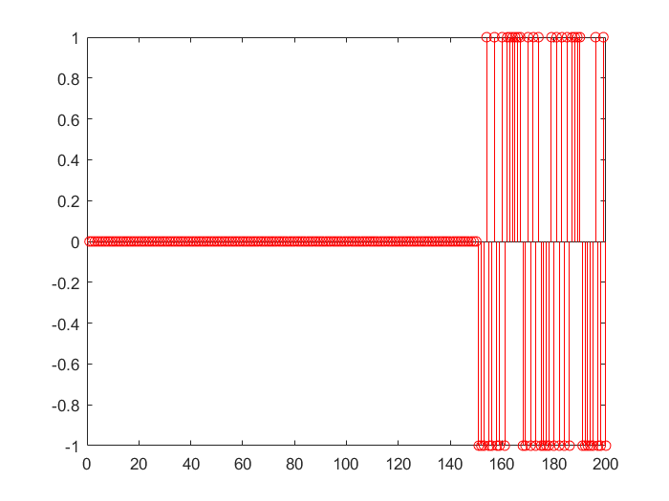
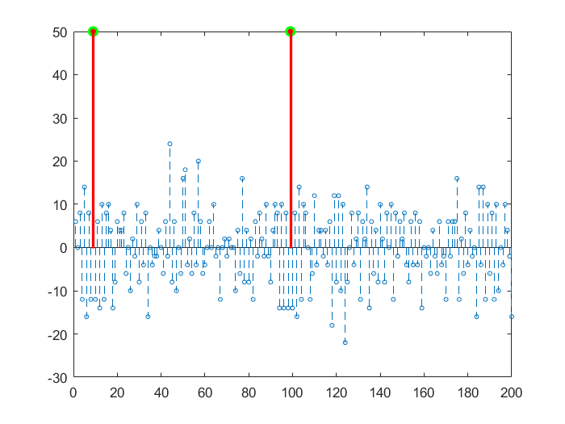
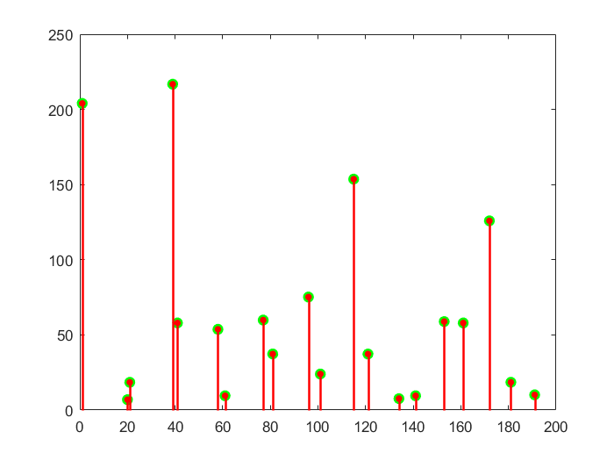
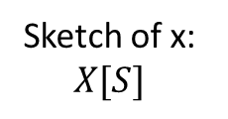






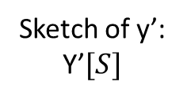
Database: $x\left[n\right]$
Sketch of x: $X[S]$
N-pt. FFT
$$⊙$$
$$y\left[n\right] { y}^{′}\left[n\right]=y\left[−n\right]$$
Sketch of y’: Y’$[S]$
N-pt. FFT
$$=$$
$τ_{1}=10 τ_{2}=100$
RSIDFT
$R\left[S\right]=X\left[S\right]⊙$ Y’[S]

