Slide 1
Transmission over a Binary Erasure Channel

Slide 3
Tanner graph for the (6,3,3)
Check nodes
Variable nodes
Parity check matrix and Tanner graph convey the same info
A code can be specified by giving its Tanner graph

Slide 4
Decoding by peeling
Check nodes
Variable nodes
If exactly 1 bit is unknown in every check, it can be recovered

Slide 5
Decoding by peeling
Check nodes
Variable nodes
If exactly 1 bit is unknown in every check, it can be recovered

Slide 6
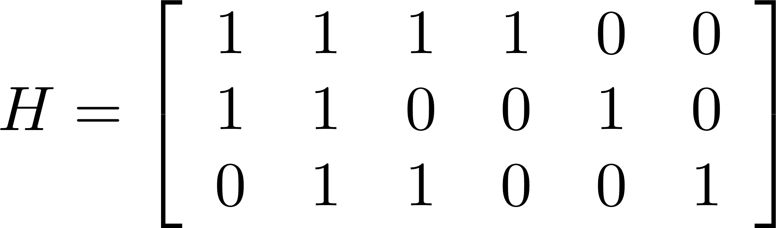
Peeling decoder is suboptimal
Check nodes
Variable nodes

Slide 7
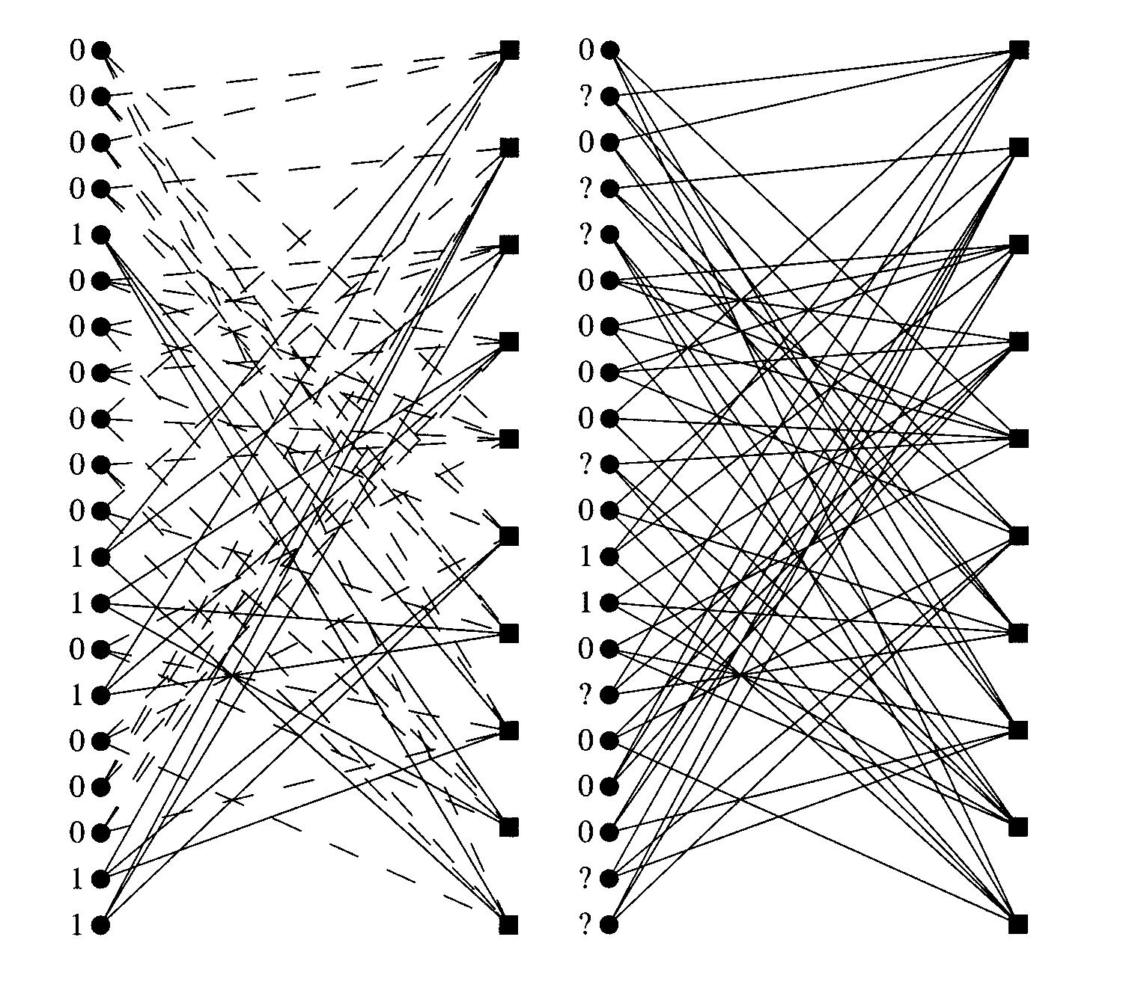
LDPC Code from a (3,6) regular ensemble

Slide 8
How good are LDPC codes ? Density Evolution
Assume
So no short cycles, we can assume graph cycle free
What is the highest fraction e for which we can correct all errors?
Compute the probability that the message along a randomly chosen edge is an erasure and see how this changes as the iterations proceed

Slide 9
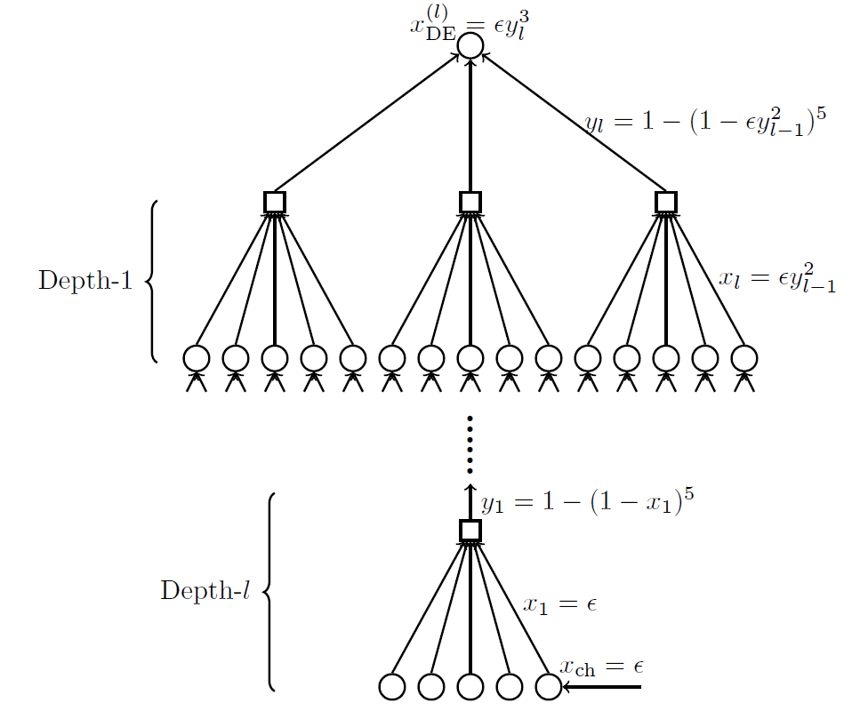
Analysis – computation tree, density evolution

Slide 10
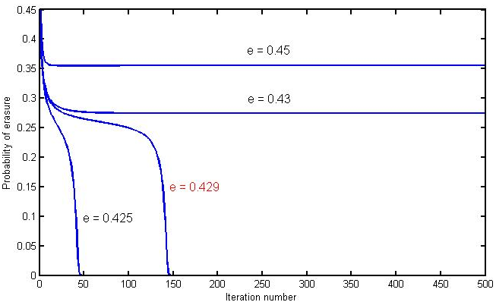
Threshold for the (3,6) regular LDPC code
For (3,6) regular codes threshold is 0.429
Although it is not 0.5, it is still quite good
How can we close the gap? – Irregular LDPC Codes

Slide 11
(3,6) LDPC Code
First iteration:
During the iteration
Threshold is the maximum value of e for which

Slide 12
(3,6) LDPC Code
First iteration: p_{l} = e
p_{r} = 1-(1-p_{l})⁵
During the q^{th} iteration
p_{l}^{q} = e (p_{r}^{q})²
p_{r}^{q} = 1-(1-p_{l}^{q-1})⁵
p_{l}^{q} = e (1-(1-p_{l}^{q-1})⁵)²
Threshold is the maximum value of e for which

Slide 13
2 erasures can be corrected
Solve the set of simultaneous equations
Mathematical tools are needed to design good matrices

Slide 14
Erasures to Non-binary Errors – Tensoring construction
Check codes
Variable nodes
If exactly 1 error in every check, it can be recovered

Slide 15
Syndrome source coding is the same as decoding
Check codes
Syndrome
Encoded output
Variable nodes
Source nodes

