Slide 1
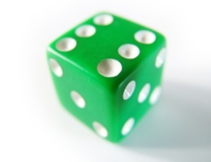


Users
Time slots
Info bits
Coded bits
+
+
….
….
+
+
Poisson
Poisson
+
+
….
….
+
+
+
+
$$f_{D}\left(i\right)=\frac{1}{ⅈ\left(ⅈ−1\right)}$$
$$f_{D}\left(i\right)=\frac{1}{ⅈ\left(ⅈ−1\right)}$$

