Slide 1
Minor Project
Predicting and Evaluating the
Popularity of Online News
PRESENTED BY
Arjun Rajpal (2K14/SE/021)
Arpit Jain (2K14/SE/022)
Avinav Goel (2K14/SE/024)

Slide 2
Introduction
01

Slide 3
Problem Statement
The aim of the project is to ― Predict and Evaluate the Popularity of Online News.
The problem is to build a model that predicts the number of shares on Social Media and in turn help to determine the popularity of Online News articles.

Slide 4
Data Set
02

Slide 5
Introduction
Mashable website: collected over a 2 year period from Jan 2013 - Jan 2015
39,644 observations
61 attributes
No missing values, but some topics were unclassified
Target: number of shares

Slide 6
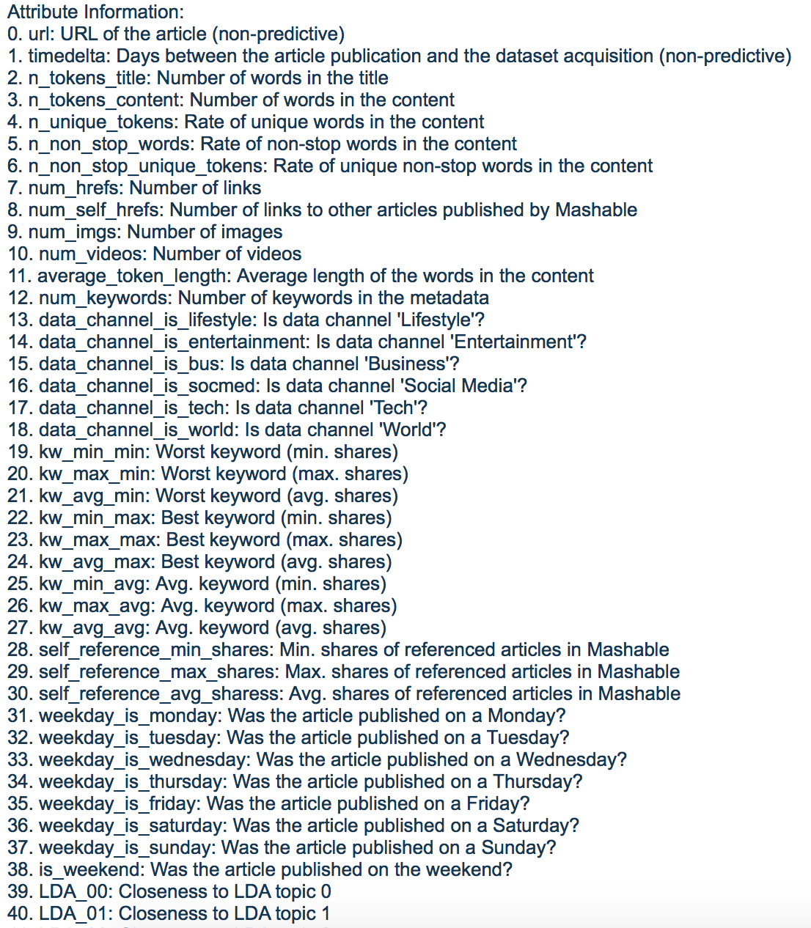
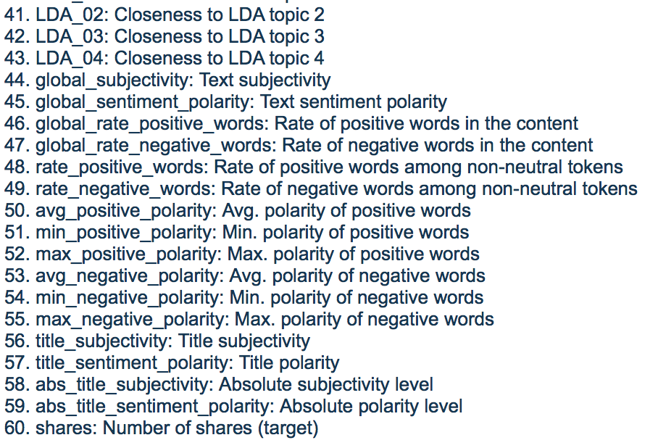
Attributes

Slide 7
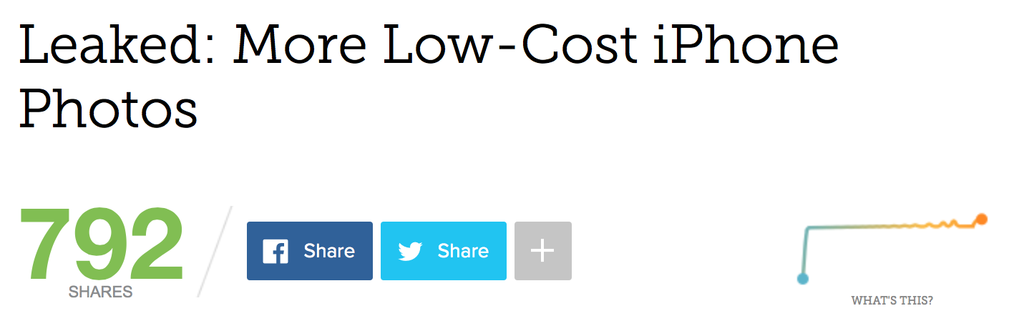
Data accuracy
Data Set | Website
843,330 shares 12 videos 128 videos | 792 shares 0 videos 12 videos

Slide 8
Data Preprocessing
03

Slide 9
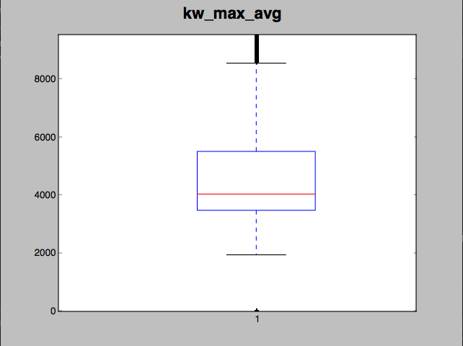
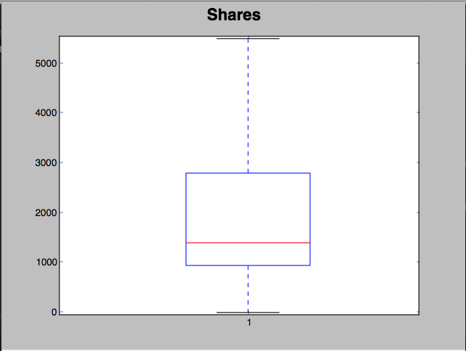
Outlier Reduction
The dataset observations were reduced from 39,644 to 21,105 after removing outliers using boxplotting.

Slide 10
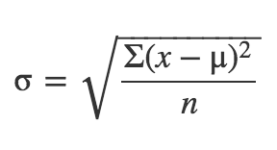
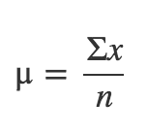
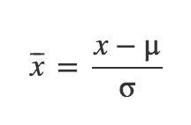
Normalization
When features differ by orders of magnitude, it is important to perform a feature scaling that can make gradient descent converge much more quickly.
Mean, Standard Deviation and Normalization Formula

Slide 11
Removal of Collinear Attributes
The following thirteen attributes were removed:
1 time_delta
2 n_tokens_title
5 n_non_stop_words
6 n_non_stop_unique_tokens
9 num_imgs
12 num_keywords
13 data_channel_is_lifestyle
15 data_channel_is_bus
18 data_channel_is_world
20 kw_avg_min
22 kw_max_max
23 kw_avg_max
29 self_refence_avg_sharess
31 weekday_is_tuesday
36 weekday_is_sunday
37 is_weekend
41 lda_03
46 global_rate_negative_words

Slide 12
Model Selection
04

Slide 13
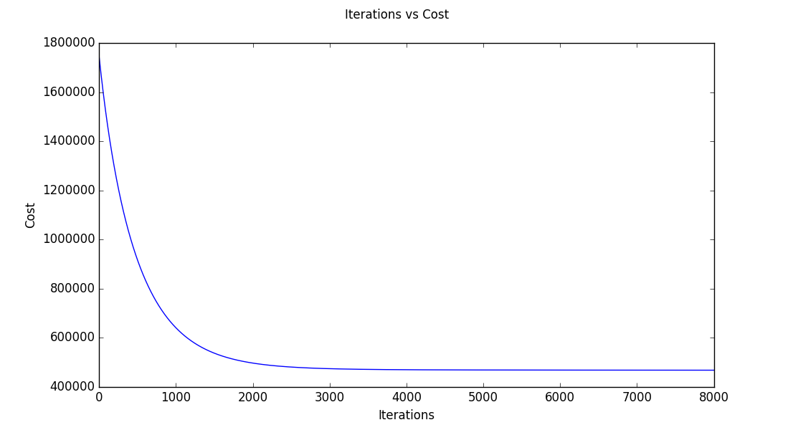
Multivariate Linear Regression
The aim is to predict the depend variable(number_of_shares) by determining set of parameters (theta).
To determine theta, we employed gradient descent to find the point of minima in the hyper-dimensional space.
Minimization of Cost Function in Gradient Descent

Slide 14
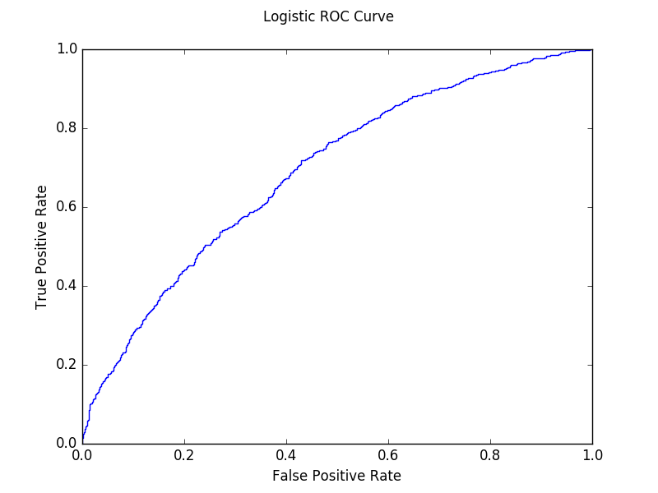
Logistic Regression
Classified the instances into two categories:
“popular”
“unpopular”
based on the median of dependent variable (number of shares).
Area Under Curve: 0.697
ROC Curve for Logistic Classifier

Slide 15
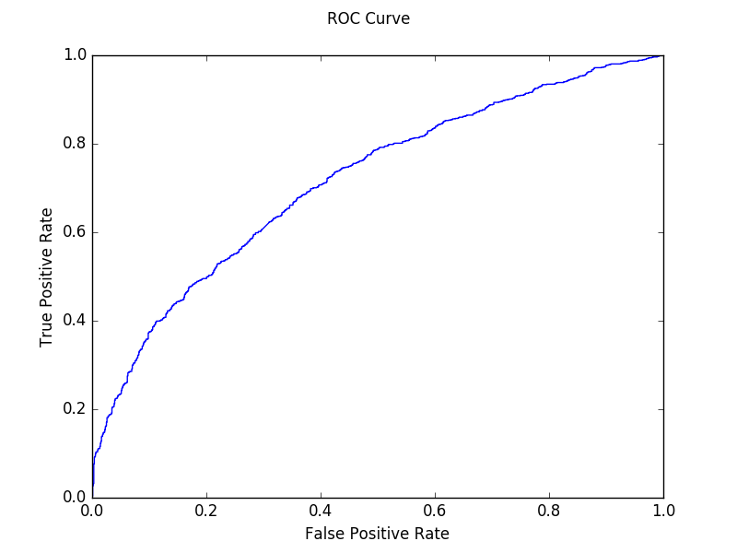
Support Vector Classification
SVM is used to find the "maximum-margin hyperplane" that divides the group of points so that the distance between the hyperplane and the nearest point from either group is maximized.
Area Under Curve: 0.694
ROC Curve for SVM Classifier

Slide 16
Conclusion

Slide 17
Conclusion
The problem was to build a model that predicts the number of shares on Social Media and in turn help to determine the popularity of Online News articles.
The developed model was able to classify given articles as “popular” or “unpopular” with an accuracy around 70%.
The developed model can help the media publishing houses to make important decisions like when to publish an article, if a given article will be popular, which category is famous, etc.
Notes:
Heba

Slide 18
Future Scope

Slide 19
Future Scope
To improve accuracy, there is little room in model selection but much room in feature selection.
The context of the article can be taken into consideration more incisively.
In the future, we could directly treat all the words in an article as additional features.
More advanced algorithms like Random Forest, Decision Tree, etc. can be used.

Slide 20
THANK YOU!
PRESENTED BY
Arjun Rajpal (2K14/SE/021)
Arpit Jain (2K14/SE/022)
Avinav Goel (2K14/SE/024)

