Slide 1
Image Super resolution
Team # 11
Team Members:
Avinav Srivastava – 20173014
Sreenivasan M – 20173013
Greenu Sharma – 20173032
Nararaju Gundala – 20173027

Slide 2
Problem statement
Estimation of Low resolution image to higher resolution
Useful in many military and civilian applications, like surveillance, auto target recognition, forensic and satellite imaging.

Slide 3
Methods
K - Nearest Neighbor
Convolution Neural Network
Support Vector Regression

Slide 4
K - Nearest neighbor
HR Image
LR Image & Down Scaled
Upscaled
Bi Cubic Interpolated
Difference
Computation
Generate Training Set
LR/Test Image
Upscaled
Bi Cubic Interpolated
KNN Computation
Reconstruction Of Image
HR Image

Slide 5
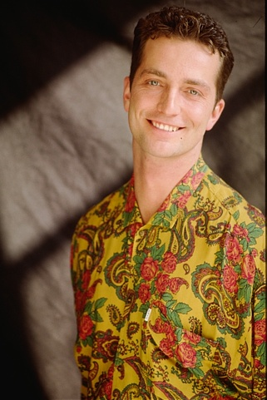


Ideal reconstruction: SRKNN: Image comparison PSNR: 21.42
HR IMAGE
BLURRED LOW RESOLUTION
IMAGE
PREDICTION IMAGE

Slide 6
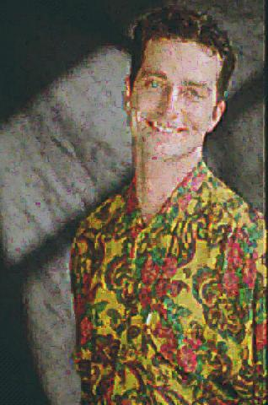
More Different training data: SRKNN: Image comparison PSNR: 19.69
HR IMAGE
Blurred low resolution IMAGE
PREDICTION IMAGE

Slide 7
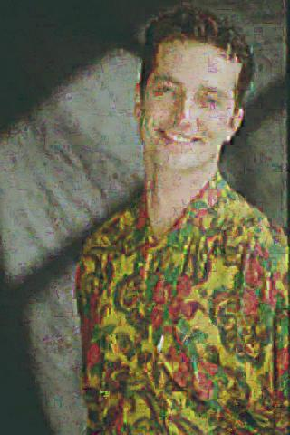
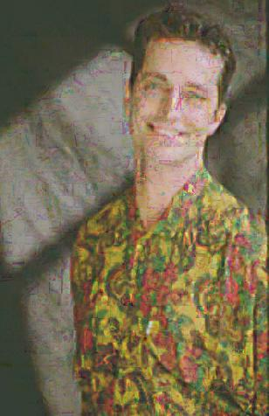
KNN=3, HR_LR=6_3
KNN=3, HR_LR=10_5
KNN=3, HR_LR=14_7

Slide 8


KNN=7, HR_LR=6_3
KNN=5, HR_LR=6_3
KNN=3, HR_LR=6_3

Slide 9
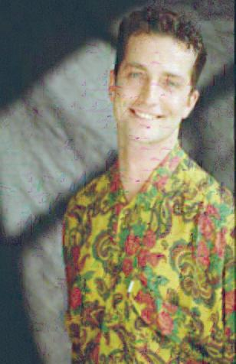

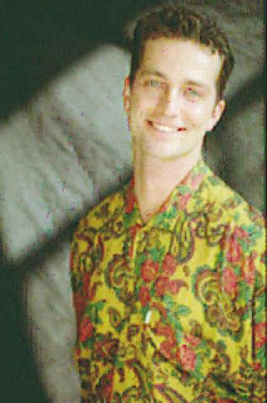
KNN=3, HR_LR=14_7
KNN=3, HR_LR=10_5
KNN=3, HR_LR=6_3

Slide 10
Convolution neural network
HR Image
LR Image & Down Scaled
Upscaled
Bi Cubic Interpolated
CNN/SRCNN
Learning
Generate Model
LR Image
Upscaled
Bi Cubic Interpolated
CNN Prediction
Reconstructed Image
HR Image

Slide 11


SRCNN: Image comparison PSNR: 29.69
HR IMAGE
INTERPOLATED IMAGE
PREDICTED IMAGE

Slide 12



SRCNN: ZOOMED COMPARISION
HR IMAGE
INTERPOLATED IMAGE
PREDICTED IMAGE

Slide 13
Space vector regression
HR Image
LR Image & Down Scaled
Upscaled
Bi Cubic Interpolated
SVR
Learning
Generate Model
LR Image
Upscaled
Bi Cubic Interpolated
SVR Prediction
Reconstructed Image
HR Image

Slide 14



HR IMAGE
INTERPOLATED IMAGE
PREDICTED IMAGE
K = 2.5e3
PSNR : 19.28
PSNR MEAN : 22.74
PSNR Max : 24.54
Patch Size = 5x5
Epsilon=0.2
C=362

Slide 15

HR IMAGE
INTERPOLATED IMAGE
PREDICTED IMAGE
K = 5e3
PSNR : 20.40
PSNR MEAN : 23.54
PSNR Max : 27.5
Patch Size = 5x5
Epsilon=0.2
C=362

Slide 16

HR IMAGE
INTERPOLATED IMAGE
PREDICTED IMAGE
K = 10e4
PSNR : 22.06
PSNR MEAN : 23.22
PSNR Max : 24.97
Patch Size = 5x5
Epsilon=0.2
C=362

Slide 17
Comparison Of DIFFERENT Methods
INPUT IMAGE
KNN, PSNR=19.69
SRCNN, PSNR=29.69
SVR, PSNR=22.06

