Slide 1
Image Super resolution
Team # 11
Team Members:
Avinav Srivastava – 20173014
Sreenivasan M – 20173013
Greenu Sharma – 20173032
Nararaju Gundala – 20173027

Slide 2
Problem statement
Estimation of Low resolution image to higher resolution
Useful in many military and civilian applications, like surveillance, auto target recognition, forensic and satellite imaging.

Slide 3
Methods
K - Nearest Neighbor
Convolution Neural Network
Support Vector Regression

Slide 4
K - Nearest neighbor
HR Image
LR Image & Down Scaled
Upscaled
Bi Cubic Interpolated
Difference
Computation
Generate Training Set
LR/Test Image
Upscaled
Bi Cubic Interpolated
KNN Computation
Reconstruction Of Image
HR Image

Slide 5
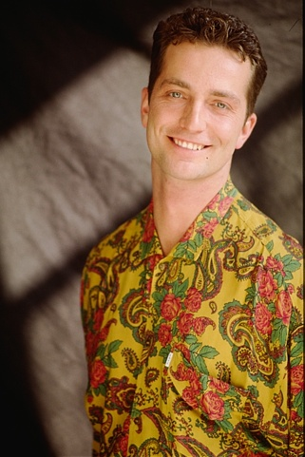

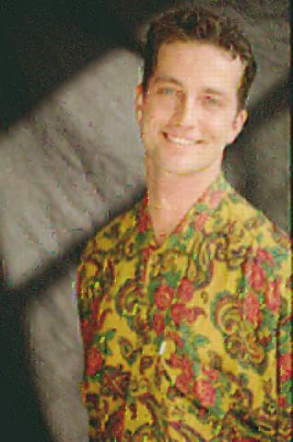
Ideal reconstruction: SRKNN: Image comparison PSNR: 21.42
HR IMAGE
BLURRED LOW RESOLUTION
IMAGE
PREDICTION IMAGE

Slide 6
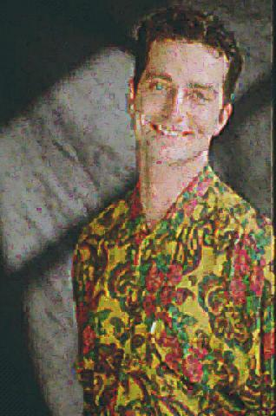
More Different training data: SRKNN: Image comparison PSNR: 19.69
HR IMAGE
Blurred low resolution IMAGE
PREDICTION IMAGE

Slide 7
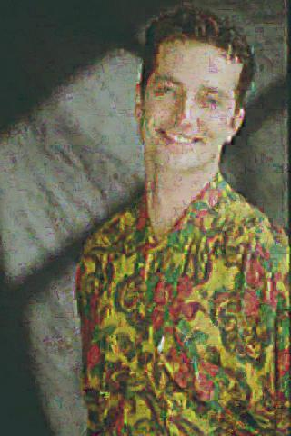
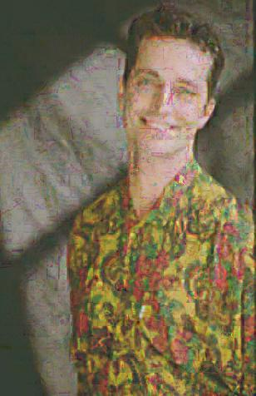
KNN=3, HR_LR=6_3
KNN=3, HR_LR=10_5
KNN=3, HR_LR=14_7

Slide 8


KNN=7, HR_LR=6_3
KNN=5, HR_LR=6_3
KNN=3, HR_LR=6_3

Slide 9
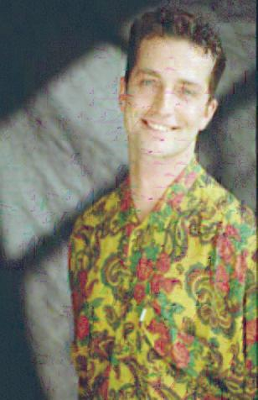

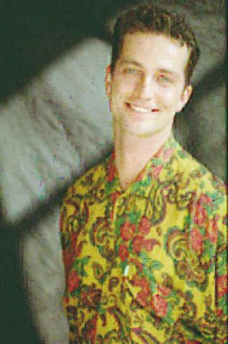
KNN=3, HR_LR=14_7
KNN=3, HR_LR=10_5
KNN=3, HR_LR=6_3

Slide 10
Convolution neural network
HR Image
LR Image & Down Scaled
Upscaled
Bi Cubic Interpolated
CNN/SRCNN
Learning
Generate Model
LR Image
Upscaled
Bi Cubic Interpolated
CNN Prediction
Reconstructed Image
HR Image

Slide 11


SRCNN: Image comparison PSNR: 29.69
HR IMAGE
INTERPOLATED IMAGE
PREDICTED IMAGE

Slide 12
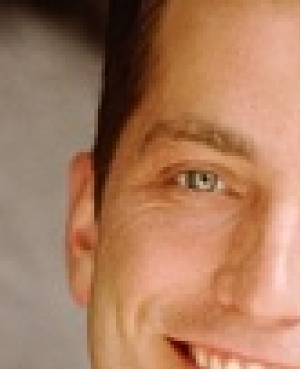
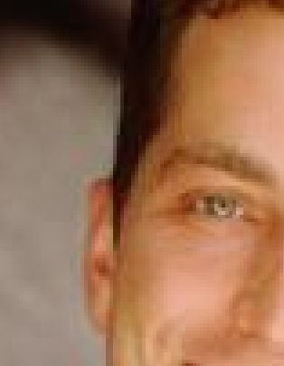
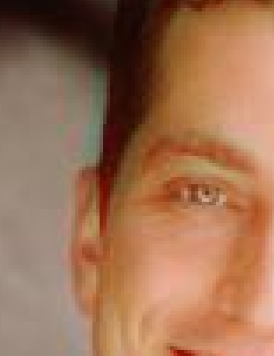
SRCNN: ZOOMED COMPARISION
HR IMAGE
INTERPOLATED IMAGE
PREDICTED IMAGE

Slide 13
Space vector regression
HR Image
LR Image & Down Scaled
Upscaled
Bi Cubic Interpolated
SVR
Learning
Generate Model
LR Image
Upscaled
Bi Cubic Interpolated
SVR Prediction
Reconstructed Image
HR Image

Slide 16
Comparison Of DIFFERENT Methods
INPUT IMAGE
KNN, PSNR=19.69
SRCNN, PSNR=29.69

