Slide 1
Part-Of-Speech
Tagging and Chunking using CRF & TBL
Avinesh.PVS, Karthik.G
LTRC
IIIT Hyderabad
{avinesh,karthikg}students.iiit.ac.in

Slide 2
Outline
  1.Introduction
  2.Background
  3.Architecture of the System
  4.Experiments
  5.Conclusion

Slide 3
Introduction
POS-Tagging:
It is the process of assigning the part of speech tag to the NL text based on both its definition and its context.
  Uses:
  Parsing of sentences, MT, IR, Word Sense disambiguation, Speech synthesis etc.
  Methods:
  1. Statistical Approach
  2. Rule Based

Slide 4
Cont..
Chunking or Shallow Parsing:
  It is the task of identifying and segmenting the text
  into syntactically correlated word groups.
  Ex:
  [NP He ] [VP reckons ] [NP the current account deficit ] [VP will narrow ] [PP to ] [NP only # 1.8 billion ] [PP in ] [NP September ] .

Slide 5
Background
Lots of work has been done using various machine learning approaches like
  HMMs
  MEMMs
  CRFs
  TBL etc…
  for English and other European Languages.

Slide 6
Drawbacks For Indian Languages:
  These techniques don’t work well when small amount of tagged data is used to estimate the parameters.
  Free word order.

Slide 7
So what to do???
Add more information…
  Morphological Information
    Root, affixes
  Length of the Word
    Adverbs, Post-positions : 2-3 chars long.
  Contextual and Lexical Rules

Slide 8
    OUR APPROACH

Slide 9
POS-Tagger
Training Corpus
Training Corpus
Features
CRF’s Training
TBL
(Building Rules)
Model
CRF’s Testing
Test Corpus
Lexical &
Contextual Rules
Pruning CRF output
using TBL Rules
Final Output

Slide 10
Chunker
HMM Based Chunk
Boundary Identification
Training Corpus
CRF’s Training
Features
Model
Test Corpus
CRF’s Testing
Final Output

Slide 11
Experiments
Pos-Tagging:
a) Features for CRF:
1) Basic Template of the combination of surrounding words have been used.
i.e. window size of 2,4, and 6 are tried with all possible combinations.
(4 was best for Telugu)
Ex: Window size of 2 : W-1,cW,W+1
Window size of 4 : W-2, W-1, cW, W+1, W+2
Window size of 6 : W-3, W-2, W-1, cW, W+1, W+2,W+3
cW : Current word
W-1: Previous word, W-2: Previous 2nd Word, W-3: Previous 3rd word
W+1: Next Word, W+2: Next 2nd Word, W+3: Next 3rd word
Accuracy: 62.89% (5193 test data)

Slide 12
2) n-Suffix information:
This feature consists of the last, last 2,last 3 and last 4 chars of a word. (Here the suffix mean statistical suffix not the linguistic suffix)
Reason:
Due to the agglutinative nature of Telugu considering the suffixes increases the accuracy.
Ex: ivvalsociMdi (had to give) : VRB
ravalsociMdi (had to come): VRB
Accuracy: 73.45 %

Slide 13
3) n-Preffix information:
This feature consists of the first, first 2, first 3, and so on up to first 7 chars of the words. ( prefix means statistical prefix not the linguistic prefix)
Reason:
Usually the vibakthis get added to nouns.
    puswakAlalo (in the books) NN
    puswakAmnu (the book) NN
Accuracy: 75.35%

Slide 14
4)Word Length:
All the words with length <=3 are tagged as Less and the rest are tagged as More.
Reason:
This is to account large number of functional words in Indian Language.
Accuracy: 76.23%

Slide 15
5) Morph Root & Expected Tags:
Root word and the best three expected lexical categories are extracted using the morphological analyzer and are added as feature.
Reason:
It is similar to the concept of the prefix and suffix. But here the root is extracted using the Morph Analyzer. Expected tags can be used bind the output of the tagger.
Accuracy: 76.78%

Slide 16
b) Pruning :
Next step is pruning the output using the rules generated by TBL i.e. the contextual and the lexical rules.
Ex:
VJJ to VAUX when bigram is lo unne
JJ to NN when next tag is PREP
Accuracy: 77.37%

Slide 17
Tagging Errors:
Issues regarding the nouns/compound nouns/adjectives.
  NN → NNP
  NNC → NN
  NN → JJ
  And Also,
  VRB → VFM; VFM → VAUX etc…

Slide 18
Experiments…(chunking)
1) Chunk Boundary identification
Initially we tried out HMM model for identifying the chunk boundary .
First level:
pUrwi NVB B
cesi VRB I
aMxiMcamani VRB I

Slide 19
2) Chunk Labeling Using CRFs
Features used in the CRF based approach are:
Word window of 4 : W-2,W-1,cW,W+1,W+2
Pos-tag window of 5 : P-3,P-2,P-1,cP,P+1,P+2
We used the chunk boundary label as a feature.
Second level:
pUrwi NVB B-VG
cesi VRB I-VG
aMxiMcamani VRB I-VG

Slide 20
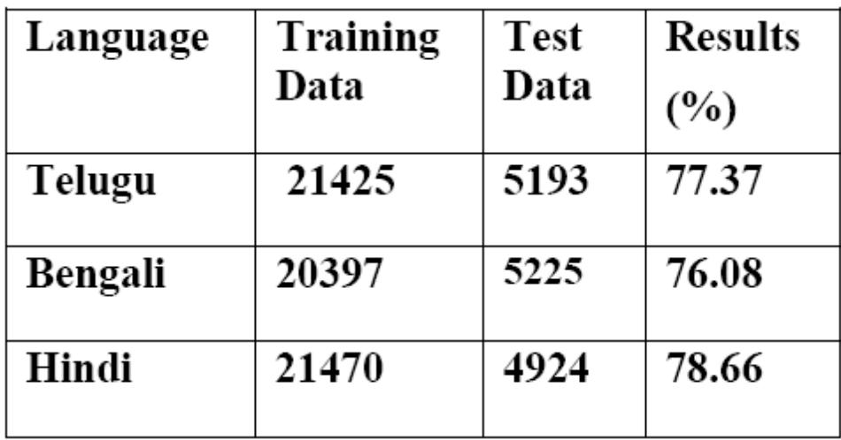
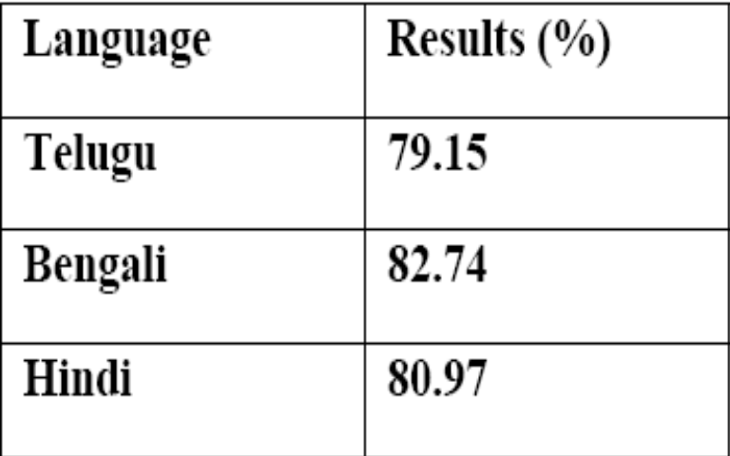
Results
Fig.1 Results of the POS-Tagging
Fig.2 Chunking Results
*The same model is used for Telugu, Hindi and Bengali except for variations in the window size i.e. for Hindi, Bengali and Telugu we used a window size of 6, 6 and 4 respectively.
* Using the Golden Standard tags the accuracy for Telugu tagger was 90.65%

Slide 21
Conclusion
The best accuracies were achieved with the use morphologically rich features like suffix, prefix of information etc... coupled with various efficient machine learning techniques
Sandhi Spliter could be used to improve furture.
    Eg:
    1: pAxaprohAlace (NN) = pAxaprahArAliiu (NN) + ce (PREP)
2: vAllumtAru(V) = vAlylyu(NN) + uM-tAru(V)

Slide 22
Queries???
Thank You!!

