Slide 1
Parking Solution using
Automatic Number Plate Recognition
Supervised by: Mr. Bhupendra Ram Luhar

Slide 2
Presented By
Abin Timlisina 24042
Kritika Sharma 24053
Ruza Kansakar 24067

Slide 3
INTRODUCTION
1
Basic introduction on ANPR System

Slide 4
INTRODUCTION
ANPR System
Automatic Number Plate Recognition (ANPR) system is designed to autonomously read vehicle number plates through high-speed image capture, illumination, character detection, and recognition. It eliminates the need for human intervention in the process.
The technology involves capturing high-speed images, detecting characters on the number plates, verifying character sequences and converting the recognized characters into text—resulting in metadata that identifies the image containing a vehicle number plate along with the associated decoded text.

Slide 5
PROBLEM STATEMENT
2
Problems that our system tries to eliminate

Slide 6
PROBLEM STATEMENT
Traditional Parking Problems
Manual billing processes lead to inaccuracies, slow operations, errors, and higher labor costs.
Impact on Users
The absence of user-friendly features diminishes overall convenience and customer satisfaction.
Proposed Solution
By incorporating Automatic Number Plate Recognition (ANPR), YOLOv8, and EasyOCR, our system aims to automate processes, improve security, and enhance overall user experience.

Slide 7
OUR OBJECTIVES
3
The main objectives our project

Slide 8
OUR OBJECTIVES
To utilize YOLOv8 algorithm for automatic license plate recognition of the uploaded video.
To introduce time-based pricing for registered and non registered vehicles during check-in and check-out.

Slide 9
DEVELOPMENT METHODOLOGY
4
Methodology we used to develop our system

Slide 10
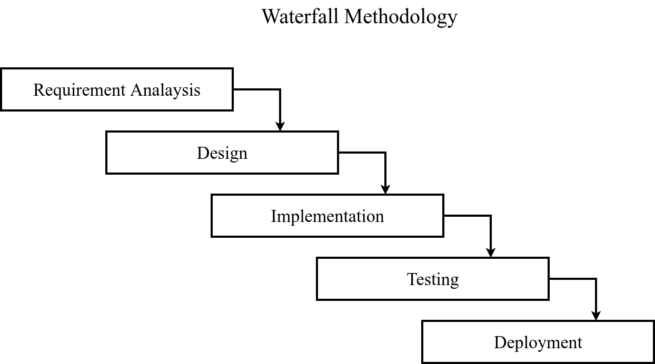

Slide 11
FUNCTIONAL
REQUIREMENTS
5
Functional requirements of our system

Slide 12
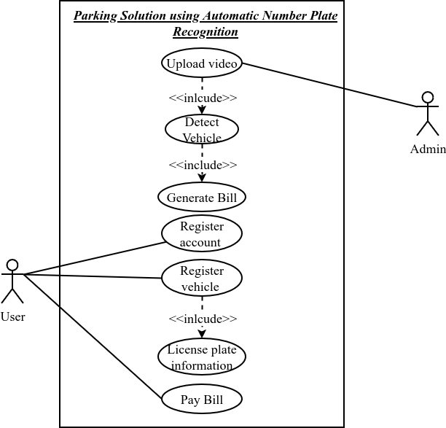

Slide 13
NON-FUNCTIONAL
REQUIREMENTS
6
Non-Functional requirements of our system

Slide 14
NON-FUNCTIONAL REQUIREMENTS
Performance
The system is designed for swift and accurate vehicle detection, license plate recognition, and authentication.
Availability
To guarantee a seamless user experience, the system is engineered for continuous and uninterrupted operation, providing 24/7 availability.
Security
The system prioritizes user data protection with robust security measures, including encryption for confidentiality.
Usability
The parking system is crafted with a user-centric approach, featuring a user-friendly interface designed for easy navigation and accessibility.

Slide 15
SYSTEM
FEASIBILITY
7
Feasibility analysis of our system

Slide 16
SYSTEM FEASIBILITY
Economic Feasibility
Assess the ANPR system financial viability by comparing costs, calculating return on investment and conducting a comprehensive cost-benefit analysis.
Operational Feasibility
Address training needs for staff, evaluate scalability concerning user and vehicle growth, and ensure ongoing support and adaptability to evolving requirements for sustained performance.
Technical Feasibility
Assess technology availability, compatibility, integration with existing systems, and legal adherence for ANPR system implementation.

Slide 17
DATABASE
SCHEMA DIAGRAM
8
Schema representation of database

Slide 18
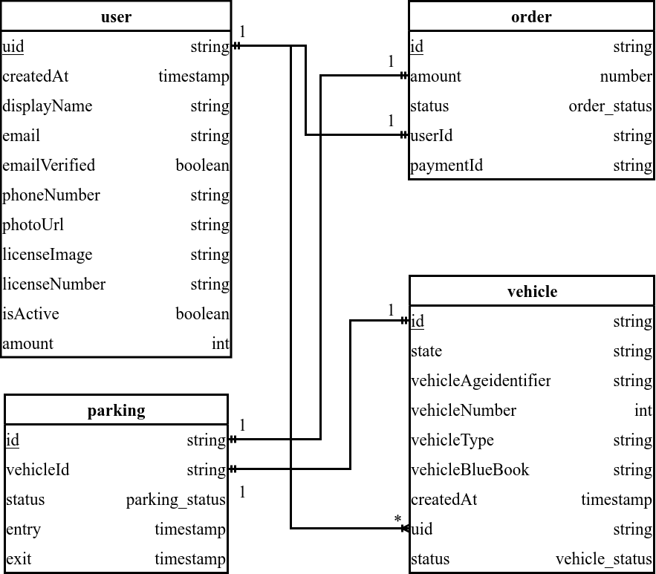

Slide 19
CONTEXT DIAGRAM
9
Interaction with the system

Slide 20
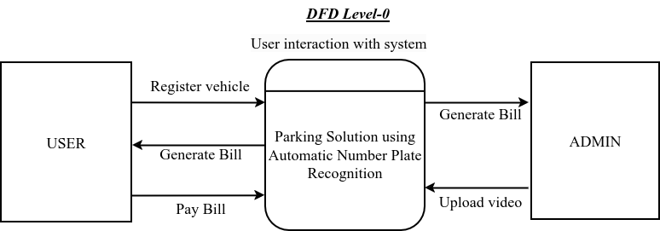

Slide 21
DATA FLOW DIAGRAM LEVEL-1
10
Detailed process of the system

Slide 22
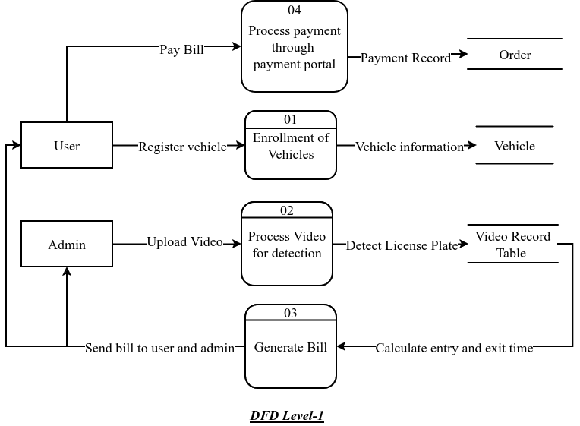

Slide 23
YOLO ALGORITHM
11
Workings of YOLOv8 Detection Model

Slide 24
YOLO ALGORITHM FOR OBJECT DETECTION
YOLO ALGORITHM
YOLO is a widely used object detection algorithm in computer vision and deep learning. The acronym stands for "You Only Look Once," emphasizing its ability to simultaneously predict bounding boxes and class probabilities for multiple objects in real-time, treating object detection as a regression problem.
HOW DOES IT WORK?
YOLO divides the input image into an n x n grid, with each grid cell responsible for predicting multiple bounding boxes (typically 5).The algorithm predicts bounding box coordinates, and a confidence score for each box, indicating the algorithm's confidence that an object is present. This simultaneous prediction of all bounding boxes in a single pass through the network enables real-time processing and distinguishes YOLO from multi-stage detection approaches.

Slide 25
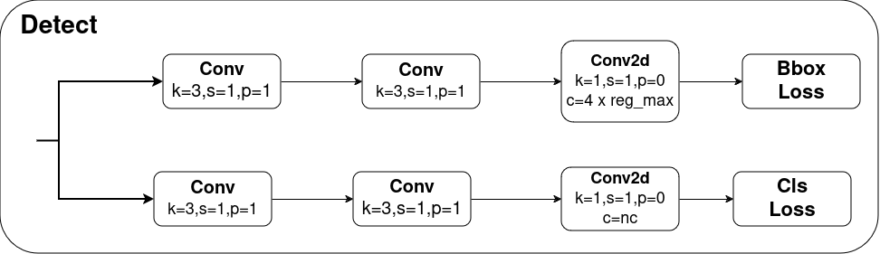
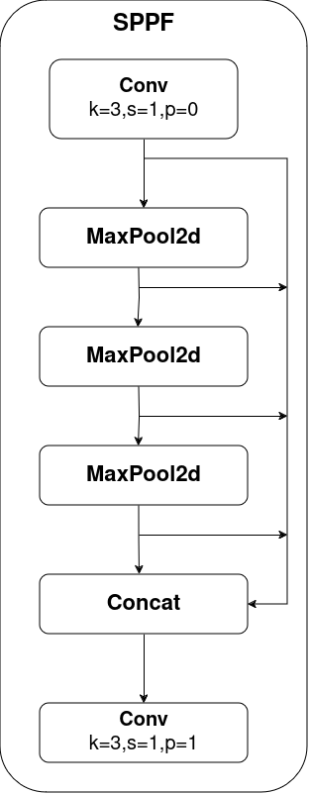
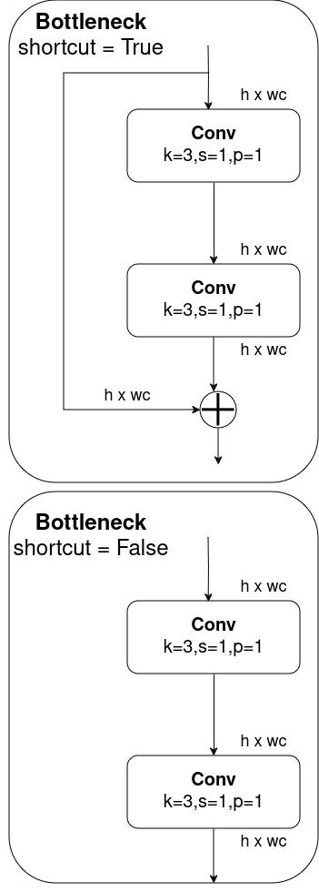
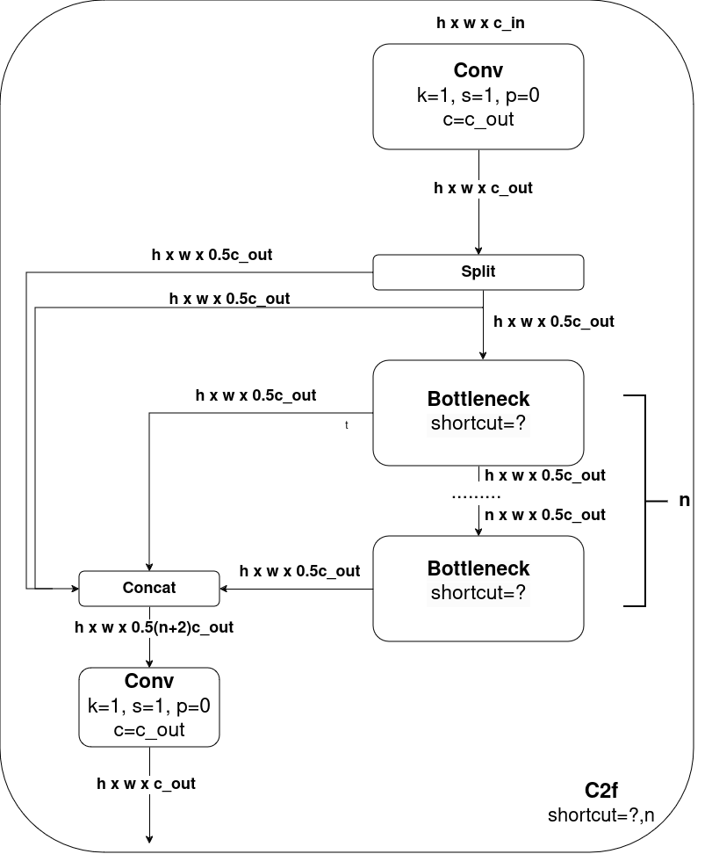
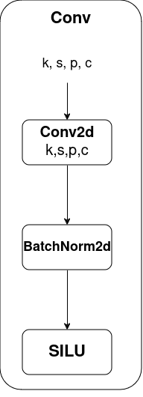

Slide 26
EasyOCR ALGORITHM
12
Workings of EasyOCR Algorithm

Slide 27
EasyOCR ALGORITHM FOR CHARACTER RECOGNITION
EasyOCR ALGORITHM
EasyOCR is a Python-based Optical Character Recognition (OCR) module designed for simplicity and user-friendly implementation, making it accessible to developers without prior OCR or computer vision expertise.
HOW DOES IT WORK?
EasyOCR takes images from various sources like scanned documents or photos, allowing users to specify languages for enhanced accuracy, and employs preprocessing, text detection, and OCR algorithms, including support for multiple engines and models, utilizing deep learning for character recognition within identified regions.

Slide 28
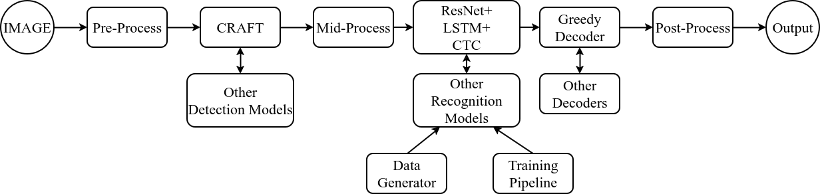
EasyOCR Framework

Slide 29
IMPLEMENTATION TOOLS
13
Tools used for development

Slide 30
IMPLEMENTATION TOOLS?
Web Application Development Tool.
Nextjs (React)
Shad-cn for styling
Backend Tools
Python (for model training and detection using YOLOv8 and EasyOCR).
Firebase for user information, vehicle information and licence plate information authentication, database and storage.
Khalti for payment gateway.
Other Tools
Vercel for Deployment
Git for Version Control System & GitHub for Collaboration
VS Code for IDE

Slide 31
CONCLUSION
14
Summary of the project

Slide 32
CONCLUSION
The Parking Solution leveraging YOLOv8 detection model and EasyOCR character recognition has been successfully implemented.
The ANPR model demonstrates a high accuracy rate of 95% when considering predictions with a confidence score greater than 0.5, showcasing its reliability in license plate detection.
The system has effectively automated license plate recognition from uploaded videos, significantly improving efficiency and accuracy in vehicle identification.
Time-based pricing for registered and non-registered vehicles during check-in and checkout processes has been seamlessly introduced, offering a fair and dynamic pricing model for users.

Slide 33
DEMO
15

Slide 34
Thank You!
Any questions ?

