Slide 1
Virus Simulation
Aaron, Nate, Nick

Slide 2
Problem Definition
Create a simulation program to see how quickly a virus could infect a population

Slide 3
Challenges
Cocos2d-x

Slide 4
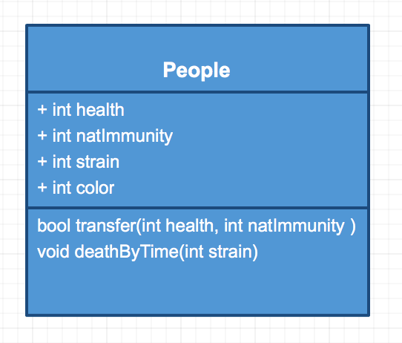
UML Diagram

Slide 5
Flow Diagram

