Slide 1
Relation between Suicides, Inflation and Unemployment
Orhan Kocak, Enis Arda Iskender, Kerem Efe Akyurt

Slide 2
Datasets Used
- Consumer Price Index
- Unemployment Rates
- Yearly Suicide Data
- Global Suicide Data
- Global Inflation Data
- Global Unemployment Rates

Slide 3
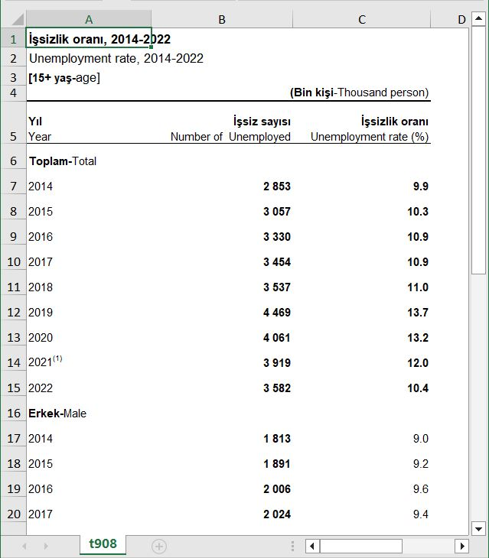
Unemployment Rate

Slide 4
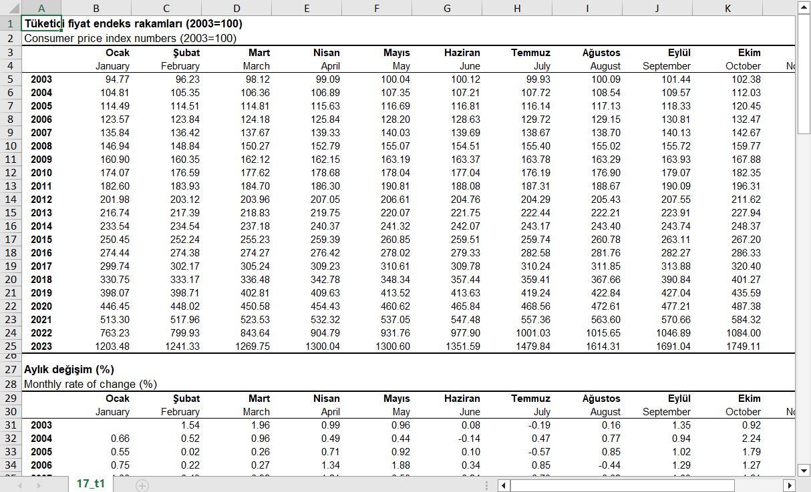
Consumer Price Index

Slide 5
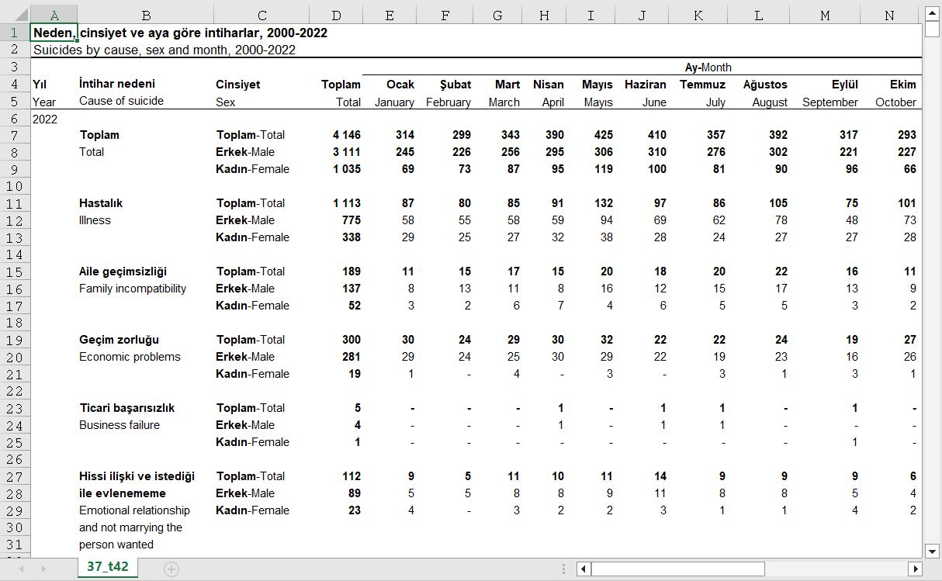
Suicide Data

Slide 6
Cleaning Datas

Slide 7
UnemploymentData
unemploymentData <- read_excel("unemployment.xls", skip = 6, col_names = c("Year","Count","Percentage")) unemploymentData <- unemploymentData |> slice(0:8) unemploymentData[8,1] = "2021" head(unemploymentData,2)
## # A tibble: 2 × 3 ## Year Count Percentage ## <chr> <dbl> <dbl> ## 1 2014 2853 9.91 ## 2 2015 3057 10.3

Slide 8
Consumer Price Index
#Consumer Price Index priceIndex <- read_excel("inflation.xls", skip = 4, col_names = c("Year","January","February","March","April","May","June","July","August","September","October","November","December")) priceIndex <- priceIndex |> slice(12:19)|> mutate(across(2:last_col(), as.numeric))|> mutate(Total = rowSums(across(January:December)), .before = January)

Slide 9
Suicide Data
rows_to_read_male <- c(42,81,120,159,198,237,276,315) rows_to_read_female <- c(43,82,121,160,199,238,277,316) suicideData <- read_excel("suicide.xls", skip = 4) suicideData_male <- suicideData |> slice(rows_to_read_male)|> select(-c(1,2))|> mutate(Year = c(2021,2020,2019,2018,2017,2016,2015,2014), .before = Sex)|> arrange(-dplyr::row_number()) suicideData_female <- suicideData |> slice(rows_to_read_female)|> select(-c(1,2))|> mutate(Year = c(2021,2020,2019,2018,2017,2016,2015,2014), .before = Sex)|> arrange(-dplyr::row_number())

Slide 10
Plots

Slide 11
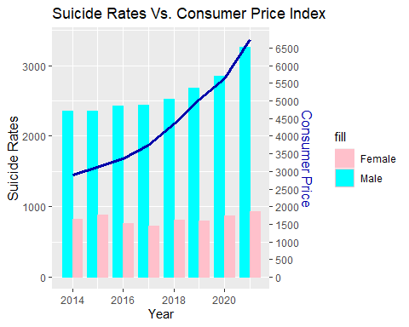
Suicide - Consumer Price Index Plot
plot_suicide_vs_price <- ggplot() + geom_bar(data = suicideData_male, aes(x = as.numeric(Year) - 0.2, y = as.numeric(Total), fill = "Male"), color = "cyan", position = "dodge", stat = "identity", width = 0.4) + geom_bar(data = suicideData_female, aes(x = as.numeric(Year) + 0.2, y = as.numeric(Total), fill = "Female"), color = "pink", position = "dodge", stat = "identity", width = 0.4) + geom_line(data = priceIndex, aes(x = as.numeric(Year), y = as.numeric(Total) / 2, group = 1), color = "#0000aa", linewidth = 1.2) + scale_y_continuous( name = "Suicide Rates", sec.axis = sec_axis(~ . * 2, name = "Consumer Price", breaks = seq(0, max(priceIndex$Total), by = 500)) ) + scale_fill_manual(values = c("Male" = "cyan", "Female" = "pink")) + theme( axis.title.y = element_text(color = "black", size = 12), axis.title.y.right = element_text(color = "#0000aa", size = 12) ) + labs(title = "Suicide Rates Vs. Consumer Price Index") + xlab("Year") plot_suicide_vs_price

Slide 12
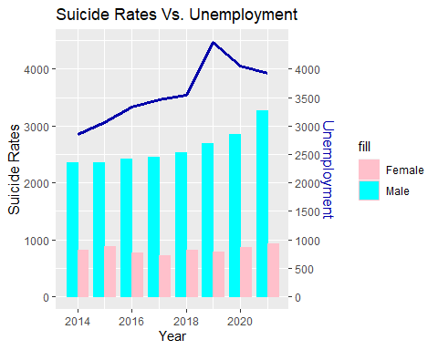
Suicide - Unemployment Rate Plot
plot_suicide_vs_unemployment <- ggplot() + geom_bar(data = suicideData_male, aes(x = as.numeric(Year) - 0.2, y = as.numeric(Total), fill = "Male"), color = "cyan", position = "dodge", stat = "identity", width = 0.4) + geom_bar(data = suicideData_female, aes(x = as.numeric(Year) + 0.2, y = as.numeric(Total), fill = "Female"), color = "pink", position = "dodge", stat = "identity", width = 0.4) + geom_line(data = unemploymentData, aes(x = as.numeric(Year), y = Count), color = "#0000aa", linewidth = 1.2, group = 1) + scale_y_continuous( name = "Suicide Rates", sec.axis = sec_axis(~ ., name = "Unemployment", breaks = seq(0, max(unemploymentData$Count), by = 500)) ) + scale_fill_manual(values = c("Male" = "cyan", "Female" = "pink")) + theme( axis.title.y = element_text(color = "black", size = 12), axis.title.y.right = element_text(color = "#0000aa", size = 12) ) + labs(title = "Suicide Rates Vs. Unemployment") + xlab("Year") plot_suicide_vs_unemployment

Slide 13
Global Data Cleaning

Slide 14
Global Inflation Data
inflation_data <- read.csv("inflation_oecd.csv") inflation_data_cleared <- inflation_data[, !(names(inflation_data) %in% c("INDICATOR","MEASURE", "SUBJECT", "FREQUENCY", "Flag.Codes"))] inflation_data_filtered <- inflation_data_cleared %>% filter(between(TIME, 2000, 2019))

Slide 15
Global Unemployment Data
unemployee_data <- read.csv("unemployee_rate.csv") unemployee_data_oecd <- unemployee_data %>% filter(LOCATION == "OECD") unemployee_data_oecd_filtered <- unemployee_data_oecd[, !(names(unemployee_data_oecd) %in% c("MEASURE", "SUBJECT", "FREQUENCY", "Flag.Codes"))]

Slide 16
Global Suicide Data
suicide_data <- read.csv("global_suicide_rates.csv", skip = 1) suicide_data_cleared <- suicide_data %>% mutate(across(starts_with("X"), ~gsub("\\[.*?\\]", "", .))) suicide_data_filtered <- suicide_data_cleared %>% gather(key = "year_rate", value = "rate", starts_with("X")) %>% mutate(year = gsub("X\\.", "", year_rate)) %>% separate(year, into = c("year", "X"), sep = "\\.") %>% select(-X, -year_rate) %>% arrange(year) suicide_data_filtered_avg <- suicide_data_filtered %>% group_by(year, Sex) %>% summarise(rate = mean(as.numeric(rate), na.rm = TRUE))
## `summarise()` has grouped output by 'year'. You can override using the ## `.groups` argument.
suicide_data_filtered_avg_unisex <- suicide_data_filtered_avg %>% filter(Sex == " Male")

Slide 17
Global Plots

Slide 18
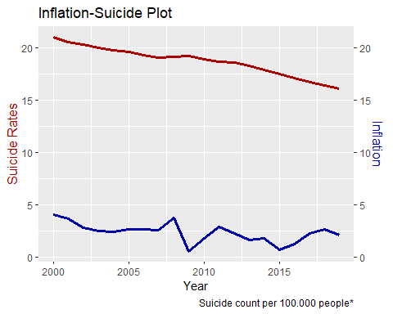
Inflation-Suicide Plot
ggplot() + geom_line(data=suicide_data_filtered_avg_unisex,aes(x=as.numeric(year), y = (as.numeric(rate))), color="#aa0000", linewidth=1.2) + geom_line(data=inflation_data_filtered, aes(x=as.numeric(TIME),y=as.numeric(Value)), color="#0000aa", linewidth=1.2) + scale_y_continuous( name = "Suicide Rates", sec.axis = sec_axis(~., name="Inflation") ) + theme( axis.title.y = element_text(color = "#aa0000", size=12), axis.title.y.right = element_text(color = "#0000aa", size=12) ) + labs( title="Inflation-Suicide Plot", caption="Suicide count per 100.000 people*" ) + xlab("Year")

Slide 19
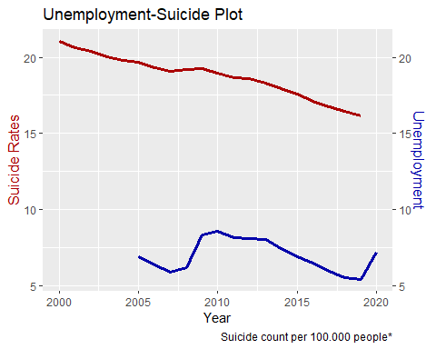
Unemployment - Suicide Plot
ggplot() + geom_line(data=suicide_data_filtered_avg_unisex,aes(x=as.numeric(year), y = (as.numeric(rate))), color="#aa0000", linewidth=1.2) + geom_line(data=unemployee_data_oecd_filtered, aes(x=as.numeric(TIME),y=as.numeric(Value)), color="#0000aa", linewidth=1.2) + scale_y_continuous( name = "Suicide Rates", sec.axis = sec_axis(~., name="Unemployment") ) + theme( axis.title.y = element_text(color = "#aa0000", size=12), axis.title.y.right = element_text(color = "#0000aa", size=12) ) + labs( title="Unemployment-Suicide Plot", caption="Suicide count per 100.000 people*" ) + xlab("Year")

Slide 20
That’s the end, thank you all for listening.

