Slide 1

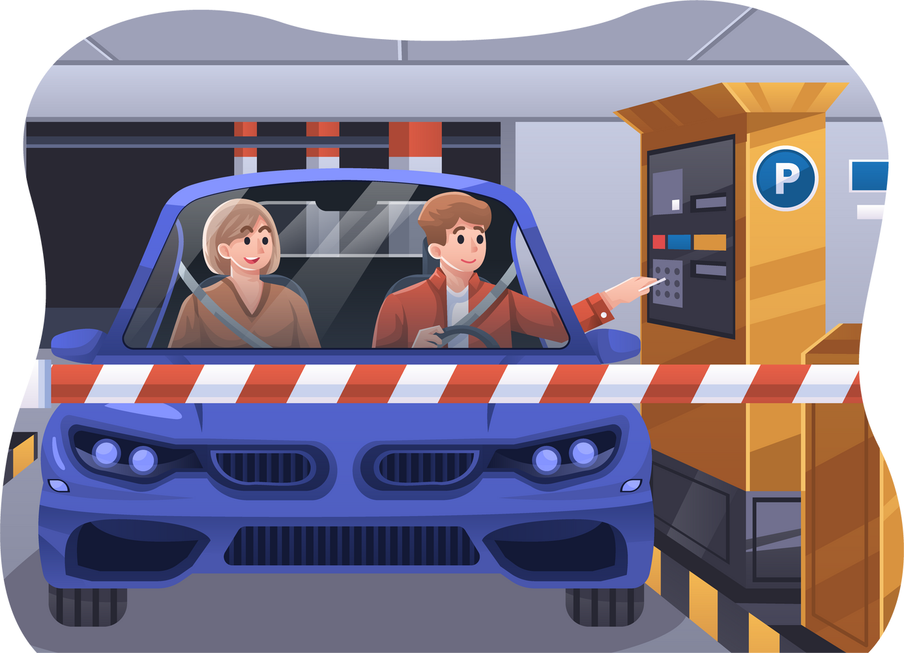

Smart In-Campus Car
Parking System

Slide 2
Abstract-
Finding a vacant parking space is becoming a real problem, especially in areas with limited parking spots such as airports, shopping centers, offices, and universities. Searching for available parking slots usually is time-consuming and always results in frustration especially when time is the major constraint.
Moreover, vacant parking is hard to be noticed due to an unsystematic parking system. This will result in a longer searching time which can also lead to traffic congestion. In addition, lack of security enforcement on cars entering universities campus is also one of the main issues contributing to insufficient parking spaces. This might cause some unauthorized cars to take the opportunity to get inside the campus without any approval and consent from the security department.
Therefore, A Cloud-based Automated Parking System for Smart campuses is developed in this project. It consists of a sub-system that is developed to display the available number of parking slots so that it will assist authorize users to easily find their parking spots. The proposed system can also recognize car plate numbers through Automated Car Plate Recognition (ACPR) mechanism which is located at the campus's main entrance gate to avoid unauthorized cars from getting in. This has strengthened the security level inside the campus and ensured the safety of students and staff. All the information collected is sent into the cloud and stored inside a database system. The information regarding vacant parking can also be displayed using the developed mobile apps.

Slide 3
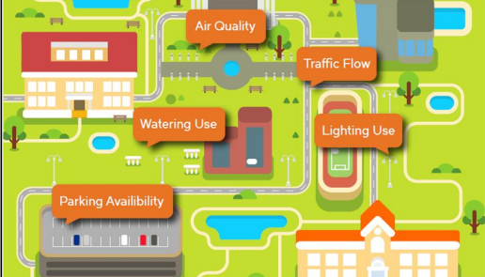
Introduction-
Smart Campus Facilities
Rapid development in smart cities leads to the realization of many innovations that span a wide variety of sectors and societies. One of the dominant applications includes a smart parking system that takes into consideration of the mechanism of finding available parking spots. The development of smart parking involves the integration of various sensors and microprocessors to assist in real-time parking information updates and systematic management systems. The idea of smart parking is triggered by the common difficulties in finding vacant spots, especially in crowded areas in cities, shopping centers, and universities. Finding a vacant parking spot can be troublesome, especially in a hurry situation. In this project, we narrow down our focus for developing a smart and automatic parking system for Smart Campus.
In this project, a smart parking system is developed to provide fast and accurate real-time parking information to drivers (students, staff, visitors) even before they arrive at their destination. The aim of this project is to provide a convenient parking system, as well as to make parking easier, faster to be found, and thus, less stressful. This project is developed as part of Smart Campus realization with the purpose to lessen the use of manpower with the help of electronic devices to provide an efficient parking management system. Smart Campus is aimed to achieve a remarkable reduction in energy consumption. It has been introduced in different areas inside the campus, including the smart watering system, smart electric usage control, air

Slide 4
Considering the significance of having an efficient parking system, this project emphasizes on implementation of a Smart Parking System in Smart Campus. Various types of electronic sensors are used in this project to monitor and guide users to identify the number of available parking slots on the campus. In addition to providing convenience and accurate parking information to users, the development of this smart parking also facilitates solving security issues by enabling the recognition of authorized and unauthorized vehicles.
The smart parking system in this project is designed to solve the ever-increasing difficulties in finding available parking slots on campus. Due to limited spaces, available parking slots are hard to be noticed or found on campus. This is especially true throughout semesters when students and staff are rushing for class and available parking is hard to be found near facilities. Moreover, when the parking area is almost full of cars, free parking spots are becoming harder to be noticed, making it more time-consuming for drivers. In this case, drivers need a longer time to search for the available parking slots. Another common problem on the campus is difficulties in recognizing unauthorized visitors.
Until recently, most security inspections on cars entering any campus is done manually by security guards. Security guards may inspect passengers individually or just check the car stickers whether they belong to the university or not. Upon inspection, if they are neither staff nor students, visitors’ identification will be manually recorded on paper. The obvious problem with this manual inspection and recording is visitors’ IDs may be impersonated. This might be difficult to manually identify the authorized and unauthorized vehicles and cause them to take the opportunity to get inside without approval and consent from the security department. In addition, jotting down the car plate number and visitor ID will not solve the unauthorized visitors since it is almost impossible for the security guards to manually compare with previous records (if there are any).
Manual authorize car stickers can be simply stuck onto cars by unauthorized visitors, which could be worsening the situation. For instance, many thefts of equipment inside the campus are a major problem that might be done by unauthorized visitors. These problems are hence becoming the matter of utmost importance in developing smart campuses and thus require an efficient solution. Therefore, to prevent any undesirable circumstances, a smart parking system needs to be developed.

Slide 5
Objective-
To develop a smart parking system that can detect vehicle occupancy and management of parking slots. To solve the aforementioned problems, the Smart Parking system proposed in this project can assist users in two aspects. Upon arriving at the university’s main gate, drivers (staff, students, or visitors) will be provided with information on several available parking slots. This information will be displayed on the LCD screen near the main gate. For convenient purposes, this information can also be accessed through their mobile apps (for students and staff only). In addition, once drivers reach the parking compound, there is also an on-spot display at the parking area. The mobile phone application enables immediate information to be disseminated about the available parking slots before they arrive at the parking area. Users can choose not to install the mobile application as there is also an on-spot display that is installed at the main gate entrance on campus. Not only that this will reduce fuel consumption but also air pollution, by providing a smart campus.
To increase the campus security level and cater to the problem of unauthorized visitors, an Automatic Car Plate Recognition system is built. This part of the system is designed to prevent unauthorized cars from entering campus without approval from the security department. The Automated Parking System for Smart Campus in this project is integrated with the Internet of Things (IoT) that allows physical devices which are embedded with electronic components like sensors or software to collect and exchange data through the internet. Various sensors are used to record the information about the environment and are sent to the cloud for storage purposes. Information that is stored in the cloud is then shared with the user through Graphical User Interface (GUI) which is either Android-based GUI or website-based GUI. Users can also send the data from GUI to the cloud for certain purposes such as reservation of free parking slots. Thus, information exchange between devices and the cloud through the internet will take place.

Slide 6
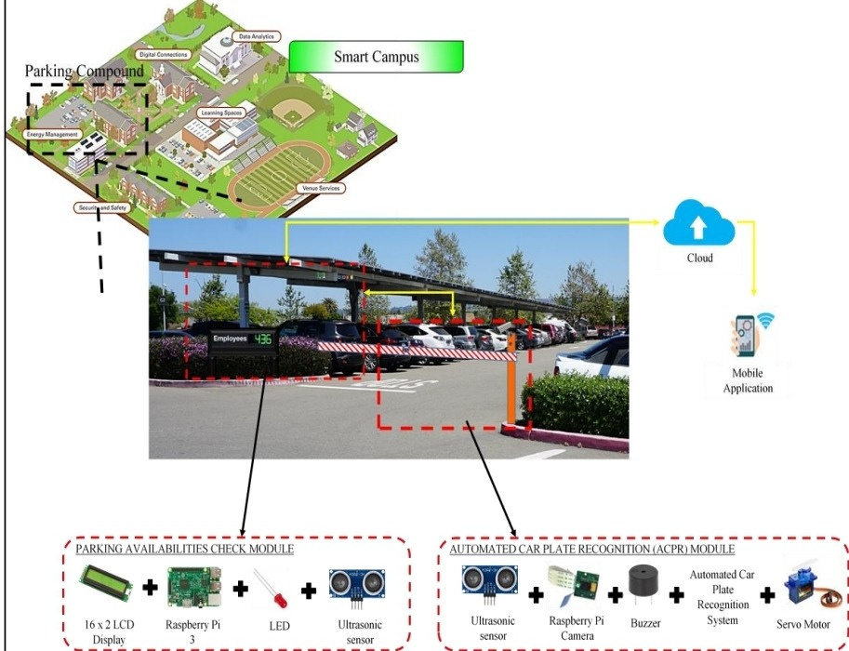
Proposed System
A smart parking system in this project can be divided into two parts: (i) available parking detection and notification (ii) secure authorization through Automatic Car Plate Recognition (ACPR).
This section presents the details of the system overview and illustrates the design. A brief introduction to this project will also be carried out in this section. The overall system overview is shown in figure while the prototype of the system is shown in next slide. The system is consisting of two main parts: (i) the main entrance gate and (ii) the parking compound. At the main gate entrance, an ultrasonic sensor is installed to sense the presence of cars, whereby upon detection of any vehicle, the camera which is placed at an appropriate position will capture the image of the incoming cars for recognition. When the ultrasonic sensor sense any car existence at the main gate, the microcontroller will instruct to turn on the camera for recognition and authorization purposes.
Smart Parking System Design

Slide 7
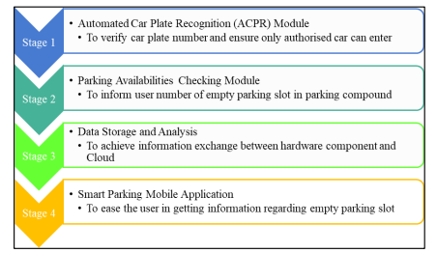
After the image is captured, the Raspberry pi which is the microcontroller will collect the information and send it into Firebase which acts as a Cloud and database in this system. The Cloud will store the information sent by the microcontroller which will then perform data comparison with the existing car plate numbers that are already stored beforehand by the authority. After the comparison is completed, the microcontroller will instruct the gate to be opened if the car plate number is matching the one in the database.
On the other hand, the gate will remain closed if the system fails to identify the matching car plate number. Security units will then act to check and record the visitor’s ID and the purposes of visiting for security purposes. Next, to collect information about the available parking spots, ultrasonic sensors are placed above each parking slot.
The sensors send the information about the empty slots to the microcontroller (Raspberry pi) which will in turn calculate the total empty spaces. The LCD screen that is placed at the main gate entrance will then be updated with the latest number of empty parking slots. Information on empty parking slots is also being updated into the Firebase cloud. Users can also access the updated information regarding the remaining parking spots when they are not in the parking area through a mobile application that has been developed. The overall structure of the Cloud-based Automated Parking System is as illustrated in the Figure below. This project involves 4 stages.
Overall Structure Of The System

Slide 8
Stage 1: Automated Car Plate Recognition (ACPR) ModuleThis stage consists of an Automated Car Plate Recognition (ACPR) System which is made up of Raspberry pi as a microcontroller, camera, ultrasonic sensor, and servo motor. An ACPR system is implemented by connecting the system to the camera to fulfill the requirement of capturing and recognizing the car plate number. This system captures any car plate number from the car that is in the range of the camera capturing area. The system will then process the image captured to obtain the car plate number.
This is done by comparing the captured car plate number with the information stored in a pre-defined database which is developed to record all the car plate numbers of all staff and students on the campus. In this module, a servo motor helps to open and close the main gate entrance. The servo motor is connected to the ACPR system to control the in and out of visiting cars. Few conditions have been set for that purpose. For instance, the system will only allow a car to enter the campus when the captured image of the car plate number matches with the registered car plate number inside the database. If the car plate number matches the one inside the database, the entrance gate will be opened, and the car will be allowed to enter the campus compound.
If the car plate number is not available inside the database, the entrance gate will not lift to prevent the user from entering the campus and the buzzer will be turned on to warn and inform security of unauthorized incoming cars. This system will then go back to the initial state to stand by for the next car's arrival. In this case, Raspberry pi is used to send information and control the pre-defined condition. This module increases the security level of the campus by avoiding any unauthorized cars from entering the campus compound. Indirectly, it also ensures the safety of students and staff.

Slide 9
Stage 2: Parking Availabilities Checking Module, This stage consists of the process of checking out the available spaces for the parking compound. Several ultrasonic sensors are installed in the parking area to sense the presence of cars and empty spaces. This system provides real-time information updates about parking slot availability. The information is then sent to the Raspberry pi for processing and determination of vacant parking slots. The parking slot information is conveyed to users in two ways, which are through the LCD screen at the main gate and the mobile application (which needs to be installed by users).
The information displayed can be used by users to plan where to park before arriving at the parking compound. Using this method, users can save time searching for available parking slots. If there is any empty slot available, the microcontroller gives instructions to the LCD screen to update the number of availabilities. Green LED at specific empty parking slots will light up and several availabilities in the Smart Parking System application will also be updated. However, if there is no available parking slot inside the parking compound, the microcontroller will give instruction to the LCD screen to display “Empty Slot: 0”, and red LEDs at the parking slot will light up and the numbers of availabilities in the Smart Parking System application will be updated to “0”.
The system will continue to check for any updates on parking availabilities. If there is any car leaving or incoming, the ultrasonic will immediately update the information to the microcontroller which will then send updates to the cloud. If any car is leaving, the microcontroller will give instruction to the LCD screen to update to the latest number of available parking slots, the red LED is turned off and the green LED of a particular empty slot will be lighted up. The number of available parking slots is also being updated inside the Smart Parking System application. Despite that, the number of availabilities of empty parking slots will remain the same on both the LCD screen and the Smart Parking System application if no car is leaving the parking compound.

Slide 10
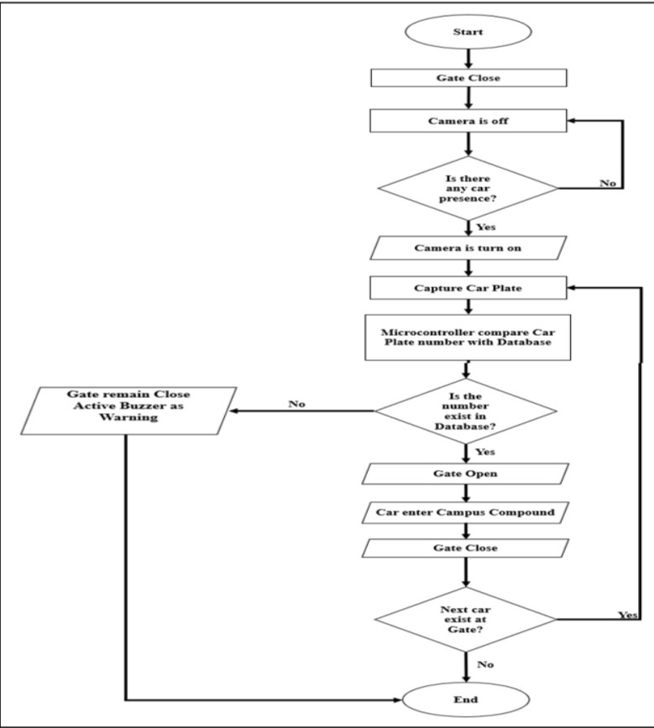
Stage 3: Data Storage and AnalysisAs mentioned in Stage 1 and Stage 2, all the collected information are sent to cloud interface (Firebase) for information storage and analysis purposes. Few information about staffs’ and students’ cars are also be registered or stored before-hand inside the cloud system for the data comparing purposes. This information can be easily extracted and accessed regardless of location and time.
Flow chart for Automate Car Plate Recognition(ACPR) Module

Slide 11
Stage 4: Smart Parking Mobile Application A Smart Parking mobile application is developed to give an immediate and updated information to users. All the information regarding the parking compound are conveyed to users through this mobileapplication. It will update the users with the number of the available parking slots and inform users when the parking compound is full.
The mobile apps is convenient to users as they do not have to be presented there to check the parking availabilities. It is designed to direct the users to the empty parking slots inside the campus parking compound. This method helps in saving the users’ time to search for an empty parking slot. The mobile apps also can help the authority to monitor the list of authorized cars, and allow them to register new users.
Figure show int the right shows the top-level entity for the proposed system design.
All the components used in this project are connected directly or indirectly to the Raspberry Pi 3. The microcontroller is connected to the Automated Car Plate Recognition (ACPR) Module, Parking Availabilities Checking Module and Cloud, while the mobile application is connected directly to the cloud.

Slide 12
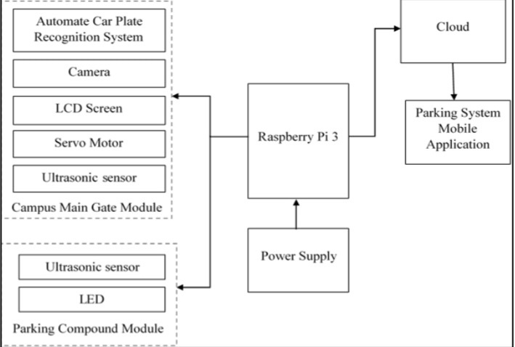
When the system detects the presence of any car at the gate, the ultrasonic sensor then senses the change in distance and it will recalculate the number of available spaces and send the information to Raspberry pi. Then, the red LED at the empty slot will light up and the green LED will go dim. This latest information is sent into the database for storage and update purposes. The same process is repeated when another car is entering. The results can also be visualized using the user’s mobile application. Only the registered users will be able to access this application and view the car park’s information through the apps.
This is to ensure that users that are not registered inside the system by the Authority cannot get any information about the parking compound via this app. This user login page also consists of a button that allows the authority to enter security login.
Block Diagram for the Proposed Smart Parking System

Slide 13
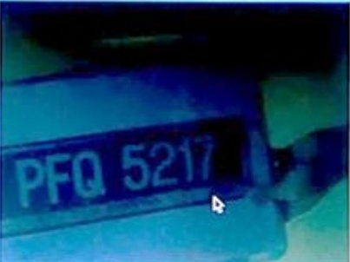
How number plate will work
After users successfully log in to the apps, a User Main Page will appear, User Main Page shows all the details regarding the registered user which is extracted from the database. Those details included the name of user and his/her registered car plate number. The empty parking slot number that is available at current moment at the specific parking area also will be displayed in this page for users’ information.
The availability of parking slot will be updated real-time, This function fulfilled the first objective of this project which can provide convenience to users in which they can plan which parking area to park and estimate the time to arrive at the campus parking area. After finish viewing all the information needed, users can click on the logout button to quit the user main page. For ACPR, right side of the slide shows the image captured by the camera. After the car plate number
photo is captured by camera and processed by the Raspberry pi, it will compare the car plate number from the extracted image with the car plate number stored inside the database.
Number plate
Scanned by Senser

Slide 14
UI LINK
https://www.figma.com/file/ZXIJrG7S741lHCw087P3jE/SMART-IN-CAMPUS-CAR-PARKING-SYSTEM?node-id=0%3A1
CONCLUSION
This Smart Parking system is built to provide a convenient and safety environment to users. It can provide users with real-time parking information using a mobile application and also display the information to users at the main entrance of the parking area. With this service provided, users can plan their journey before leaving for campus and save their time searching around the parking area just to look for an empty parking slot. Another feature of this Smart Parking system is Automatic Car Plate Recognition which enhances the security level of the campus. While allowing only authorized cars to enter, helps to lower the rate of unauthorized cars or people who want to sneak on the campus. This feature secures the safety of students and staff inside the campus area.
01.

Slide 15
[1] Aydin I, Karakose M and Karakose E 2017 A navigation and reservation-based smart parking platform using genetic optimization for smart cities Proc. 5th International Istanbul Smart Grid and Cities Congress and Fair (ICSG) (Istanbul) pp 120-124
[2] Wang M, Dong H, Li X, Song L and Pang D 2017 A novel parking system designed for smart
cities Proc Chinese Automation Congress (CAC) (Jinan) pp 3429-3434
[3] Sadhukhan P 2017 An IoT-based E-parking system for smart cities Proc. Int. Conf. on Advances in Computing (Udupi: Communications and Informatics (ICACCI)) pp 1062-1066
[4] Grodi R, Rawat D B, and Rios-Gutierrez F 2016 Smart parking: Parking occupancy monitoring and visualization system for smart cities Proc. SoutheastCon (Norfolk: VA) pp 1-5
[5] Fang J, Ma A, Fan H, Cai M and Song S 2017 Research on smart parking guidance and parking recommendation algorithm Proc. 8th IEEE Int. Conf. on Software Engineering and Service Science (ACCESS) (Beijing) pp 209-212
[6] Kasaei S H M and Kasaei S M M 2011 Extraction and Recognition of the Vehicle License Plate for Passing under Outside Environment Proc. European Intelligence and Security Informatics Conf. (Athens) pp 234-237
[7] Mutholib A, Gunawan T S and Kartiwi M Design and implementation of automatic number plate recognition on android platform Prof. Int. Conf. on Computer and Communication Engineering (ICCCE) (Kuala Lumpur) pp 540-543
[8] Ruckus Wireless 2017 Smart Campus Learning (Sunnyvale, CA, US) Ruckus Wireless, Inc.
References
08
Thank You

