Slide 1
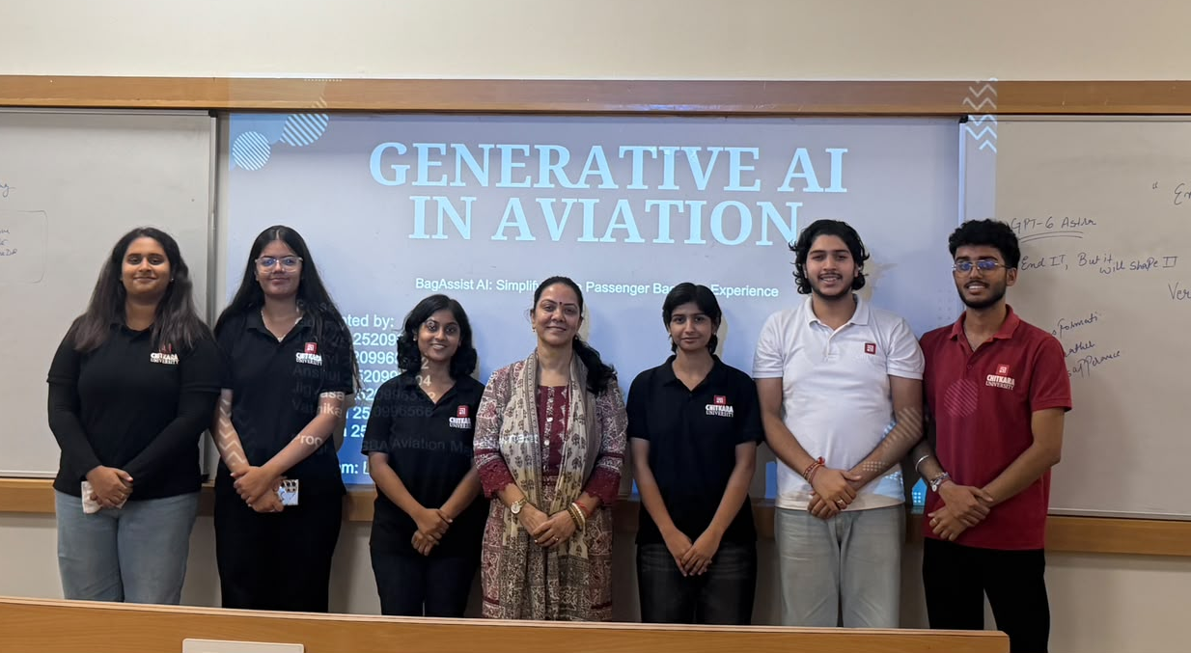
Dharvi
Jigyasa
Anshul
Gourav
Varnika
Jyoti

Slide 2
GENERATIVE AI IN AVIATION
BagAssist AI: Simplifying the Passenger Baggage Experience
Presented by:
Gourav 2520996518
Jyoti 2520996533
Dharvi 2520996512
Anshul 2520996504
Jigyasa 2520996532
Varnika 2520996566
Program: BBA Aviation Management

Slide 3
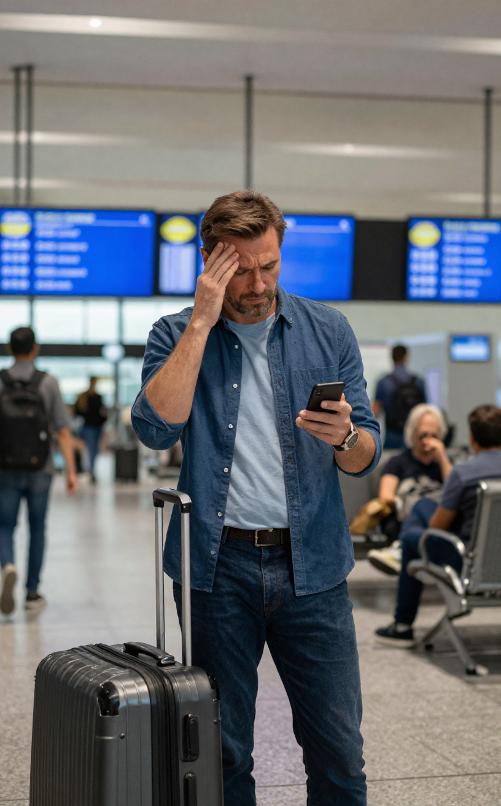
Lost in the Airport Maze
Every day, thousands of passengers face the same struggle - searching for baggage rules, asking the same questions repeatedly, and never getting a clear answer. Confusion leads to missed flights, overpacked bags, and a frustrating travel experience.
Generative AI in Aviation | AeroNova Airways

Slide 4
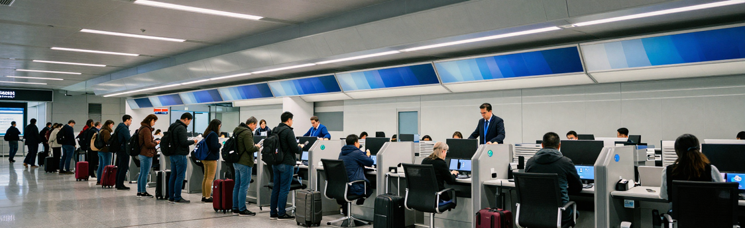
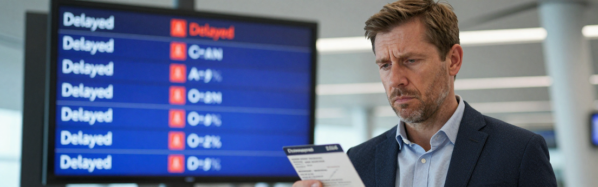
The Hidden Cost of
Baggage Confusion
AeroNova Airways handles 4,000+ daily passengers. Over 38% of support queries are baggage-related — flooding service desks with repeated questions, creating long queues, and leaving staff overwhelmed with inconsistent answers.
Passenger satisfaction scores dropped 22% in 2023. Missed connections, delayed resolutions, and frustrated travelers are costing AeroNova both loyalty and revenue — a problem that demands an intelligent solution.

Slide 5

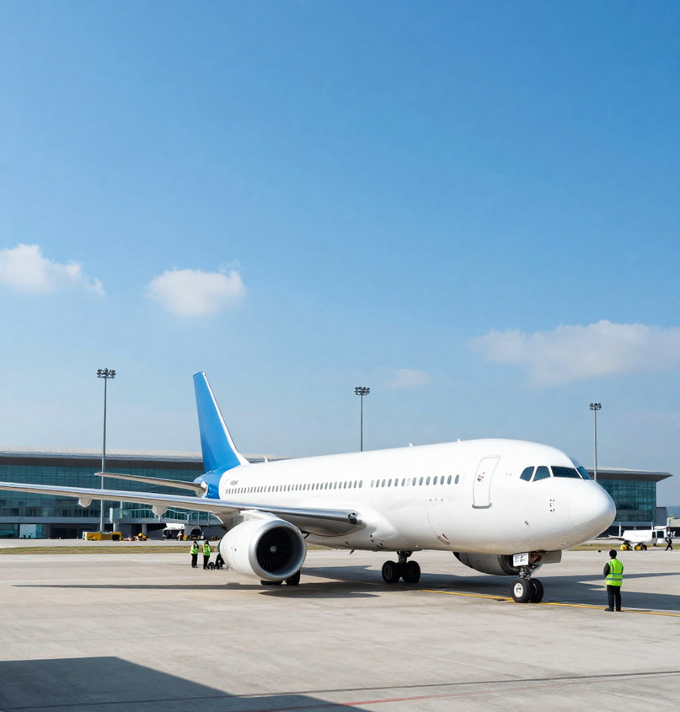
About AeroNova Airways
AeroNova Airways is a modern, digital-first airline built on a simple promise: every passenger deserves a seamless, stress-free journey. Operating over 200 routes across 40 countries, AeroNova connects millions of travelers each year through a network of smart airports and next-generation aircraft. From the moment a ticket is booked to the final baggage claim, AeroNova is reimagining what air travel can feel like.
At the heart of AeroNova's vision is technology. The airline invests heavily in digital infrastructure — mobile-first check-in, real-time flight tracking, and AI-powered passenger support. Yet despite these advances, one persistent pain point remained: baggage information. Passengers were confused, staff were overwhelmed, and the experience suffered. AeroNova knew it was time for a smarter solution.

Slide 6


Why Generative AI?
Passengers ask complex, varied questions — and expect instant, accurate answers. Traditional systems fail with rigid menus and scripted responses.
Generative AI understands natural language, retrieves live baggage policies, and delivers personalized replies — across chat, voice, and mobile channels — in seconds.
✦ Natural Language Understanding — interprets any passenger query
✦ Policy Retrieval — pulls real-time baggage rules instantly
✦ Personalized Responses — tailored to flight, route & passenger profile
✦ Omnichannel Support — app, kiosk, web & voice, all unified

Slide 7

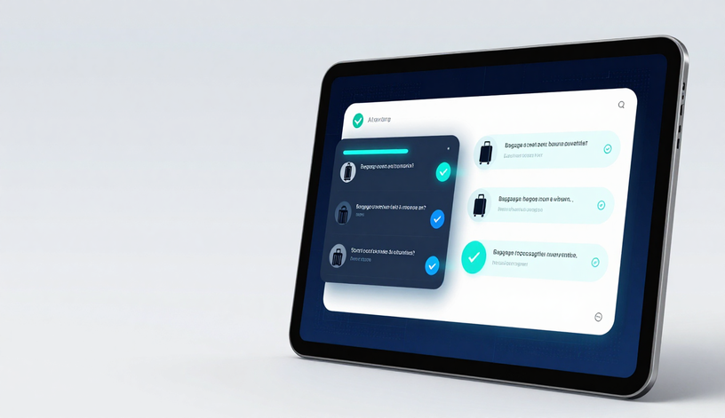
Introducing
BagAssist AI
BagAssist AI is AeroNova Airways' intelligent, conversational baggage assistant — available 24/7 across web, app, and airport kiosks.
Powered by Generative AI, it delivers instant, clear answers on allowances, restricted items, excess fees, real-time bag tracking, and lost baggage claims.
No more queues. No more confusion. BagAssist AI speaks the passenger's language — turning complex baggage policies into simple, human conversations at every step of the journey.

Slide 8
BagAssist AI: Core Capabilities
Understand Passenger Questions
Policy-Grounded Answers
BagAssist AI uses natural language understanding to interpret passenger queries — whether typed, spoken, or ambiguous. It recognizes intent across multiple languages, handling baggage questions of any complexity with speed and accuracy.
Every response is grounded in AeroNova Airways' live baggage policies. BagAssist AI retrieves up-to-date rules on weight limits, fees, restricted items, and special baggage — ensuring passengers always receive accurate, compliant information.
Personalized by Route & Booking
Smart Escalation to Staff
BagAssist AI connects to passenger booking data to deliver tailored responses. Allowances, fees, and policies are presented based on the passenger's specific route, fare class, and loyalty tier — no generic answers, only relevant guidance.
When a query exceeds AI scope — such as lost baggage claims or special handling disputes — BagAssist AI seamlessly escalates to a human agent, passing full context so passengers never have to repeat themselves.

Slide 9

BagAssist AI — Live Chatbot Demo
Passenger Query
BagAssist AI Response
"Hi, I'm flying AeroNova Airways tomorrow on Route AN-204 (Dubai to London). Can I take a power bank in my carry-on? And can I bring an extra bag? I already have one checked bag booked."
Hi there! Great question. Here's your baggage summary for Route AN-204:
✅ Power Bank: Allowed in carry-on only (max 100Wh). Not permitted in checked baggage.
✅ Extra Bag: Yes! You can add a 2nd checked bag (23kg) for Rs500 via Manage Booking.
Need help adding it now?
Escalation Options
Why It Works
BagAssist AI offers seamless escalation:
📞 "Connect me to an agent"
📧 "Email me this summary"
🔗 "Take me to Manage Booking"
All responses are route-aware, real-time, and powered by AeroNova's live policy database — no wait times, no confusion.
BagAssist AI understands natural language, retrieves route-specific policies instantly, and guides passengers to action — reducing baggage-related queries to AeroNova support desks by up to 60% and boosting passenger satisfaction scores significantly.

Slide 10
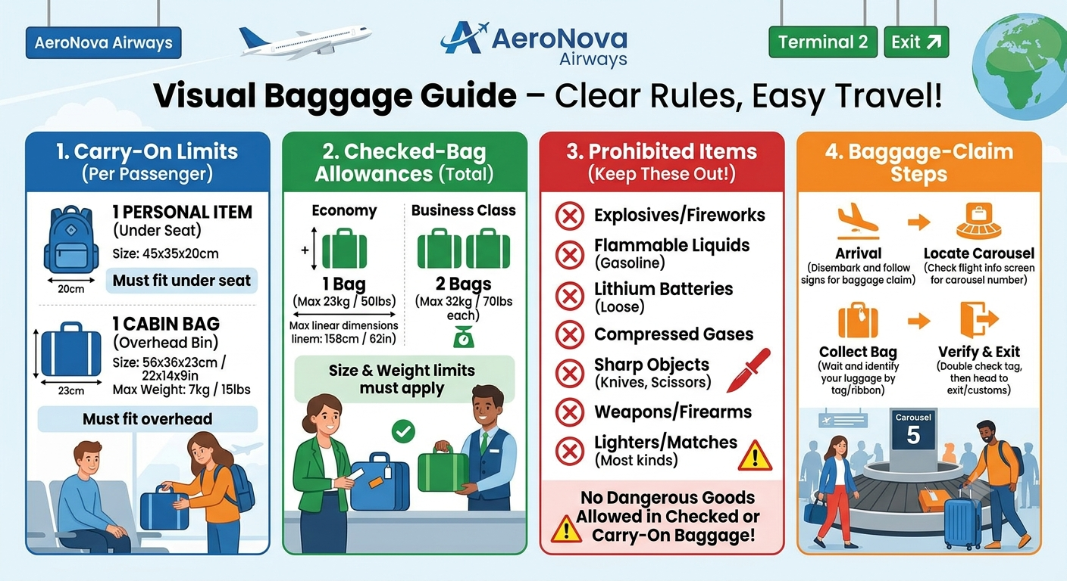
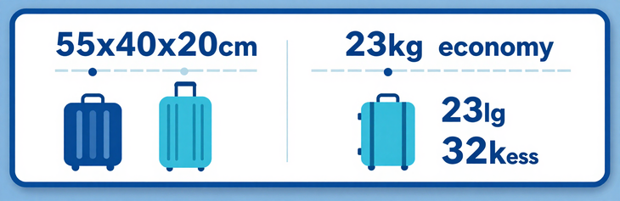
AI-Generated Baggage Infographic
BagAssist AI instantly generates clear, visual baggage guides for AeroNova Airways passengers — covering carry-on limits, checked bag allowances, prohibited items, and claim steps. No more confusion at the gate.
Powered by Generative AI, these infographics are auto-created in real time, tailored to each route, class, and passenger profile — delivered via app, kiosk, or boarding pass.

Slide 11
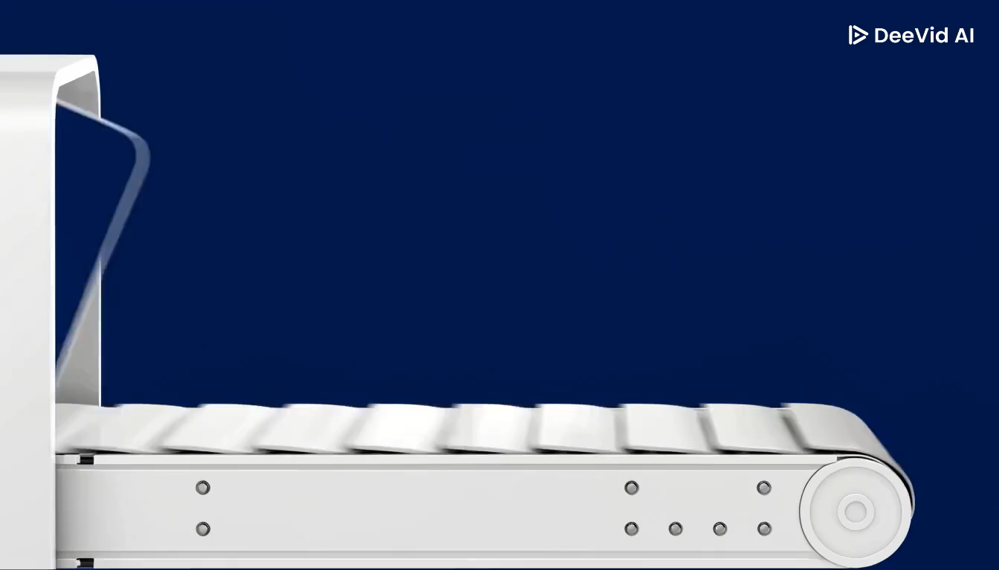
AI-Generated Baggage Video Demo
BagAssist AI produces short animated explainer videos — instantly, on demand — guiding passengers through every baggage step: from check-in drop-off and automated tagging to security restrictions and baggage claim collection.
Each video is personalised to the passenger's route, language, and baggage type. No more printed leaflets or missed announcements. Clear, visual, and accessible guidance — delivered before the passenger even reaches the airport.

Slide 12

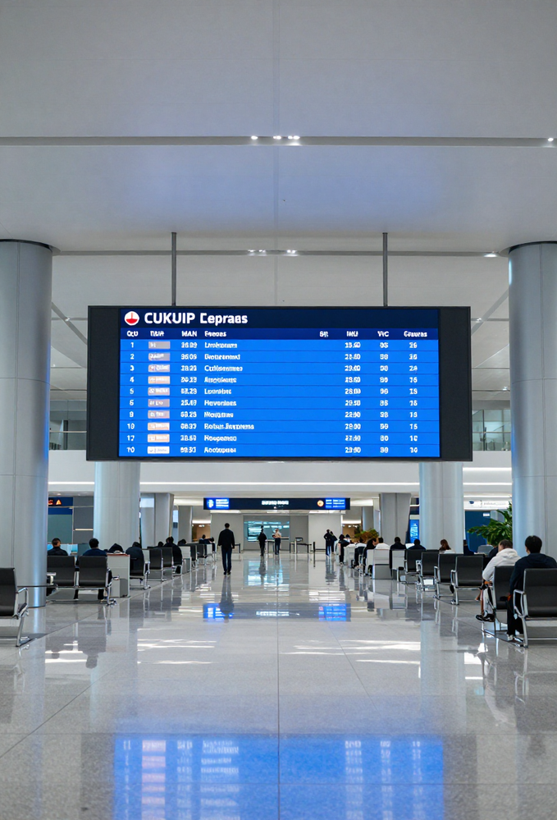

AI-Generated Baggage
Announcements
BagAssist AI instantly generates calm, multilingual baggage announcements — covering carousel changes, delays, and lost luggage alerts — broadcast across AeroNova terminals in seconds, with human-review safeguards before every transmission.
Demo: "Attention passengers on Flight NV-204, your baggage will now arrive at Carousel 7. We apologize for the delay.
Accessibility-ready: audio, visual display, and braille-compatible output.

Slide 13
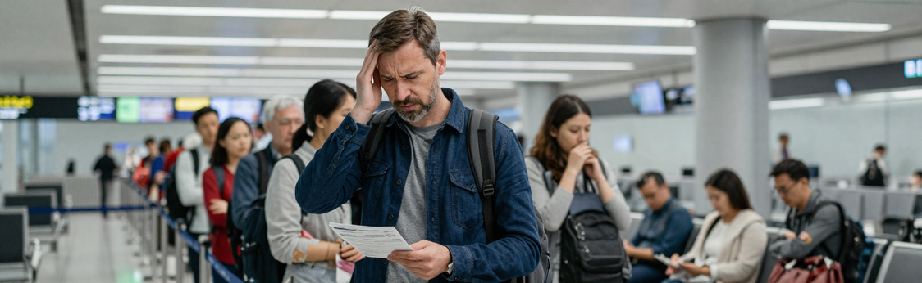
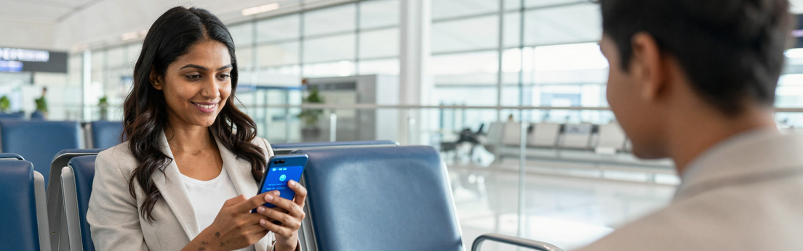
Passenger Journey:
Before & After BagAssist AI
BEFORE BagAssist AI
✗ Long queues at baggage desks
✗ Inconsistent staff answers
✗ Repeated queries & confusion
✗ Missed connections & delays
✗ High passenger frustration
AFTER BagAssist AI
✓ Instant answers via AI chat
✓ Clear step-by-step guidance
✓ Fewer escalations to staff
✓ Confident, stress-free journey
✓ Higher passenger satisfaction

Slide 14
Business & Passenger Benefits
Passenger Satisfaction
Lower Support Volume
BagAssist AI delivers instant, accurate baggage answers 24/7, eliminating long wait times at help desks. Passengers feel informed and confident at every step of their journey with AeroNova Airways, driving higher satisfaction scores and loyalty.
Repetitive baggage queries handled by BagAssist AI reduce pressure on human agents by up to 60%. Staff are freed to focus on complex cases, improving overall service quality while significantly cutting operational support costs for AeroNova.
Consistent Policy Communication
Faster Issue Resolution
BagAssist AI ensures every passenger receives the same accurate, up-to-date baggage policy information every time. No miscommunication, no outdated answers — just clear, reliable guidance aligned with AeroNova's latest rules and regulations.
AI-powered triage routes complex baggage issues to the right team instantly, reducing resolution time by over 40%. Proactive alerts and real-time tracking updates keep passengers informed, turning potential complaints into positive brand experiences.

Slide 15
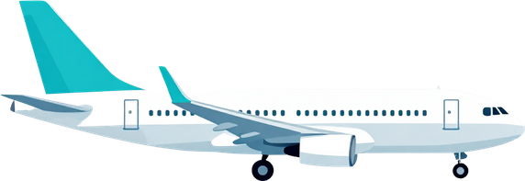
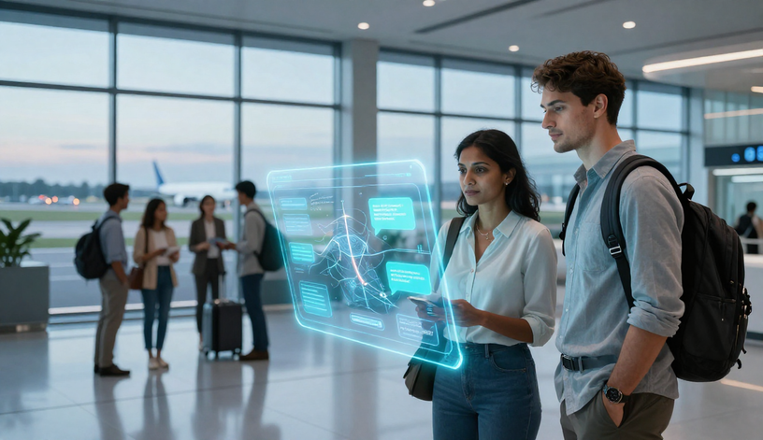
The Future of AI-Powered Passenger Support
BagAssist AI is just the beginning. AeroNova Airways envisions a fully proactive passenger support ecosystem — one where AI anticipates disruptions before they happen, predicts baggage risk at check-in, and delivers real-time multilingual voice assistance to every traveller, in every terminal, around the world.
Next on the roadmap: personalized travel companions that remember passenger preferences, proactive delay and rebooking alerts, and AI-driven baggage-risk scoring. Every step forward is guided by responsible, human-supervised AI — ensuring technology serves people, not the other way around. The story of smarter, kinder aviation has only just begun.

Slide 16
Thank You

