Slide 1
Functional Programming in Python
Introduction, Python built-in Data Types, Copying and Sharing Compound Data Objects, Control Statements, Files Usage, Functions, OOP.

Slide 2
A few words about Python
Python is a very easy-to-learn and easy-to-use Scripting Programming Language.
Python was invented in the 1990’s by Guido Van Rossum , as a further development of the ABC programming language.
Python has been purposefuly developed for ease of use, high readability, high writeability and high supportability.
The code which implements this language is Open Source, which allows everybody to get it, to change it as he wants, and to publicize those changes.
Python 3.x is the version we use here. We need to know that it is not fully compatible with Python 2.x and previous versions.

Slide 3
Python is a Scripting Language
Python is implemented by Interpretation and not by Compilation (and Linkage).
Every Python IDE comes with an Interpreter, which allows us to directly write and evaluate Python statements and expressions, without the need of writing a full program, in order to execute them.
This way allows us to experiment with the language’s features, without the need of writing (and compiling) a program containing what we wish to try.

Slide 4
Comparison of the translation process of the text of a program, the Python’s way and the C’s way (©גבהים)
Script
Code
Code
Code
Code

Slide 5
Advantages and Disadvantages of Python
Advantages | Disadvantages
Easy to learn, read, and write.. It’s standard distribution comes with a great number of importable modules It actually is a multi-paradigm language: it supports OOP, has functional programming features, etc. In principle, it supports back-compatibility with previous versions, but versions 2.x and 3.x are not fully compatible. Python is one of the most popular programming languages nowadays. | Calculations run relatively slow in Python, because of its interpreter-based implementation. Python is a dynamic language, which means that most of the program’s (syntactic and semantic) errors occur at run-time, something that will not occur in static languages (because they are compiled languages).

Slide 6
References
Think python (an e-book which may be freely downloaded).
It is one of the best textbooks to learn Python programming.
Several print copies are available at JCT’s libraries.
Learning Python
Python in a Nutshell
Fluent Python
www.python.org

Slide 7

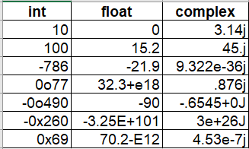
Python’s values
In Python, everything are values (objects)
Built-in basic data types
- bool
True, False
- NoneType
None
- Numerical Types
int, long, float, complex

Slide 8
Python’s values
In Python, everything are values (objects)
Functions (and methods) are values as any other values
Data types:
BuiltinFunctionType FunctionType, LambdaType BuiltinMethodType, MethodType
Classes are values
Data type: type
In general, all of them are callables.
Built-in Compound data types
str
tuple
list
dictionary
set
built-in iterables

Slide 9
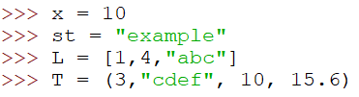
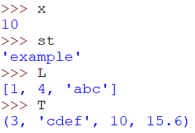
Variables in Python
A variable is a binding between an identifier and an object. Actually, it is a reference to the memory address where the object is stored.
Every identifier, before being bound to a value, is an unbound variable or undefined variable.
Every identifier, after being bound to a value, is a bound variable or defined variable.
Immediately after the binding was done, it is possible to use the variable.
The data type of any variable is the data type of its value. Thus, it is not necessary to declare a variable in Python.
A variable (actually, a pair <identifier, value>) is created as the result of executing an assignment operation:
identifier = valueOfExpression

Slide 10
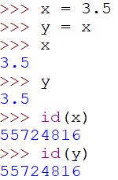
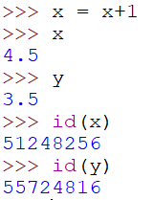
Basic Data Types: int, long, float, complex
Numbers are immutable data
x
3.5
y
x
4.5
y
3.5

Slide 11
The basic data type bool
The two values of type bool, are True and False.
Every “empty” value is equivalent to False:
0, 0.0
the empty string: “” and str()
the empty list: [] and list()
the empty tuple: () and tuple()
the empty set: {} and set()
the empty dictionary: {} and dict()
and the special value None.
Everything else is equivalent to True.

Slide 12
The basic data type bool
Compound boolean expressions short circuit.
and and or return one of the elements in the expression.
Note that when None is returned, the interpreter does not print anything.
>>> True and False
False
>>> False or True
True
>>> 7 and 14
14
>>> None and 2
>>> None or 2
2
The None value is returned here!

Slide 13
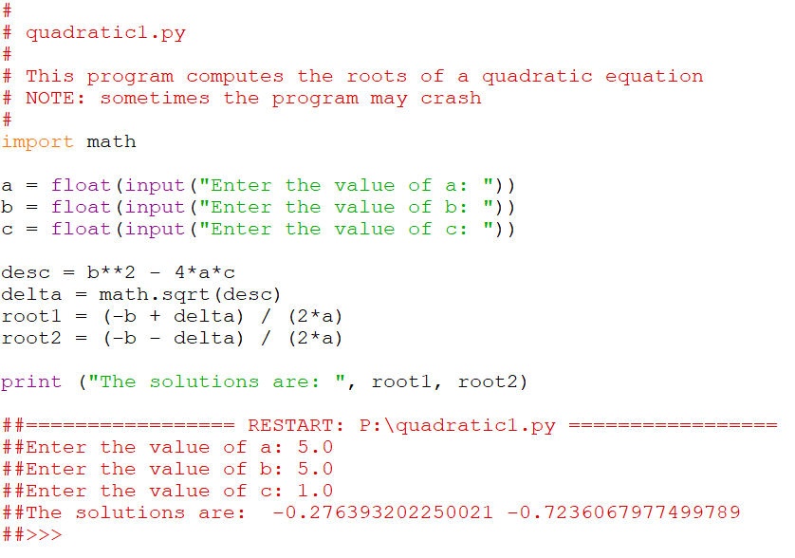
Example: a solution to the quadratic equation

Slide 14
Built-in Compound Data Type: str
Three alternatives to specify a string constant:
Using single quotes.
Using double quotes.
Using three double, or single, quotes (for a multi-line string).
>>> 'I am a string'
'I am a string'
>>> "So am I!"
'So am I!’
>>> s = """And me too!
though I am much longer
than the others :)"""
'And me too!\nthough I am much longer\nthan the others :)‘
>>> print(s)
And me too!
though I am much longer
than the others :)‘

Slide 15
Built-in Compound Data Type: str
There is no char type like in C++ or Java
+ is overloaded to do concatenation
* is overloaded to do self-concatenation
>>> x = 'hello'
>>> x = x + ' there'
>>> x
'hello there’
>>> y = 2*x
>>> y
‘hello therehello there’
>>>

Slide 16
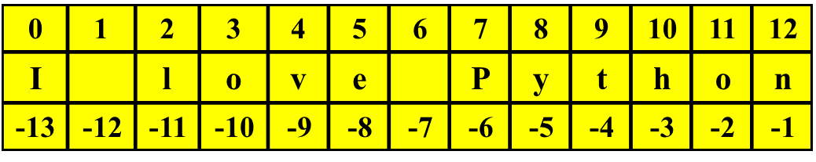
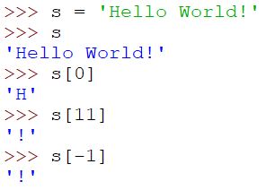
Built-in Compound Data Type: str
Retrieving the character in position i
string[i]
i >= 0 - Referrers to a position numbered from left.
i <= -1 - Referrers to a position numbered from right.
0 referrers to the first character of the string.
-1 referrers to the last character of the string.

Slide 17

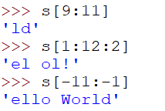
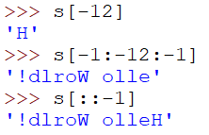
Built-in Compound Data Type: str
Retrieving a slice of a string (a substring)
string[i:j:k]
Returns a new string containing the characters
of string between positions i and j-1with step-length k.

Slide 18
Built-in Compound Data Type: str
Methods on strings
len(string) – returns the number of characters in string
str(object) – returns a string representation of object
string.upper( ) – returns a new string all in uppercase
string.split([sep]) – splits the string and returns a new list containing the substrings of string.
string.join(list_of_strings) – returns a new string containing the strings in the list, separated by string.
>>> x = ‘I love Python’
>>> len(x)
13
>>> str(10.3)
'10.3’
>>> x.split(‘ ‘)
[‘I’, ‘love’, ‘Python’]
>>> ‘ ‘.join(x.split(‘ ‘))
‘I love Python’
>>>

Slide 19
Built-in Compound Data Type: str
Search Methods on strings
string.find(substr) – returns the index of the first occurrence of substr in string. It returns -1 if not found. See also string.rfind()
string.index(substr) – like find, but instead -1 it raises the exception Value Error. See also string.rindex()
string.count(substr) – returns number of non-overlapping occurrences of substr.
>>> s = “Jerusalem is my city”
>>> s.find(“e”) # s.index(“e”) returns the same value
1
>>> s.rfind(“e”) # s.rindex(“e”) returns the same value
7
>>> s.find(“salam”)
-1
>>> s.index(“salam”)
Traceback ….
….
Value Error: substring not found
>>> s.count(“e”)
2
>>> s.count(“er”)
1
>>> s.count(“era”)
0
Go to https://www.python.org/doc/
and learn all about Python’s strings.

Slide 20
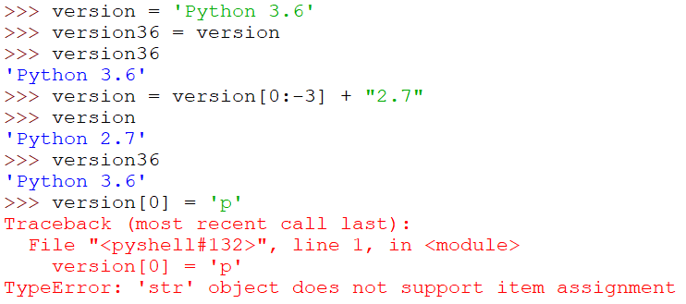
Built-in Compound Data Type: str
Strings are immutable data
version
‘Python 3.6’
version36
version
‘Python 2.7’
version36
‘Python 3.6’

Slide 21
Built-in Compound Data Type: list
list
Ordered collection of heterogeneous data
Different lists may refer to shared objects
Indices and slices as in strings
+ and * as in strings
>>> x = [1,'hello', (3 + 2j)]
>>> x
[1, 'hello', (3+2j)]
>>> x[2]
(3+2j)
>>> x[:2]
[1, 'hello’]
>>> x[::2]
[1,(3+2j)]
>>>
>>> y = [5, x, ‘abc’] # y is a nested list
>>> y
[5,[1, 'hello', (3+2j)],’abc’]
>>> id(x)
2516447480072
>>> id(y[1])
2516447480072
>>> z = x[:] # a copy list is created
>>> id(z)
2516447551880
Both, y[1] and x, refer to the same object!

Slide 22
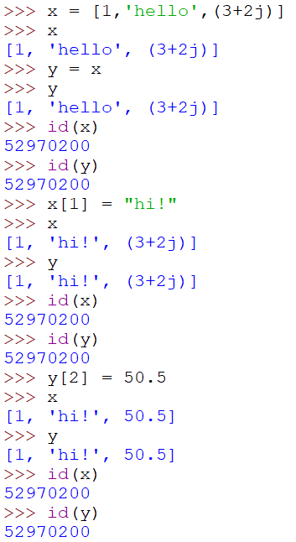
Built-in Compound Data Type: list
Lists are mutable data
x
[1,'hello',(3+2j)]
y
x
[1,’hi!’,50.5]
y

Slide 23
Built-in Compound Data Type: list
Search Methods on lists
L.index(val) – like index in strings.
L.count(val) – returns number of occurrences of val.
>>> L = “Jerusalem is my city, my love”.split()
>>> L.index(“my”)
2
>>> L.count(“my”)
2
>>> L.index(“lobe”)
Traceback ….
….
Value Error: ‘lobe’ is not in list
Go to https://www.python.org/doc/
and learn all about Python’s lists.

Slide 24
Built-in Compound Data Type: list
Methods that modify contents on lists
The methods append, extend, insert, pop, del, and remove.
>>> x = [1, 15, (3+2j)]
>>> x
[1,15,(3 + 2j)]
>>> x.append([1,2,3])
>>> x
[1,15, (3 + 2j), [1,2,3]]
>>> topitem = x.pop()
>>> topitem
[1,2,3]
>>> x
[1,15, (3 + 2j)]
>>> x.extend([‘a’,23])
>>> x
[1,15, (3 + 2j), ’a’,23]
>>> x.insert(2,”yes”)
>>> x
[1,15, “yes”,(3 + 2j), ’a’,23]
>>> del x[2]
>>> x
[1,15, (3 + 2j),’a’,23]
>>> x.remove(‘a’)
>>> x
[1,15, (3 + 2j),23]
>>>
Go to https://www.python.org/doc/
and learn all about Python’s lists.
Note that those methods modify the list, but return None.

Slide 25
Built-in Compound Data Type: tuple
tuple
Tuples are immutable lists
(with the exception of tuples containing at least one mutable item).
Different tuples may refer to shared objects as in lists.
Indices and slices as in strings and lists.
+ and * as in strings and lists.
Search is done as in lists.
>>> x = (1,2,3)
>>> x[1:]
(2, 3)
>>> y = (2,) # a one-element tuple
>>> y
(2,)
>>>
>>> z = tuple([“a”, x, “rt”])
>>> z
(“a”, (1,2,3), “rt”)
>>> id(x)
2516448241776
>>> id(z[1])
2516448241776
>>>
Go to https://www.python.org/doc/
and learn all about Python’s tuples.

Slide 26
Lists vs Tuples
>>> a=('a','b',1,2)
>>> b=['a','b',1,2]
>>> a==b
False
>>> a[0]==b[0]
True
>>> a[0]='b'
TypeError: 'tuple' object does not support item assignment
>>> b[0]='b'
>>> b
['b', 'b', 1, 2]
>>> a=('a','b',1,2,['a','b','c'])
>>> a[4][0]='b'
>>> a
('a', 'b', 1, 2, ['b', 'b', 'c'])

Slide 27
Built-in Compound Data Type: set
set
Unordered collection of heterogeneous data without duplicates.
Data in sets must be Hashable.
Sets are mutable.
Set operators: & (intersection), | (union), - (difference), ^ (xor)
s.issubset(t) – is s a subset of t?, s.issuperset(t) – is t a subset of s?
>>> s1 = {1, 'two’, 'blah’, 5, 1}
>>> s1
{'two’, 1, 'blah’, 5}
>>> s2 = set([‘was’, 4, 5, 4, ‘two’, (5,3,8)])
>>> s2
{‘two', (5, 3, 8), 4, 'was’, 5}
>>> s1 & s2
{5, ‘two’}
>>> s1 | s2
{'two’, 1, 'blah’, 5, (5, 3, 8), 4, 'was’}
Go to https://www.python.org/doc/
and learn all about Python’s sets.

Slide 28
Built-in Compound Data Type: set
Retrieving, Deleting, and Inserting Contents on Sets
s.add(x) – x is added to the set s has a new element of the set.
s.remove(x) – removes the element x from the set s; if not present, raises a KeyError exception.
s.discard(x) – removes the element x from the set s if it is present.
s.pop() – removes and returns an arbitrary element; raises KeyError if the set is empty.
s.clear() – removes all elements from the set.
The only way to retrieve elements from a set is by iterating on it with a for loop.
Go to https://www.python.org/doc/
and learn all about Python’s sets.

Slide 29
Built-in Compound Data Type: dict
dictionary
A set of (key, value) pairs.
Dictionaries are mutable.
Keys must be Hashable values.
>>> d1 = {1 : 'hello', 'two' : 42, 'blah' : [1,2,3]}
>>> d1
{1: 'hello', 'two': 42, 'blah': [1, 2, 3]}
>>> d2 = dict([(1, 'hello’), ('two’, 42), ('blah’, [1, 2, 3])])
>>> d2
{1: 'hello', 'two': 42, 'blah': [1, 2, 3]}
Go to https://www.python.org/doc/
and learn all about Python’s dictionaries.

Slide 30
Built-in Compound Data Type: dict
Retrieving and Modifying Contents of Dictionaries
x[k] = a – if a pair with key k does not exist in the dictionary
x, the pair (k, a) is created and added to the
dictionary.
– if a pair with key k exists in the dictionary x, the
pair is updated, and becomes the pair (k, a).
n = x[k] retrieves the value of the pair whose key is k, and assigns it to the variable n.
>>> d
{1: 'hello', 'two': 42, 'blah': [1, 2, 3]}
>>> d['blah’] # retrieves [1,2,3]
[1, 2, 3]
>>>
Go to https://www.python.org/doc/
and learn all about Python’s dictionaries.

Slide 31
Built-in Compound Data Type: dict
Retrieving and Modifying Contents of Dictionaries
Entries can be changed by assigning to that entry
>>> d
{1: 'hello', 'two': 42, 'blah': [1, 2, 3]}
>>> d['two'] = 99
>>> d
{1: 'hello', 'two': 99, 'blah': [1, 2, 3]}
Assigning to a key that does not exist, adds an entry
>>> d[7] = 'new entry'
>>> d
{1: 'hello', 7: 'new entry', 'two': 99, 'blah': [1, 2, 3]}
Go to https://www.python.org/doc/
and learn all about Python’s dictionaries.

Slide 32
Built-in Compound Data Type: dict
Deleting Elements (pairs) from Dictionaries
The del function deletes an entry from a dictionary
>>> d
{1: 'hello', 2: 'there', 10: 'world'}
>>> del(d[2])
>>> d
{1: 'hello', 10: 'world'}
Go to https://www.python.org/doc/
and learn all about Python’s dictionaries.

Slide 33
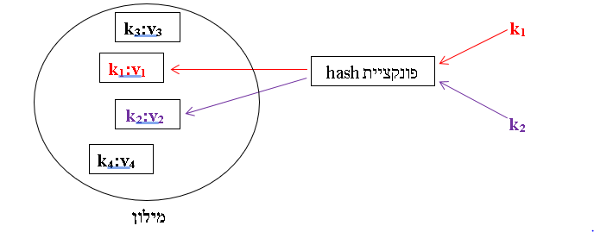
Hashable values
The place where an element of a set, or a pair (key,value) of a dictionary, is stored, is determined by Python’s hash function.
Only “Hashable” values may be passed to Python’s hash function.
The value returned by Python’s hash function is the memory address where an element of a set, or a pair of a dictionary will be stored.
An object is of type “Hashable” if its hash value does not change during all its life time; this means the following:
- every value whose data type is a built-in immutable data type, is Hashable.
- every value whose data type is a built-in mutable data type, is not Hashable.
- every instance of a programmer-defined class, is Hashable; two different instances of the same
class, even if their contents are identical, are considered different instances, and their hash value
is different.
hash
dictionary

Slide 34
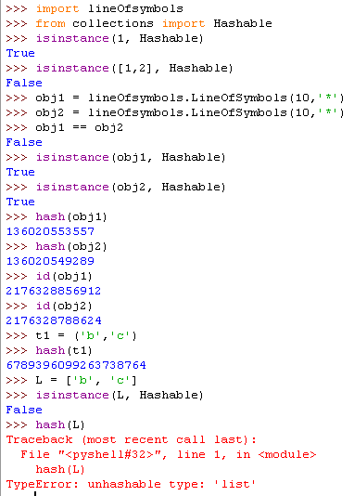
Hashable values: an example

Slide 35
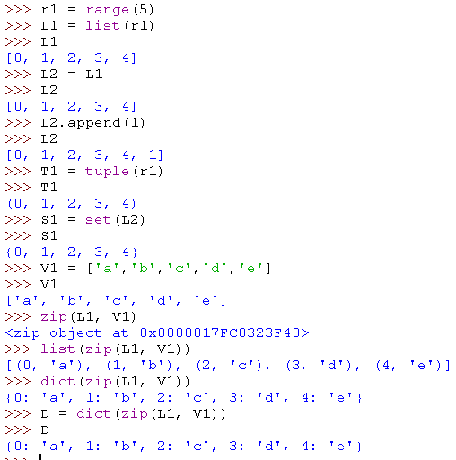
Compound Data Types
Creating lists, tuples, sets, and dictionaries with the range function

Slide 36
Python’s Built-in Compound Data Types
Retrieval Operations in Sequences (or Containers )
Operation | Result | Defined?
x in s | True if the value of x is an item of s, else False | In any sequence or container
x not in s | False if the value of x is not an item of s, else True | In any sequence or container
s + t | the concatenation of s and t | In sequences only
s * n, n * s | n shallow copies of s concatenated | In sequences only
s[i] | item i of s | In sequences, i is an index value. In dictionaries, i is a key value. Undefined In sets.
s[i:j] | slice of s: elements from i to j-1 | In any sequence

Slide 37
Python’s Built-in Compound Data Types
Retrieval Operations in Sequences (or Containers )
Operation | Result | Defined?
s[i:j:k] | slice of s: elements from i to j-1 with step k | In any sequence.
len(s) | length (or size) of s | In any sequence, container.
min(s) | smallest item of s | In any sequence, container. In dictionaries, refers to the key values
max(s) | largest item of s | In any sequence, container. In dictionaries, refers to the key values
s.index(x[, i[, j]]) | index of the first occurrence of x in s | In any sequence. Undefined in dictionaries. Undefined in sets.
s.count(i) | total number of occurrences of i in s | In any sequence

Slide 38
Python’s Built-in Compound Data Types
Modification Operations in Sequences (or Containers )
Operation | Result | Defined?
s[i] = x | In lists: item i of s is replaced by x In dicts: if key i exists, x replaces the value, if key i does not exist, pair (i,x) is inserted | In lists: i is an index, x is a new item In dicts: i is a key, x is a value
s[i:j] = t | slice of s from i to j is replaced by the contents of the iterable t | Only in lists.
del s[i:j] | same as s[i:j] = [] | Only in lists.
s[i:j:k] = tt | the elements of s[i:j:k] are replaced by those of tt | Only in lists.
del s[i:j:k] | removes the elements of s[i:j:k] from the list | Only in lists.
s.append(x) | same as s[len(s):len(s)] = [x] | Only in lists.
s.extend(x) | same as s[len(s):len(s)] = x | Only in lists.

Slide 39
Python’s Built-in Compound Data Types
Modification Operations in Sequences (or Containers )
Operation | Result | Defined?
s.insert(I, x) | same as s[i:i] = [x] | Only in lists: i is an index, x is a new item
s.pop([i]) | same as x = s[i];del s[i]; return x | Only in lists: i is an index.
s.remove(x) | same as del s[s.index(x)] | Only in lists: x is the value of the item to be removed.

Slide 40
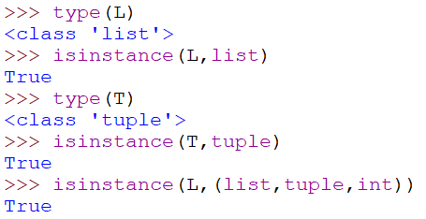
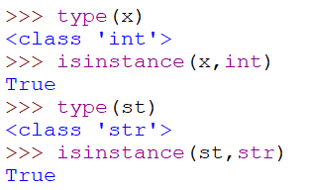
Python’s Type Checkers
Python provides us with two type checkers:
Type(variable)
returns the name (an identifier) of the data type of the variable.
Isinstance(variable, type-of-class-name) or isinstance(variable, (type-or-class-name1, …,type-or-class-nameN)
returns a boolean value; if it is True, this means that the data type of the variable value is the type (or one of the types) of the second parameter. isinstance(variable, (type-or-class-name1, …, type-or-class-nameN))

Slide 41
Python’s Built-in Data Types
Data Types Summary
Numbers, booleans, strings, and tuples as immutable.
Lists, Tuples, and Dictionaries can store any type of value (including other lists, tuples, sets, and dictionaries!)
Sets can store only Hashable values.
Dictionary’s keys must be Hashable values.
Only lists, sets and dictionaries are mutable
All variables are references

Slide 42
Python’s Built-in Data Types
Data Types Summary
Integers: 2323, 3234L
Floating Point: 32.3, 3.1E2
Complex: 3 + 2j, 1j
Booleans: True, False
Lists: L = [ 1,2,3]
Tuples: t = (1,2,3)
Sets: s = {2.0, 6, ‘Hi!’, (3,7)}
Dictionaries: d = {‘hello’ : ‘there’, 2 : 15}
NoneType: None
FunctionType: function object
Type: class object

Slide 43
Copying Dictionaries and Lists
Copying Dictionaries and Lists
>>> l1 = [1]
>>> l2 = list(l1)
>>> l1[0] = 22
>>> l1
[22]
>>> l2
[1]
>>> l3 = l1[:]
>>> d = {1 : 10}
>>> d2 = d.copy()
>>> d[1] = 22
>>> d
{1: 22}
>>> d2
{1: 10}
Two alternative ways are available to copy a list:
- Using the built-in list function.
- Using the special kind of slice L1[:].
Dictionaries have a method called copy.
(More about copy in the next slides)
Go to https://www.python.org/doc/and learn all about Python’s lists and dictionaries.

Slide 44
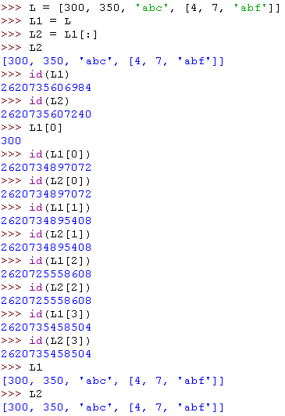
Shallow Copy: Sharing substructures
L
300
350
‘abc’
[4, 7, ’abf’]

Slide 45
Shallow Copy: Sharing substructures
Aliasing
L
L1
300
350
‘abc’
[4, 7, ’abf’]

Slide 46
Shallow Copy: Sharing substructures
L
L1
Shallow copy
300
350
‘abc’
[4, 7, ’abf’]
L2

Slide 47

Shallow Copy: Sharing substructures
L
L1
300
350
‘abc’
[4, 7, ’abf’, 10]
L2

Slide 48

Shallow Copy: Sharing substructures
L
L1
300
350
‘abc’
[4, 7, ’abf’, 10]
[1, 3, ‘abg’]
L2

Slide 49
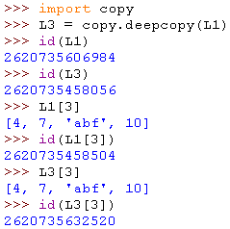
Deep Copy
L
L1
300
350
‘abc’
[4, 7, ’abf’, 10]
[4, 7, ‘abf’, 10]
L3

Slide 50
Control Flow Statements

Slide 51
No braces!
Python uses indentation instead of braces to determine the scope of expressions in control flow statements, function definitions, class definitions, etc.
All lines must be indented the same amount to be part of the scope (or indented more if part of an inner scope)
This forces the programmer to use proper indentation since the indenting is part of the program!
Proper indentation must be tab-based or spaces-based, but it cannot be a mixture of tabs and spaces.

Slide 52
if Statement
if booleanExpr1:
………
………
[[elif booleanExpr2:
………
………]
[elif booleanExprN:
………
………]
[elif booleanExprN:
………
………]
[else:
………
………]
]

Slide 53
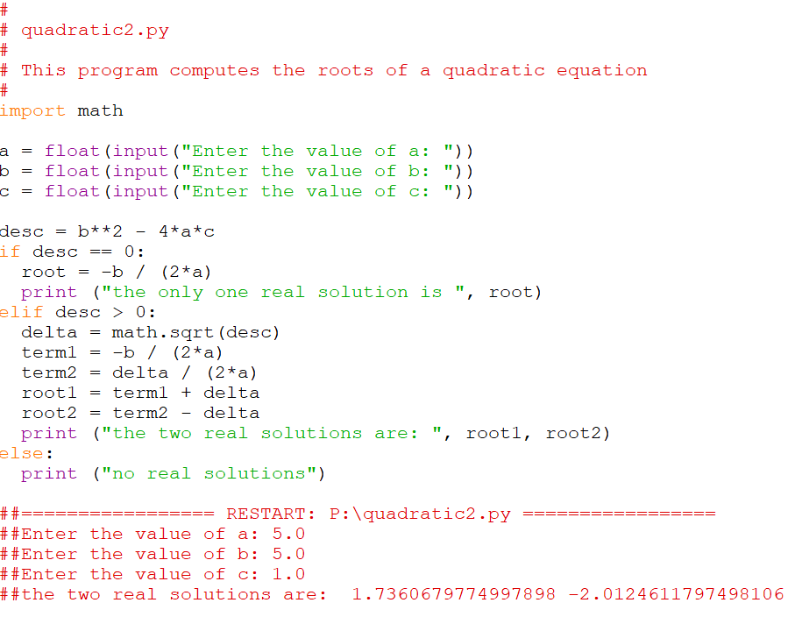
A solution of the quadratic equation

Slide 54
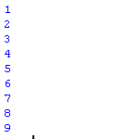
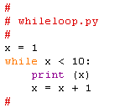
while Loop
while booleanExpr:
………
………
the Loop body

Slide 55
Loop Control Statements
break | Jumps out of the closest enclosing loop
continue | Jumps to the top of the closest enclosing loop
pass | Does nothing, empty statement placeholder

Slide 56
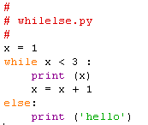
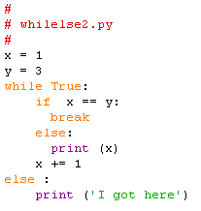


The while Loop else Clause
The optional else clause runs only if the loop exits normally (not by break)
while booleanExpr:
………
………
else:
………
………

Slide 57
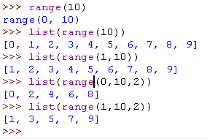
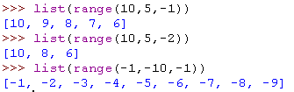
Python for Loops
for loopVar in iterable:
………
………
the Loop body
Looping over the values provided by a range iterator
range([i,] j [,k])
Ascending range (i < j, k > 0)
range(i. j. k) -- generates a range iterator that represents the range of numbers i, i+k, i+2k, …, (<= j-1)
range(i, j) -- equivalent to range(i, j, 1)
range(j) -- equivalent to range(0,j)
Descending range (i > j, k < 0)
range(i. j. k) -- generates a range iterator that represents the range of numbers i, i+k, i+2k, …, (>= j+1)

Slide 58
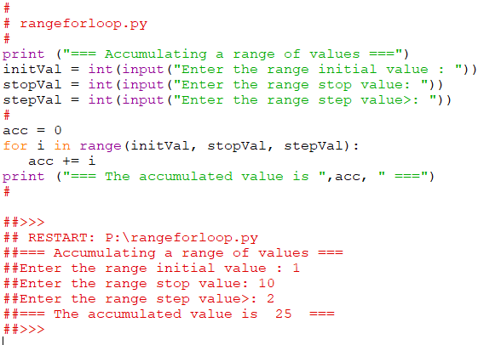
Python for Loops
for loopVar in iterable:
………
………
the Loop body
Looping over the values provided by a range iterator

Slide 59
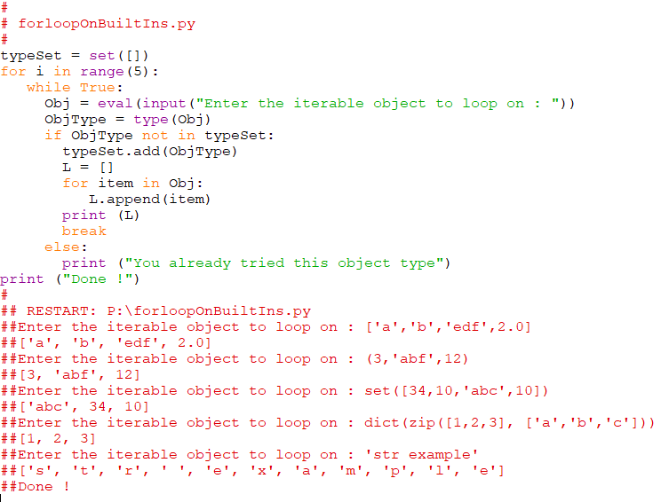
Python for Loops
for loopVar in iterable:
………
………
the Loop body
Looping over the values provided by a Python built-in iterable

Slide 60
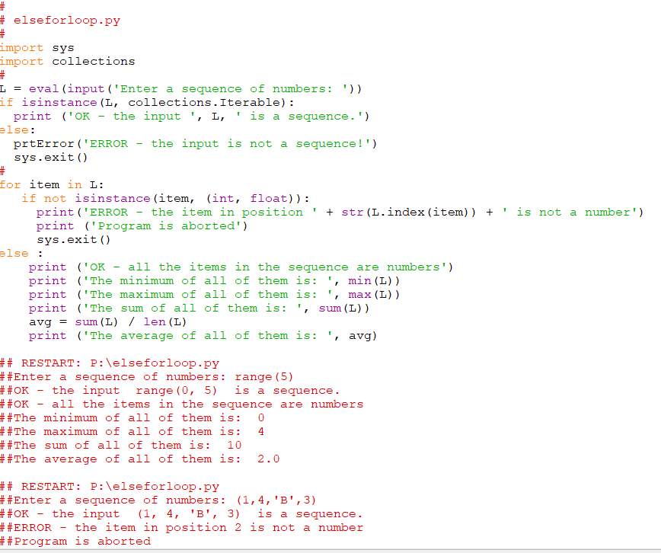
The for Loop else Clause
Looping over the values provided by iterables and iterators

Slide 61
Files: Input
inflobj = open(‘data’, ‘r’) | Open the file ‘data’ for input
S = inflobj.read() | Read whole file into one String
S = inflobj.read(N) | Reads N bytes (N >= 1)
L = inflobj.readlines() | Returns a list of line strings

Slide 62
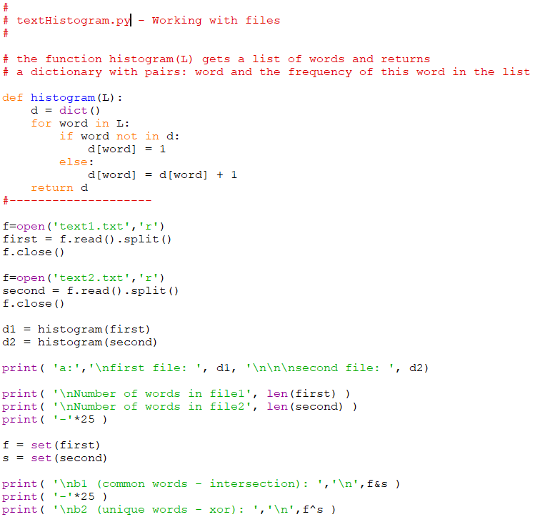
File Objects are Iterables

Slide 63
Files: Output
outflobj = open(‘data’, ‘w’) | Open the file ‘data’ for writing
outflobj.write(S) | Writes the string S to the file
outflobj.writelines(L) | Writes each of the strings in list L to the file
outflobj.close() | Closes the file

Slide 64
Functions

Slide 65
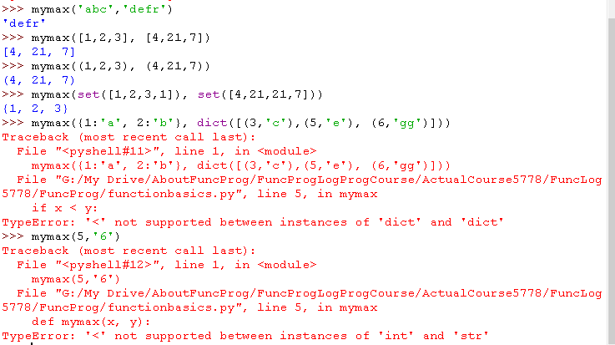
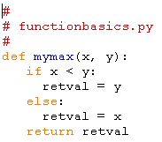
Function Basics
def funcName ([arg0, arg1, …, argN]):
………
………
[return [retValue]]
the Function body

Slide 66
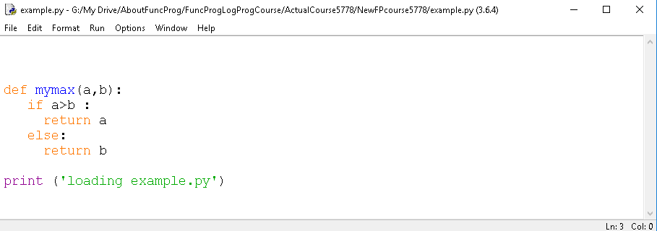
Function Definition and Function Application/Call
def
Arguments list (that may be empty)
Function name
Function body (indented!!)
dynamic typing
Actually, functions in Python are polymorphic
(see programming examples in the next two slides)

Slide 67
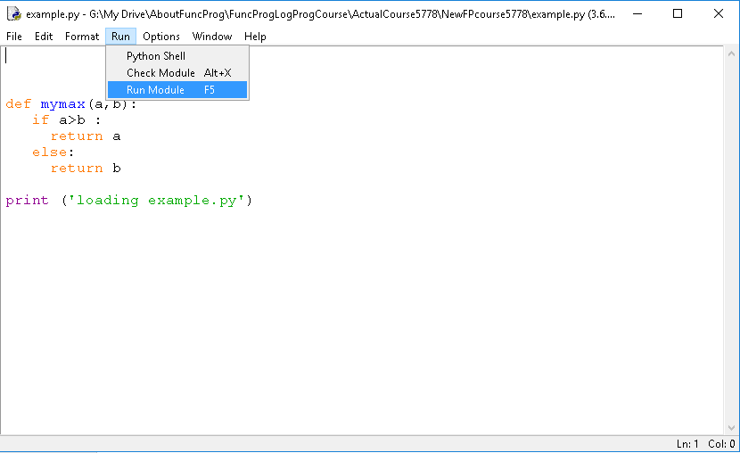
Function Definition and Function Application/Call

Slide 68
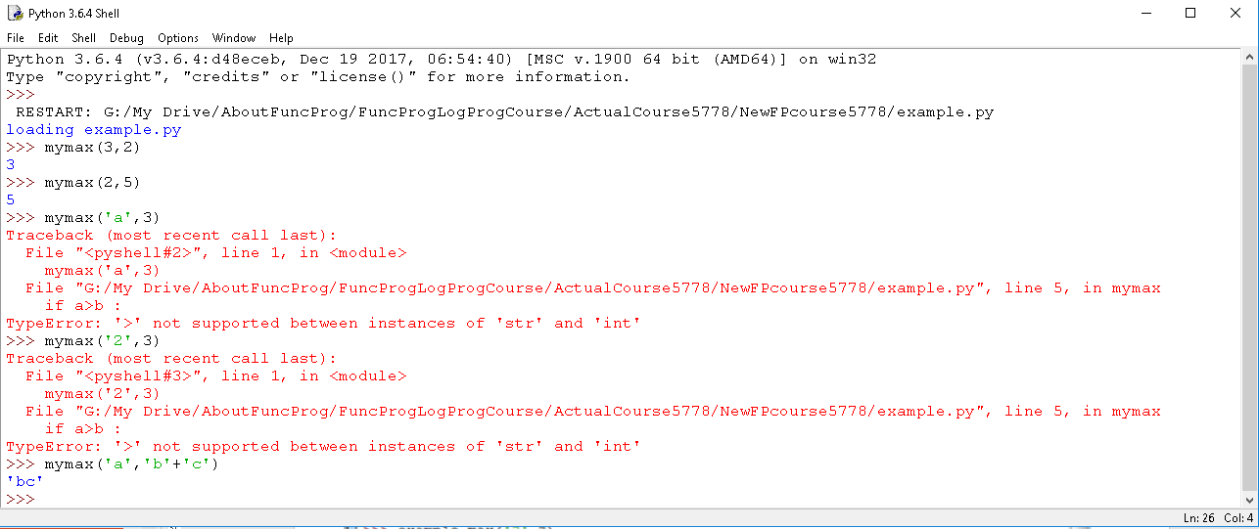
Function Definition and Function Application/Call
Calling the function mymax with different parameter values

Slide 69
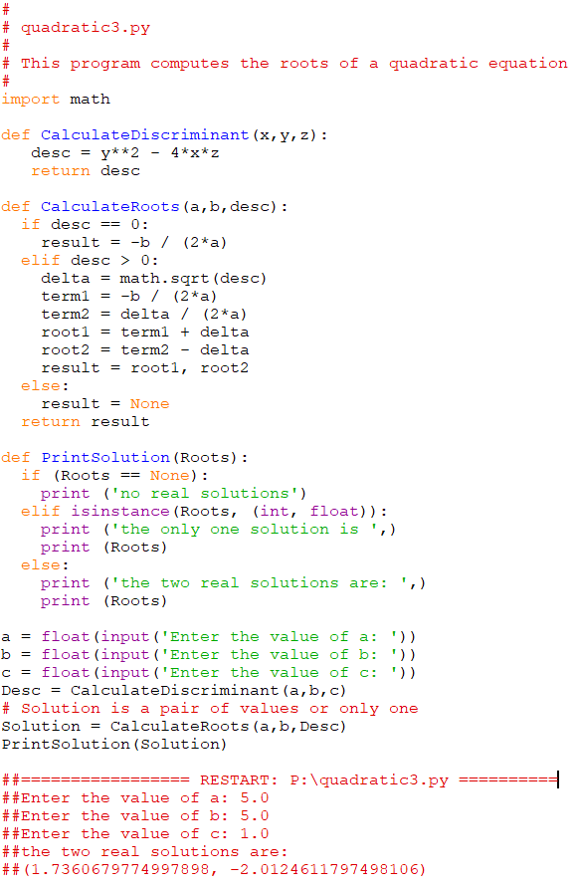
A solution of the quadratic equation

Slide 70
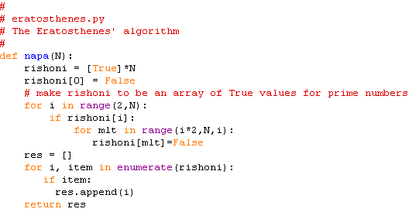
Eratosthenes

Slide 71
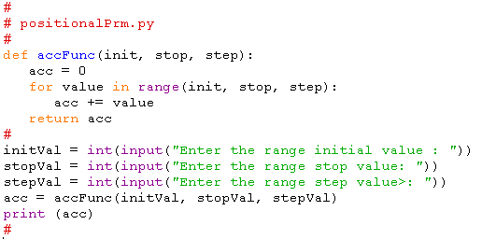
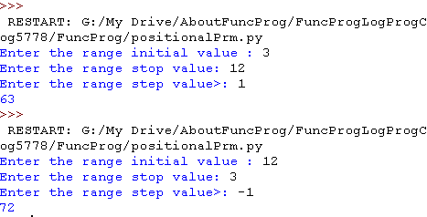
Function Basics: Positional Parameters
Actual Parameters are passed to Formal Parameters by their position in the parameters list.
When a function is called, the Formal Parameters are assigned the Actual Parameters by position.

Slide 72
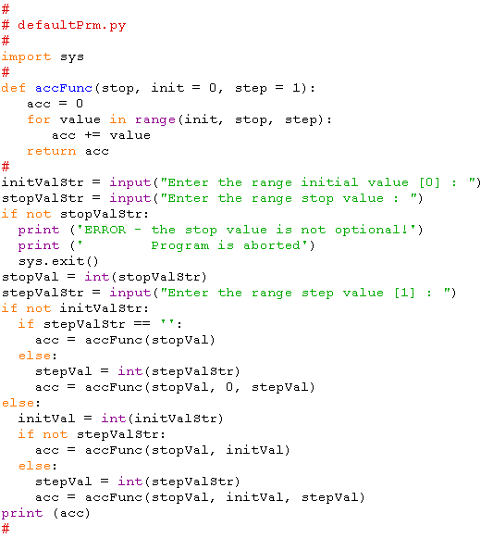
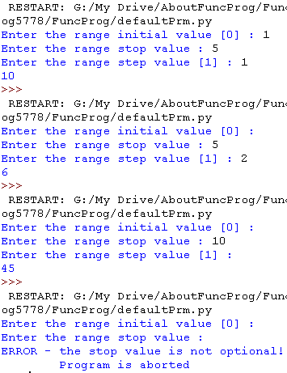
Function Basics: Default Parameters
Parameters can be assigned default values.
They are overridden if actual parameters are given for them.
Default formal parameters must come after all the positional formal parameters.

Slide 73
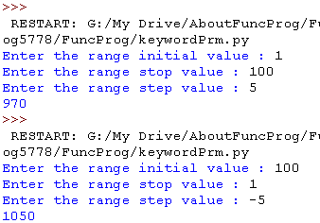
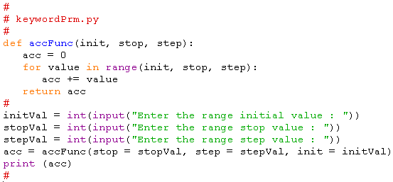
Function Basics: Keyword Parameters
Call by name (CBN)
Keyword (actual) parameters syntax: formalParamName = ActualParamValue
Any positional arguments must come before named ones in a call to the function.
Keyword actual parameters may come in any order in a call to the function.

Slide 74
Function Basics: *args - Non-keyworded unlimited parameters
*args as formal parameter
It may be used to allow passing an unlimited number of positional actual parameters to a function.
It may be used when the programmer does not know in advance how many actual parameters will the caller pass to the function.
At runtime, the actual parameter values passed by the caller, are received as part of a tuple.
*args is only a convention; any name may be used.
*args as actual parameter
It may be used to allow the elements of a sequence to be passed as actual parameters to a function.
It may be used when the programmer wants to decompose a sequence and pass all its elements as actual parameters to a function.
At runtime, the actual number of elements in the sequence (its length) needs to be in accordance to the number of actual parameters the function expects to receive.

Slide 75
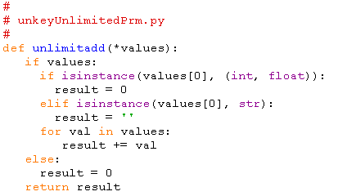
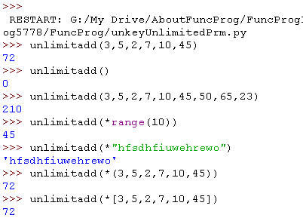
Function Basics: *args - Non-keyworded unlimited parameters

Slide 76
Function Basics: **kwargs - Keyworded unlimited parameters
**kwargs as formal parameter
it may be used to allow passing an unlimited number of keyword parameters to a function.
it may be used when the programmer does not know in advance how many keyword parameters will the caller pass to the function.
At runtime, the keyword parameters are received as part of a dictionary, where the keys are the formal parameter names, and the values are the actual parameter values passed by the caller.
**kwargs is only a convention; any name may be used.
*kwargs as actual parameter
It may be used to allow the pairs of a dictionary to be passed as actual keyword parameters to a function.
It may be used when the programmer wants to decompose a dicitonary and pass all its pairs as actual keyword parameters to a function.
At runtime, the actual number of pairs in the dictionary (its length) needs to be in accordance to the number of actual parameters the function expects to receive.

Slide 77
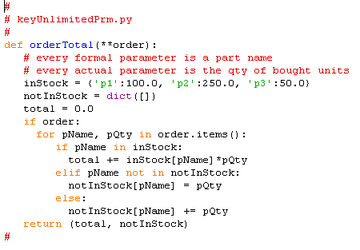
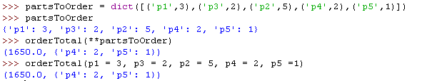
Function Basics: **kwargs - Keyworded unlimited parameters

Slide 78
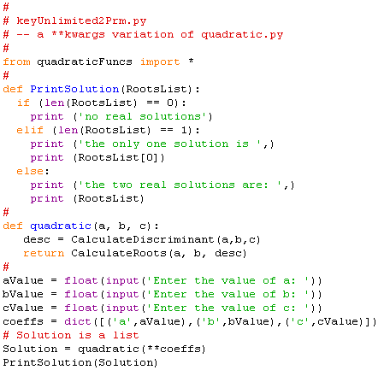
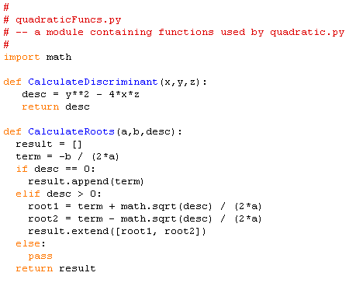
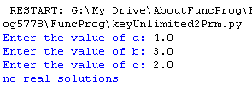

Function Basics: **kwargs - Keyworded unlimited parameters

Slide 79


module, program, or both: if __name == “__main__”

Slide 80
Classes
Not relevant in our course, but you are invited to see the following slides which are hidden.

Slide 81
Python is Object-Oriented
Everything in Python are objects.
A class is a collection of data and methods that act on that data.

Slide 82
Class Syntax
class myclass :
def __init__(self, val) :
self.x = val
def printit(self) :
print (self.x)
Every method in a class takes a self-pointer as the first parameter
(self is a convention) like this in Java or C++
__init__ is a built-in function that you override as the initializer of an object of the class (it is not a constructor like in Java or C++)

Slide 83
Class Method Calls
>>> from classbasic import *
>>> x = myclass(3)
>>> x.printit()
3
self is automatically added as the first parameter when a method is called on an instance of a class.
Internally, self must be explicitly passed.

Slide 84
Class Inheritance
class c1 :
x = 10
class c2 :
x = 20
y = 15
class c3(c1,c2) :
z = 2
>>> from classinherit import *
>>> x = c3()
>>> obj = c3()
>>> obj.z
2
>>> obj.x
10
>>> obj.y
15
Super classes are listed in brackets after the name of the class.
Python allows multiple inheritance.
Name resolution is bottom to top, left to right.

Slide 85
Explicit Call to a Super-class Method
class Person:
def __init__(self, first, last):
self.firstname = first
self.lastname = last
def toString(self):
return self.firstname + " " + self.lastname
class Employee(Person):
def __init__(self, first, last, staffnum):
Person.__init__(self, first, last)
self.staffnumber = staffnum
def toString(self):
return Person.toString(self) + ", " + str(self.staffnumber)
>>> from lomda import *
>>> person1 = Person('avraham','cohen')
>>> person2 = Employee('yisaac','levi',1234)
>>> person1.toString()
'avraham cohen'
>>> person2.toString()
'yisaac levi, 1234'
lomda.py

Slide 86
Instance Variables
Created as they are assigned
Referenced as self.<variable>
Classes as Objects
Classes exist as objects and contain their own variables.
Name resolution starts looking in the instance of the class for a variable, then walks up the inheritance tree.
Variables don’t exist in the instance until they are assigned there.
>>> class myclass :
... x = 10
...
>>> a = myclass()
>>> b = myclass()
>>> a.x, b.x, myclass.x
(10, 10, 10)
>>> a.x = 15
>>> a.x, b.x, myclass.x
(15, 10, 10)
>>> myclass.x = 20
>>> a.x, b.x, myclass.x
(15, 20, 20)
>>> a.x = myclass.x
>>> a.x, b.x, myclass.x
(20, 20, 20)
>>> myclass.x = 99
>>> a.x, b.x, myclass.x
(20, 99, 99)

Slide 87
Functional Programming Concepts and their Implementation in Python

Slide 88
Functional Programming Concepts
What is Functional Programming?
Pure Functions and Referential Transparency
Data Immutability IN, Side-Effects OUT
What is a Variable?
Functions as First Class Objects
Lambda Expressions / Anonymous Functions
The Concept of Closure
High-Order Functions
Expressing Iteration as Recursion
Lazy Evaluation and Python Generators
Currying
Pipelines

Slide 89
Functional Programming in Python
(in the following slides presentation …)
(in the following slides presentation …)

