Slide 1
Functional Programming in Python

Slide 2
Functional Programming Concepts
What is Functional Programming?
Pure Functions and Referential Transparency
Data Immutability IN, Side-Effects OUT
What is a Variable?
Functions as First Class Objects
Lambda Expressions / Anonymous Functions
The Concept of Closure
High-Order Functions
Expressing Iteration as Recursion
Programming Design Patterns and High-Order Functions
List Comprehensions
Lazy Evaluation and Python Generators
Currying
Pipelines

Slide 3
Expressing Iteration as Recursion

Slide 4
Recursion
Recursion as a particular case of the “Divide-and-Conquer” problem solving method
The idea of Recursive Thinking as a problem solving method is as follows:
Decompose the whole problem into two sub-problems:
The base case of the recursion (the stop condition) – it is one sub-problem (or more) whose solution is known in advance (or it is trivial).
The general case of the recursion (the recursive case) – it is one sub-problem (or more) whose structure is exactly as that of the whole problem, but smaller (it is simpler to solve).
Assuming that the solution(s) of the sub-problem(s) is/are known, the solution of the whole problem will be based on the solution(s) of the sub-problem(s).

Slide 5
Recursion
Similarity to Proof by Induction
The fundamental idea of Recursion as a Problem Solving method, is similar to Proof by Induction, in Mathematics:
There exists a base case for which the solution in known.
Let’s assume that there exists a solution for a sub-problem whose structure is exactly as that of the whole problem, and its size is smaller , and it is possible to express the solution of the whole problem as some relationship between both.
Let’s apply step 2’ repeatedly; this process generates a hierarchy of sub-problems, until we get to the base case.
The solution of the whole problem will be found by composing the solutions of the sub-problems, bottom-up through the hierarchy generated in step 3’.

Slide 6
Recursion
Examples
n!
0! = 1! = 1
n! = n * (n-1)!
b^{n}
b⁰ = 1 b¹ = b
b^{n} = b^{n-1} * b

Slide 7
Recursion
Examples
The length of a list
Lst == [] len(Lst) = 0
Lst != [] 1 + len(Lst[1:])

Slide 8
Recursion
Recursion as a Functional Method to express Iteration
A loop has state which changes in every iteration, and this is expressed by the values of the local variables of the loop body.
Because of that, a loop is not a Functional Programming concept.
If we want to write programs according to the functional approach, we must prevent of using loops. We will have to use stateless functional programming tools: recursion, high-order functions, list-comprehensions, and pipelines.

Slide 9
Recursion
Recursion as a Functional Method to express Iteration
One of the stateless functional ways that we have to express iterative processes is by using Recursive Calls.
In Recursion, opposite to loops, an iterative process is controlled by the values of the parameters passed by the recursive call. In fact, every recursive call generates new local variables, instead of changing the value of existing variables.

Slide 10
Recursion
Recursion as a Functional Method to express Iteration – Methodology
When a problem is decomposable into smaller sub-problems, of the same type, the problem we are dealing with is a recursive problem.
Thus, in a case like this, it is advisable to find how to express its solution in a recursive way, which will prevent the use of state variables (or mutable data collections), because the recursive calls allow us to gradually build data sequences without the need to make any changes in existing data.
As soon as we succeed to identify the base case(s) and the general case(s) of the recursion, the writing of a recursive solution of the problem we are dealing with, is almost trivial.

Slide 11
Recursion
Recursion as a Functional Method to express Iteration – Methodology
Identifying the base case(s) of the recursion
Let’s try to find the value (or the structure) of the operation that expresses the general case of the recursion.
The base case of the recursion has to deal with all what doesn’t have any role in the general case of the recursion:
the correctness of the base case expression is crucial; expressing it incorrectly will produce an infinite number of recursive calls, which will overflow the calls stack, provoking the program to crash.
The value returned by the base case must be in the function’s range of values.

Slide 12
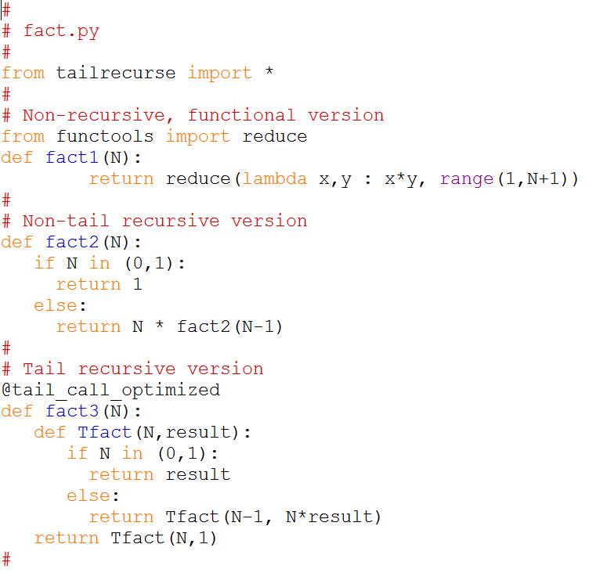
Recursion
Implementing n! in Python (fact.py)

Slide 13
Recursion
Implementing n! in Python (fact.py)
Non-recursive version

Slide 14
Recursion
Implementing n! in Python (fact.py)
Non-tail recursive
version

Slide 15
Recursion
Implementing n! in Python (fact.py)
Non-tail recursive
version
Base Case (Stop Condition)

Slide 16
Recursion
Implementing n! in Python (fact.py)
Non-tail recursive
version
Base Case (Stop Condition)
General Case

Slide 17
Recursion
Implementing n! in Python (fact.py)
Non-tail recursive
version
Base Case (Stop Condition)
General Case
Recursive Call

Slide 18
Recursion
Implementing n! in Python (fact.py)
Non-tail recursive
version
Base Case (Stop Condition)
General Case
Recursive Call
It is a component of another expression, meaning that (1) the computation of that expression depends on the value returned by the recursive call.
(2) the computation will be obtained while returning from the base case of the recursion.

Slide 19
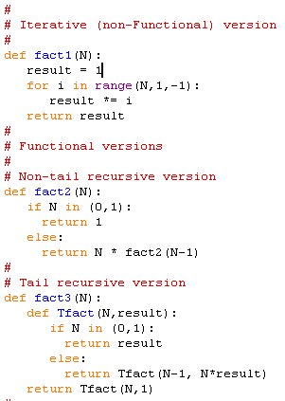
Recursion
Implementing n! in Python (fact.py)
Running the non-tail recursive version
>>> fact2(4)
Returned value | N
4 * fact2(3) 4 * 6 24 | 4
3 * fact2(2) 3 * 2 6 | 3
2 * fact2(1) 2 * 1 2 | 2
1 | 1

Slide 20
Recursion
Implementing n! in Python (fact.py)
Tail recursive version

Slide 21
Recursion
Implementing n! in Python (fact.py)
Tail recursive version
Base Case (Stop Condition)

Slide 22
Recursion
Implementing n! in Python (fact.py)
Tail recursive version
Base Case (Stop Condition)
General Case

Slide 23
Recursion
Implementing n! in Python (fact.py)
recursive call
It is not part of any other expression, allowing to compute of the result during the process of recursive calls.
In order to enable this, in most cases of tail recursion, we need to have an additional parameter, in which the result will be accumulated during the process of recursive calls.
Tail recursive version
Base Case (Stop Condition)
General Case

Slide 24
Recursion
Implementing n! in Python (fact.py)
Note the following:
When we get to the base case of the recursion, there is no need to return all the recursive calls way back, because the result is already calculated, and the only thing to do is to return it.
Because of that, tail recursion needs only one activation record in the calls stack, which makes it equivalent to a loop.
In standard Python, property b’ (TCO – Tail-Call Optimization) is not supported. Because of that, we imported the external tailrecurse module that implements it.
Running the tail recursive version
>>> fact3(4)
Returned value | result | N
Tfact(4,1) 24 |  | 4
Tfact(3,4) | 1 | 4
Tfact(2,12) | 4 | 3
Tfact(1,24) | 12 | 2
24 | 24 | 1
(Look at the recursive implementation of b^{n} (in exp.py))

Slide 25
Recursion
Implementing n! in Python (fact.py)
Note the following:
When we get to the base case of the recursion, there is no need to return all the recursive calls way back, because the result is already calculated, and the only thing to do is to return it.
Because of that, tail recursion needs only one activation record in the calls stack, which makes it equivalent to a loop.
In standard Python, property b’ (TCO – Tail-Call Optimization) is not supported. Because of that, we imported the external tailrecurse module that implements it.
Running the tail recursive version
>>> fact3(4)
Returned value | result | N
Tfact(4,1) 24 |  | 4
Tfact(3,4) | 1 | 4
Tfact(2,12) | 4 | 3
Tfact(1,24) | 12 | 2
24 | 24 | 1
(Look at the recursive implementation of b^{n} (in exp.py))

Slide 26
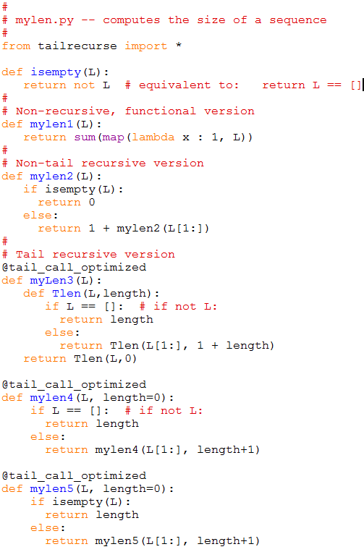
Recursion
Implementing recursion on a sequence (mylen.py)

Slide 27
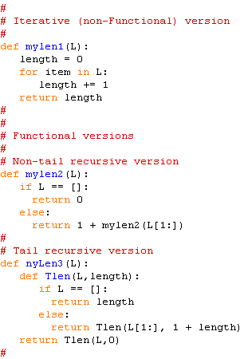
Recursion
Implementing recursion on a sequence (mylen.py)
non-tail recursion
>>> myLen2([‘a’,4,(1,2),[‘abc’]])
Returned value | L
1 + mylen2([4,(1,2),[‘abc’]]) 1+3 4 | [‘a’,4,(1,2),[‘abc’]]
1 + mylen2([(1,2),[‘abc’]]) 1+2 3 | [4,(1,2),[‘abc’]]
1 + mylen2([[‘abc’]]) 1+1 2 | [(1,2),[‘abc’]]
1 + mylen2([]) 1+0 1 | [[‘abc’]]
0 | []

Slide 28
Recursion
Implementing recursion on a sequence (mylen.py)
tail recursion
>>> myLen3([‘a’,4,(1,2),[‘abc’]])
Returned value | length | L
Tlen([‘a’,4,(1,2),[‘abc’]],0) 4 |  | [‘a’,4,(1,2),[‘abc’]]
Tlen([4,(1,2),[‘abc’]],1) | 0 | [‘a’,4,(1,2),[‘abc’]]
Tlen([(1,2),[‘abc’]],2) | 1 | [4,(1,2),[‘abc’]]
Tlen([[‘abc’]],3) | 2 | [(1,2),[‘abc’]]
Tlen([],4) | 3 | [‘abc’]
4 | 4 | []

Slide 29
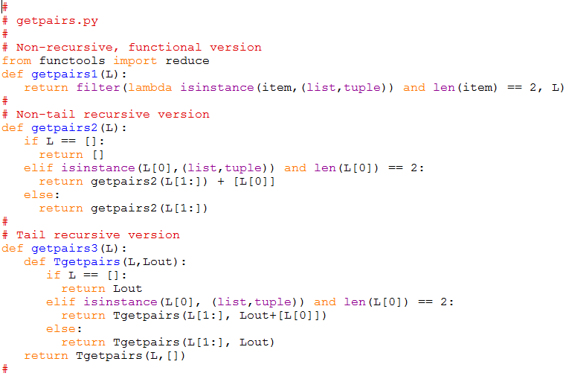
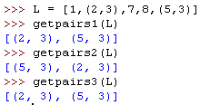
Recursion
Implementing recursion on a sequence (getpairs.py)
Note the following:
The output list of the tail recursion is the reverse of the output list of the non-tail recursion.
Why??
Run above example by hand, and explain to yourself why this happens.

Slide 30
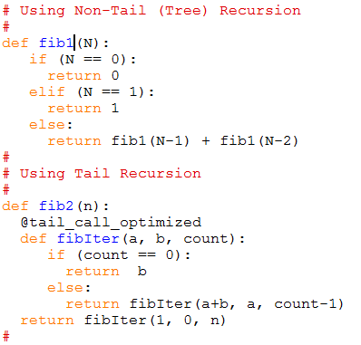

Recursion
- tree recursion Computing the Fibonacci Series (fib.py)
fib(0) = 0 fib(1) = 1 base cases
fib(n) = fib(n-2) + fib(n-1) general case
3
fib(4)
1
2
fib(2)
fib(3)
0
1
1
1
fib(0)
fib(1)
fib(1)
fib(2)
1
0
fib(0)
fib(1)

Slide 31
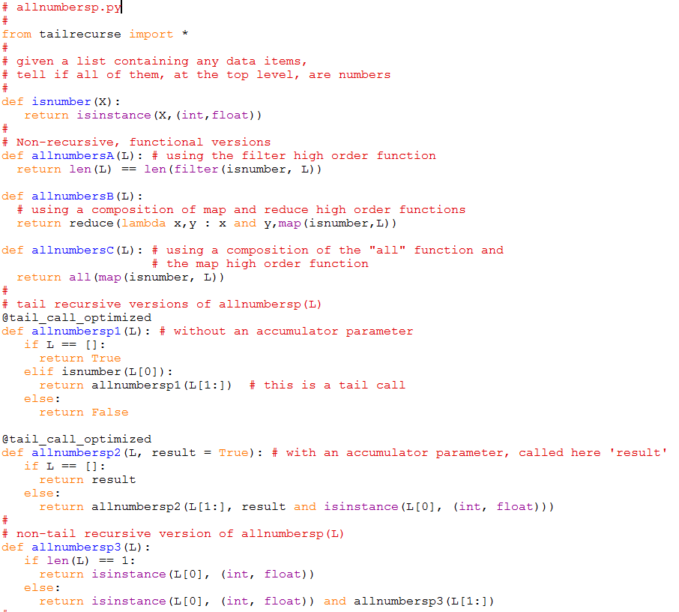
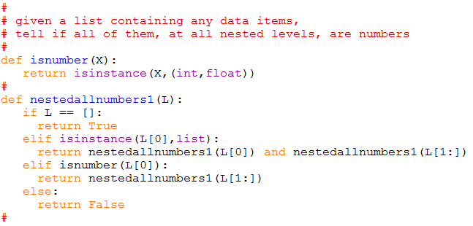
Recursion
- tree recursion upon nested sequences (allNestedNumbersp.py)

Slide 32
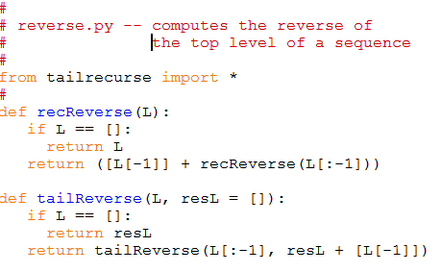
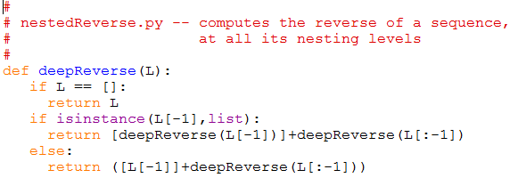
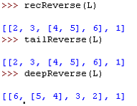
Recursion
- tree recursion upon nested sequences - list reversing (reverse.py)

